Slide 1

PYTHON DEVELOPER
INTERNSHIP PRESENTATION
IILM UNIVERSITY
Greater Noida, Uttar Pradesh
Submitted as part of the Python Developer Internship, completed in partial fulfillment of the practical/industrial training component of the B.Tech CSE program.
School of Computer Science
& Engineering
STUDENT NAME
Amandeep Dixit
ORGANIZATION
ENROLLMENT / ROLL NO.
Codec Technologies
25SCS1003004670
Academic Session 2026–2027
PROGRAM & SEMESTER
B.Tech CSE — 3rd Semester (2nd Year)
BATCH
2025 – 2029
Internship Defense Presentation

Slide 2
FRONT MATTER
Candidate's Declaration & Acknowledgement
D
Candidate's Declaration
A
Acknowledgement
I hereby affirm that this internship presentation — including all analysis, code, and documentation — represents my own independent work, carried out in fulfillment of the B.Tech CSE degree requirements at IILM University.
I gratefully acknowledge the guidance and support extended throughout this internship journey:
Original work, not submitted elsewhere for any degree or diploma
All external references and sources duly cited
Sole responsibility accepted for authenticity of content
IILM University faculty, for academic mentorship and structured direction
Mentors at Codec Technologies, for hands-on technical guidance
Peers and family, for continuous encouragement and support
Amandeep Dixit | Python Developer Intern | Codec Technologies
2

Slide 3
THE ORGANIZATION
About Codec Technologies
Codec Technologies Pvt. Ltd. is an AICTE- and ICAC-approved training partner that runs structured, industry-aligned internship programs for engineering and computer science students, delivered in partnership with the National Internship Portal.
1 Month
Program Duration
Focus on hands-on, project-based learning rather than passive coursework
Structured 1-month remote internship track for Python development
Recognized as a Google for Education partner
Mentorship led by Dr. Anurag Shrivastava, Program Manager
Python
Core Track
AICTE + ICAC
Approved Program
Amandeep Dixit | Python Developer Intern | Codec Technologies
3

Slide 4
PROGRAM SNAPSHOT
Internship Overview
1
2
3
4
ROLE
DURATION
ORGANIZATION
TRACK
Python Developer Intern
01 Aug 2026 – 30 Aug 2026 (1 Month)
Codec Technologies Pvt. Ltd.
Web Scraping & Automation
What the internship covered
A guided, project-based track in Python covering scripting fundamentals, third-party libraries, and real-world automation — culminating in an end-to-end script that automates a repetitive, manual task.
Amandeep Dixit | Python Developer Intern | Codec Technologies
4

Slide 5
GOALS
Objectives of the Internship
1
Strengthen Python Fundamentals
2
Learn Automation Tooling
Apply core Python (functions, file I/O, error handling) to a real automation problem.
Get hands-on with libraries used for browser control, HTTP requests, and file handling.
3
Eliminate a Manual Task
4
Build Industry Practices
Identify a repetitive, time-consuming task and design a script to handle it end-to-end.
Follow structured development: planning, testing, debugging, and documentation.
Amandeep Dixit | Python Developer Intern | Codec Technologies
5

Slide 6
TECH STACK
Tools & Technologies Used
Py
Python 3
Req
Requests
BS4
BeautifulSoup
Core scripting language for the entire project
Sending HTTP requests and handling responses
Parsing HTML and extracting page data
Sel
Selenium
Pd
Pandas
Git
Git & GitHub
Automating browser actions and form submission
Structuring and exporting collected data
Version control and project tracking
Amandeep Dixit | Python Developer Intern | Codec Technologies
6

Slide 7
THE PROJECT
Automating a Repetitive Manual Task
The core project involved analyzing a task that was previously done by hand — repeatedly filling out forms and processing files — and building a Python script to perform it automatically, reliably, and faster than manual effort.
01
02
03
Input Handling
Automated Execution
Validation & Logging
Read task data from source files (CSV/Excel) instead of manual entry
Script fills forms / processes files programmatically, task after task
Each run is checked and logged so errors can be traced and re-run safely
Amandeep Dixit | Python Developer Intern | Codec Technologies
7

Slide 8
HOW IT WORKS
Project Workflow
Read Input Data
Launch Automation Script
Process Each Record
Fill / Submit Form
Log Result
Export Summary
Each stage runs unattended once triggered — the script pulls the next record, performs the required action, and logs the outcome before moving to the next item, removing the need for manual repetition.
Amandeep Dixit | Python Developer Intern | Codec Technologies
8

Slide 9
CAPABILITIES
Key Features Delivered
Reads task lists directly from spreadsheet/CSV input — no manual copy-paste
Built-in error handling so one bad record doesn't stop the whole run
✓
✓
Automatically fills and submits repetitive forms using Selenium
Generates a log/summary report after every run for easy review
✓
✓
Handles files in bulk — renaming, moving, and organizing outputs
Reusable and configurable — new tasks can be added without rewriting the script
✓
✓
Amandeep Dixit | Python Developer Intern | Codec Technologies
9

Slide 10
PROBLEM SOLVING
Challenges Faced & Solutions
Inconsistent page/form structure
→
Added explicit waits and flexible element selectors so the script tolerates minor layout changes
1
Occasional failed submissions
→
Wrapped each step in try/except blocks with retry logic and clear error logging
2
Large volume of repetitive records
→
Refactored the script into reusable functions and looped over structured input data
3
Tracking what succeeded or failed
→
Added a logging system that records the status of every processed record
4
Amandeep Dixit | Python Developer Intern | Codec Technologies
10

Slide 11
TAKEAWAYS
Skills & Learning Outcomes
Practical Python scripting beyond classroom exercises
Web scraping and browser automation with real tools
★
★
Structuring code into clean, reusable functions
Debugging and handling real-world errors gracefully
★
★
Working with data files (CSV/Excel) programmatically
Professional habits: documentation, logging, version control
★
★
Amandeep Dixit | Python Developer Intern | Codec Technologies
11

Slide 12
WRAP UP
Conclusion
This one-month internship with Codec Technologies turned classroom Python knowledge into a working automation tool that solves a real, repetitive problem. Beyond the code, it built confidence in planning a project end-to-end — from understanding the task, to building, testing, and refining the solution.
Certified Completion
Python Developer Intern
Codec Technologies Pvt. Ltd.
AICTE & ICAC Approved Program
01 Aug 2026 – 30 Aug 2026
Thank you to Codec Technologies and mentor Dr. Anurag Shrivastava for the guidance and opportunity throughout this program.
Amandeep Dixit
IILM University, Greater Noida
Thank You
Amandeep Dixit | Python Developer Intern | Codec Technologies
12

Slide 13
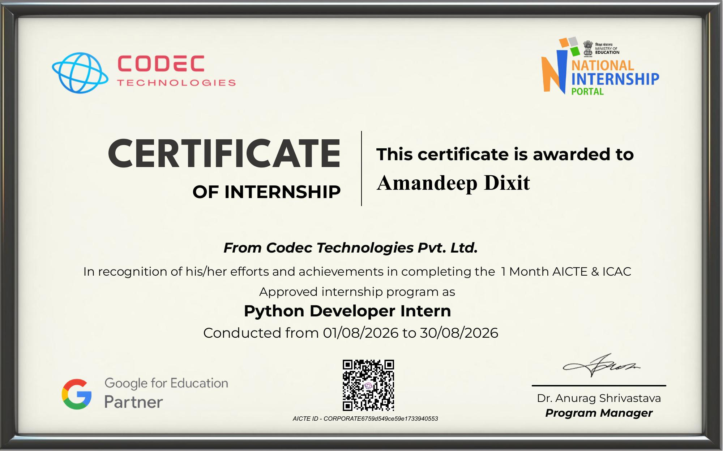
PROOF OF COMPLETION
Internship Certificate
Amandeep Dixit | Python Developer Intern | Codec Technologies
13

