Slide 1
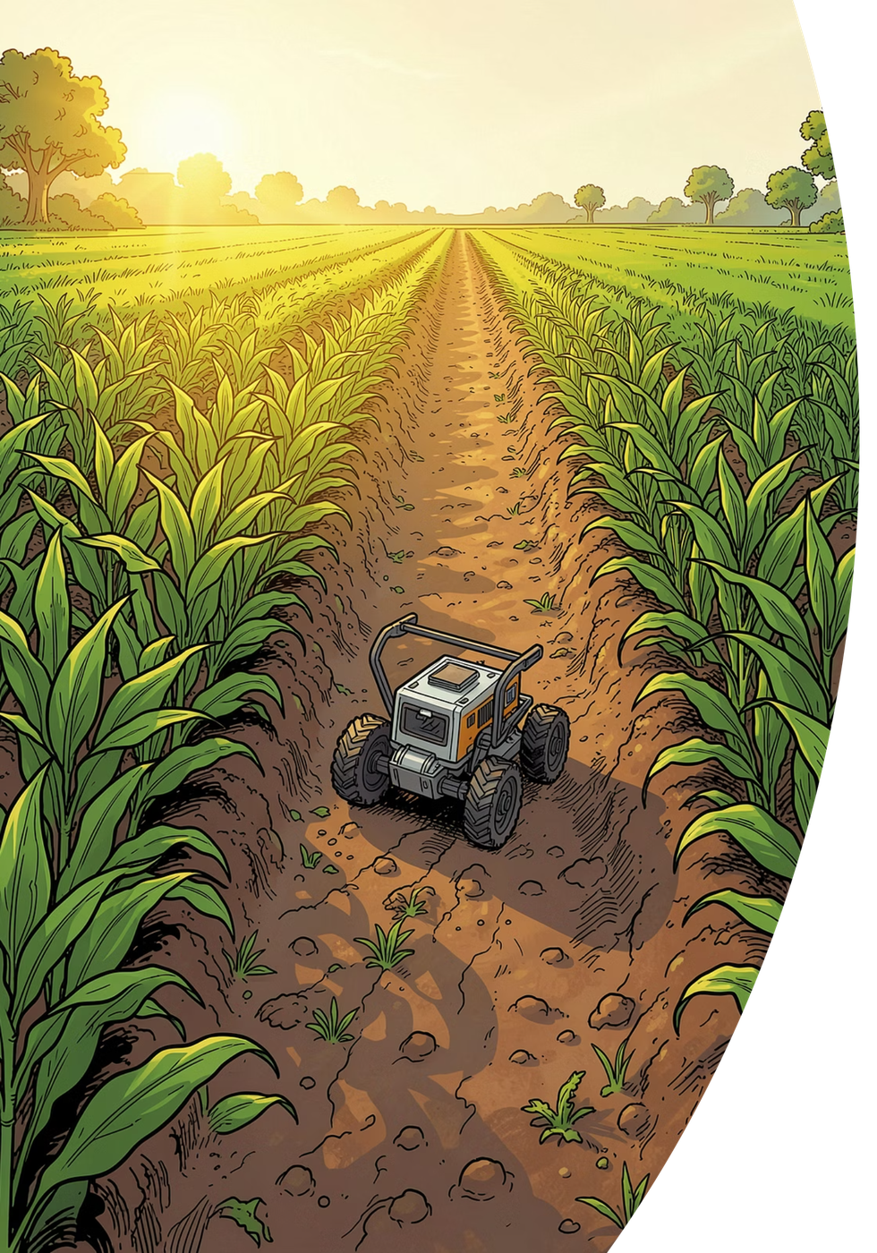
AgriRover
Precision farming
for every small farm.
A small self-driving rover that checks the soil, looks at every plant, and gives each one exactly what it needs — nothing more, nothing wasted.
IITB–Groww INV.ENT · Track A
Hitanshu Kapadiya · Vivek Gupta · Shreyash Wagh · Pritish Nandy
Team of 4 · IIT Bombay

Slide 2
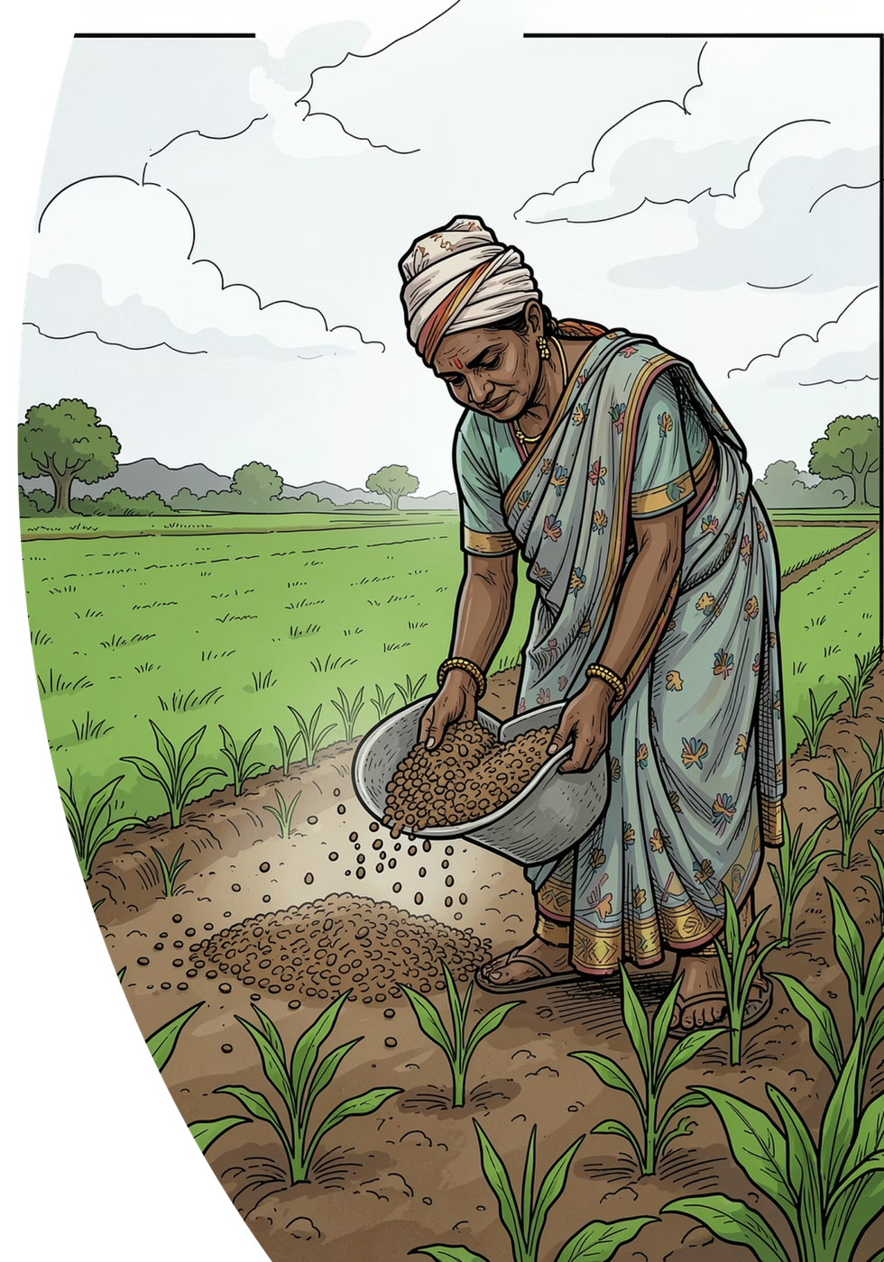
THE PROBLEM
Farmers spend more every year —
and waste much of it.
Farming is done blind.
Fertilizer and water are spread evenly by hand, because there is no way to know what each plant needs. A big share is simply wasted.
Waste costs real money.
Fertilizer, chemicals and labor get costlier every season — and over-use quietly damages the soil for years to come.
Existing machines don't fit.
86% of India's farms are under 2 hectares — too small for tractors and big precision equipment. A lab soil test takes 2–3 weeks, so almost nobody does one.
From our field visits: fertilizer is still thrown by hand — evenly, everywhere, every season.
AgriRover · IITB–Groww INV.ENT · Track A
2 / 5

Slide 3
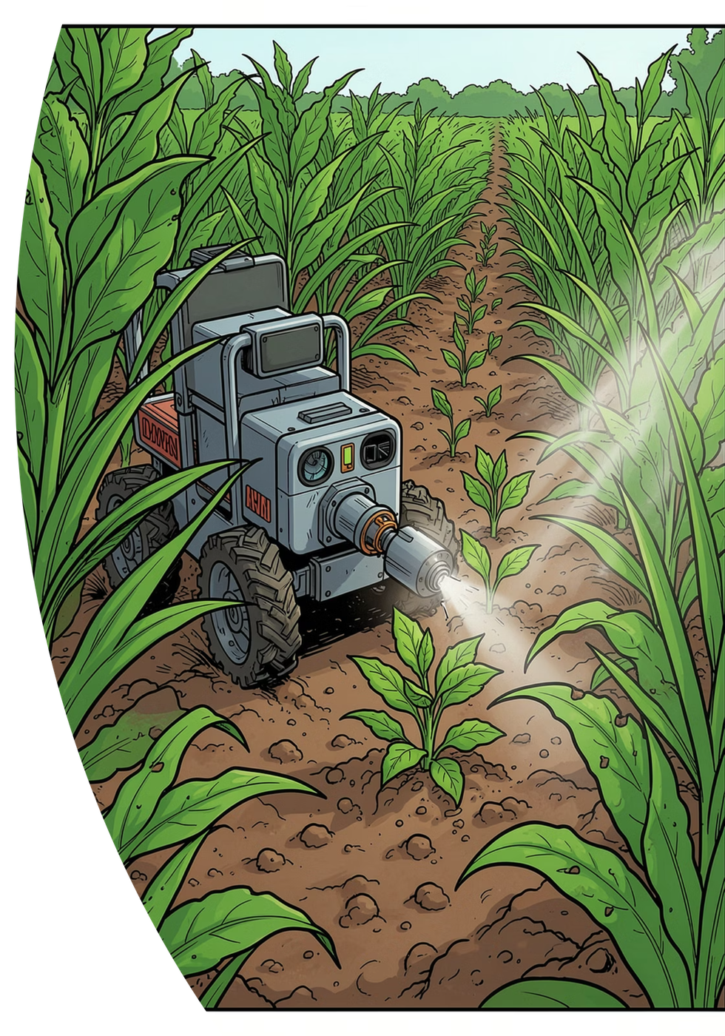
OUR SOLUTION
A small rover that farms plant by plant.
It drives the crop rows on its own and treats every plant individually — like a careful farmhand that never gets tired.
1
CHECK
2
SEE
A probe dips into the soil and reads its health in seconds — no lab, no waiting.
An AI camera spots weeds and sick plants as the rover drives the rows.
3
TREAT
4
REPORT
Drops fertilizer or a tiny spray only where it is needed, plant by plant.
Sends a simple map to the farmer's phone: what it found, what it did.
HOW IT WORKS INSIDE — TWO BRAINS, ALWAYS SAFE
A thinking brain sees and decides; an acting brain drives and doses. If anything fails — camera, AI or signal — the rover simply stops. It cannot run away or overdose a plant.
AgriRover · IITB–Groww INV.ENT · Track A
3 / 5

Slide 4
IN PRACTICE
What this means on a real farm.
EXAMPLE 1 · FERTILIZER
Not a tractor. Not a drone.
Today: a full bag of urea is spread evenly by hand — much of it is wasted.
With AgriRover: the probe finds the one patch that is truly nitrogen-poor and feeds only there.
Target: 30–50% less fertilizer, same yield — what our first pilots will prove.
TRACTOR
DRONE
AGRIROVER
Sees every plant
–
–
✓
Tests the soil
–
–
✓
Treats plant-by-plant
–
–
✓
Fits a 1-acre farm
–
✓
✓
EXAMPLE 2 · WEEDS
Works without an operator
–
–
✓
Today: the entire field is sprayed with weedkiller.
With AgriRover: the camera finds each weed and sprays that spot only — far less chemical, and none of it on the food.
Tractor = muscle. Drone = a quick look from the sky. AgriRover = eyes and hands at every plant.
Tractor ₹3–8 lakh · agri drone ₹3–6 lakh · AgriRover under ₹50,000 to build
AgriRover · IITB–Groww INV.ENT · Track A
4 / 5

Slide 5

MARKET, MODEL & THE ASK
A big market. A simple business.
146M
86%
$2.5Bn
farm holdings in India
of farms under 2 hectares — our users
India agritech market by 2034
HOW WE EARN
1. Sell the rover with a yearly service plan.
2. Rent it per acre through farmer groups (FPOs) — no upfront cost for the farmer.
3. Monthly subscription for soil-health and crop reports.
WHERE WE ARE TODAY
Full software stack — driving, AI vision, navigation, farmer dashboard — built and tested in simulation. Hardware fully designed and costed: ₹27,000–48,000 per rover.
The ask: seed support to build the first prototype, plus a pilot with one farmer group to prove 30–50% input savings on real farms.
Hitanshu Kapadiya · Vivek Gupta · Shreyash Wagh · Pritish Nandy · Team of 4, IIT Bombay · Track A
5 / 5

