Slide 1
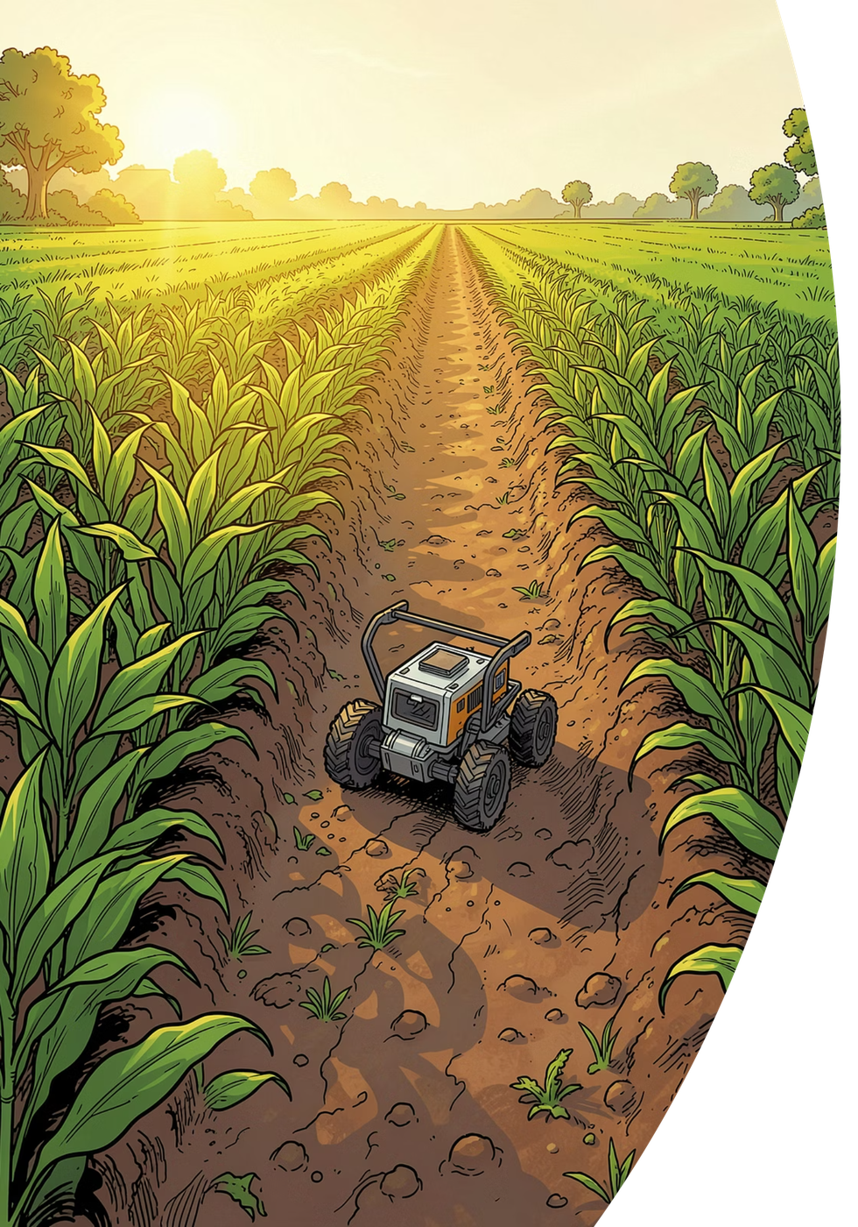
AgriRover
Precision farming
for every small farm.
A small self-driving rover that checks the soil, looks at every plant, and gives each one exactly what it needs — nothing more, nothing wasted.
IITB–Groww INV.ENT · Track A
Hitanshu Kapadiya · Vivek Gupta · Shreyash Wagh · Pritish Nandy
Team of 4 · IIT Bombay

Slide 2
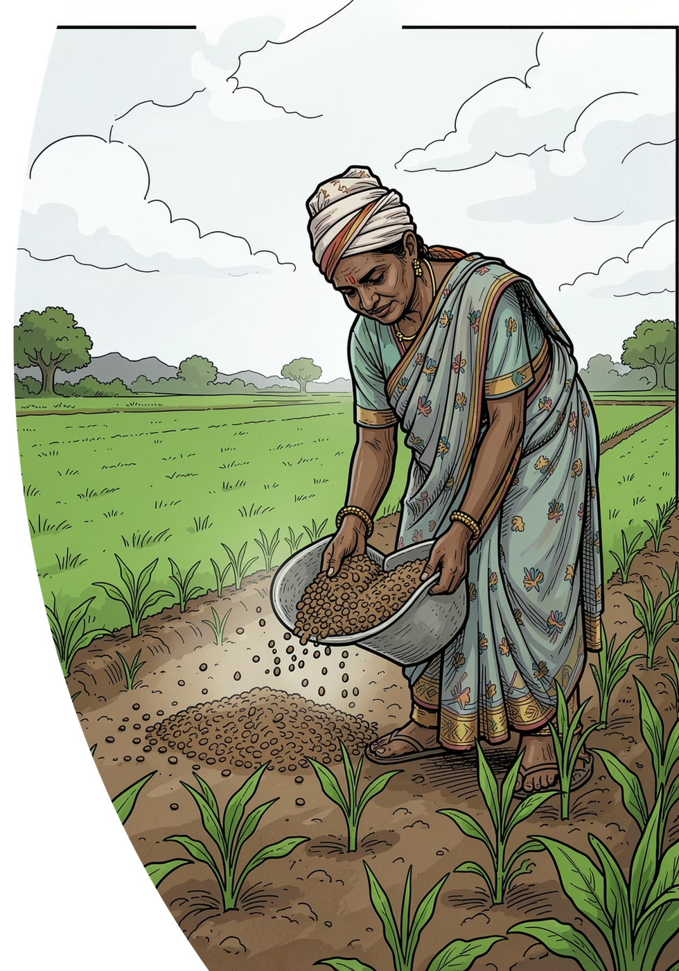
THE PROBLEM
Farmers spend more every year —
and waste much of it.
Farming is done blind.
Fertilizer and water are spread evenly by hand, because there is no way to know what each plant needs. A big share is simply wasted.
Waste costs real money.
Fertilizer, chemicals and labor get costlier every season — and over-use quietly damages the soil for years to come.
Existing machines don't fit.
86% of India's farms are under 2 hectares — too small for tractors and big precision equipment. A lab soil test takes 2–3 weeks, so almost nobody does one.
From our field visits: fertilizer is still thrown by hand — evenly, everywhere, every season.
AgriRover · IITB–Groww INV.ENT · Track A
2 / 10

Slide 3
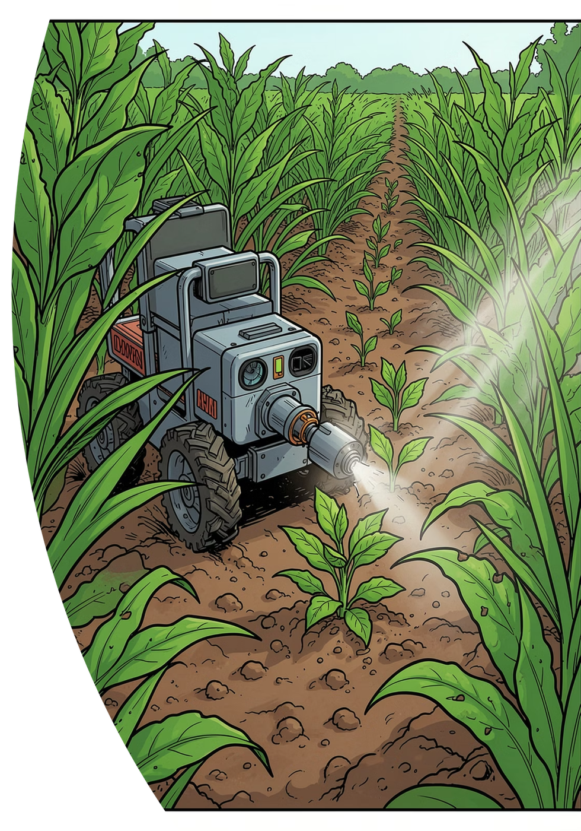
OUR SOLUTION
A small rover that farms plant by plant.
It drives the crop rows on its own and treats every plant individually — like a careful farmhand that never gets tired.
1
CHECK
2
SEE
A probe dips into the soil and reads its health in seconds — no lab, no waiting.
An AI camera spots weeds and sick plants as the rover drives the rows.
3
TREAT
4
REPORT
Drops fertilizer or a tiny spray only where it is needed, plant by plant.
Sends a simple map to the farmer's phone: what it found, what it did.
HOW IT WORKS INSIDE — TWO BRAINS, ALWAYS SAFE
A thinking brain sees and decides; an acting brain drives and doses. If anything fails — camera, AI or signal — the rover simply stops. It cannot run away or overdose a plant.
AgriRover · IITB–Groww INV.ENT · Track A
3 / 10

Slide 4
COMPETITION
India already builds farm robots and drones. None reach the small farm.
XMACHINES · Hyderabad
Head to head
Autonomous field robots (X100, Neo)
XMACHINES
MARUT
AGRIROVER
Serious machines for weeding, spraying and mowing — RTK-GPS, AI vision, 300 kg payload. But the Neo is priced at $19,995 (≈ ₹17 lakh) and aimed at large farms and export markets. No in-soil nutrient testing.
Machine price
~₹17 L
₹7–10 L
<₹0.5 L
On-the-spot soil test
–
–
✓
MARUT DRONES · Hyderabad
Per-plant fertilizer dose
–
–
✓
AG365 certified spray drone
Sprays 6 acres an hour from the sky; service model at ~₹400/acre. But the drone costs ₹7–10 lakh, needs a licensed pilot, and it is blanket spraying — it cannot test soil or treat one plant differently from the next.
Spot-sprays single weeds
✓
–
✓
Fits a 1-acre veg. plot
–
–
✓
No licensed pilot needed
✓
–
✓
WHAT THEY PROVE — AND MISS
Both prove Indian farms will pay for automation. Both are priced for the 14% of farms above 2 hectares. The other 86% is open — that's ours.
A drone looks from the sky. A big robot works the big farm. AgriRover is the first one cheap enough — and small enough — for the farmer with one acre of vegetables.
AgriRover · IITB–Groww INV.ENT · Track A
4 / 10

Slide 5
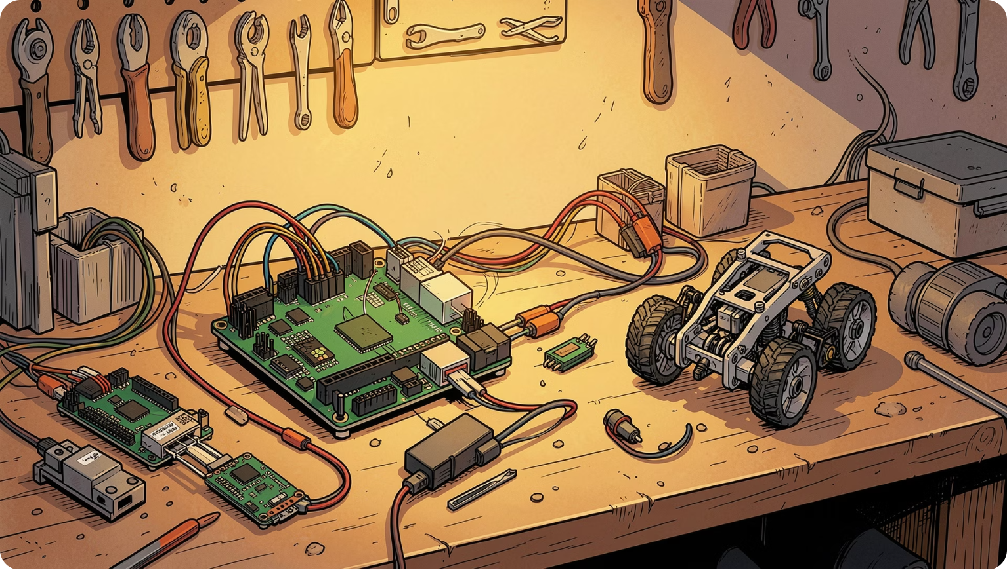
WHY I'M BUILDING THIS
I grew up in the fields this is built for.
My name is Vivek Kumar Gupta. I study Mechanical Engineering at IIT Bombay, but I come from a farmer family in Jaunpur, Uttar Pradesh. My family grows what most of eastern UP grows: rice in kharif, wheat in rabi, season after season.
Every season, the same ritual. Urea thrown by hand — evenly, everywhere — because no one knows what the soil actually needs. The nearest soil lab is a bus ride away and the report takes 2–3 weeks. In ten years, I have never seen a neighbour test twice.
“I couldn't build a robot for my father's rice. So I built one for every crop planted in rows — starting with the vegetable plots around my own village.”
— Vivek, AgriRover team
Our wheat and rice can't use this rover — and that's the point. Broadcast-sown grain leaves no path for a machine to walk. But all around us, the money crops — tomato, chilli, cauliflower, potato, brinjal — are planted in neat rows. Rows a small rover can drive. Those plots take the most fertilizer and spray per acre, and lose the most when it's wasted.
First pilot fields: the row-crop vegetable plots around Jaunpur — farmers we already know by name.
AgriRover · IITB–Groww INV.ENT · Track A
5 / 10

Slide 6

MARKET, MODEL & THE ASK
A big market. A simple business.
146M
86%
$2.5Bn
farm holdings in India
of farms under 2 hectares — our users
India agritech market by 2034
HOW WE EARN
1. Sell the rover with a yearly service plan.
2. Rent it per acre through farmer groups (FPOs) — no upfront cost for the farmer.
3. Monthly subscription for soil-health and crop reports.
WHERE WE ARE TODAY
Full software stack — driving, AI vision, navigation, farmer dashboard — built and tested in simulation. Hardware fully designed and costed: ₹27,000–48,000 per rover.
The ask: seed support to build the first prototype, plus a pilot with one farmer group to prove 30–50% input savings on real farms.
AgriRover · IITB–Groww INV.ENT · Track A
6 / 10

Slide 7
POC HYPOTHESIS & METRICS
One season. Three plots. Numbers, not promises.
HYPOTHESIS: if soil is sensed and fertilizer dosed plant-by-plant on row vegetables, the farmer saves 30–50% of input cost with no loss of yield.
HOW WE TEST IT
A/B on 3 vegetable plots (Jaunpur network), one growing season: half of each plot farmed as usual, half managed by AgriRover. Same seed, same water, same farmer.
−30–50%
−60–80%
±0
fertilizer used per acre
weedkiller sprayed
yield per acre
measured in kg, A vs B
spot-spray vs blanket spray
must not drop — else we fail
30 sec
1 acre/day
<2 seasons
soil test, in the field
covered per rover
payback for the farmer
vs 2–3 weeks at a lab
coverage & uptime logged
input savings vs rover cost
AgriRover · IITB–Groww INV.ENT · Track A
7 / 10

Slide 8
EXECUTION & BUSINESS PLAN
Build. Test. Iterate. Then rent it out.
M1 · BUILD
Weeks 1–8
M2 · TEST
Weeks 9–20
M3 · ITERATE
Weeks 21–28
Assemble the first rover from our fully-costed BOM (₹27–48k). The design, wiring and firmware are already done — this is assembly and bench testing, then autonomous runs on campus.
One growing season with 3–5 farmers from our own networks (Jaunpur UP, Nashik MH). Run the A/B protocol from slide 7 and collect the savings and yield data.
Fix what the field breaks. Add the attachment farmers ask for most. Start the first paid rental pilot with one FPO.
PRICING PLAN
COMPETITORS
Own it: ₹75,000 per rover + ₹6,000/yr service & software plan.
Rent it: ₹300 per acre-pass through FPOs — cheaper than the drone's ₹400, and it tests soil while it drives.
Know it: ₹199/month soil-health & crop report subscription.
XMachines (₹17 L robots) and Marut (₹7–10 L drones) — detailed on slide 4. Nobody serves the under-2-hectare farm at under ₹1 lakh. We do.
Every milestone ends in something a farmer can see: a rover that drives (M1), a savings number (M2), a paying pilot (M3).
AgriRover · IITB–Groww INV.ENT · Track A
8 / 10

Slide 9
TEAM, BUDGET & IMPACT
Four builders. One of us grew up on the farm.
Hitanshu Kapadiya
Vivek Kumar Gupta
Shreyash Wagh
Pritish Nandy
Mech. Engg, IITB
Mech. Engg, IITB
Mech. Engg, IITB
IITB
Chassis, CAD
Electronics , firmware & AI vision· farmer-family domain (Jaunpur)
Structural integration (Nashik veg. belt)
Dashboard , data sourcing , mechanical design & structural integration
WHY US
IMPACT — WHAT IT'S WORTH
We already built the full software stack — and we know the user by name. Our pilot farmers are our own families' neighbours.
For one farmer: ₹8–15k saved per season on one acre of vegetables — often the family's entire margin.
For the soil & the plate: less chemical in the ground and none of it on the food.
USE OF FUNDS — ₹1.0 LAKH, 28 WEEKS
₹49k
Prototype parts (full BOM, next slide)
M1 · weeks 1–8
₹30k
Field pilot: travel, spares, consumables
M2 · weeks 9–20
LONG-TERM VISION
₹21k
Iteration, attachments, FPO pilot
M3 · weeks 21–28
A rover in every village, not every farm: FPO-owned fleets with swappable attachments (weeder, sower, sprayer) working plots on demand — precision farming as a ₹300 service, not a ₹17 lakh machine.
Proposed output: one field-proven rover + a one-season savings dataset + a signed FPO rental pilot.
AgriRover · IITB–Groww INV.ENT · Track A
9 / 10

Slide 10
BUDGET SHEET
Every rupee is already itemised — 110 parts, priced.
SUBSYSTEM
₹ (range)
BUILD TIERS
Brain & compute (ESP32, Pi 4, cams)
5,880 – 8,150
Core (drives + soil test + dosing)
₹8–14k
Power (LiPo, buck, protection, solar)
2,350 – 4,040
+ Navigation (GPS, encoders, safety)
₹12–20k
Full AI (camera + weed/disease AI)
₹28–49k
Motors & drive (4 gear motors, drivers)
1,840 – 3,600
We build Full AI for the PoC — it's what we must prove.
Soil & field sensors (NPK probe, GPS…)
3,740 – 8,080
AI camera kit (Pi Cam, Coral TPU)
4,680 – 7,100
PILOT & CONTINGENCY
Field pilot (travel, spares, consumables)
₹30k
Dosing & actuation (pump, actuator…)
1,760 – 3,330
Iteration & attachment parts
₹21k
Chassis, wiring & passives
2,210 – 4,130
Biggest swing items: NPK probe, Pi 4, Coral TPU.
Safety, thermal & tools
3,630 – 7,040
Total ask: ₹1.0 lakh — one rover, one season of proof, one paying pilot.
Comms, interface & upgrade parts
1,740 – 3,440
FULL AI ROVER — TOTAL
₹27,830 – 48,910
Full 110-part priced list with vendors lives in our repo (docs/shopping-list.md) — available on request.
AgriRover · IITB–Groww INV.ENT · Track A
10 / 10

