Slide 1
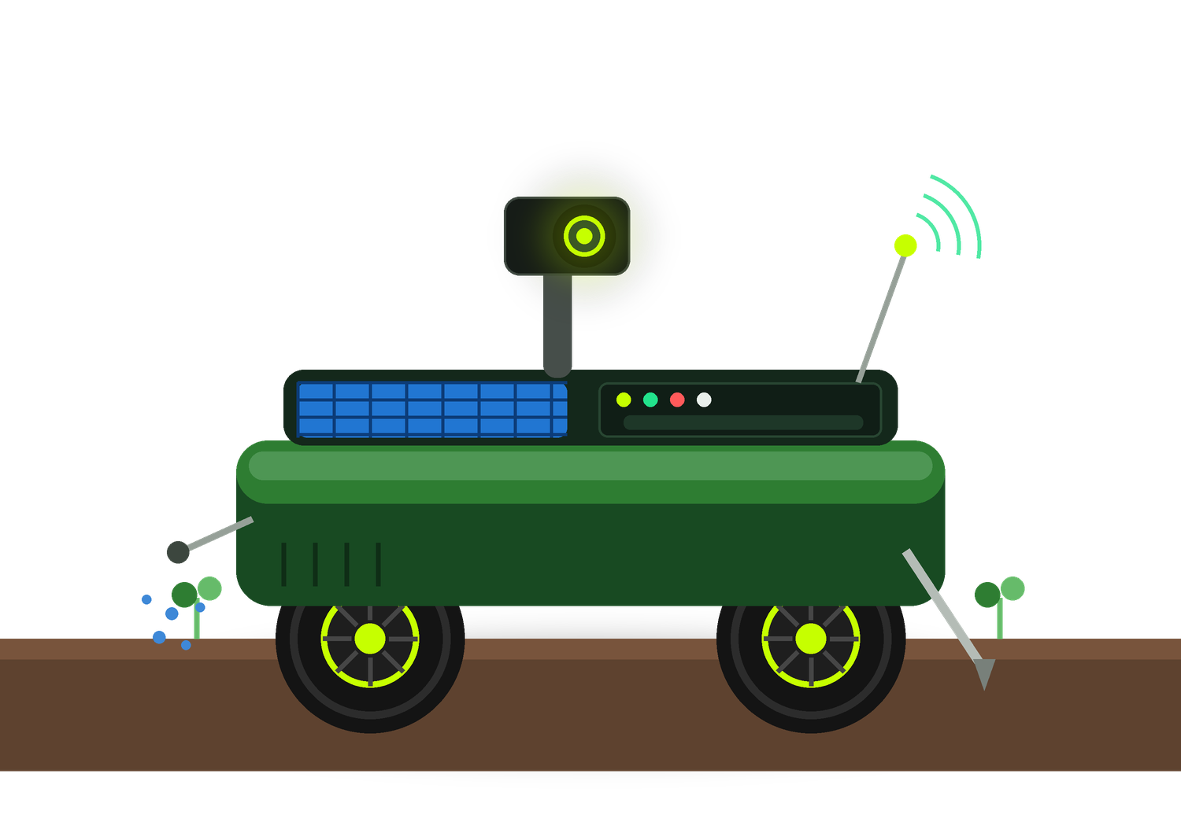
IDEAS KICKOFF · IIT BOMBAY
AgriRover
A production-intent agricultural scouting rover: dual-controller firmware, on-device AI inference, and a fully parametric CAD build.
2
42
12,137
CONTROLLERS
CAD PARTS
LINES OF CODE
Vivek Kumar Gupta · Shreyash Wagh · Hitanshu Kapadiya · Pritish Nandy
01/10

Slide 2

WHAT EXISTS TODAY
A built system, not a concept sketch
Shipped in this repository
REPOSITORY SCALE
ESP32 firmware (PlatformIO + FreeRTOS) for drive, sensing, dosing and MQTT
files
116 C++ / Python source files
71 Raspberry Pi Python modules: AI inference, EKF pose fusion, path planning
lines
12,137 across firmware, pi, ros2, cad
A ROS 2 package with sensor, drive, AI and mission nodes
docs
11 design documents in docs/
BOM
110 components + 15 gap-audit items
Fusion 360 script that generates the whole rover to scale
training
3 Colab notebooks + dataset builder
11 pytest modules covering AI interfaces, navigation, data and stop logic
deploy
systemd, MQTT TLS, Pi hardening
SOURCE README.md
02/10

Slide 3
COMMERCIAL HYPOTHESIS
Tomato crop-protection, Narayangaon/Junnar
Weekly repeatable sentinel sample and trap read → count and geotag suspected problems → compare against an economic threshold → trigger a full-row scan only when risk justifies it → agronomist-reviewed action → record treatment and pre-harvest interval → revisit and verify.
Why this cluster
SCOPE LIMITS STATED IN THE REPO
2023-24 tomato area: Nashik 22,040 ha, Pune 4,772 ha, Ahmednagar 4,324 ha, Solapur 4,072 ha
pilot v1
pesticide application stays manual
KVK Narayangaon provides local agronomy; a tomato FPO aggregates the route
NPK probe
not used to prescribe fertilizer
500 ml tank
spot treatment only, not full-field
Concentration dense enough to test operating economics, not just technology
category
not a universal farm robot
SOURCE research/AGRIROVER_MARKET_ADOPTION_RESEARCH.md README.md
03/10

Slide 4

SYSTEM ARCHITECTURE
Two controllers, split by timing guarantee
REAL-TIME TIER
INFERENCE TIER
board
ESP32 DevKit V1 (WROOM-32)
board
Raspberry Pi 5 + Hailo-8 AI HAT+
runtime
FreeRTOS, both cores used
throughput
26 TOPS accelerator
core 1
driveTask - motor PWM, obstacle reaction
fallback
Pi 4 + Coral USB Edge TPU
core 0
sensorTask - NPK, dosing, MQTT publish
workload
obstacle, weed, leaf-disease paths
signalling
FreeRTOS EventGroup, not volatile bool
services
evidence capture, dashboard, OTA
Command link is HMAC-authenticated and encrypted · heartbeat timeout 1500 ms halts the rover · 10 s lockout after repeated auth failures
SOURCE README.md firmware/include/config.h
04/10

Slide 5
FIRMWARE · ACTUATION
Drive and servo PWM on separate timers
TANK DRIVE - 2X BTS7960 (IBT-2)
SG90 SWEEP MOUNT
GPIO
19 / 21 left, 22 / 23 right
GPIO
27, LEDC channel 4 → timer 2
direction
PWM on RPWM fwd, LPWM rev
frame
50 Hz, 16-bit resolution
enable
R_EN + L_EN tied high to 3.3 V
range
duty 1638 (0°) → 8192 (180°)
PWM
LEDC 1 kHz, 8-bit, duty 0-255
startup
centred at 90°
Channel 4 is deliberately on timer 2 so the servo's 20 ms frame can never collide with the 1 kHz drive PWM on timers 0 and 1. Moving from L298N to BTS7960 freed GPIO 32/33.
SEQUENTIAL DOSING STATE MACHINE — MOTORS HELD STOPPED WHILE THE PROBE IS IN SOIL
pre-soak
extend
dwell
micro-dose
retract
1500 ms
4000 ms
800 ms
1500 ms
4000 ms
SOURCE firmware/include/pins.h firmware/src/servo.cpp firmware/include/config.h
05/10

Slide 6
MECHANICAL DESIGN
Double-decker chassis, 320 × 450 mm
Top & mast — GPS, camera, antenna
Z 257+
FUSION 360 GENERATOR
input
docs/mechanical-layout.md is source of truth
Sun canopy
Z 254-257
output
42 named, colour-coded components
tree
6 assembly groups, browser mirrors the build
Upper deck — compute, sensors, UI
Z 158-162
origin
chassis front-left corner, +Y toward rear
Lower deck — power, drive, fluid
Z 64-68
Layout rules that drove the stack
Fluid sits below electronics so leaks drain away
Underside — ultrasonics, actuator, NPK probe
Z -30
MPU6050 at centre of gravity; GPS and LoRa on the mast, clear of BTS7960 RF noise
Battery and tank low and centred for stability on uneven ground
SOURCE docs/mechanical-layout.md cad/AgriRoverPrototype/AgriRoverPrototype.py
06/10

Slide 7
SENSING & SAFETY
Layered stop logic and a verified pin map
SENSING BUSES
STOP LAYERS (DESIGN CONTROLS)
RS485
NPK probe via MAX485, GPIO 17/16/4
proximity
VL53L1X time-of-flight
analog
moisture 34, VBAT 35, TDS 36 (ADC1)
vision
obstacle inference on device
1-wire
DHT22 ambient on GPIO 14
attitude
IMU tilt threshold
UART1
GPS Neo-6M, RX 39 / TX 15 for RTCM
link
heartbeat watchdog, 1500 ms
relays
pump 26, actuator 13, polarity 2
motor
stall detection via ACS712
I2C
MPU6050, ADS1115, PCF8574, VL53L1X
manual
E-STOP on the upper deck + Telegram /stop
GPIO 34/35/36/39 are input-only, so every analog sensor is placed on ADC1. GPIO 15 is a strapping pin whose required boot level matches an idle UART TX line, which is why GPS TX can safely live there.
SOURCE firmware/include/pins.h README.md
07/10

Slide 8
HONEST STATUS
What is built vs. what is proven
VERIFIED IN REPOSITORY
NOT YET ESTABLISHED
Firmware, Pi services, ROS 2 nodes, CAD, wiring and BOMs
Crop-detection accuracy on local tomato classes
Simulation that runs with no hardware attached
Productive acres per day and route density
Automated test suite over AI interfaces and stop logic
Field reliability and ruggedness
Encrypted, authenticated Pi ↔ ESP32 command link
Chemical reduction, yield protection, rupee savings
Model OTA and active-learning frame capture
Willingness to pay and payback period
The README states this explicitly. Nothing in this deck claims a field result.
SOURCE README.md research/AGRIROVER_MARKET_ADOPTION_RESEARCH.md
08/10

Slide 9
NEXT MILESTONES
Validation gates before any paid launch
01
02
03
04
05
Supervised traversal
Local tomato data
Hailo export path
Row navigation
12-grower pilot
Physical drive tests with the layered stop logic active in a real row.
Collect and label local classes; held-out per-class validation.
Compile and benchmark the model chain on the Hailo-8 accelerator.
Camera-based row following and boundary behaviour beyond GPS geotags.
Paired pilot with KVK / agronomist review and calibrated measurement.
Repo analysis also flags open engineering items to close first: a 45× flow-configuration conflict, and a savings tracker that currently mixes incompatible units.
SOURCE research/AGRIROVER_MARKET_ADOPTION_RESEARCH.md README.md
09/10

Slide 10
TEAM
IIT Bombay · Mechanical Engineering
Vivek Kumar Gupta
Shreyash Wagh
Hitanshu Kapadiya
Pritish Nandy
25B2269
25B2227
25B2228
—
B.Tech 2029 · Uttar Pradesh
B.Tech 2029 · Nashik, Maharashtra
B.Tech 2029 · Gujarat
Team member
github.com/aman123825/agrobot
Roll numbers and details for the first three are from IDEAS_team_members.csv; the repository holds no record for Pritish Nandy, so no details are asserted.
10/10

