Slide 1
AgriRover
PRECISION FARMING FOR EVERY SMALL FARM
AgriRover
Affordable autonomous rover — soil-NPK sensing · AI weed & disease detection · per-plant micro-dosing
IITB–Groww INV.ENT · Track A
Team of 4 · IIT Bombay: Hitanshu Kapadiya · Vivek Gupta · Shreyash Wagh · Pritish Nandy
Mechanical Engineering ×3 · Aerospace Engineering ×1

Slide 2
PROBLEM & VALIDATION
AgriRover
Farming runs on guesswork
India's small farms can't use big machinery — and fertilise blind. That wastes money and degrades soil.
▪
Farms too small for machinery
▪
Fertilise by guesswork
≈86% of India's holdings are under 2 ha
(Agriculture Census 2015–16).
No affordable way to sense soil NPK or
dose per plant.
▪
NPK imbalance vs 4:2:1 (FAI)
▪
Soil Health Cards underused
Excess urea wastes money and
degrades the soil.
Lab tests take 2–3 weeks — so old
habits win.
Validated in the field: talks with local farmers & input dealers confirm uniform hand-broadcasting and guesswork dosing is the norm.
Sources: Agriculture Census 2015–16; FAI. Indicative.
AgriRover · IITB–Groww INV.ENT · Track A · Team of 4 (IIT Bombay)
2

Slide 3
SOLUTION & INNOVATION
AgriRover
One low-cost autonomous rover
AgriRover senses, decides and acts per plant — precision farming at a fraction of big-ag machinery cost.
1
SENSE
2
DECIDE
3
ACT
4
LEARN
7-in-1 NPK probe
moisture · TDS · pH
GPS + IMU + encoders
YOLOv8n vision
weed · disease
obstacle detection
micro-dosing
aimed spot-spray
cutter · seeder · weeder
geo-tagged logs
prescription maps
dashboard + alerts
Why it's different: the only affordable, autonomous, per-plant solution purpose-built for India's small farms.
AgriRover · IITB–Groww INV.ENT · Track A · Team of 4 (IIT Bombay)
3

Slide 4
WHY AGRIROVER?
AgriRover
Vs the alternatives
Capability | AgriRover | Big-ag machinery | Manual labour | Ag-drones
Affordable for <2 ha farms | ✓ | ✗ | ✓* | ~
Senses soil NPK per spot | ✓ | ✗ | ✗ | ✗
Per-plant micro-dosing | ✓ | ✗ | ~ | ✗
AI weed & disease ID | ✓ | ✗ | ✗ | ~
Autonomous operation | ✓ | ✓ | ✗ | ~
One-time low-cost asset | ✓ | ✗ | ✗ | ~
Our edge: affordable + autonomous + per-plant, in one asset that also senses soil. *manual labour is cheap per use but recurring.
AgriRover · IITB–Groww INV.ENT · Track A · Team of 4 (IIT Bombay)
4

Slide 5
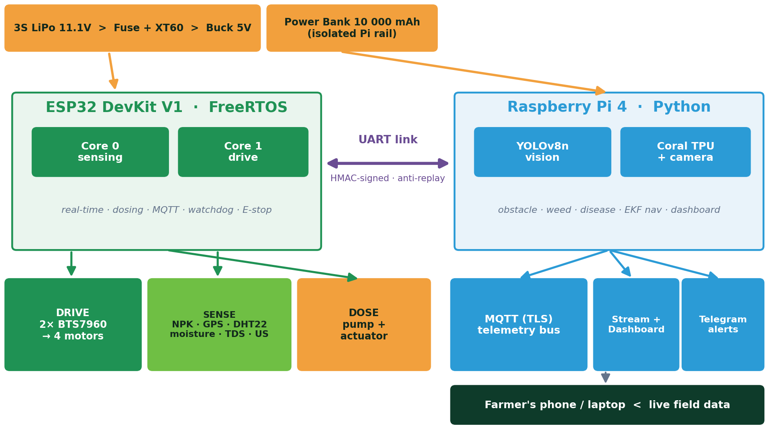
HOW IT WORKS
AgriRover
Two brains, one mission
A real-time ESP32 (FreeRTOS) runs drive, sensing & dosing; a Raspberry Pi 4 runs AI vision & analytics — over an HMAC-signed link.
Dual-controller architecture — real-time control + on-board AI.
AgriRover · IITB–Groww INV.ENT · Track A · Team of 4 (IIT Bombay)
5

Slide 6
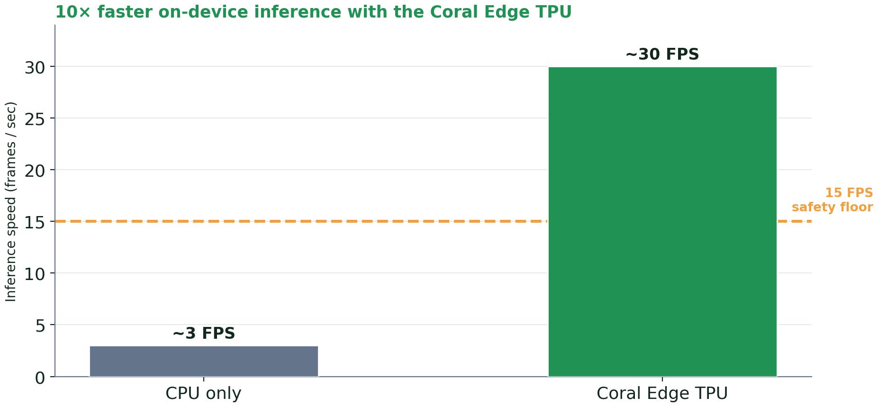
SENSE & SEE
AgriRover
Know the soil, see the crop
▸ 7-in-1 soil probe — N·P·K·pH·EC·moisture·temp over RS485 Modbus
▸ Calibrated & robust — oversampled ADC, multi-point moisture, temp-comp TDS
▸ Three AI models — obstacle · weed (DeepWeeds) · disease (PlantVillage)
▸ Runs on Coral Edge TPU — ~10× faster than CPU; fails safe if a model is absent
7-in-1
38
~30
~10–20cm
soil probe
disease classes
FPS on Coral
plant geo-tag
AgriRover · IITB–Groww INV.ENT · Track A · Team of 4 (IIT Bombay)
6

Slide 7
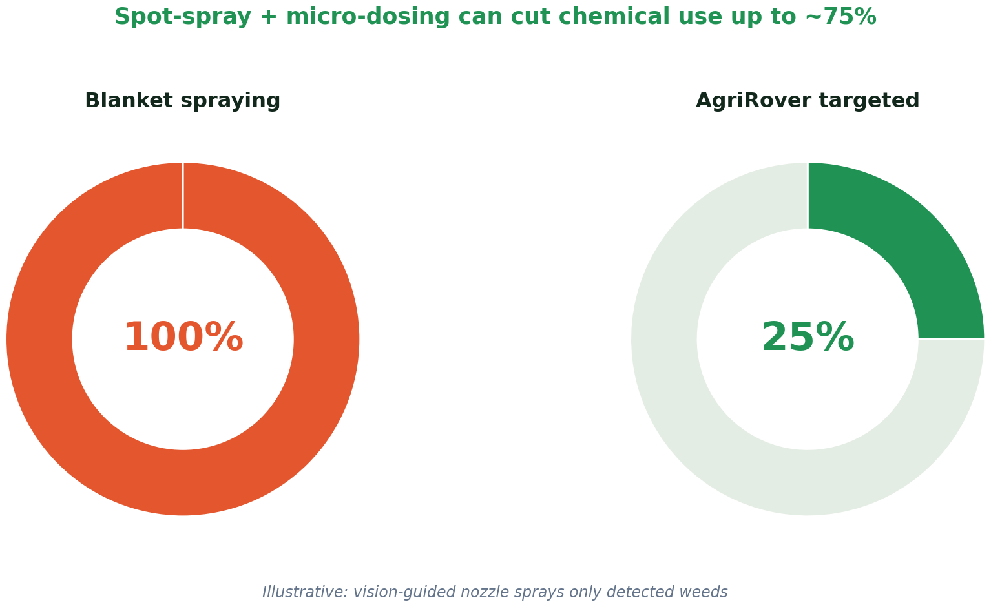
ACT & AUTONOMY
AgriRover
Treat the plant, drive the field
▸ Sequential micro-dosing — pre-soak → probe → dose → retract; drive frozen while dosing
▸ Vision-aimed spot-spray — pan/tilt nozzle targets each detected weed (FC-01)
▸ Autonomous snake-route — GPS + SBAS + EKF fusion → sub-meter coverage
▸ Closed-loop velocity PID — encoder feedback → straight rows, repeatable spacing
▸ Fail-safe by design — E-stop, dead-man heartbeat, thermal guardian, stall stop
AgriRover · IITB–Groww INV.ENT · Track A · Team of 4 (IIT Bombay)
7

Slide 8
MARKET OPPORTUNITY & SCOPE
AgriRover
A large, growing market
$2.5 Bn
Scope — what it does today
▪ Soil NPK sensing, AI weed/disease ID, targeted micro-dosing, autonomous nav.
Scope — where it grows
▪ Crops: vegetables, cotton, cereals, orchards, polyhouses.
▪ Geography: India's small-farm belts via FPOs / co-ops.
▪ Add-ons: seeding, spraying, weeding, scouting, yield mapping.
▪ Data services: soil & crop analytics + prescription maps (recurring).
India agritech market by 2034 (from ~$0.97 Bn in 2025, ~10.6% CAGR).
$739 Mn
India precision-agriculture market by 2034 (~9.2% CAGR).
~146 M
farm holdings in India — 86% small/marginal (<2 ha): our core market.
Sources: IMARC (agritech & precision-ag), Agriculture Census 2015–16. Indicative.
AgriRover · IITB–Groww INV.ENT · Track A · Team of 4 (IIT Bombay)
8

Slide 9
TAILWINDS & BUSINESS MODEL
AgriRover
Policy is on our side
▸ SMAM — 50–80% subsidy on farm machinery; funds Custom Hiring Centres
▸ Agri Infrastructure Fund — interest-subvented loans for FPOs/SHGs to set up CHCs
▸ Namo Drone Didi — 15,000 drones to women SHGs — momentum for ag-robotics
▸ Soil Health Card scheme — national soil-testing push — aligns with our NPK sensing
▸ 10,000 FPOs + Digital Agri — aggregation & farm-data tailwinds
How we leverage it
▪ Rover qualifies as agri-machinery → SMAM subsidy cuts farmer cost.
▪ Deploy via FPOs / CHCs financed by AIF → shared-asset model.
Revenue streams
▪ Rover sale + annual service contract.
▪ Rover-as-a-Service: per-acre fee via FPO/CHC.
▪ Subscription: soil & crop analytics + prescription maps.
Scheme details per Govt of India / PIB — verify exact terms before claims.
AgriRover · IITB–Groww INV.ENT · Track A · Team of 4 (IIT Bombay)
9

Slide 10
WHAT WE'VE BUILT
AgriRover
A working POC / MVP
●
Firmware · ESP32/FreeRTOS
●
AI Vision · Raspberry Pi
●
Navigation & Systems
Dual-core drive + RS485 NPK
Dosing state machine · secure link
YOLOv8n weed/disease/obstacle
Coral TPU · training notebooks
EKF + GPS + vision geo-tag
Snake planner · ROS2 · simulator
●
Software Tooling
●
Hardware Design
●
Field Reliability
Live dashboard + Telegram
CI pipeline · black-box logging
Verified circuit + wiring v2
110-part costed BOM (+15 audit)
10 real field risks engineered
Heat, stall, comms-loss, sealing
Built end-to-end by our 4-member team — software validated in simulation; hardware integration is the next step.
AgriRover · IITB–Groww INV.ENT · Track A · Team of 4 (IIT Bombay)
10

Slide 11
POC HYPOTHESIS & METRICS
AgriRover
What we will prove
Hypothesis: per-plant sensing + targeted dosing cuts fertiliser/chemical use sharply — with no yield loss.
▸ Input reduction — fertiliser & pesticide saved vs hand-broadcasting
▸ Detection accuracy — weed/disease precision & recall; dosing placement (cm)
▸ Coverage & economics — area per charge; cost saving per acre per season
Targets to prove in pilot: 30–50% input reduction · >85% detection accuracy.
AgriRover · IITB–Groww INV.ENT · Track A · Team of 4 (IIT Bombay)
11

Slide 12
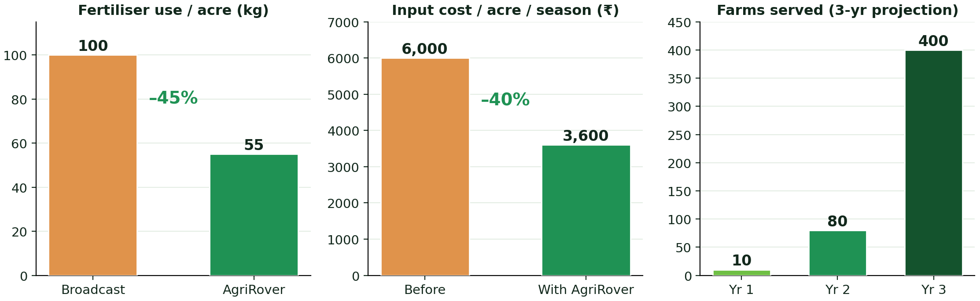
PROJECTED IMPACT & SCALE
AgriRover
The numbers we're chasing
AI detection accuracy
Fertiliser reduction
Cost saving / acre
88%
45%
40%
Projected from our simulation model & targets — to be validated in field pilots.
AgriRover · IITB–Groww INV.ENT · Track A · Team of 4 (IIT Bombay)
12

Slide 13
EXECUTION & GO-TO-MARKET
AgriRover
From prototype to fleet
BUILD
ITERATE
Hardware prototype
BTS7960 drive, NPK probe, pan/tilt sprayer, LiFePO4 — ~3 months
Harden from field data
tune dosing + AI; seal for dust & 40–45 °C heat
TEST
SCALE
Pilot on 5–10 farms
measure input savings, accuracy & uptime
FPO / CHC roll-out
SMAM/AIF support → Rover-as-a-Service + data subscription
AgriRover · IITB–Groww INV.ENT · Track A · Team of 4 (IIT Bombay)
13

Slide 14
TEAM OF 4 & IMPACT
AgriRover
Built end-to-end at IIT Bombay
HK
VG
SW
PN
Hitanshu Kapadiya
Mechanical Engineering
Vivek Gupta
Mechanical Engineering
Shreyash Wagh
Mechanical Engineering
Pritish Nandy
Aerospace Engineering
Why us
▪ An IIT Bombay team of 4 that built the full software stack, circuit design and mechanical fabrication — end to end.
Impact
▪ Lower input cost, less runoff, healthier soil and higher net income — affordable precision farming for every smallholder.
AgriRover · IITB–Groww INV.ENT · Track A · Team of 4 (IIT Bombay)
14

Slide 15
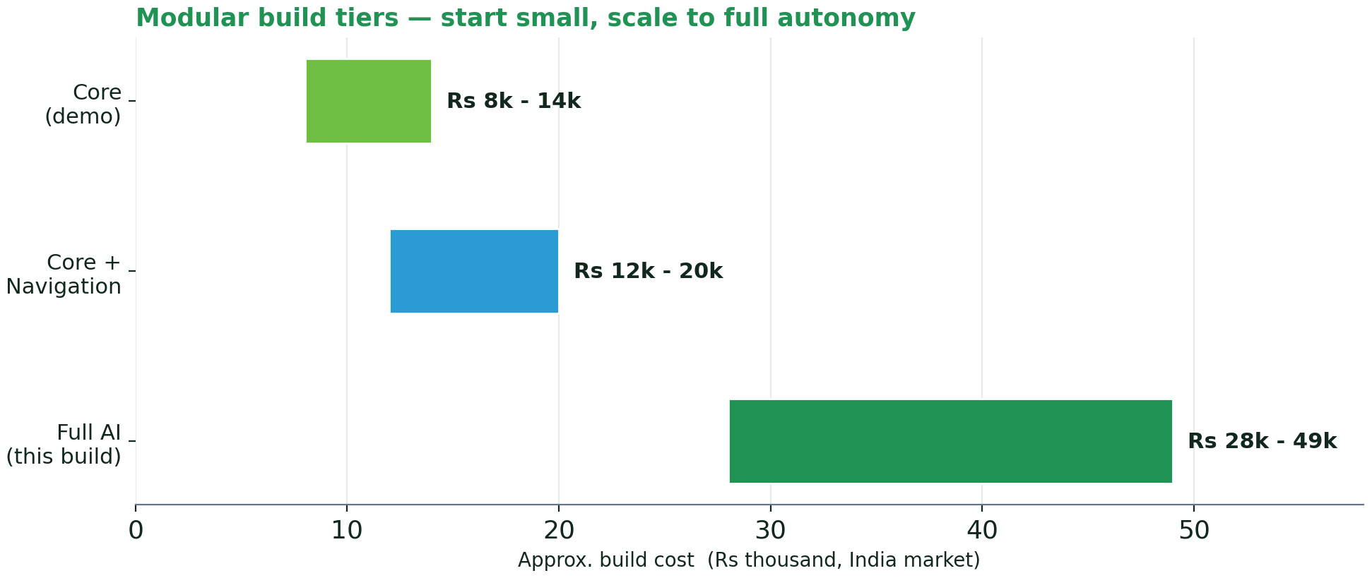
BUDGET & BUILD TIERS
AgriRover
Affordable, modular, costed
Build tiers (India prices)
▪ Core / demo: ₹8,000–14,000
▪ Core + Navigation: ₹12,000–20,000
▪ Full AI build: ₹27,000–48,000
Notes
▪ Off-the-shelf parts; software is free.
▪ 3D-printed parts are PETG, not bought.
▪ Verify prices before ordering.
AgriRover · IITB–Groww INV.ENT · Track A · Team of 4 (IIT Bombay)
15

Slide 16
AgriRover
Thank you.
Precision farming for every small farm.
OUR ASK
▸ Mentorship & a pilot — field access via an FPO / Custom Hiring Centre
▸ Seed support — to build the hardware prototype and run the first pilots
Hitanshu Kapadiya · Vivek Gupta · Shreyash Wagh · Pritish Nandy
IIT Bombay · IITB–Groww INV.ENT · Track A

Slide 17
APPENDIX
Engineering Depth
Verified circuit, drive, mechanical layout & field-risk engineering.

Slide 18
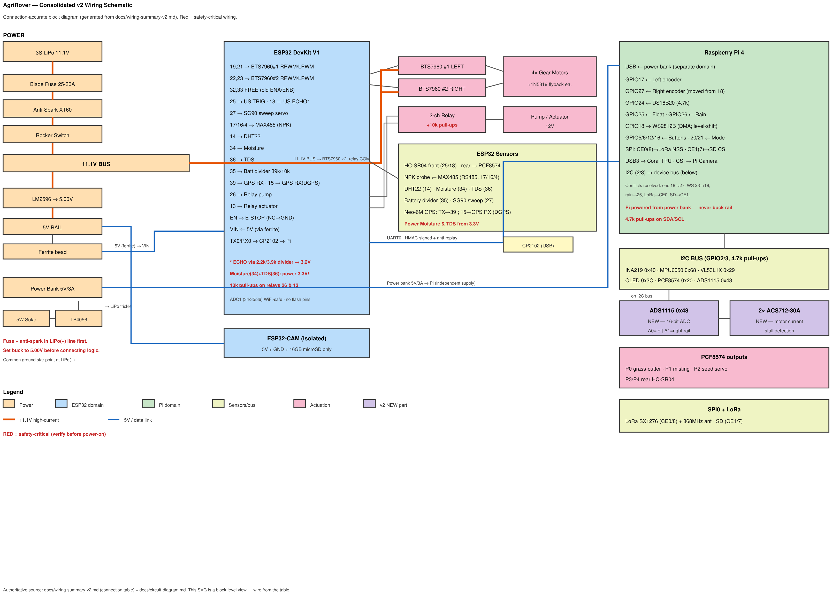
APPENDIX · ELECTRONICS
AgriRover
Every wire accounted for
110 BOM components + 15 gap-audit items — every bus, divider and safety part placed.
Consolidated v2 wiring schematic — red = safety-critical paths.
AgriRover · IITB–Groww INV.ENT · Track A · Team of 4 (IIT Bombay)
18

Slide 19
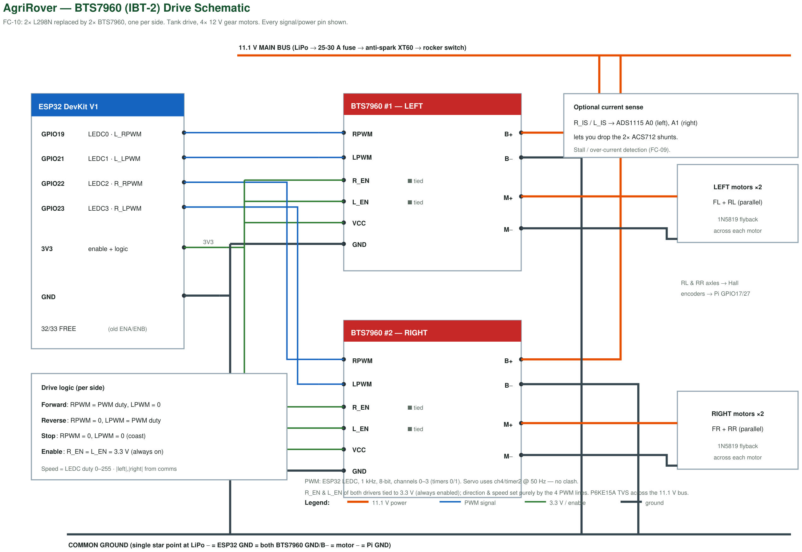
APPENDIX · DRIVE SYSTEM
AgriRover
MOSFET power for soil loads
▸ 2× BTS7960 — replaced the L298N (FC-10)
▸ ~43 A peak/side — handles soil-loaded motors
▸ Dual-PWM — forward / reverse / coast
▸ 1N5819 flyback — clamps back-EMF
▸ Current-sense — IS → stall detection
Pin-level 2× BTS7960 (IBT-2) drive schematic.
AgriRover · IITB–Groww INV.ENT · Track A · Team of 4 (IIT Bombay)
19

Slide 20
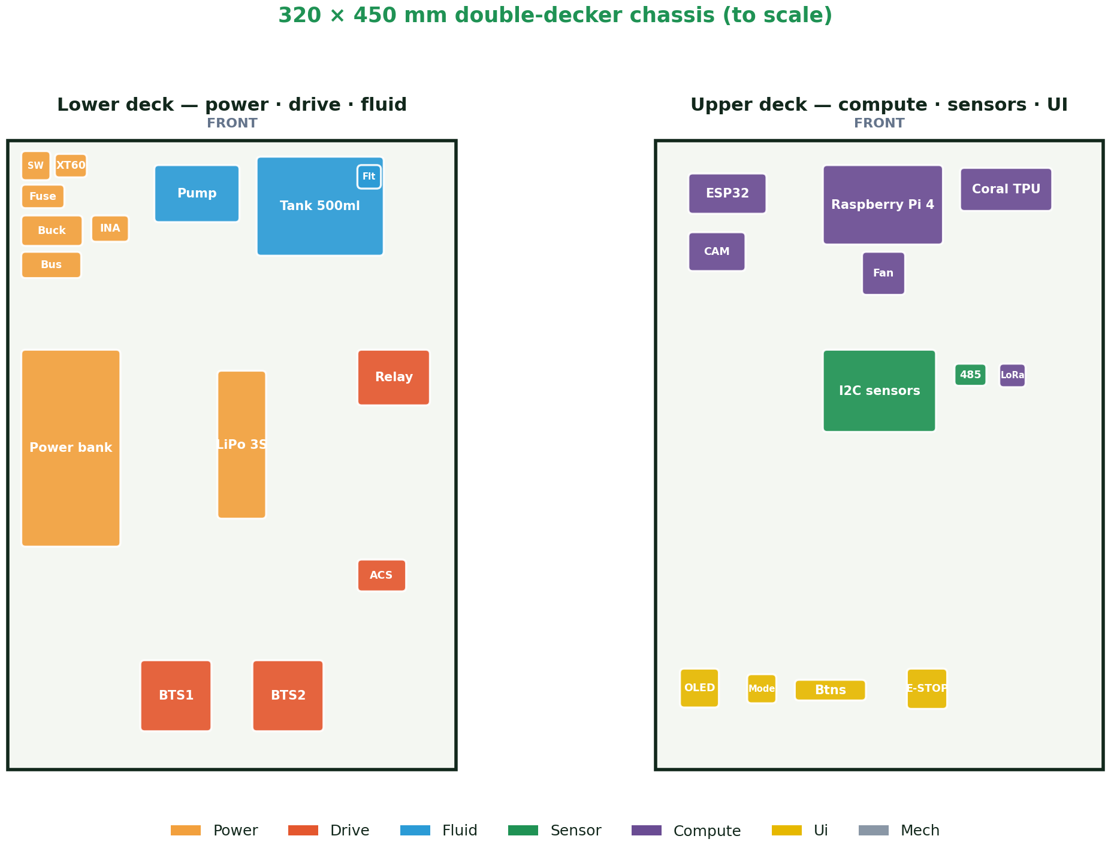
APPENDIX · MECHANICAL
AgriRover
Stable, service-friendly
▸ Double-decker — 320 × 450 mm, two layers
▸ Low CoG — battery + tank low, centred
▸ Fluids below — leaks drain from the Pi
▸ Heat apart — drivers at the rear + fan
▸ Field-hardened — grommets, glands, coating
To-scale layout from verified component coordinates.
AgriRover · IITB–Groww INV.ENT · Track A · Team of 4 (IIT Bombay)
20

Slide 21
APPENDIX · FIELD-READY
AgriRover
Ten field risks, engineered
ID | Field challenge | Engineered solution | Status
FC-01 | Weeds above the pathway | Vision-guided pan/tilt aimed spray | Code-ready
FC-02 | Field heat → battery fire | Thermal guardian + NTC + LiFePO4 | Code-ready
FC-03 | Actuator retract type | Dual compile-flag branches | Code-ready
FC-04 | Per-plant GPS precision | SBAS + averaging + EKF + vision | Implemented
FC-05 | Sensors over-volt the ADC | Powered from the 3.3 V rail | Implemented
FC-06 | Relays twitch ON at boot | 10 kΩ pull-ups + fail-safe OFF | Implemented
FC-07 | Comms link drops | HMAC heartbeat dead-man halt | Implemented
FC-08 | Dust, dew & spray | Conformal coat + glands + gaskets | Implemented
FC-09 | Wheel / cutter jam | ADS1115 current-sense stall stop | Implemented
FC-10 | Driver under-spec (L298N) | 2× BTS7960 MOSFET drivers | Code-ready
AgriRover · IITB–Groww INV.ENT · Track A · Team of 4 (IIT Bombay)
21

