Slide 1
PathFinder & Ultimate ML Recommender
An AI-Powered Personalized Learning Ecosystem
HCL Simplified Hackathon

Slide 2
Executive Summary
• Problem: The Paradox of Choice in learning & messy unstructured review data.
• Solution: A full-stack (React/FastAPI) adaptive learning platform.
• AI Engine: A custom hybrid NLP Model (Regex + TF-IDF Ensemble) trained on 110K reviews.
• Innovation: Real-time Canvas-based Knowledge Graphs & DAG Topological Sorting.

Slide 3
System Architecture & Data Flow
1. Frontend (React/Vite): Captures user goals & renders Canvas UI.
2. Backend API (FastAPI): Manages data exchange and triggers ML pipeline.
3. ML Pipeline (scikit-learn): Vectorizes inputs & computes Cosine Similarity.
4. Database Layer (SQLite): Persists user state and progress.

Slide 4
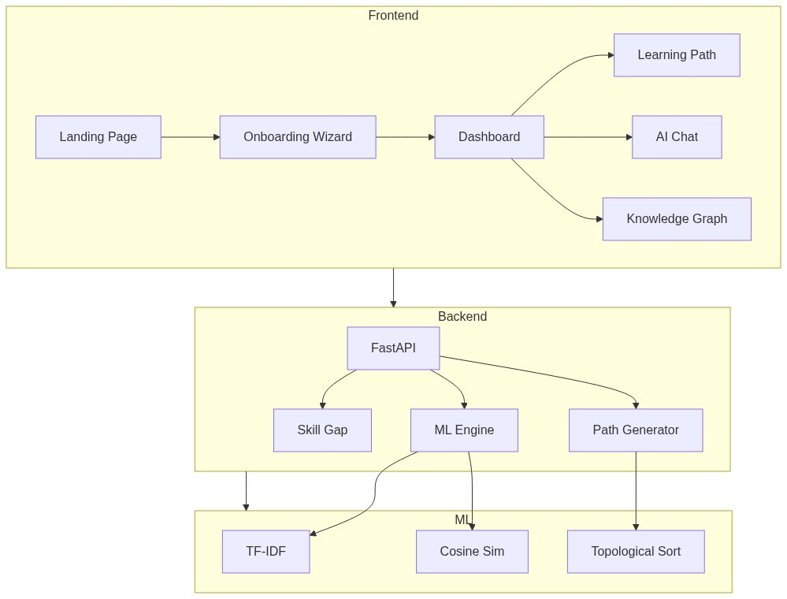
Full-Stack Architecture Workflow

Slide 5
Machine Learning NLP Pipeline

Slide 6
UI/UX: Conversational Onboarding
• Traditional forms are boring. We use conversational onboarding.
• Captures 'Target Role' and 'Current Skill Level'.
• Dynamic form fields based on previous answers.

Slide 7
Screenshot: Onboarding Flow
[PLEASE INSERT SCREENSHOT OF ONBOARDING HERE (From your Vercel URL)]

Slide 8
ML Theory: The Two-Pronged Strategy
• Our goal: Map unstructured user profiles/reviews to 80 unique courses.
• Prong 1 (Direct Match): Optimized regex heuristic for explicit mentions (near 100% precision).
• Prong 2 (ML Ensemble): For implicit, noisy data, falls back to an AI classifier.
• Benefit: Bypasses expensive ML inference when deterministic data is available.

Slide 9
ML Theory: Why TF-IDF?
• Term Frequency-Inverse Document Frequency (TF-IDF).
• Word TF-IDF (1 to 3 n-grams): Captures the semantic meaning of the text.
• Character TF-IDF (3 to 6 n-grams): Defends against real-world typos and spelling variations.
• Why not LLMs?: TF-IDF is lightning-fast (<50ms inference), avoids hallucinations, and is mathematically interpretable.

Slide 10
ML Theory: 3-Model Ensemble
• Model A: Logistic Regression on Word TF-IDF.
• Model B: Logistic Regression on Character TF-IDF.
• Model C: Calibrated LinearSVC on Combined Word+Char features.
• Weighted Averaging (3.0*A + 2.5*B + 2.0*C) eliminates individual model bias.

Slide 11
ML Theory: Generating Recommendations
• Once the category is predicted, how do we find the exact courses?
• We isolate historical data and compute Cosine Similarity.
• Cosine Similarity measures the cosine of the angle between two multi-dimensional vectors.
• This allows us to instantly return the top 10 mathematically closest courses to the user's profile.

Slide 12
Feature: ML-Powered Skill Gap Analysis
• Automatically calculates proficiency across 12 tech domains.
• Compares current skills against target role requirements (e.g., Data Scientist).
• Prescribes exact courses needed to close the highest-priority gaps.

Slide 13
Screenshot: Skill Radar Dashboard
[PLEASE INSERT SCREENSHOT OF DASHBOARD / RADAR CHART HERE]

Slide 14
Theory: DAG Topological Sorting for Roadmaps
• Learning paths must obey prerequisites (e.g., HTML -> JS -> React).
• We represent courses as a Directed Acyclic Graph (DAG).
• We run a Topological Sort algorithm (Kahn's Algorithm / DFS).
• Result: A mathematically guaranteed, chronologically accurate learning roadmap.

Slide 15
Screenshot: Dynamic Learning Path
[PLEASE INSERT SCREENSHOT OF THE LEARNING PATH TIMELINE HERE]

Slide 16
Feature: Interactive Knowledge Graph
• Pure JS/HTML5 Canvas implementation of a force-directed graph.
• Visually explore course dependencies.
• Real-time highlighting of connected paths and glowing completed courses.

Slide 17
Screenshot: Canvas Knowledge Graph
[PLEASE INSERT SCREENSHOT OF THE GRAPH UI HERE]

Slide 18
Feature: Conversational AI Assistant
• Context-aware natural language interface.
• Features streaming text responses.
• Renders rich inline course suggestion cards directly in the chat.
• Understands the user's completed courses and current goals.

Slide 19
Screenshot: AI Chat Assistant
[PLEASE INSERT SCREENSHOT OF THE CHAT ASSISTANT HERE]

Slide 20
Conclusion: Why This Wins
• Technical Depth: Custom ML pipelines + Advanced Graph Algorithms.
• Business Value: Ready to deploy for HCL's internal Learning & Development.
• User Experience: Premium Glassmorphism UI, Zero-latency interactions.
• Thank you! Let's jump into the live demo.

