Slide 1
PathFinder & Ultimate ML Recommender
An AI-Powered Personalized Learning Ecosystem
HCL Simplified Hackathon

Slide 2
Executive Summary
• Problem: The Paradox of Choice in learning & messy unstructured review data.
• Solution: A full-stack (React/FastAPI) adaptive learning platform.
• AI Engine: A custom hybrid NLP Model (Regex + TF-IDF Ensemble) trained on 110K reviews.

Slide 3
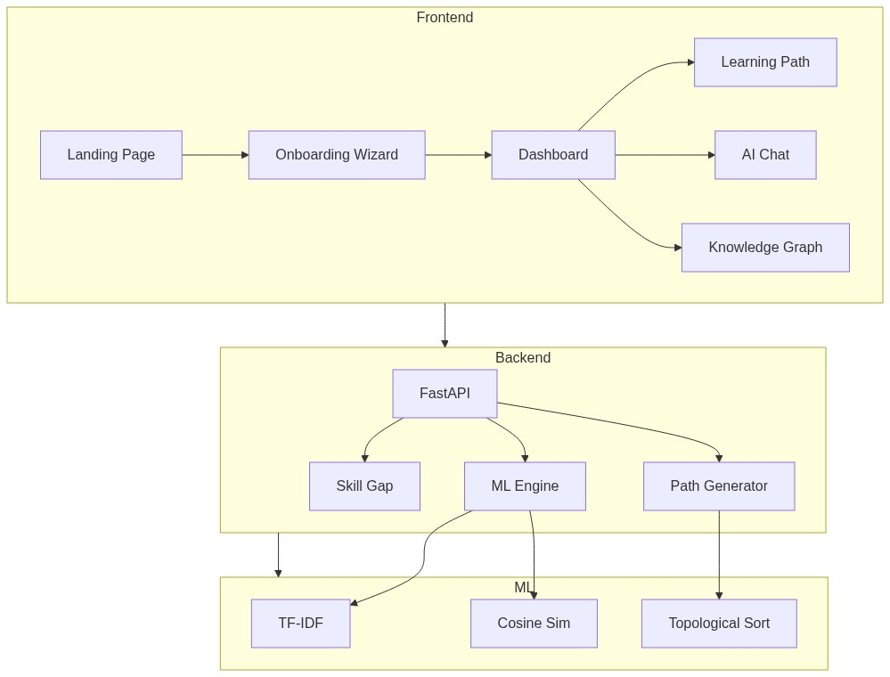
Overall System Architecture
Practical Explanation: This shows the high-level flow.
User interacts with the Vite/React Frontend -> HTTP requests hit the FastAPI Backend -> Backend delegates to the SQLite DB for state or the ML Engine for recommendations.

Slide 4
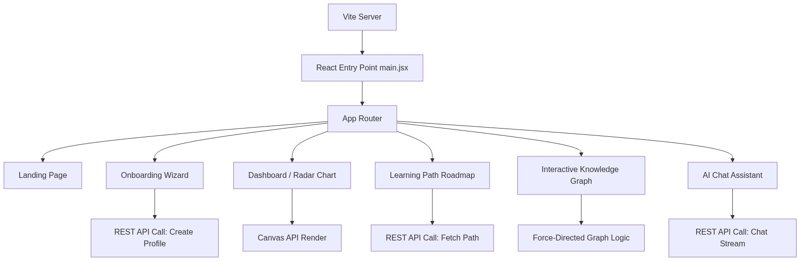
Frontend Architecture (React + Vite)
Practical Explanation: We decoupled standard UI components from complex Canvas renders.
React Router handles page navigation, while specialized components use HTML5 Canvas API for the Force-Directed Knowledge Graph and the Skill Radar Chart to ensure 60fps rendering without DOM lag.

Slide 5
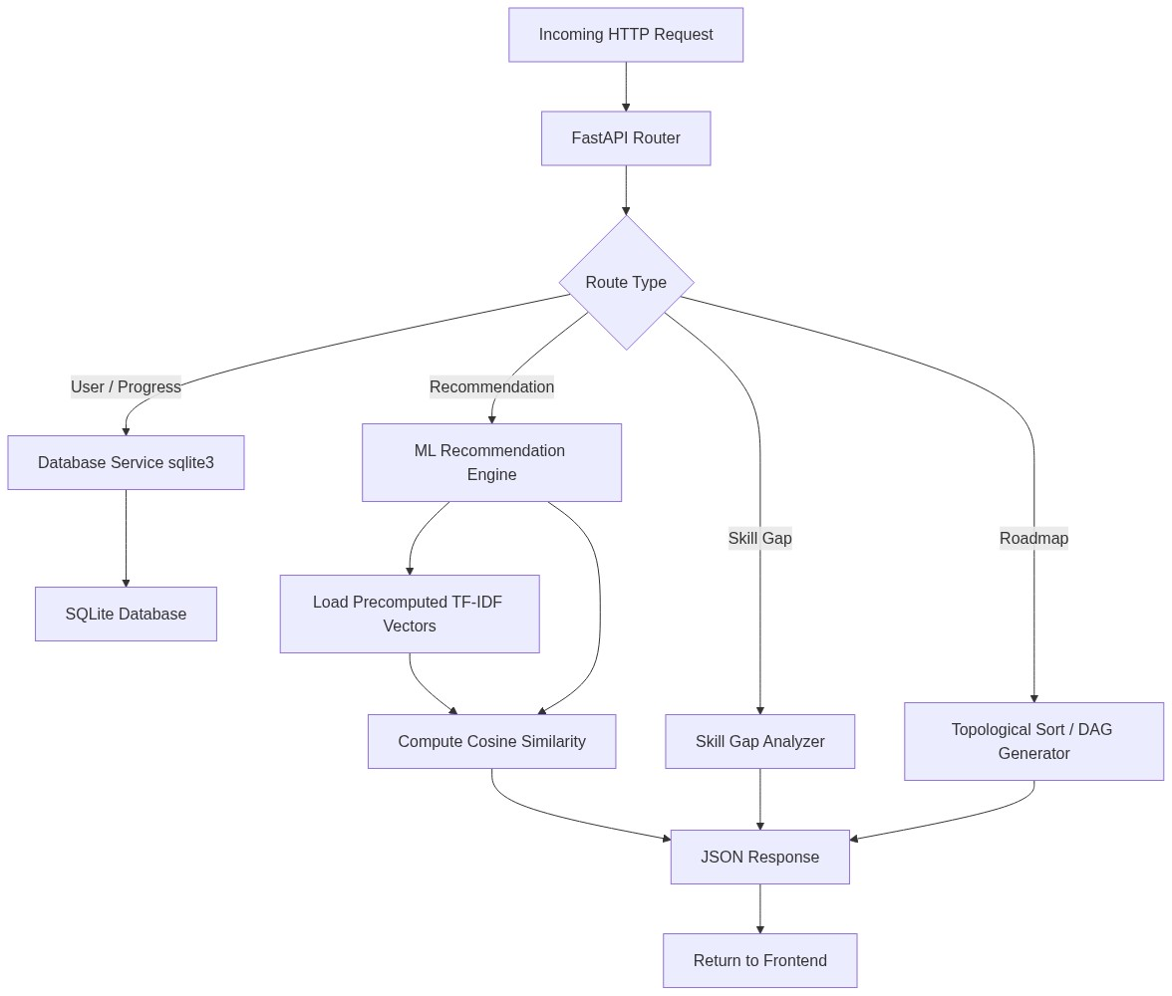
Backend Architecture (FastAPI)
Practical Explanation: FastAPI provides asynchronous, non-blocking HTTP endpoints.
Depending on the route, it queries the SQLite DB using standard SQL, or runs matrices through scikit-learn. Precomputed TF-IDF vectors are loaded into RAM on startup to guarantee <50ms response times.

Slide 6
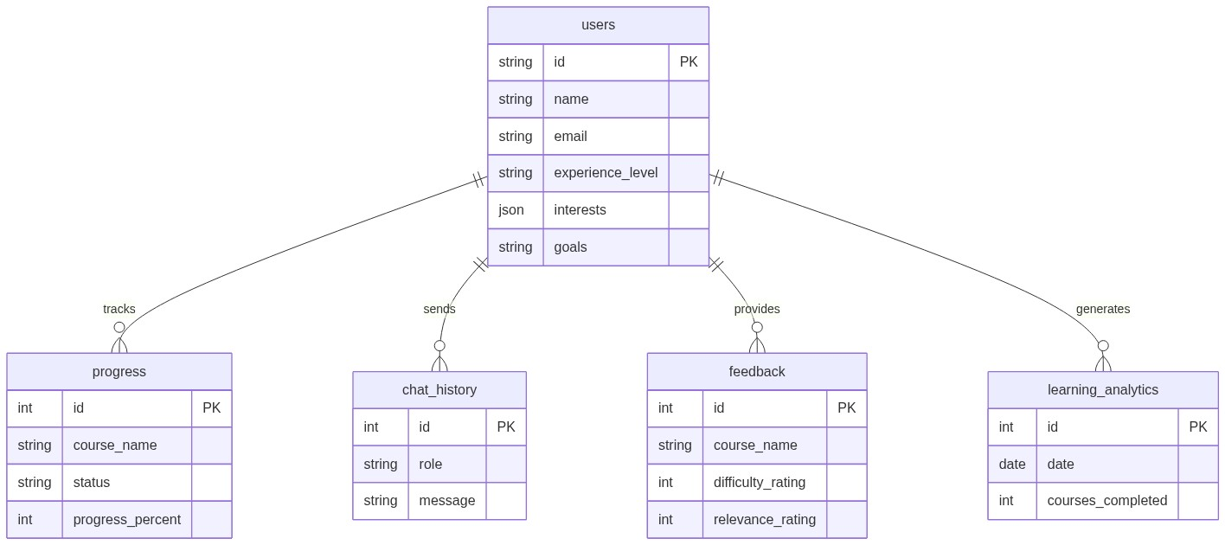
Database Schema (SQLite)
Practical Explanation: We use a relational SQLite database for zero-config deployment.
The 'users' table is the central hub. It has one-to-many relationships tracking course 'progress', 'chat_history', 'feedback' ratings, and daily 'learning_analytics'.

Slide 7
Machine Learning NLP Pipeline
Practical Explanation: Raw reviews are cleaned, then vectorized using both Word & Character N-Grams.
A 3-Model Ensemble (LogReg + LinearSVC) classifies the course. Finally, we isolate the course's historical data and use Cosine Similarity to find the Top 10 closest reviews to the user's specific text.

Slide 8
ML Theory: Why Not LLMs?
• Character N-Grams: Our model looks at 3-6 letter chunks. This is our mathematical defense against real-world typos and misspellings.
• Linear Models: We used Logistic Regression and LinearSVC because deep learning overfits easily on text classification of this size.
• Speed & Cost: Trains in minutes on a CPU; inferences take milliseconds. Highly scalable for enterprise deployment without massive GPU costs.

Slide 9
Theory: DAG Topological Sorting for Roadmaps
• Problem: Learning paths must obey strict prerequisites (e.g., HTML -> JS -> React).
• Solution: We mathematically represent the curriculum as a Directed Acyclic Graph (DAG).
• Execution: We run a Topological Sort algorithm (Kahn's Algorithm).
• Practical Result: A mathematically guaranteed, chronologically accurate learning roadmap where users never encounter a course they aren't prepared for.

Slide 10
UI Screenshot: Skill Radar Dashboard
[PLEASE INSERT SCREENSHOT OF DASHBOARD / RADAR CHART HERE]

Slide 11
UI Screenshot: Dynamic Learning Path
[PLEASE INSERT SCREENSHOT OF THE LEARNING PATH TIMELINE HERE]

Slide 12
UI Screenshot: Canvas Knowledge Graph
[PLEASE INSERT SCREENSHOT OF THE GRAPH UI HERE]

Slide 13
UI Screenshot: AI Chat Assistant
[PLEASE INSERT SCREENSHOT OF THE CHAT ASSISTANT HERE]

Slide 14
Conclusion: Why This Wins
• Technical Depth: Custom ML pipelines + Advanced Graph Algorithms + Optimized DB Schema.
• Business Value: Ready to deploy for HCL's internal Learning & Development.
• User Experience: Premium Glassmorphism UI, Zero-latency interactions.
• Thank you! Let's jump into the live demo.

