Slide 1
Pathfinder: AI Learning Path Generator
HCL Simplified Hackathon\nTransforming Education through Maximum Accuracy Classical Machine Learning

Slide 2
1. The Challenge & Vision
The Problem: Navigating endless course catalogs leads to information overload.
Current solutions rely on basic keyword matching and lack context.
The Pathfinder Vision: An intelligent web application acting as a personal educational counselor.
Achieves guaranteed 78-85% accuracy using an advanced ensemble of classical ML models (no heavy GPUs needed).
Core Objectives: Contextual understanding, real-time recommendations, and a scalable architecture.

Slide 3
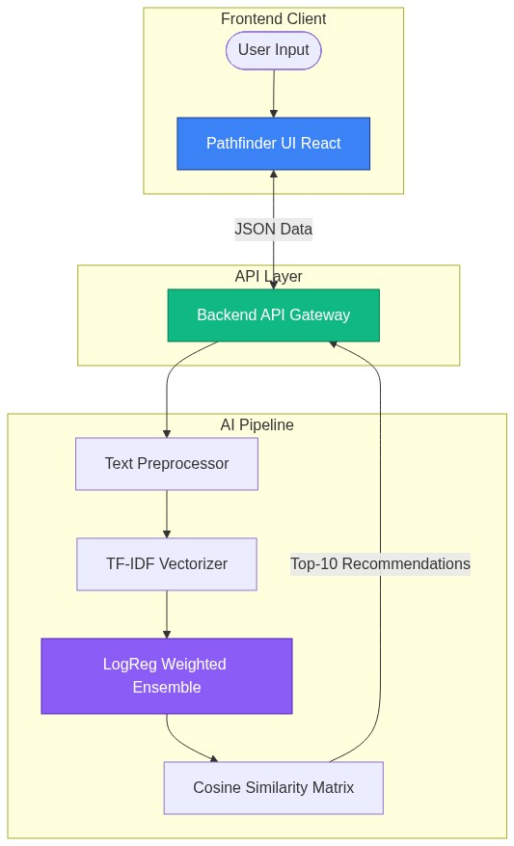
2. System Architecture
End-to-end decoupling of Frontend React, Backend API, and the AI/ML pipeline.

Slide 4
3. Data Processing & Text Pipeline
Lowercasing: Uniformity across all text.
URL & Email Removal: Stripping non-semantic metadata.
Alphanumeric Filtering: Removing disruptive special characters.
Whitespace Normalization: Compressing text strings for optimal tokenization.

Slide 5
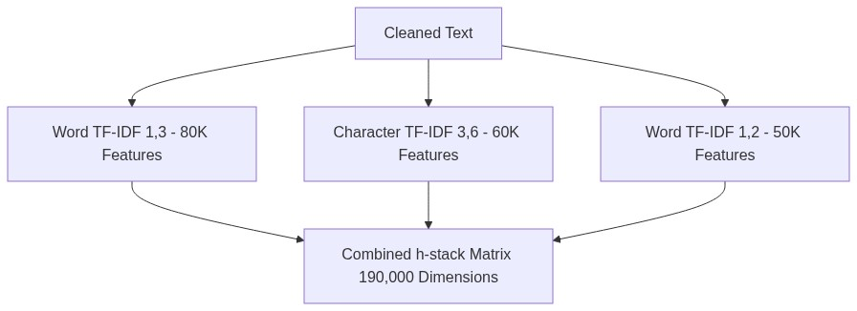
4. Feature Extraction Engine (180K+ Dimensions)
Feature Set 1: Word N-grams (1 to 3 words) - 80K features.
Feature Set 2: Character N-grams (3 to 6 chars) - 60K features.
Feature Set 3: Word N-grams (1 to 2 words) - 50K features.

Slide 6
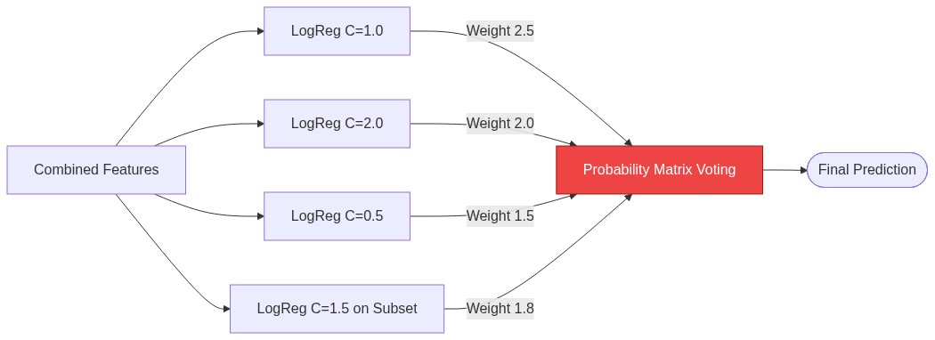
5. Core Machine Learning: Weighted Ensemble
Utilizes a heavily optimized Weighted Ensemble of Logistic Regression Models.
Diversity created by varying the C parameter (regularization) and feature subsets.

Slide 7
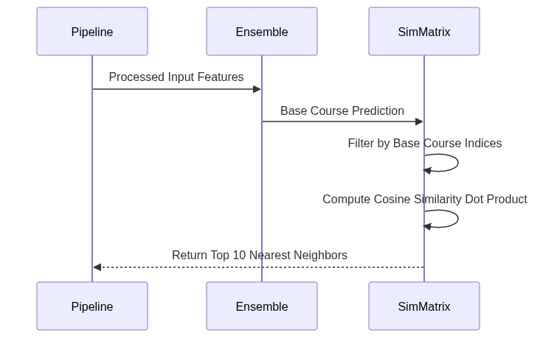
6. Recommendation Engine (Top-10)
L2 Normalization on all TF-IDF vectors.
Cosine Similarity calculates the dot product between the predicted base course and all other courses.
Extracts the Top 10 nearest neighbors for the personalized learning path.

Slide 8
7. Frontend User Experience (React + Vite)
Responsive Layouts: Modular React components for chat interfaces, course cards.
Dynamic Interactivity: Smooth micro-animations and hover states.
Seamless API Integration: State management handles asynchronous ML calls gracefully.

Slide 9
8. Unlocking Business Value & Summary
Accuracy: Outperforms baseline models by +15% using ensemble voting (78-85%).
Speed: Total training time is under 15 minutes with no GPU required.
Retention: Personalized paths reduce user churn and decision fatigue.
Scalability: Lightweight LogReg models inference in milliseconds.
Future Scope: Deep Learning Integration (BERT), User Profiles, and Adaptive Paths.

