Slide 1
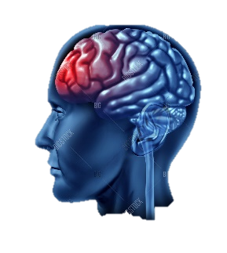
Advanced Functional Brain Imaging
COL 786
Final Project Presentation
“Brain Tumor classification and Segmentation in FMRI Images”
Akshat Jain (2020BSY7632)
Ashray Aman (2016MT60650)
Sunav Vidyarthi (2017ME10618)

Slide 2
About – MRI
Classification and Segmentation of Brain Tumor has been a major task in medical image analysis.
In brain MRI analysis, image segmentation is commonly used for:
Measuring and visualizing the brain's anatomical structures,
Analyzing brain changes,
Delineating pathological regions
For surgical planning and image-guided interventions.
Automated methods have been developed for various problems; segmentation of regions of interest, white matter lesion segmentation and segmentation of brain tumor. Contd...

Slide 3
Literature Review
Article | Year | Study
Fully Automatic Segmentation of the Brain in MRI – M Stella Atkins | 1998 | Fully automatic intracranial boundary detection algorithm that has proven effective on clinical and research MRI data sets acquired from several different scanners
Automatic anatomical brain MRI segmentation combining label propagation and decision fusion – Rolf, Joseph et al | 2006 | Inter subject anatomical correspondence estimates can be used to propagate expert segmentations of three-dimensional magnetic resonance brain images to previously unsegmented image volumes.
An Adaptive Mean-Shift Framework for MRI Brain Segmentation – Arnaldo, Hayit | 2009 | Automated segmentation framework for brain MRI volumes based on adaptive mean-shift clustering in the joint spatial and intensity feature space.
Review of brain MRI image segmentation methods – MA Balafar, AR Ramli et al | 2010 | Using improved atlas based methods, parallelization and combining different methods can be the way for making improvement in brain segmentation methods.
Segmentation of multiple sclerosis lesions in brain MRI: A review of automated approaches – Xavier Llado, Arnau et al | 2012 | Automated segmentation of different MS lesion types in MRI is a challenging task due to heterogeneous intensity values among the different MR images. There is not yet a specific automated lesion segmentation approach robust enough to emerge as a standard for clinical practice.

Slide 4
Literature Review
Article | Year | Study
Automated MRI brain tissue segmentation based on mean shift and fuzzy c-means using a priori tissue probability maps – Mahmood et. al. | 2015 | The accuracy and efficacy of the proposed framework, and that it consistently outperforms the three widely used brain segmentation toolboxes: FAST, SPM and PVC as well as the AMS and FCM methods for each tissue classification for all datasets.
Automatic brain tissue segmentation in MR images using Random Forests and Conditional Random Fields - Sergio et. al. | 2016 | The skull strip-ping is achieved by registration of a set of templates to the test subject to estimate a brain mask. This skull refinement led to significantly better CSF and ICC segmentations
Deep fMRI: End to end Deep Netwrok for classificaiton of fMRI Data | 2018 | It has been proposed innovative end-to-end convolutional neural network-based deep learning model for classification of ADHD from fMRI data. The proposed model takes raw time-series signals of fMRI as input and learns to predict the classification label directly from the raw input values. Experimental results on the ADHD-200 dataset demonstrate that utilizing such model outperforms the current state-of-the-art.
Hand Classification of fMRI ICA Noise components | 2019 | The main spatial and temporal features of ICs and provide general guidelines on how to evaluate these examples

Slide 5
What we have planned to do ??
Brain tumor classification
No Tumor
Meningoima
Pituitary
Glioma
Segmentation – getting the tumors out!

Slide 6
Classification & Segmentation
Part 1 - Classification
Classification of BTs
MRI data
Machine Learning based Techniques
Part 2 - Segmentation
Segmentation of BT area
fMRI data
Image Processing Segmentation Techniques

Slide 7
Datasets We Used
Part 1 - Classification
GitHub Repository
Training Data – 826 Glioma, 822 Meningioma, 395 no Tumor, 827 Pituitary tumor data
Ref -https://github.com/sartajbhuvaji/brain-tumor-classification-dataset
Part 2 - Segmentation
UK Data Service
Univ Stanford, Edinburg
2017 data of 22 patients
Ref - https://reshare.ukdataservice.ac.uk/851861/

Slide 8
Problem Statement
MRI - best technique to detect brain tumors.
Huge amount of image data generated through the scans.
Examined by the experienced radiologists and is time taking and prone to errors.
An automated solution could fasten up the process of diagnosis.
Brain Tumors are complex and there is a lot of abnormalities in the sizes and location of the brain tumor(s) and brain tumors account for 80 -90 percent of all CNS tumors.
This makes it really difficult for complete understanding of the nature of the tumor.
Often times in developing countries the lack of skillful doctors and lack of knowledge about tumors makes it really challenging and time-consuming to generate reports from MRI’.
So an automated system using techniques – ML, AI, DL, CNN, Transfer Learning can assist pathologists and fasten up the process.

Slide 9
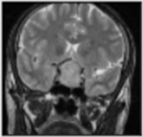
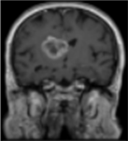
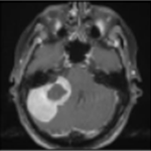
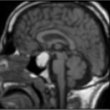
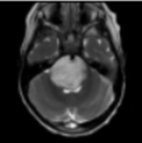
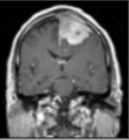
Classification Data Set Examples
Distribution of Data Set
No Tumor : 395
Pituitary : 827
Meningioma : 822
Glioma : 826
Pituitary Glioma Meningoima

Slide 10
Methodology and Results
Resized the images to same size 150x150.
Made a NN model with 5 CNN layers followed by 2 dense layers to classify the dataset into 4 classes.
Trained for 50 epochs with 0.01 Learning rate and Adam optimizer.
The model was overfitting so introduced dropout.
Took ~30 mins to train the model and reached train accuracy of 96% accuracy and test accuracy: 89.81%
This gap can be further reduced by using advanced ML techniques or bigger dataset or Image augmentation.

Slide 11
Datasets We Used
Part 2 - Segmentation
UK Data Service
Univ Stanford, Edinburg
2017 data of 22 patients
Ref - https://reshare.ukdataservice.ac.uk/851861/

Slide 12
How we do - Segmentation
Acquired data conversion to jpeg format using fslEyes, now ready to use
Application of IP algorithms
Hyper tuning (Scope of?)
Brain tumor detected has been segmented out and ready for use of doctors!

Slide 13
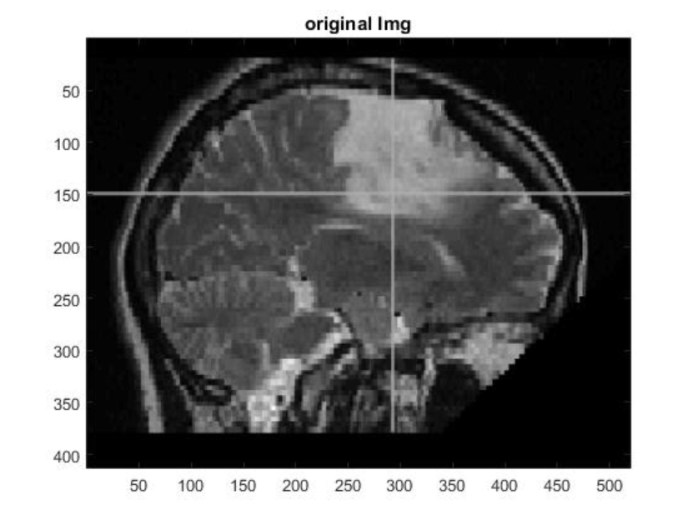
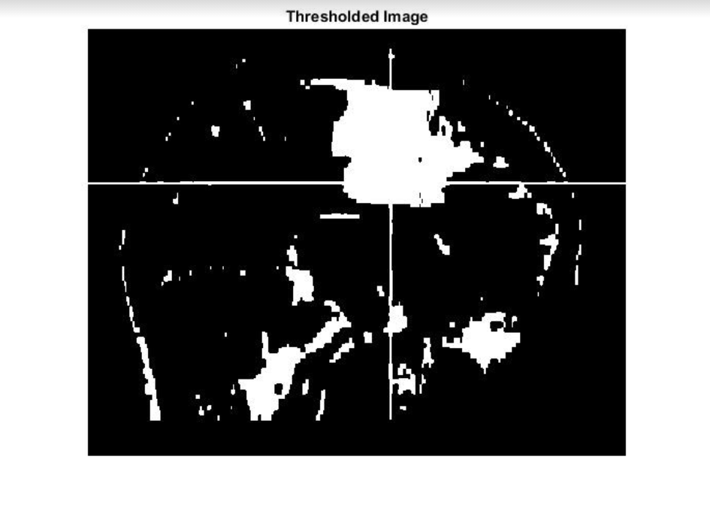
Methodology - Thresholding

Slide 14
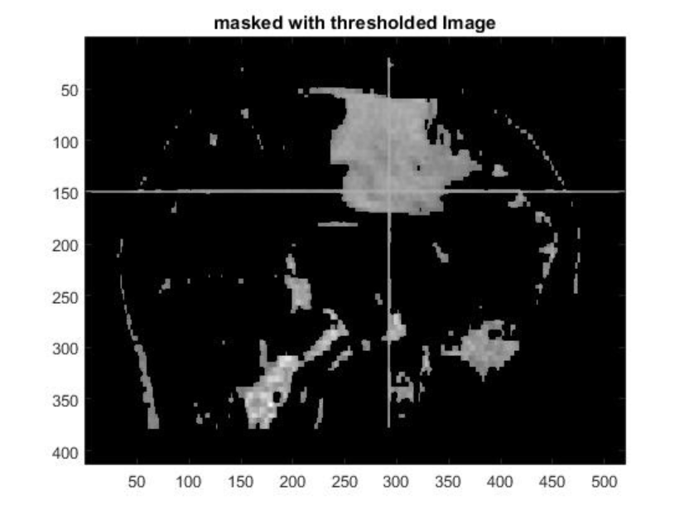
Methodology – Thresholding with Masking

Slide 15
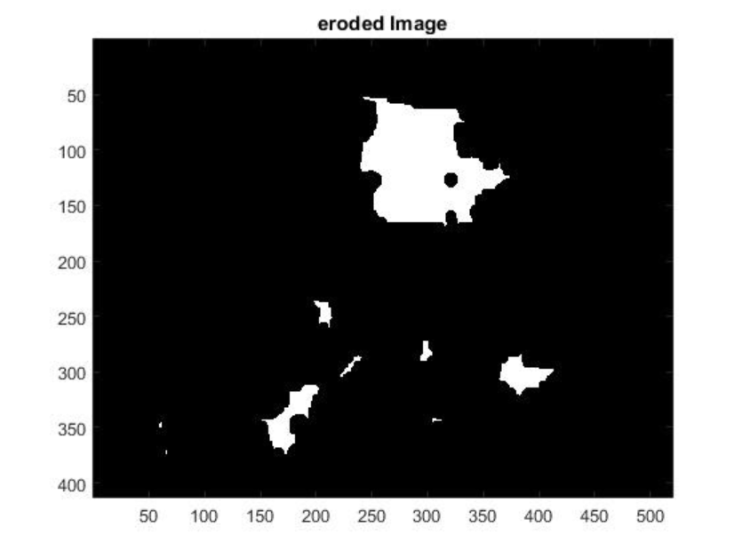
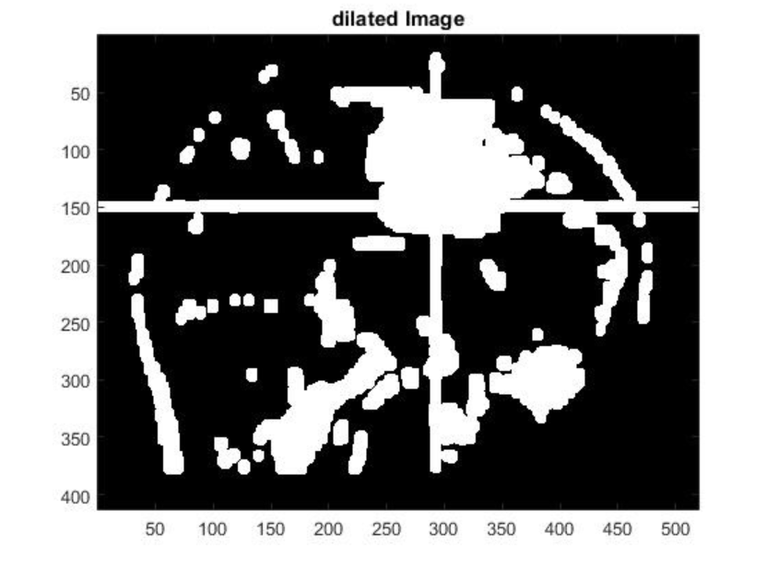
Methodology – Erosion and Dilation

Slide 16
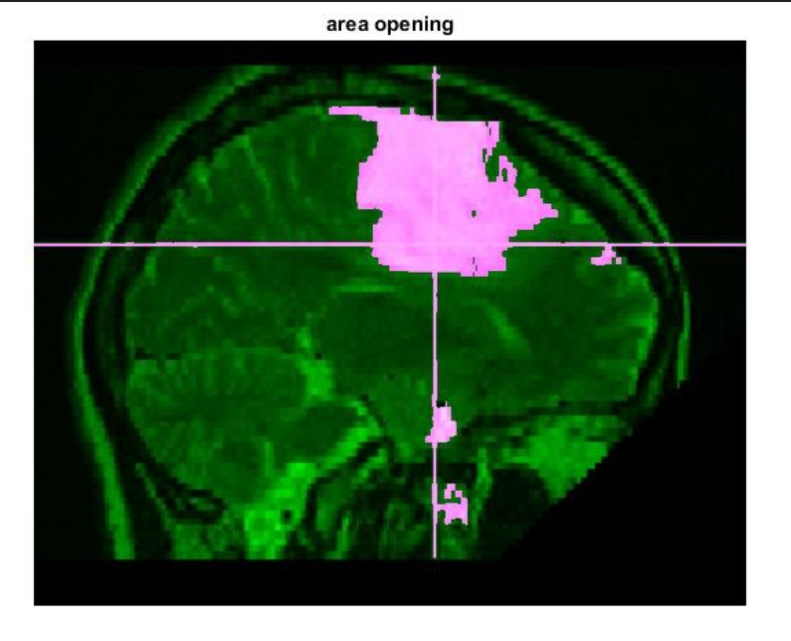
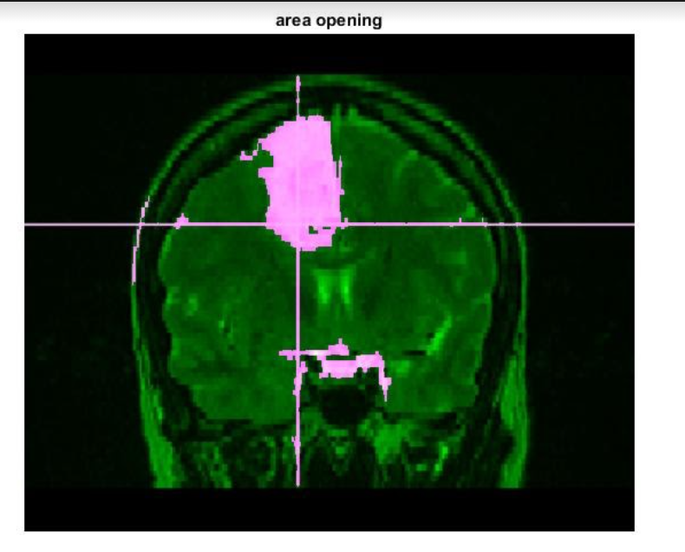
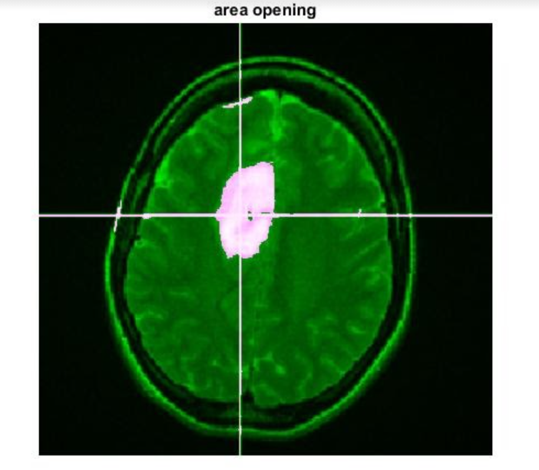
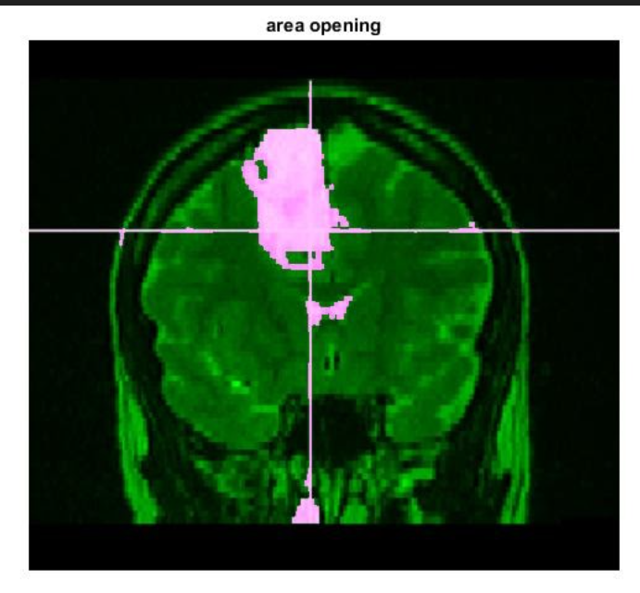
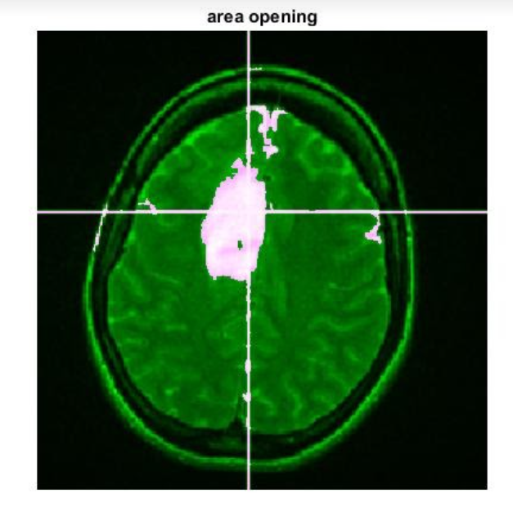
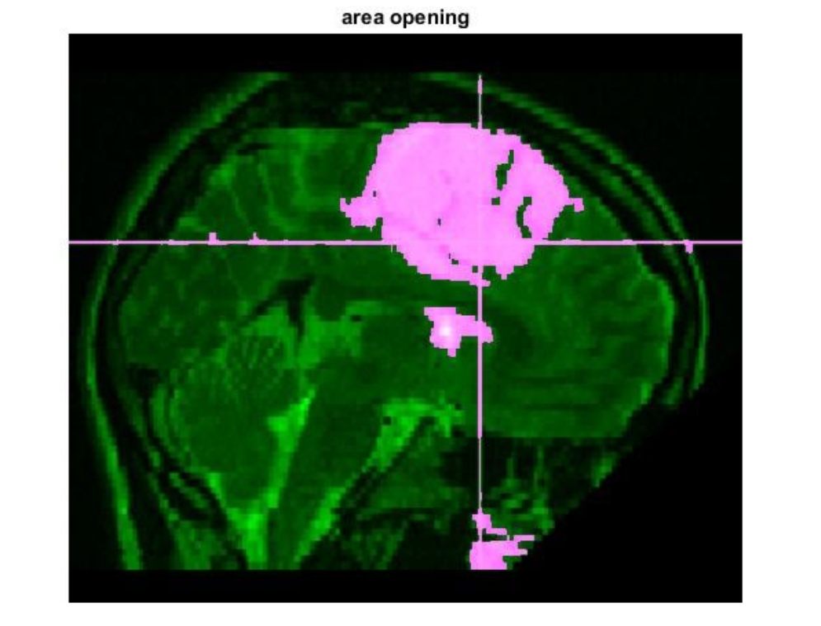
Results
Patient 1
Patient 2

Slide 17
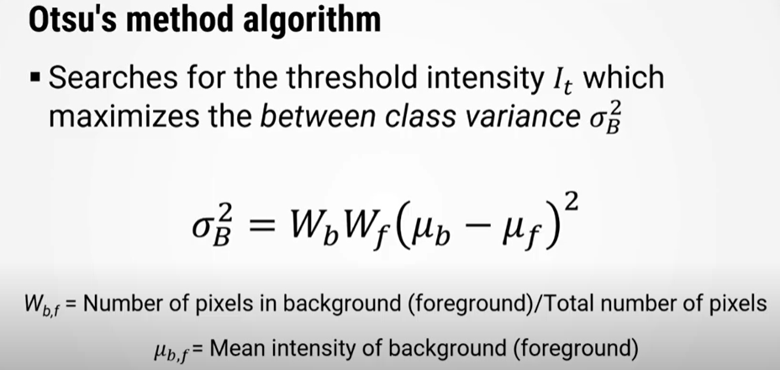
Otsu’s Threshold? Maybe

Slide 18
How we impact
Quicker classification of BT data using this technique
The image data can be acquired as in Part – II for Part – I
The segmented image can be used by doctors for further study

Slide 19
Thank You… Question?

