Slide 1

Food Recipe Generator
Madan Mohan Malaviya Univ. of Technology, Gorakhpur
Project Member 1 :: Aman Jaiswal(2018021019)
Project Member 2 :: Piyush Shankar Tiwari(2018021082)
Project Member 3 :: Anurag Chaudhary(2018021029)
Project Guide :: Mr. Sushil Kumar Saroj
Computer Science and Engineering Madan Mohan Malaviya University of Technology, Gorakhpur (UP State Govt. University)
Side 1

Slide 2
PROBLEM STATEMENT
Madan Mohan Malaviya Univ. of Technology, Gorakhpur
To generate food recipe from food image and to recommend food that could be made according to the available ingredients.
Side 2

Slide 3
INTRODUCTION
Madan Mohan Malaviya Univ. of Technology, Gorakhpur
A Food recipe generator which generates recipe and required ingredients available by food Image or food name. And there will be facility through which a user can purchase ingredients for the food.
A Food recommender system which recommends food that could be made according to the available ingredients.
Side 3

Slide 4
Components
Madan Mohan Malaviya Univ. of Technology, Gorakhpur
Food Classification
Ingredients extraction
Recipe generator
Food Bucket
Food Recommender

Slide 5
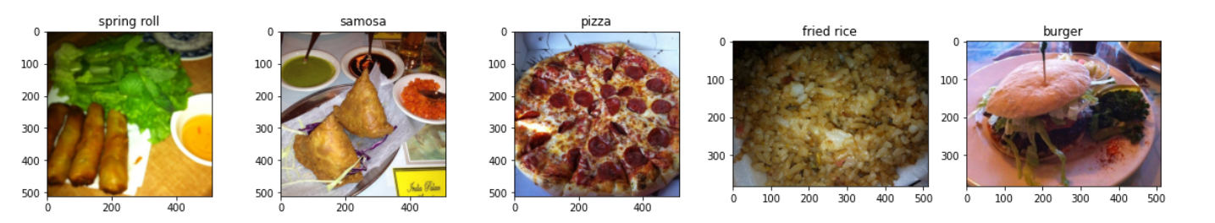
Madan Mohan Malaviya Univ. of Technology, Gorakhpur
1. Food Classification - Done
A Convolution Neural Network model will be used to classify the image of the food.
We have used VGG19 model to train the images of food on 5 classification as a prototype. (spring roll, samosa, pizza, fried rice, burger)
We have collected a dataset from Kaggle which has a 1000 of images of each type of food. We have taken 100 of each image to train this model.

Slide 6
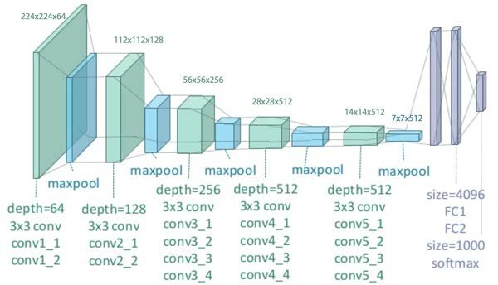
1. Food Classification
VGG 19 Architecture

Slide 7
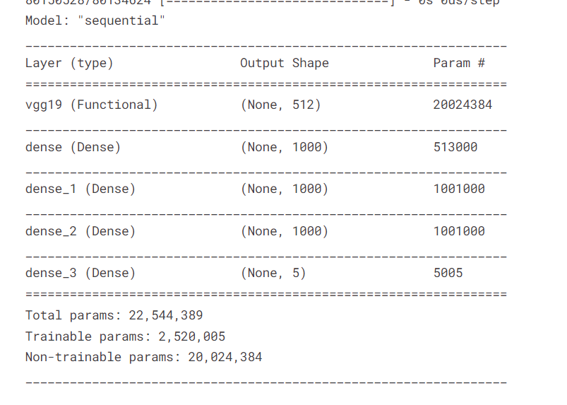
Model parameters

Slide 8
1. Food Classification
We have used validation set of 30% of our total dataset.
We have used batch size of 16.
We train our model to 50 epoch. i.e. iterations
Our model accuracy is about 99% for the training set.
For the testing set this is about 80%. Some kind of overfitting is there.

Slide 9
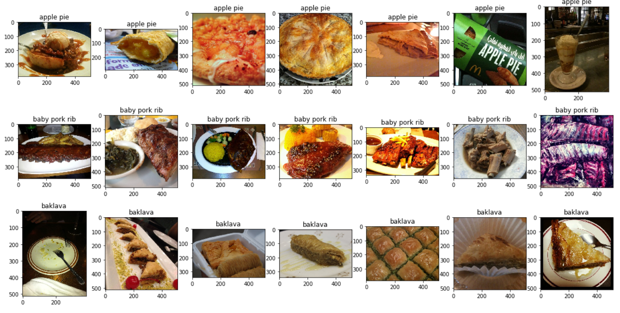
Madan Mohan Malaviya Univ. of Technology, Gorakhpur
1. Food Classification

Slide 10
Madan Mohan Malaviya Univ. of Technology, Gorakhpur
2. Ingredients Extraction - Done
Ingredient recognition is not an easy task. But we will do it partially.
Difficulties of ingredients recognition come from these aspects:
Different cutting and cooking methods can make the same ingredients look quite differently, however, different ingredients look quite similar.
Dish images contain multiple ingredients and are difficult to focus on specific ingredients at the time of training. Since the frequent appearance of some kind of ingredients composition may influence learning features.
In current situation we will use food classification model to extract ingredients.

Slide 11
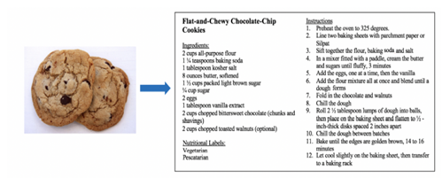
Madan Mohan Malaviya Univ. of Technology, Gorakhpur
3. Recipe Generator - Done
There will be a Database where food recipe will be stored along with the given food.
Food Classification model will classify the image of food. The output of the model will be used to search the food recipe.
The idea of Recipe generator can be extended with the GAN based model which automatically generate recipe for that product. Currently, we are not going to implement it but it can be implemented in future or in extension of the project.

Slide 12
Madan Mohan Malaviya Univ. of Technology, Gorakhpur
4. Food Bucket – Currently working
There will be a bucket system for the user where user can directly purchase the required ingredients with much less effort rather than searching every ingredient
on different places/sites.
There will be order placed system where some of the local stores are registered which delivers the required ingredients to the customer.

Slide 13
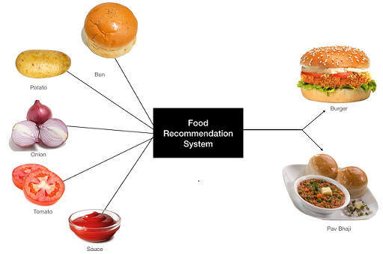
Madan Mohan Malaviya Univ. of Technology, Gorakhpur
5. Food Recommender - view part is pending
A Food Recommender suggests a list of food that can be cooked according to the available ingredients to the user.
An Ensemble model is used to suggest food to the user.
Input :- User will input/select the available ingredients.
Output:- User will get list of dishes along with their recipe.

Slide 14
Tech Stack
Madan Mohan Malaviya Univ. of Technology, Gorakhpur
Frontend
1. HTML
2. CSS
3. JavaScript
Backend
1. Machine Learning/Deep Learning
2. Django
3. Rest API
Database
1. MongoDB

Slide 15
Utility and Impact
Madan Mohan Malaviya Univ. of Technology, Gorakhpur
1. Easy availability of food recipes along with ingredients.
2. Saves time in purchasing different ingredients from outside store.
3. A good recommendation to cook from the available ingredients at home.
4. Very useful for the beginner who wants to try to cook some dish.

Slide 16
CONCLUSION
Madan Mohan Malaviya Univ. of Technology, Gorakhpur
This project contains various technology stack that will bind the full stack and Machine Learning/Deep Learning together.
We are currently working on the Deep Learning model which will classify the food image. Food 101 dataset has images of food which we already preprocess that into 224 width by 224 height image with 3 channels. That image will fed into the model.
The project can be improved with various automation by using GAN based model for recipe generation and a dedicated model to detect ingredients of food. But those models are quite complex and research is going on to come up with a feasible solution which will be computationally effective.

Slide 17
CONCLUSION
We had collected the data regarding food image to train our model.
We made a classifier model which will classify image of food.
We collect the database of food and put it into the mongo dB database.
We can access the data from mongo dB database to show the list of ingredient of the food inputted by user.
We can access the data from mongo dB database to show the steps of reciepe of the food.

Slide 18
CONCLUSION
Food classification component is complete.
We have integrated food component in our project.
We have added more food items to our databases.
Food recommender system is on the way to complete.
We are working on the food bucket component.

Slide 19
RERERENCES
Madan Mohan Malaviya Univ. of Technology, Gorakhpur
Food-101 Dataset
https://www.kaggle.com/kmader/food41
https://www.kaggle.com/shuyangli94/food-com-recipes-and-user-interactions?select=RAW_recipes.csv
Weight Initializers:
Hyper-parameters in Action! Part II — Weight Initializers
Priming neural networks with an appropriate initializer.
Optimizers:
An overview of gradient descent optimization algorithms

Slide 20
THANKING YOU
Madan Mohan Malaviya Univ. of Technology, Gorakhpur

