Slide 1


Smart India Hackathon 2020
Ministry/Organisation name : Govt. of Bihar (DOA)
Team Name : AnnAztecs
College Code : 1-3516007856

Slide 2


Farm Plan
Personal Details
Land Record Number
Active Bank Account Details
Area of farm
Types of Crops grown
Location of Farm
Soil Types
Proximity of water resources
Department of Revenue and Land Reforms, Government of Bihar
ICAR - Indian Institute of Soil Science
Google Maps
Farm Plan

Slide 3
Procurement Plan
Farmer 1
Government Seed providers/ Seed Traders
Seed orders stored crop wise associated with each farmer
Procurement Request
Farmer 2
.
.
.
Seed Distribution Centre
Farmer n

Slide 4
Overproduction of crops
Farmer is shown his expected yield for each crop
Crop that he plans to grow
Current stock available at the granaries
If already in stock
If not in stock
Continue growing planned crop
Suggest alternative crops

Slide 5
Checking distress sale
ML model gives the
Real Time Crop Yield prediction
Government sets the MSP
No farmer would ever be in a situation where he has to sell crops below the MSP

Slide 6
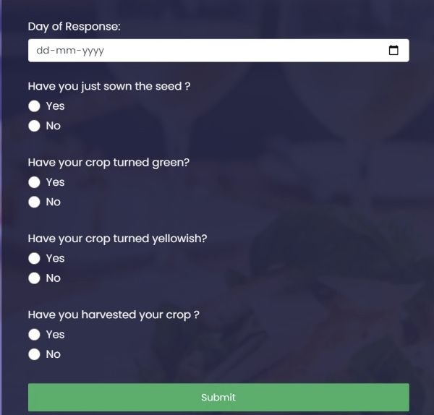
Crop cycle monitoring

Slide 7
Module | Status
Farmer Registration Portal | Done
Farm Planning | Done
Life cycle monitoring data input | Done
District View for current plan | Done
Report loss of crop | Done
Verification of loss | Done
Advisory module | In progress
Price prediction | Done
Crop Procurement | Almost Done

