Slide 1

HRGenius / PEOPLE • PROCESS • INSIGHT
HRGenius
People
Every workday.
A little more human.
$
Pay
Time
An employee-centered system that connects
people, decisions and everyday progress.
Start exploring →
Growth
Insight
A LITTLE MORE HUMAN. • PROJECT SHOWCASE
Menu
‹
›
01
Notes:
The opening illustration is a native editable PowerPoint diagram: people at the center, linked to time, pay, growth and insight. It introduces the system’s structure rather than a decorative photograph.
Opening / 20 seconds
HRGenius is a human resource management system that connects employee information, daily self-service, operational workflows and workforce insight. Open with a relatable question: how many places would an employee normally visit to request leave, find a payslip and thank a teammate? This project puts those experiences into one permission-aware workspace. The presentation follows a roughly six-to-eight-minute core story; technical detail is available through four optional slides and these notes. All product screenshots come from the local HRGenius demonstration environment. Their names and figures are seeded demonstration data, not customer results. Use Slide Show mode (F5) and click Explore the story. The deck is editable and does not use macros.

Slide 2
HRGenius / YOUR STORY MAP
A clear path from problem to product.
Choose a chapter. Every olive button is clickable in Slide Show mode.
01 / Why it matters
02 / See the experience
03 / Follow the work
The problem + people
Design + daily interactions
Modules + a request journey
Explore chapter →
Explore chapter →
Explore chapter →
04 / Look underneath
05 / See the evidence
06 / Try a moment
Architecture + trust
Build + interaction checks
Pick your mini-demo
Explore chapter →
Explore chapter →
Explore chapter →
A LITTLE MORE HUMAN. • PROJECT SHOWCASE
Menu
‹
›
02
Notes:
How to navigate
This is the main navigation hub. The six cards are actual internal PowerPoint hyperlinks. Menu returns here from every slide. The left and right arrows provide a conventional sequence. For a short product pitch use slides 1–6 and 10; for a technical project review continue through 7–9 and use appendices 12–14 for questions. Slide 4 links to a dark-mode comparison on slide 11. Slide 10 offers offline slide tours plus explicit external links to the running application. External links require the local application and a suitable signed-in account; the screenshots remain available offline. There is no embedded working HR application inside the PowerPoint.

Slide 3
HRGenius / WHY THIS PROJECT
Turn scattered HR work into a shared flow.
Three common problems. One connected workplace.
Scattered records
One employee context
Profiles, documents and reporting lines
Repeated follow-ups
A visible next step
Requests, ownership and status
Hard-to-read data
Useful daily insight
Workforce trends and readable values
A LITTLE MORE HUMAN. • PROJECT SHOWCASE
Menu
‹
›
03
Notes:
Problem, objectives and users
The project addresses fragmentation in employee records and HR processes. Objectives are to provide a consistent employee source of information, support traceable request workflows, enable self-service, preserve role-appropriate access, and make operational data easier to understand. The intended users include employees, managers, recruiters, payroll administrators, HR managers, HR administrators and super administrators. Employees access their own information and applicable self-service features; operational specialists receive permissions for their responsibilities. Managers have team-oriented responsibilities where the backend permits them. Benefits on this slide are design goals and qualitative outcomes, not measured cost savings or adoption results. Do not claim percentage improvements in productivity or processing time without a separate study. The system includes public careers pages outside the authenticated application shell.

Slide 4
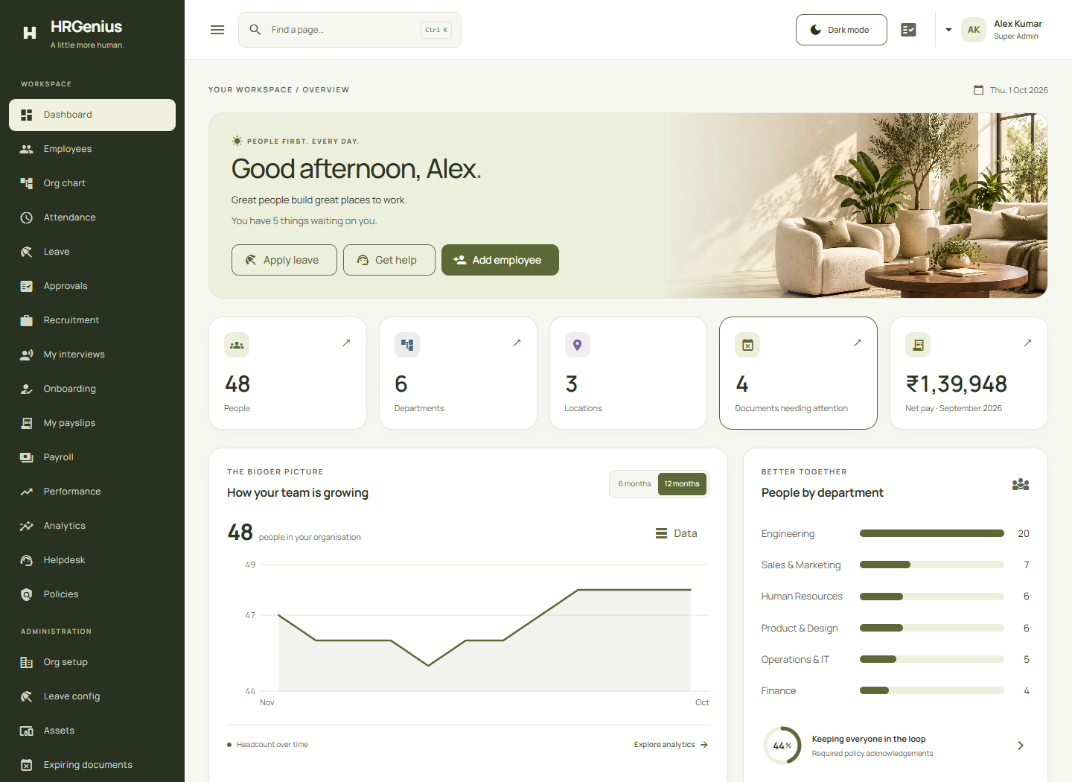
HRGenius / EXPERIENCE ANATOMY
A dashboard with a reason for every element.
Editable interface diagram · illustrative layout, not live employee data
Human first
Good morning. What’s next?
A greeting and relevant next actions.
People
Leave
$
Pay
Readable insight
Switch periods; inspect values or a table.
Workforce view
Everyday appreciation
Give a shoutout
Celebrate a teammate with real feedback.
View the real UI + dark mode →
A LITTLE MORE HUMAN. • PROJECT SHOWCASE
Menu
‹
›
04
Notes:
This slide is now an editable schematic of interface anatomy, not a screenshot. It contains no live counts. The real light and dark dashboard screenshots are together on slide 11. Explain greeting/action hierarchy, workforce insight and appreciation, then open the real UI reference if helpful.
Design system and dashboard tour
The light theme uses white surfaces, a warm off-white background (#F7F7F2), olive actions (#5C6936), a deep olive sidebar (#293121) and dark readable text (#2D3424). The screenshot is a real captured dashboard; the counts and financial figure are demonstration records. The greeting changes with time of day. Permissions influence visible actions and access to analytics. The implemented workforce chart supports six- and twelve-month periods, keyboard/hover values and a data-table alternative. Department bars and policy acknowledgement progress summarize existing API data. The shared shell includes Ctrl/Cmd+K page search, arrow-key navigation, Enter to select, Escape to close, a mobile drawer, a skip link and a persistent theme preference. First visit defaults to the light theme. Dark mode remains an intentional user option. Do not claim that individual chart points already drill into filtered business lists: that enhancement was discussed but is not part of the verified implementation. Click the theme comparison button for the corresponding dark screenshot.

Slide 5
HRGenius / THE EMPLOYEE LIFECYCLE
Six connected stages. One employee journey.
Follow the arrows through the product’s functional scope.
1. Attract & welcome
2. Know your people
3. Manage the day
Careers · interviews · offers
Onboarding plans and tasks
Profiles · org chart · files
Organization masters · assets
Attendance · regularization
Leave balances · approvals
6. Support & understand
5. Grow & recognize
$
4. Pay with structure
Tickets · policies · acknowledgements
Analytics and personal summary
Goals · reviews · progress
Praise and feedback
Components · runs · adjustments
Payslips and exports
Technical module catalogue →
A LITTLE MORE HUMAN. • PROJECT SHOWCASE
Menu
‹
›
05
Notes:
Complete functional scope
Recruitment includes requisitions, public careers, candidates, applications and pipeline events, interview scheduling/feedback, offers and onboarding. Onboarding provides templates, plans and tasks. Core HR includes employee records, contacts, statutory details, document metadata and file access, reporting relationships, timeline events, organization masters and asset allocation history. Time management includes attendance days, holidays, regularization, leave types, balances, requests, cancellations and accrual operations, integrated with approval requests and steps. Payroll includes salary components, payroll runs, adjustments, calculation, submission, paid state, payslips, PDF downloads and register/bank-file exports. Performance includes review cycles, goals, progress updates, employee self-review, manager review, acknowledgement and feedback/praise. Support includes helpdesk tickets/comments and policies/acknowledgements. Analytics and personal summaries assemble existing operational information. This scope was checked against current frontend routes, backend controllers and Flyway migrations; the older project report describes an earlier milestone and is not the sole source. Module presence does not itself prove every business scenario has been tested.

Slide 6
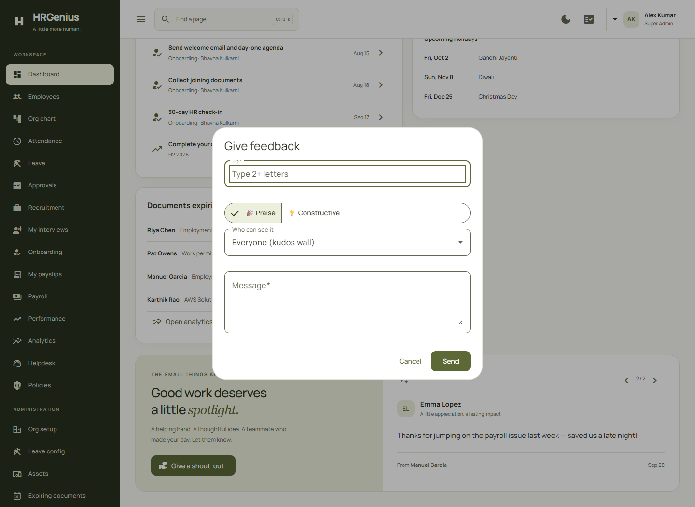
HRGenius / A REQUEST JOURNEY
Make the next step obvious.
Example: an employee requests leave. Policy and permissions shape the outcome.
Approved
Request
Validate
Review
Employee selects dates
Rules + balance + access
Authorized approver acts
Other
outcome
Good systems also notice good work.
Try the appreciation tour →
A praise wall adds recognition to everyday operations.
A LITTLE MORE HUMAN. • PROJECT SHOWCASE
Menu
‹
›
06
Notes:
The branching diagram summarizes a leave request: submit, validate and review, followed by an approval or another outcome. Exact policy and approval configuration determine behavior. The recognition strip demonstrates a second kind of interaction; its button opens the demo choices, not a submit action.
Workflow and interaction details
Use a leave request as the simple explanatory workflow: an employee submits a request, the authorized approval process handles it, and the visible outcome updates. This is a conceptual summary; the configured workflow and policy determine the actual approval stages and eligibility. Attendance adds calendar-day selection with check-in, check-out and worked-time detail; changing month clears the selected day. Leave balance graphics separate used, pending and available amounts. Payroll comparison uses existing recent-run data. The appreciation wall reads existing feedback and offers a Give shoutout action using the existing feedback form and service. The carousel and dialog were tested without posting a recognition message or making a business-data mutation. Other details include loading, empty and error states, retries, accessible chart values, responsive layouts, non-nested org-chart controls and reduced-motion behavior. These are frontend presentation improvements built around existing APIs. Avoid inventing birthdays, employee anniversaries or recognition messages when no corresponding data is available.

Slide 7
HRGenius / HOW IT WORKS
A clear boundary between experience and rules.
An editable architecture diagram of the current application.
REST
JPA
Angular 18
Spring Boot
Persistence
UI · routes · Material
Signals · accessible controls
REST · validation · security
Services · JPA repositories
Oracle target / H2 demo
Flyway schema migrations
Supporting services Files + metadata / Mail / Audit history / OpenAPI
A LITTLE MORE HUMAN. • PROJECT SHOWCASE
Menu
‹
›
07
Notes:
Architecture and technology rationale
The frontend uses Angular 18 standalone components with lazy-loaded feature routes, Angular Material and SCSS. Route guards provide navigation behavior; the backend is responsible for authorization. The backend targets Java 21 and Spring Boot 3.3.4. Features are organized into packages with controllers, services, repositories and DTOs; JPA/Hibernate persists entities, MapStruct maps data and Bean Validation validates inputs. Spring Security and JWT protect REST endpoints under /api/v1. Oracle is the intended database for the packaged deployment. The running demonstration used an H2 profile with Oracle compatibility; it must not be described as proof of production Oracle behavior. Flyway manages versioned schema changes. Document metadata lives in the database while file bytes are handled by a storage service. The codebase also contains notification/mail handling, Caffeine caching and springdoc OpenAPI support. The architecture is a modular backend application, not a deployed microservice fleet. Keeping the existing REST and business-service boundary let the UI redesign change presentation without rewriting backend contracts.

Slide 8
HRGenius / TRUST BY DESIGN
Three gates before sensitive information.
The backend enforces access. The interface makes that access understandable.
Who are you?
What may you do?
What may you see?
JWT + refresh rotation
BCrypt + login lockout
Roles + permissions
Self / team / HR scope
Selected field encryption
Masking + controlled reveal
Cross-cutting controls: audit history, input validation and validated file handling.
A LITTLE MORE HUMAN. • PROJECT SHOWCASE
Menu
‹
›
08
Notes:
Security boundaries and important limits
The access model combines roles, permissions and record-level scope. An employee's self-service access differs from manager team access and authorized HR operations; specific permissions are checked by endpoint and service. JWT access tokens and rotating refresh tokens are used, with BCrypt password hashes and a failed-login lockout policy. Logout revokes refresh-token access; do not claim every issued access token is instantly invalidated. Selected statutory and bank fields use AES-GCM at rest with masked responses and controlled reveal paths; this does not mean every database column is encrypted. Sensitive actions and operational changes have audit support. Upload handling uses generated storage keys, allowed file types/signature validation and validated paths. It is not a malware-scanning service. HTTPS, managed secrets, deployment hardening, recovery procedures and security testing remain deployment responsibilities. The slide describes implemented controls, not a compliance certification or penetration-test result. Permission-filtered UI improves usability, but a hidden button is never the security boundary.

Slide 9
HRGenius / EVIDENCE, NOT DECORATION
The experience was checked from several angles.
Recorded frontend checks in this workspace. No production certification is implied.
36
19
18
Page / theme scans
Interaction checks
Mobile routes
Frontend production build passed.
Zero reported automated accessibility violations.
Next: Oracle acceptance, business-flow regression, load and recovery.
A LITTLE MORE HUMAN. • PROJECT SHOWCASE
Menu
‹
›
09
Notes:
Verification evidence and limits
Evidence is stored in reports/ui-audit.json, ui-interactions.json, ui-mobile.json and ui-final.json. The audit records 18 routes in each of two themes, totaling 36 automated accessibility scans, with zero reported violations and no recorded page runtime errors. Nineteen interaction checks passed, including dashboard period selection, table rows, keyboard chart values, appreciation carousel and dialog cancellation, keyboard search, saved theme, attendance selection/reset, payroll tooltip, analytics period/table, org-chart keyboard behavior, mobile drawer behavior, analytics retry and employee permission restrictions. Eighteen mobile routes were checked at a 390-pixel viewport; native tab strips can scroll internally. Final checks covered first-visit light theme, light/dark dashboard scans and graceful fallback for failed organization lookups. The production Angular build passed within configured budgets. Backend test classes exist for auth, employee, leave/attendance, recruitment, payroll, performance, services, migrations and personal summary, but were not rerun for this presentation. Automated accessibility scans do not replace manual assistive-technology testing. No load benchmark, production Oracle acceptance, backup-restore exercise or business-result improvement is claimed.

Slide 10
HRGenius / CHOOSE YOUR INTERACTION
What would you like to try first?
Three quick demonstrations, each with an offline fallback.
Explore
Appreciate
Personalize
Change the period.
Inspect an exact value.
Open recognition.
Show the shoutout form.
Compare light and dark.
Notice readable controls.
Slide tour →
Open app ↗
Slide tour →
Open app ↗
Slide tour →
Open app ↗
Live links need localhost:4200 and an authorized session. Internal slide tours work offline.
A LITTLE MORE HUMAN. • PROJECT SHOWCASE
Menu
‹
›
10
Notes:
Demo script, conclusion and questions
Invite the audience to choose one moment. Explore: open Analytics with an authorized account, change between six and twelve months, inspect a data point by keyboard or pointer and show the tabular alternative. Appreciate: open Performance or the dashboard praise wall, show the carousel and open Give shoutout, then cancel unless posting is explicitly intended. Personalize: use the dashboard theme control and show its persistence and readable actions. The presentation's Slide tour buttons are offline internal links. Open app buttons use localhost:4200 and require the frontend, its configured backend and an appropriate session; on another computer localhost means that computer. Access may be denied or a login page shown if the account lacks permission. Close the core presentation here: HRGenius combines employee operations with a calm, accessible and human-centered interface. Ask which daily HR interaction the audience would improve next. Optional material follows: dark-mode comparison, module/API catalogue, logical data model and deployment/future work. No real business data needs to be created during this demo.

Slide 11
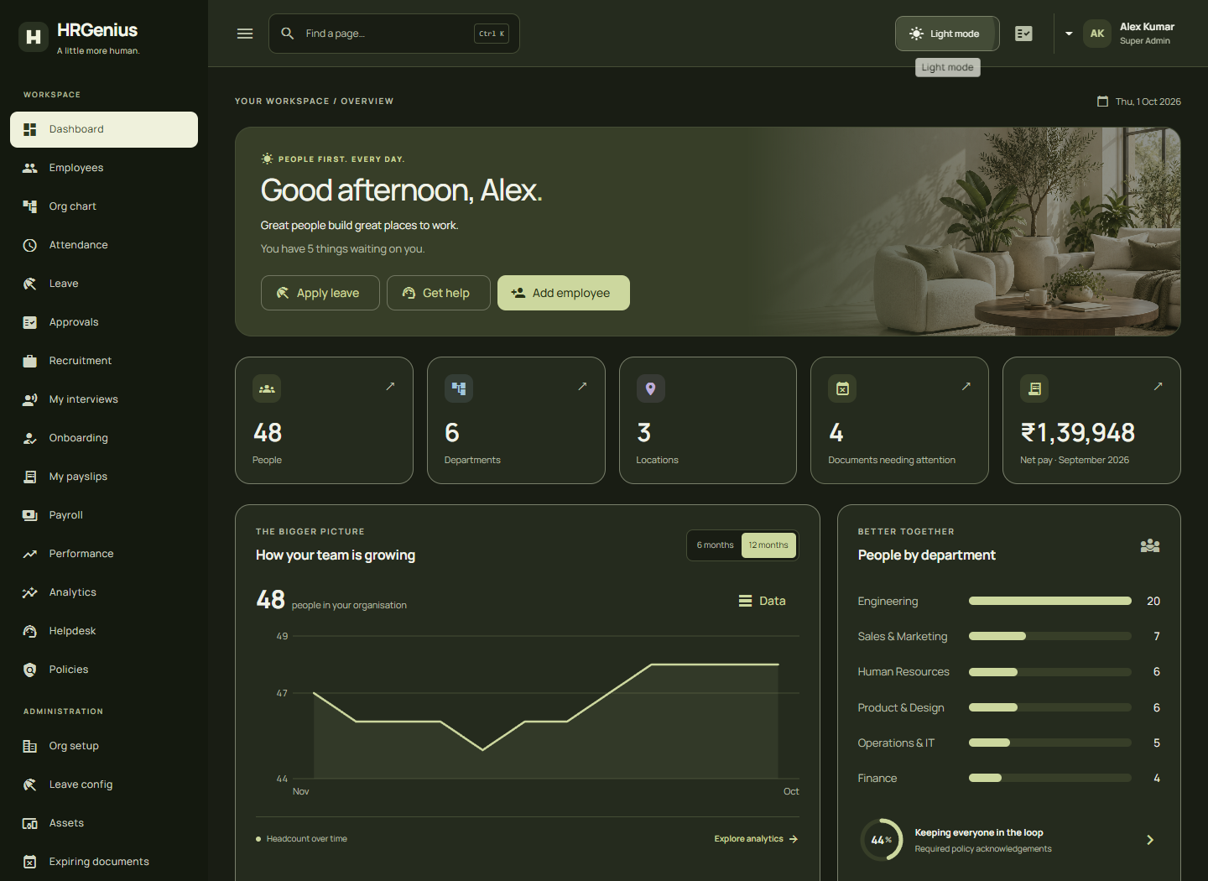
HRGenius / REAL PRODUCT REFERENCE
One interface. Two considered themes.
Actual screenshots from the demonstration environment. Sample data only.
← Return to interface anatomy
Choose another interaction →
A LITTLE MORE HUMAN. • OPTIONAL DEEP DIVE
Menu
‹
›
11
Notes:
Two actual product screenshots are shown side by side: light and dark. Use Return to interface anatomy to revisit the editable explanation or Choose another interaction to return to the demo menu.
Optional / dark theme
This screenshot shows the implemented dark theme, not a different product. Its background is #191D14, surfaces #252B1E, primary action color #CCD79E and primary text #F0F2E8. The selected sidebar state remains light and visible. Controls have separate surface, border, foreground, hover and focus treatments rather than merely darkening an entire screenshot. The preference persists between reloads, while a new session with no saved preference starts light even when the operating system prefers dark. The app has a visible Light mode / Dark mode control. Automated checks include the principal routes in both themes; automated success does not prove every contrast state or every assistive-technology interaction has been manually reviewed. Click Return to olive + white to compare with slide 4, or Menu to choose another chapter.

Slide 12
HRGenius / FUNCTIONAL + API REFERENCE
The complete scope, grouped for review.
All API roots below are prefixed with /api/v1. Full method contracts live in the controllers / OpenAPI.
PEOPLE & ORGANIZATION
TIME & APPROVALS
/employees · /org · /org-chart
/documents · /assets · /me
/attendance · /holidays
/leave · /approvals
Profiles, statutory data, files, reporting lines,
masters, asset assignments and personal summary.
Daily records, regularization, calendars, balances,
requests, accrual and approval steps.
TALENT & PAY
GROWTH, SUPPORT & CONTROL
/recruitment · /public/careers
/onboarding · /payroll
/performance · /helpdesk · /policies
/analytics · /audit-logs · /auth
Applications, interviews, offers, starter tasks,
components, runs, adjustments and payslips.
Reviews, goals, praise, tickets, acknowledgements,
insight, audit history and authentication.
A LITTLE MORE HUMAN. • OPTIONAL DEEP DIVE
Menu
‹
›
12
Notes:
Detailed feature and API catalogue
Core HR roots: /employees for directory and employee lifecycle, nested /employees/{employeeId} for profile subresources, /org for organization masters, /org-chart for reporting structure, /documents for document operations, /assets for allocation management and /me for personal summary. Time roots: /attendance, /holidays, /leave and /approvals. Leave exposes types, balances, adjustments, requests, cancellation and accrual operations. Recruitment roots: /recruitment and /public/careers; onboarding root: /onboarding. Payroll: /payroll/runs supports listing/detail, create, calculate, submit, paid state and deletion as permitted; nested run endpoints expose payslips, register, bank file and adjustments. /payroll/components manages salary components; /payroll/me/payslips, /me/structure and /payslips/{id}/pdf support self-service and downloads. Performance: /performance/cycles includes launch, close, summary and review lists; reviews support goals, progress, self/manager assessment and acknowledgement; feedback has wall, received, given and team views. Support/control roots are /helpdesk, /policies, /analytics, /audit-logs and /auth. These are API groupings, not a claim that every action is public or available to every role. Check controller annotations and services for exact HTTP methods, parameters, validation and permissions. Source: backend/src/main/java/com/hrgenius/**/controller and frontend/src/app/app.routes.ts.

Slide 13
HRGenius / DATA MODEL
An employee-centered model with history.
Selected logical relationships; the migrations contain the full physical schema.
IDENTITY & ACCESS
Candidate → application → offer
Onboarding plan → tasks
ORGANIZATION
Users ↔ roles ↔ permissions
Refresh tokens · audit log
Department · designation · grade
Location · unit · cost center
EMPLOYEES
Identity · role in organization · manager
DAILY WORK
Also linked: helpdesk tickets,
policy acknowledgements
and employee timeline events.
PAY & GROWTH
Attendance · leave · approvals
Documents · asset assignments
Payslips → lines; payroll runs
Reviews → goals; feedback
A LITTLE MORE HUMAN. • OPTIONAL DEEP DIVE
Menu
‹
›
13
Notes:
Schema, relationships and persistence
The diagram is intentionally a selected logical model, not an exhaustive ERD or a statement of every foreign-key cardinality. Flyway migrations define authentication tables (users, roles, permissions and join tables), refresh tokens and audit_log; organization masters; employees and their related statutory, emergency contact, document and timeline records; assets and assignment history; approval requests/steps; leave types, balances, requests and accrual log; holidays, attendance days and regularization requests. Recruitment tables include job_requisitions, candidates, job_applications, application_events, interviews, interview_feedback and offers. Onboarding includes templates/template tasks and plans/tasks. Payroll includes salary_components, payroll_runs, payslips, payslip_lines and payroll_adjustments. Performance includes review_cycles, performance_reviews, goals and feedback_notes. Support/compliance includes helpdesk_tickets, helpdesk_comments, policies and policy_acknowledgements. Employees have organization references and a manager self-reference. Users may link to an employee; do not imply that employee_id is necessarily a unique schema constraint without checking the migration. File metadata and storage bytes are separate. Versioned migrations document evolution of the database, but the H2 demo is not a substitute for Oracle integration and migration testing.

Slide 14
HRGenius / DELIVERY + NEXT STEPS
Ready to demonstrate. Room to grow.
Keep implementation, verification and future work distinct.
RUN THE PROJECT
CHECK THE PROJECT
EVOLVE THE PROJECT
Development & deploy
Quality evidence
Proposed next steps
Angular frontend
Spring Boot REST backend
Oracle deployment / H2 demo
Docker Compose configuration
File storage + mail service
Frontend build + UI checks
Backend test sources present
Oracle acceptance still needed
Business-flow regression
Manual accessibility review
Deeper role-based dashboards
Chart-to-record navigation
SSO and stronger operations
Monitoring + recovery drills
Measured user feedback
Back to the demo choices →
A LITTLE MORE HUMAN. • OPTIONAL DEEP DIVE
Menu
‹
›
14
Notes:
Deployment, limitations, future scope and sources
The repository provides an Angular frontend, a Spring Boot backend and a Docker Compose deployment configuration with Oracle, frontend serving, backend and mail development tooling. The current screenshots came from localhost:4200 with the development backend; environments may use different configured ports. H2 in-memory demonstration data can reset when the backend restarts. Production needs persistent database and upload storage, externalized secrets, HTTPS, backups and restore verification, monitoring and deployment-specific configuration. Existing backend tests cover several modules, but no backend test execution is represented as newly completed in this presentation. Next validation priorities are Oracle integration/migration acceptance, complete business-flow regression, manual accessibility testing, security review, realistic load tests and recovery exercises. Proposed product enhancements include richer role-specific dashboard composition and chart-to-record navigation; they were discussed but should not be presented as completed. SSO and operational hardening are future directions rather than current verified features. Primary sources: frontend/src/app/app.routes.ts; frontend/src/app/features and shared components; backend/pom.xml; backend/src/main/java/com/hrgenius; backend/src/main/resources/db/migration; reports/UI_DESIGN_NOTES.md; reports/ui-audit.json; reports/ui-interactions.json; reports/ui-mobile.json; reports/ui-final.json. The older Project Report and SRS are supporting documents; current source code takes precedence where scope differs. Slides and notes contain no real credentials, macros or unsupported business benefit statistics.

