Slide 1


welcome To proShop
E-commerce website

Slide 2
PROJECT MENTOR NAME: Dr. Vipin Kumar
TEAM MEMBER NAME
Ayush Sharma(2100290140047)
Ayush Jha (2100290140045)
Aman Raghav (2100290140020)

Slide 3
I would like to thank my major professor, Dr. Vipin Kumar, for his constant guidance and help throughout the project
Shopping has long been considered a recreational activity by many. Shopping online is no exception. The goal of this application is to develop a web based interface for online retailers. The system would be easy to use and hence make the shopping experience pleasant for the users. The goal of this application is
To develop an easy-to-use web-based interface where users can search for products, view a complete description of the products and order the products.
A search engine that provides an easy and convenient way to search for products specific to their needs. The search engine would list a set of products based on the search term and the user can further filter the list based on various parameters.

Slide 4
About project
Our Project “E-COMMERCE” is an Online Shopping Website. The objective of this online shopping website is to improve the services of customers. The main features of this project are high accuracy, design flexibility, and easy availability. This website allows customers to shop and buy items online. This project is an attempt to provide the advantages of online shopping to customers.
This online shopping website allows users to shop from anywhere and anytime and it provides users to find more variety of products with fewer expenses. Users can compare multiple items at a time in this application. This application saves a lot of time and users can avoid crowds for shopping. This project is designed from a user point of view. The user-friendly design helps the users in accomplishing their tasks with ease. Attempts have been made to keep the design simple and understandable. Technologies like MERN (MongoDB, Express.js, React.js, Node.js) have been used in this project.

Slide 5
Minimum Hardware Requirement
Processor: Intel Pentium 4 or later
System Type 32-bit operating system
Hard Disk Space: 256 GB
Ram Memory: 2GB minimum ,4 GB recommended
Operating System: Windows 8 or later
Internet : Required

Slide 6
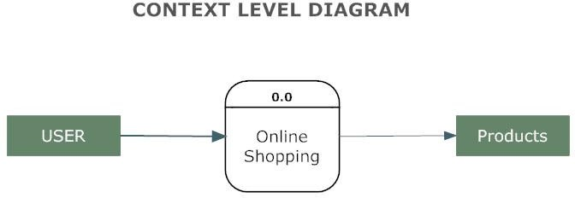
Working of the project

Slide 7
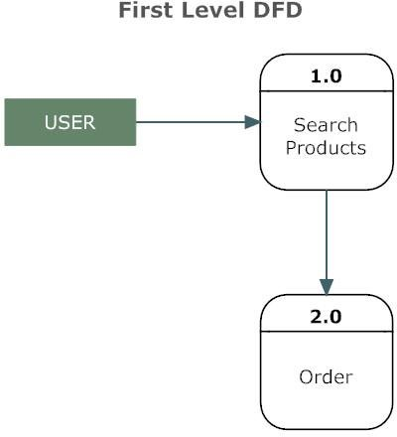
Simple view

Slide 8
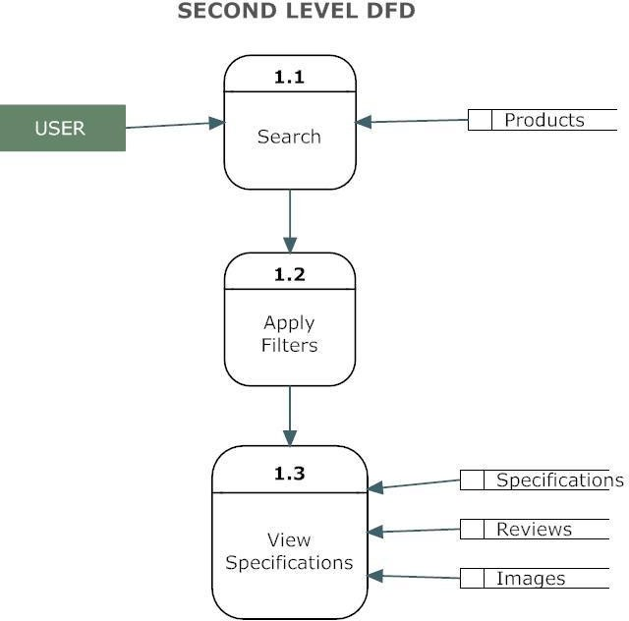
User Operation

Slide 9
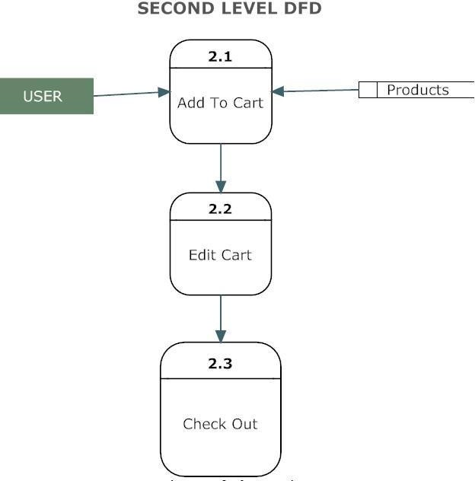
ADD TO CART PROCESS

Slide 10
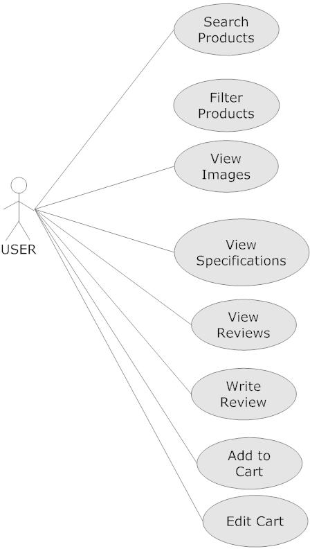

Slide 11
Technology USED IN PROJECT
DESIGNING :-
REACT JS
Bootstrap
FOR DATABASE :-
MongoDB
PAYMENT :-
PayPal: Online payment processing for internet businesses

Slide 12
CONCLUSION
In conclusion, an e-commerce website built using the MERN (MongoDB, Express.js, React.js, and Node.js) stack holds significant promise and potential for the future of online commerce. The MERN stack offers scalability, performance, and responsiveness, enabling businesses to handle increasing volumes of traffic and transactions. Additionally, the mobile compatibility of MERN-based websites ensures accessibility and convenience for users, tapping into the growing market of mobile commerce. Moreover, MERN-based e-commerce websites can leverage advanced technologies like artificial intelligence and machine learning to personalize the shopping experience and provide tailored recommendations, enhancing customer satisfaction and conversion rates. The stack's robust security measures instill trust in customers and protect their sensitive information, crucial in an era where cyber security is a top concern.

Slide 13
THANK YOU

