Slide 1
CAMP GUIDE
Team Members
Rohit Sharma - 2100290140113
NIKUNJ TYAGI - 2100290140097
hARSH - 2100290140067

Slide 2
INTRODUCTION
The Camp Guide project is all about the recreational camping activities done at the various tourist places. It also allows user to post various camping sites, comments or feedback on others posted sites as well as the related pictures of the respective places. It is basically a camping site through one camping that place and know about the camping place, see the related picture and also sign up to comment and one can also post the cost queries.

Slide 3
WEBSITE PURPOSE
Due to the vast number of camping sites spread worldwide, it is very difficult to get to know the quality of a camping ground and the services provide at the camping sites. Camp guide is one such website that provides all the information regarding a camping sites. Camp guide provides us with reviews and ratings provided by the users and other services offered at the camping sites.

Slide 4
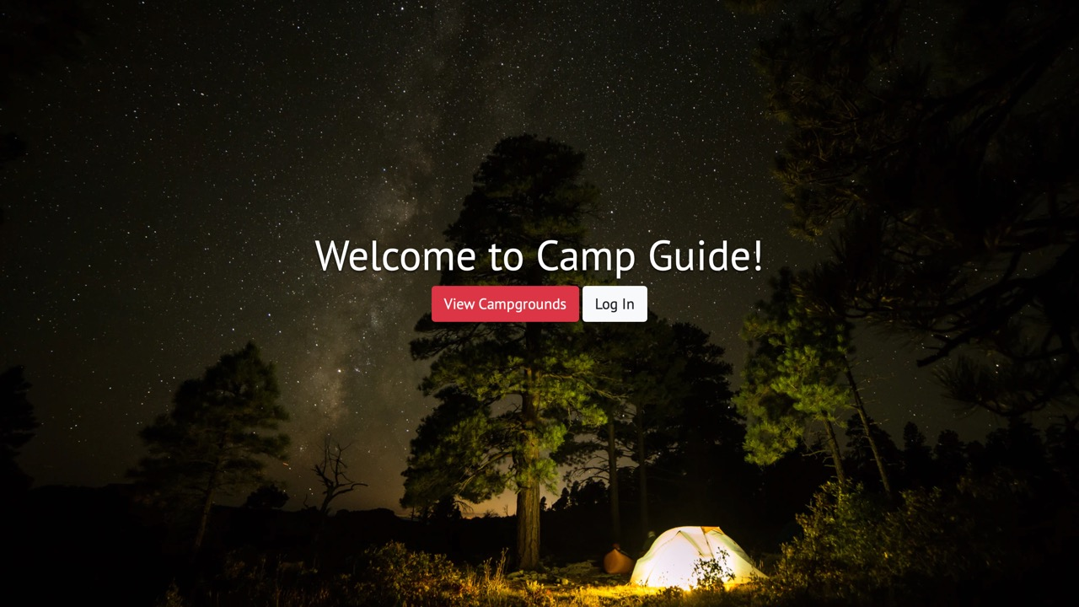
OBJECTIVE / NEED OF THE PROJECT
In this project, we are providing Camping areas available around the world. people are not getting proper information about the camping area i.e its opening time, closing time, Any stay available near the camping area, how much it will cost per person, and working.

Slide 5
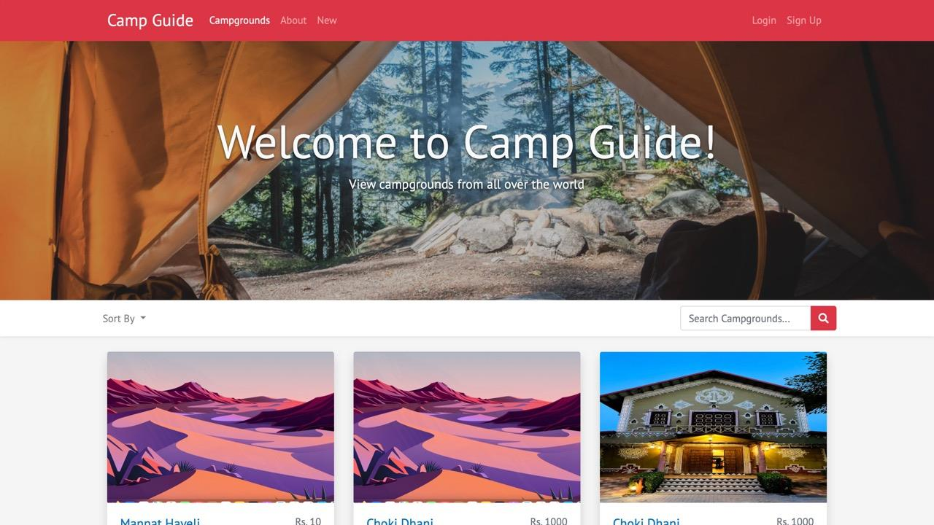
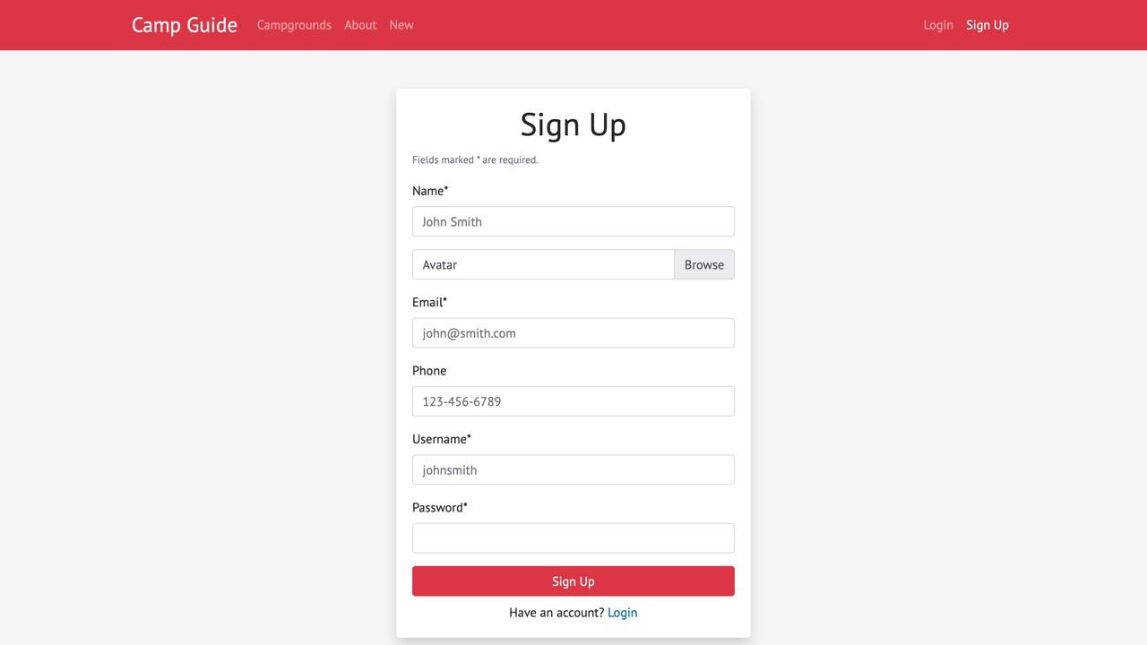

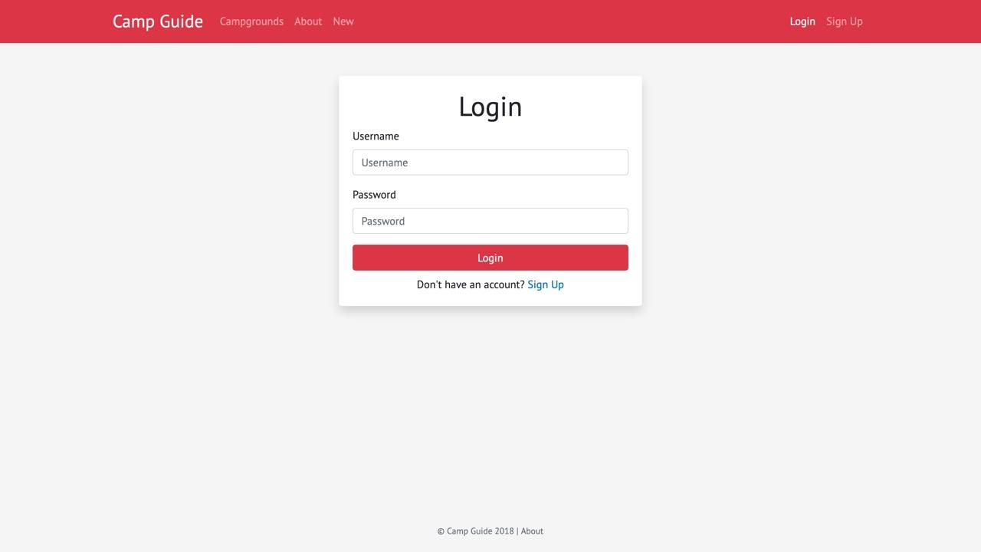


TECHNOLOGY USED
BACK END -
NODEJS
EXPRESSJS
MONGODB
FRONT END -
HTML
CSS / BOOTSTRAP
JAVASCRIPT

Slide 6
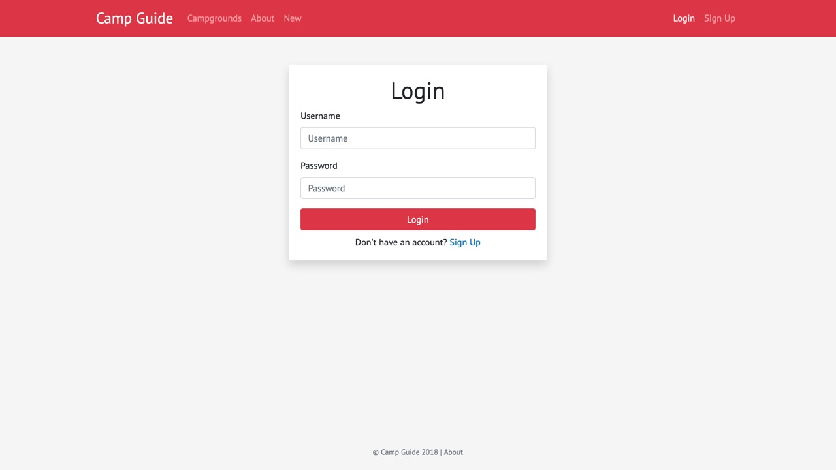
FEATURES
Authentication : User login with username and password. Admin sign-up with admin code.
Authorization : One cannot manage posts and view user profile without being authenticated.

Slide 7
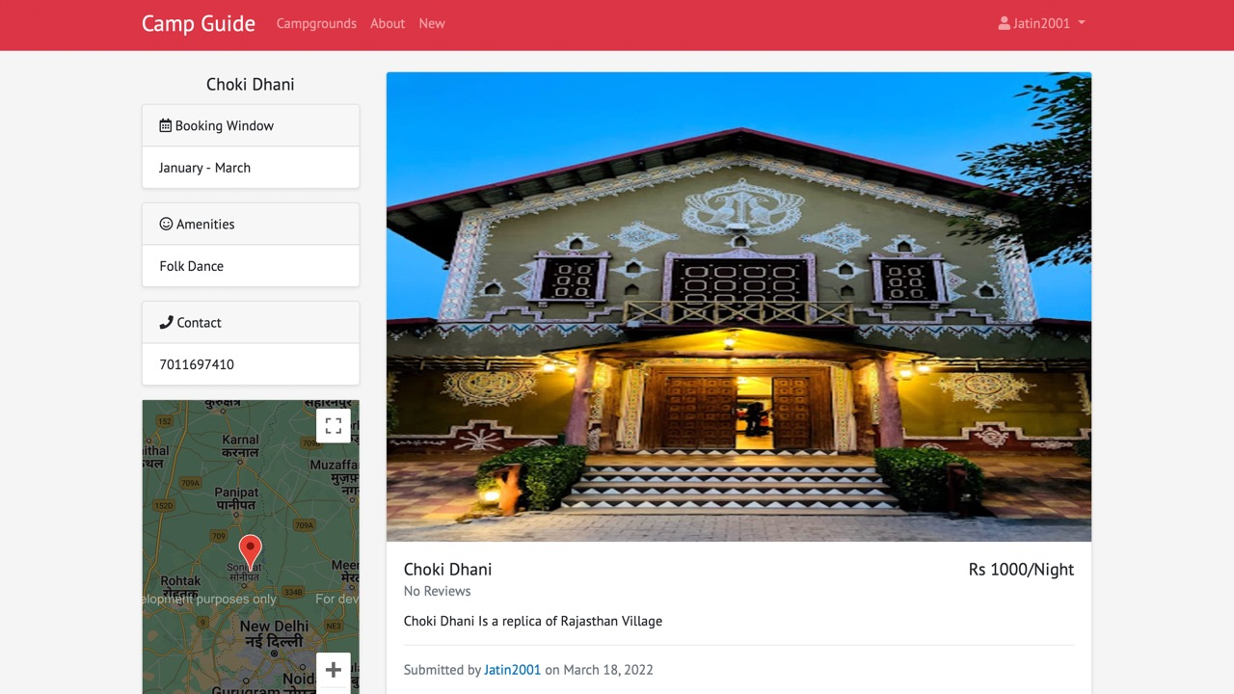
One cannot edit or delete posts and comments created by other users.
Admin can manage all posts and comments.
Posts can be sorted in many ways – according to reviews, time, trending.

Slide 8

All the camping sites can be seen on the home screen with their titles, description and reviews.
Profile section is available for users to edit their posts and reviews.

Slide 9
Campground posts
Create, edit and delete posts and comments.
Upload campground photos.
Display campground location on Google Maps o Search existing campgrounds.
Password reset via email confirmation (disabled).
Profile page setup with sign-up.
Flash messages responding to users interaction with the app.
Responsive web design.

Slide 10
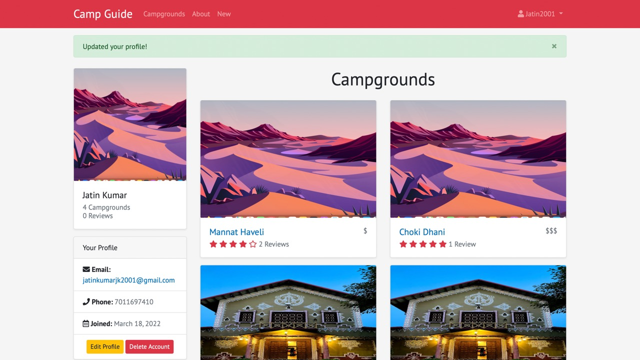
WORKING PROJECT RESULTS

Slide 11
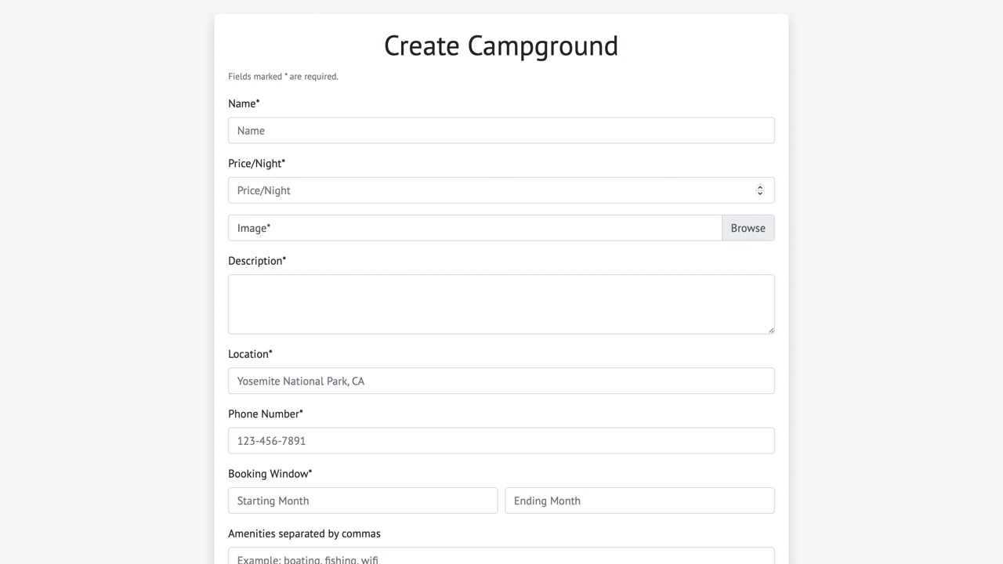

Slide 12
FUTURE SCOPE
Contact with tour guide feature can be added to improve the user experience before planning the tour.
Chat bot feature can also be added to increase the reliability of the website.
Payment feature can also be added to book the tour / camping program online.

Slide 13
CONCLUSION
Conclusion of the Camp Guide Project is that we are providing Camping areas available around the world so that people can get proper information about the camping area i.e its opening time, closing time, any stay available near the camping area, how much it will cost per person, and working.

Slide 14
THANK YOU

