Slide 1

Local Hack Day by MLH

Slide 2
Problem Statement
Agriculture
Most of the farmers are unaware of the new technologies available to the new world. Develop a solution to help the farmers be more productive with less efforts

Slide 3

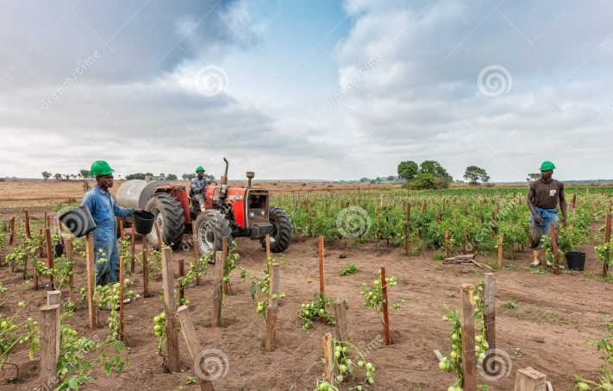
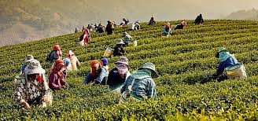
Platform where Technology helps
farmers to grow..

Slide 4
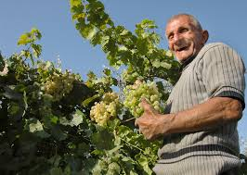
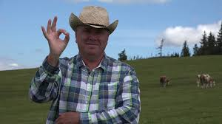
Why AgriTech ??
Provides farmers completely automated system which will minimize their loss and work..(IoT)
Predict which crop to sow according to the availability of the land, production he wants and the season in which the crop is grown..(ML)
Provide them two interactive chat bots, one of which assist them for curing disease of an animal and other gives information about the variety of crops..(Chat Bots)
Weather widget which will predict weather conditions of a particular place..

Slide 5
DETAILED WORKING..

Slide 6
Applications of IoT

Slide 7
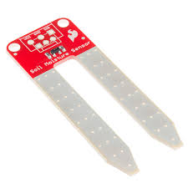
Moisture Sensors
We’ll be placing sensors like CJMCU- HUMIDITY MOISTURE sensor inside the soil which will keep record of moisture content in the soil and once the reading of the sensor reaches below a minimum limit then sprinklers will automatically be activated until the moisture content is balanced.

Slide 8
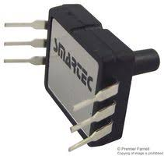
Pressure Sensors
Sensors like SPD005G will intimate the farmer about the hardness of the soil so that he can do the needfull to protect the crop such as ploughing. The farmers will receive a message alert using Blynk App and NodeMcu regarding the same.

Slide 9
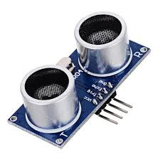
Ultrasonic Sensors
Ultrasonic Sensors near the crops wich will detect the incoming of the various animals and will warn the farmer about the same at the earliest.

Slide 10
Ultrasonic insect detector
Ultrasonic insect detector that comprises of an ultrasonic senosor, IR sensor and a GSM module in which the ultrasonic sensor will detect the sound of the insects in crops. After that the presence of the insects will be confirmed by the heat radiated by insect's body via IR sensor. If situation worsens and the farmer is also not availabe then sprinklers will be activated which will sprinkle certain amount of chemicals to destroy those pests.

Slide 11
Other Sensors
We will place suitable sensors in the places where water gets collected during rainy season and if the water level reaches certain limit then sheds will be provided automatically by the servo motors so that crops doesn't get damaged due to heavy rain.

Slide 12

Chat Bot..

Slide 13
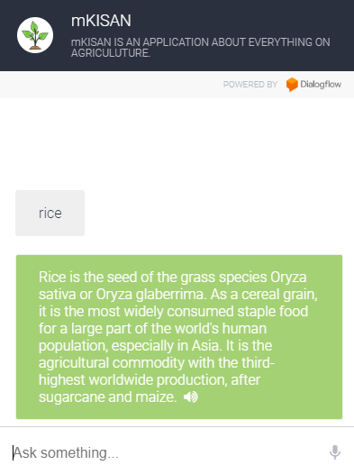
mKisan
MKisan is a farmer friendly chat bot which instantly gives answer to variety of farmers quaries related to different crops..
The chat bot is trained in such a manner so as to understand English as well as Hindi and respond to kisan..
Audio recognisition is what makes it more kisan friendly..

Slide 14
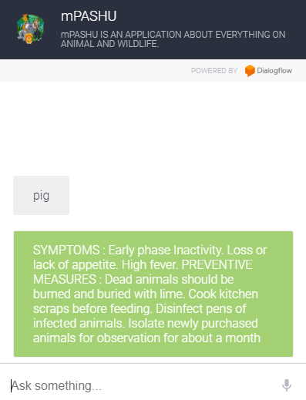
mPashu
MPashu is a farmer friendly chat bot which instantly gives answer to variety of farmers quaries related to diseases of different animals..
The distinguishing feature of MPashu is that it only requires the animal name to provide farmer with variety of symptom that the animal might be facing and then assist him with an appropriate solution immediately..
Audio recognisition is what makes it MPashu friendly to farmers..

Slide 15
Predicting Crop
We have also integrated a Machine Learning model with our project which will guide farmer which crop he should grow based on the season, area and production he wants..
The differentiating feature of these predictions will be that it will also take area and season into consideration which farmer is unlikely to find in other available application..
We assure him the quality predictions!!!

Slide 16
This project presented by
team
SAY Super3
has the potential to create
wonders for a farmer..

Slide 17
Contact us:
Shivansh Srivastava - shivanshsrivastava2000@gmail.com
Yuvraj Kumar - yuvrajkumar013@gmail.com
Aman Agarwal - aman2382000@gmail.com

