Slide 1

IILM UNIVERSITY, GREATER NOIDA
School of Computer Science and Engineering
INTERNSHIP PRESENTATION
Python Fullstack Developer Virtual Internship
STUDENT NAME
ORGANIZATION
Aman Kumar Singh
EduSkills Academy (AICTE – National Internship Portal)
ENROLLMENT / ROLL NUMBER
DURATION
2410030293
8 Weeks
PROGRAM & BATCH
CERTIFICATE ID
B.Tech CSE | Batch 2024–28
4884a2efee8431031fee

Slide 2
ABOUT THE ORGANIZATION
EduSkills Academy
A skilling and industry-academia collaboration initiative preparing a digitally skilled, Industry 4.0-ready workforce among Indian students.
ES
Operates in association with AICTE and the National Internship Portal, Ministry of Education, Government of India.
Industry–Academia
Collaboration
Partners with academic institutions to deliver structured, certification-based virtual internship programs.
Covers emerging technology domains including full stack development, data analytics, cloud computing, and cybersecurity.
Aims to bridge the gap between classroom learning and real industry requirements.
Aman Kumar Singh | Python Fullstack Developer Virtual Internship
2

Slide 3
CHAPTER 4.1 – 4.3
Introduction & Problem Statement
INTRODUCTION
PROBLEM STATEMENT
An 8-week Python Fullstack Developer Virtual Internship conducted by EduSkills Academy, in association with AICTE and the National Internship Portal — covering the complete journey from front-end design in HTML, CSS & JavaScript, through core Python back-end development, to database integration and final deployment.
Many students graduate with only a fragmented understanding of either the front-end or the back-end of web development, rarely both — leaving them unprepared to build or maintain complete, end-to-end software solutions.
The internship addressed this by training interns to design and build full stack web applications — Python & frameworks for the back-end, SQL for data, and REST APIs to connect front-end and back-end into one deployed application.
Certificate ID: 4884a2efee8431031fee | Grade: O (Outstanding)
Aman Kumar Singh | Python Fullstack Developer Virtual Internship
3

Slide 4
CHAPTER 4.4
Project Objectives
1
Understand the fundamentals of full stack web development and the roles of front-end and back-end
2
Build responsive, structured web pages using HTML5, CSS3, and JavaScript
3
Learn core and advanced Python programming for back-end development
4
Design and implement server-side logic using a Python web framework
5
Integrate relational databases and perform CRUD operations using SQL
6
Design, consume, and deploy RESTful APIs to power a complete full stack application
Aman Kumar Singh | Python Fullstack Developer Virtual Internship
4

Slide 5
CHAPTER 4.5 – 4.6
Scope & Technologies Used
SCOPE OF THE PROJECT
TECHNOLOGIES & TOOLS
Covered the complete lifecycle of a full stack web application — environment setup, front-end development, core Python programming, back-end framework development, database integration, and RESTful API design. Concluded with a capstone project: a fully built and deployed full stack web application.
Front-End
HTML5, CSS3, and JavaScript for responsive user interfaces
Python
Core programming language for back-end application logic
Back-End Framework
Python web framework (Flask/Django) for routing & views
Database
SQL-based relational database with CRUD operations
API & Deployment
RESTful APIs, Git version control, and cloud hosting
Aman Kumar Singh | Python Fullstack Developer Virtual Internship
5

Slide 6
CHAPTER 4.7
System Architecture
1
2
3
4
Presentation Layer
→
Application Layer
→
Data Layer
→
Deployment Layer
Front-end UI built with HTML5, CSS3 & JavaScript
Python back-end handles routing & business logic
SQL database stores data; CRUD operations performed
REST APIs connect layers; app published to hosting
A layered flow from user interface to deployed application, mirroring the internship’s Front-End → Python → Database → Deployment pipeline.
Aman Kumar Singh | Python Fullstack Developer Virtual Internship
6

Slide 7
CHAPTER 4.8
Methodology — Week-wise Curriculum
W1
W2
W3
W4
Full Stack Intro, Environment Setup & HTML5/CSS3
JavaScript Fundamentals, DOM & Responsive Design
Core Python Programming & OOP Concepts
Python Web Framework Basics: Routing & Templates
W5
W6
W7
W8
Database Design & SQL Integration (CRUD)
REST API Development & Front-End Integration
Real-World Project: Full Stack Web Application
Capstone: Deployment & Best Practices
Aman Kumar Singh | Python Fullstack Developer Virtual Internship
7

Slide 8
APPLIED PROJECTS
Real-World & Capstone Project
1
2
3
Full Stack Web Application
Testing, Debugging & APIs
Capstone: Deployment
Built a complete web application integrating a responsive front-end with a Python-driven back-end and database.
Developed and tested RESTful API endpoints, validated data flow, and debugged front-end–back-end integration.
End-to-end application taken from design to a live deployed build, consolidating all eight weeks of skills.
Aman Kumar Singh | Python Fullstack Developer Virtual Internship
8

Slide 9
CHAPTER 4.9
Expected Outcomes
✓
Ability to independently design and build responsive front-end interfaces using HTML, CSS & JavaScript
✓
Proficiency in core Python programming for back-end web development
✓
Capability to build and manage server-side logic using a Python web framework
✓
Practical experience designing databases and performing SQL-based CRUD operations
✓
Skill in developing and consuming RESTful APIs for front-end–back-end communication
✓
A completed and deployed capstone full stack web application
Aman Kumar Singh | Python Fullstack Developer Virtual Internship
9

Slide 10
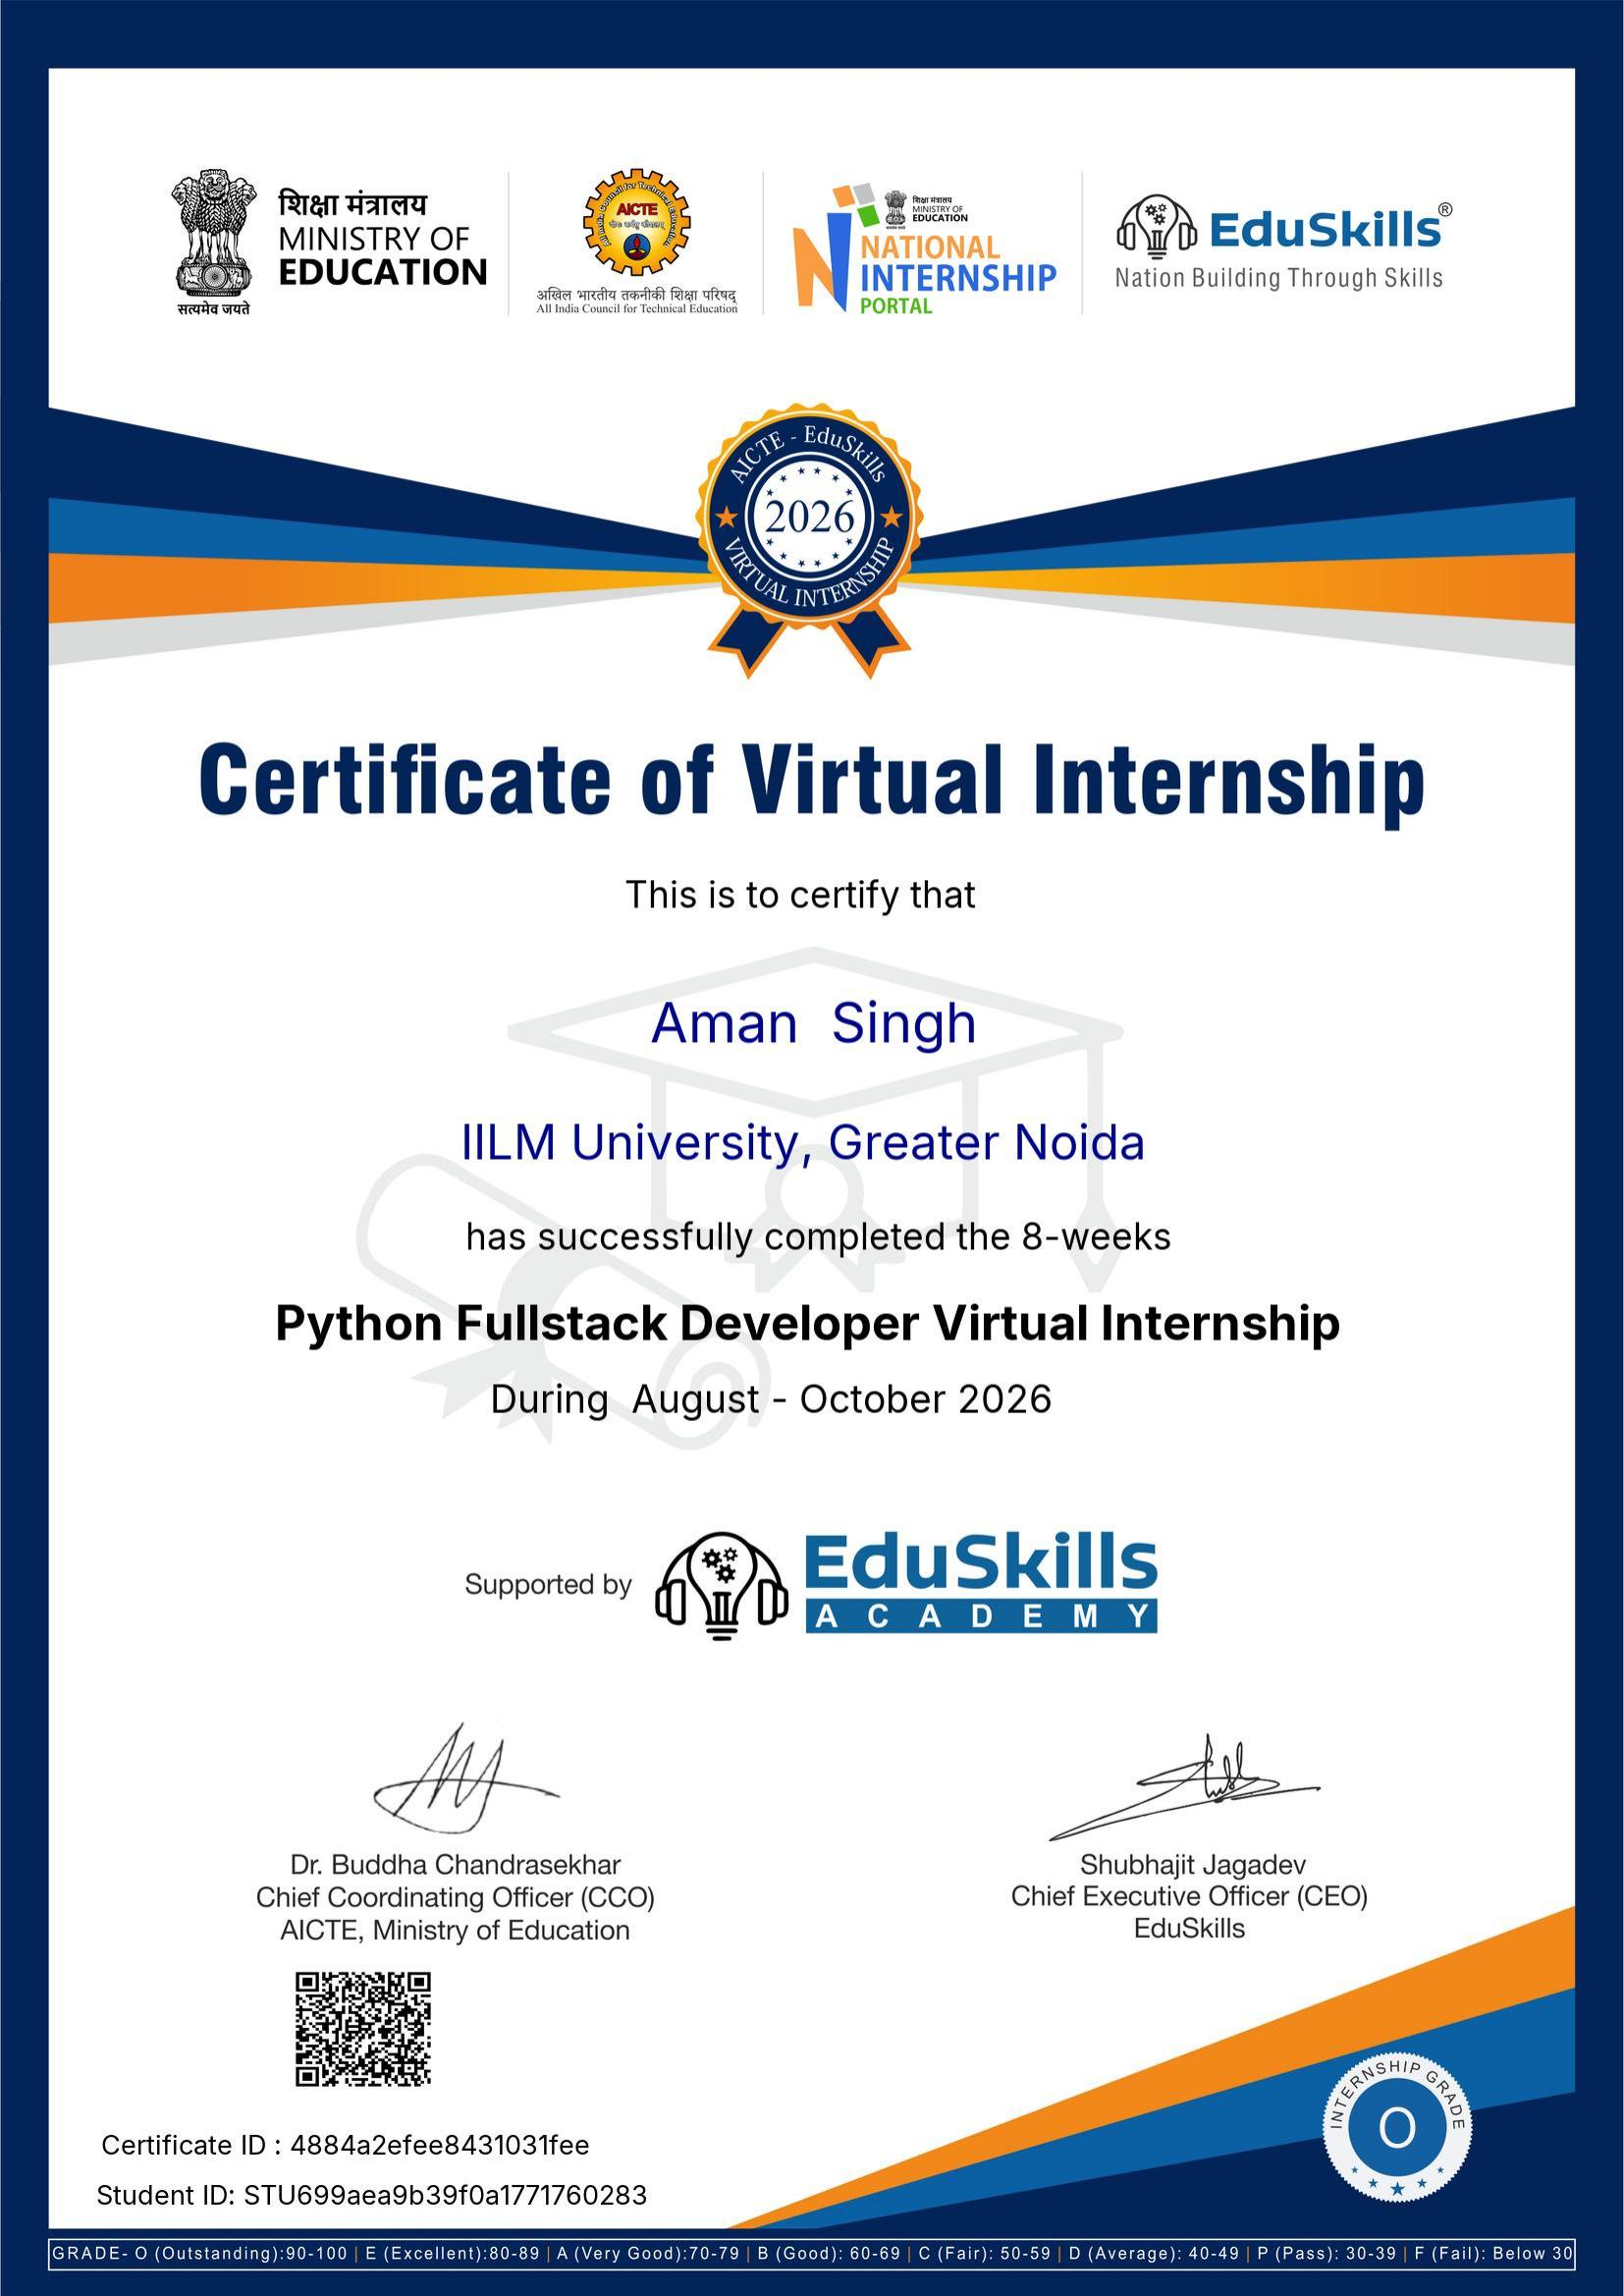
PROOF OF COMPLETION
Internship Completion Certificate
Certificate ID: 4884a2efee8431031fee | Student ID: STU699aea9b39f0a1771760283 | Grade: O (Outstanding)
Signed by Dr. Buddha Chandrasekhar (CCO, AICTE) & Shubhajit Jagadev (CEO, EduSkills)
Aman Kumar Singh | Python Fullstack Developer Virtual Internship
10

