Slide 1



/ai/ | /ee/ | /igh/ | /oa/ | /oo/ | /y-oo/ | /r/
/n/ | /m/ | /ch/ | /k/ | /sh/ | /j/ | /v/
/u/ | /e/ | /i/ | /s/ | /zh/ | /z/ | /ar/
/or/ | /ur/ | /air/ | /ear/
Sound Family /ur/; er ir
Lesson 76

Slide 2



Review and practise /ur/ sound family spelling patterns.
Recall all GPCs learned so far using flashcards.
Recall Phase 3 Common Exception Words push they me we be he she my by looked you are there here were all sure.
Grapheme to Phoneme Cards
Phoneme Frame Cards
Alien Word Cards
Common Exception Word Cards
JNL686
JNL689
JNL692
JNL687

Slide 3























Recall all GPCs learned so far using flashcards.

Slide 4



























Recall all GPCs learned so far using flashcards.

Slide 5








































Recall all GPCs learned so far using flashcards.

Slide 6
























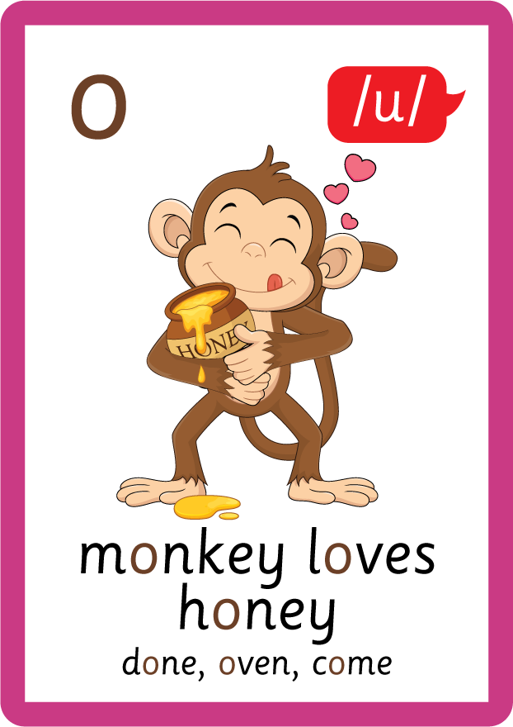












Recall all GPCs learned so far using flashcards.

Slide 7














Review Phase 2 Common Exception Words as I is no go to into the put his has of pull full.

Slide 8



























Review Phase 3 Common Exception Words push they me we be he she my by looked you are there here were all sure.

Slide 9













Review Phase 4 Common Exception Words said like out have some come what was so old do little one.

Slide 10















Review Phase 5 Common Exception Words today house mouse hour because Mr Mrs Ms where should could would move use want.

Slide 11
























Review Phase 5.5 Common Exception Words people wild child mind kind behind eye oh most only both though through who prove shoe beautiful climb Christmas school sugar love money any…

Slide 12















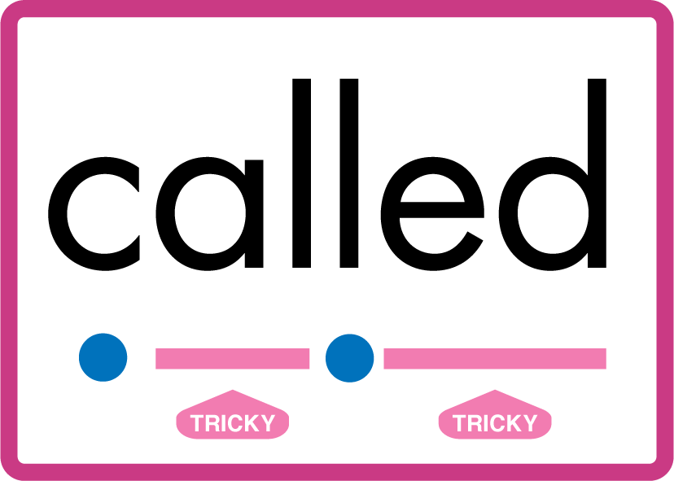


…many friend very busy pretty once please asked bath path fast class after half laughed called water your.

Slide 13
Review Grapheme Caption
burn
nurse
spur
Phase 3, Lesson 53
USING JNL686
FRONT

Slide 14
Review Grapheme Caption
fern
spider
shower
Phase 3, Lesson 52
USING JNL686
FRONT

Slide 15
Review Grapheme Caption
first
dirt
circle
Phase 5, Lesson 7
USING JNL686
FRONT

Slide 16

Explain Decoding

Slide 17
Model Blending Phonemes
f
ur
USING SOUND BUTTONS
Sound Buttons
Vowel
Consonant
Consonant Digraph
Multi Sound
Long Vowel Sound
R-controlled Digraph
Split Digraph
Syllable / Silent Letter

Slide 18
Model Blending Phonemes
th
ir
d
USING SOUND BUTTONS
Sound Buttons
Vowel
Consonant
Consonant Digraph
Multi Sound
Long Vowel Sound
R-controlled Digraph
Split Digraph
Syllable / Silent Letter

Slide 19

Explain Encoding

Slide 20
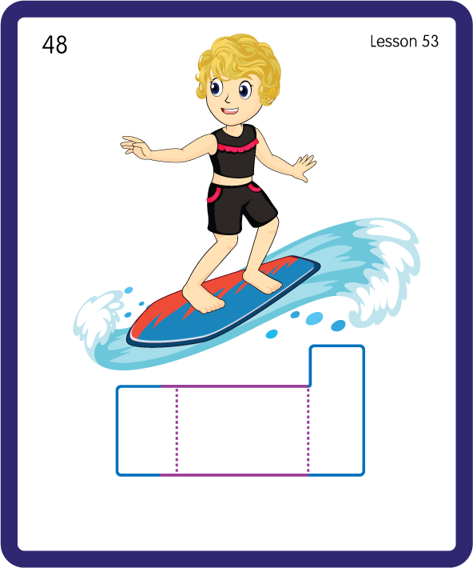
Build a Decodable Word
USING JNL689
BACK

Slide 21
Build a Decodable Word
USING JNL689
FRONT

Slide 22

Build a Decodable Word
USING JNL689
BACK

Slide 23

Build a Decodable Word
USING JNL689
FRONT

Slide 24
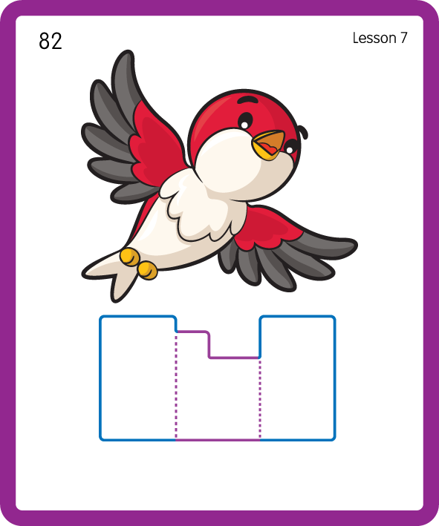
Build a Decodable Word
USING JNL689
BACK

Slide 25

Build a Decodable Word
USING JNL689
FRONT

Slide 26
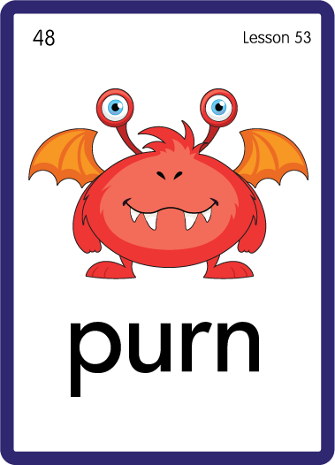
Practise with Alien Words
USING JNL692
BACK

Slide 27
Practise with Alien Words
USING JNL692
FRONT

Slide 28
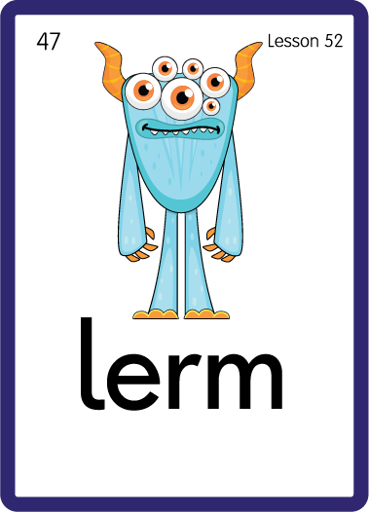
Practise with Alien Words
USING JNL692
BACK

Slide 29

Practise with Alien Words
USING JNL692
FRONT

Slide 30

Practise with Alien Words
USING JNL692
BACK

Slide 31

Practise with Alien Words
USING JNL692
BACK

Slide 32
Practise Common Exception Words
USING JNL687
FRONT

Slide 33
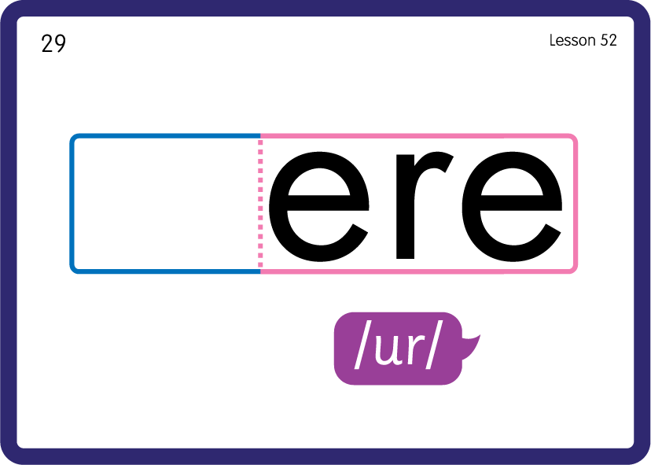
Practise Common Exception Words
USING JNL687
BACK

Slide 34

Practise Building Words
PRACTISE – 10MINS
f
er
n
h
j
k
v
t
m
b
ir
d
th
t
g
l
s
USING MAGNETIC LETTERS AND A WHITEBOARD
LAYOUT B

Slide 35
Practise Building Words
PRACTISE – 10MINS
f
er
n
h
j
k
v
t
m
b
ir
d
th
t
g
l
s
fern her jerk verb bird dirt girl term birth skirt nerve
USING MAGNETIC LETTERS AND A WHITEBOARD
LAYOUT B

