Slide 1

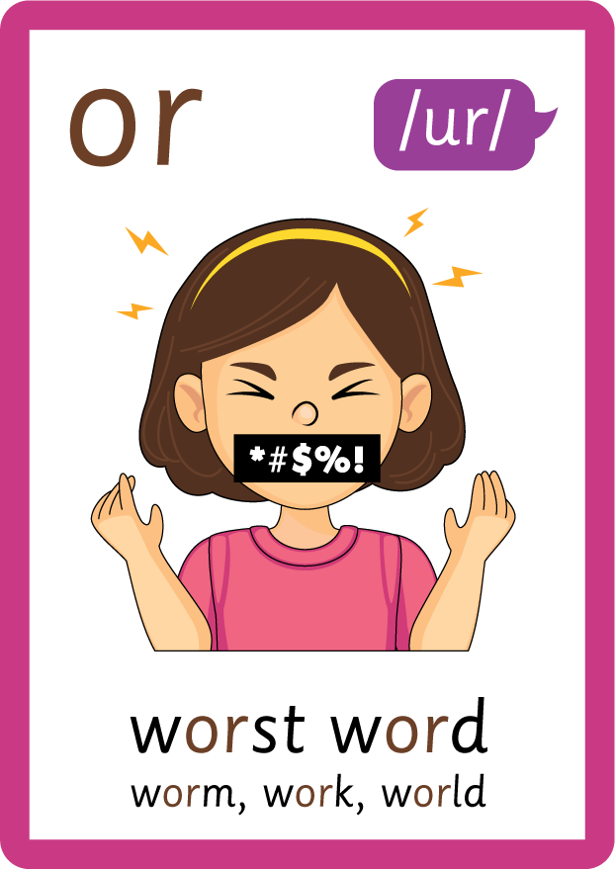
/ai/ | /ee/ | /igh/ | /oa/ | /oo/ | /y-oo/ | /r/
/n/ | /m/ | /ch/ | /k/ | /sh/ | /j/ | /v/
/u/ | /e/ | /i/ | /s/ | /zh/ | /z/ | /ar/
/or/ | /ur/ | /air/ | /ear/
Compare or; /or/ and /ur/
Lesson 79

Slide 2


Compare alternative phonemes /or/ and /ur/ for grapheme 'or'.
Recall all GPCs learned so far using flashcards.
Grapheme to Phoneme Cards
Phoneme Frame Cards
Common Exception Words
JNL686
JNL689
JNL687

Slide 3























Recall all GPCs learned so far using flashcards.

Slide 4




























Recall all GPCs learned so far using flashcards.

Slide 5



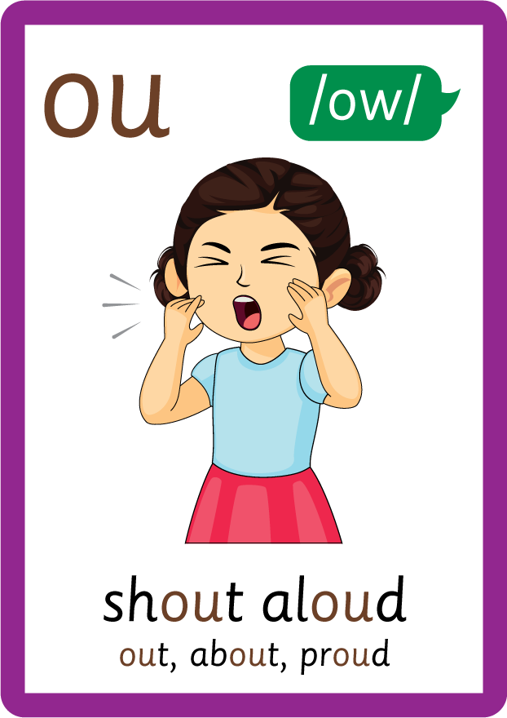
















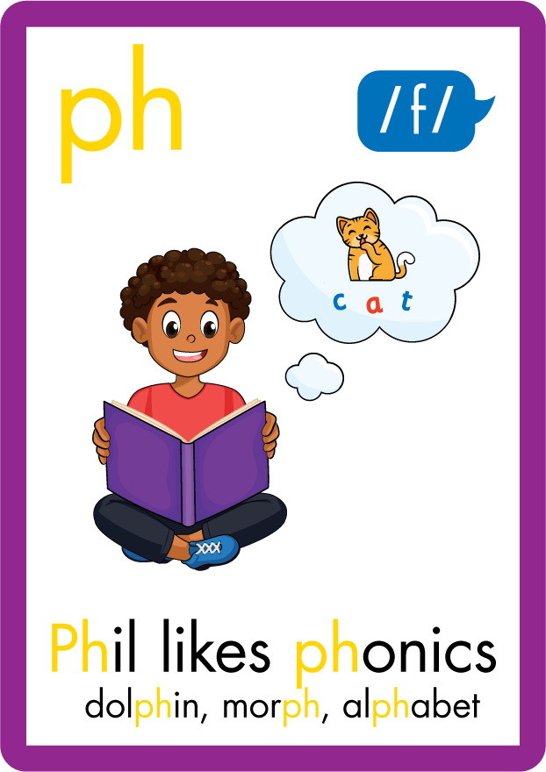




















Recall all GPCs learned so far using flashcards.

Slide 6
















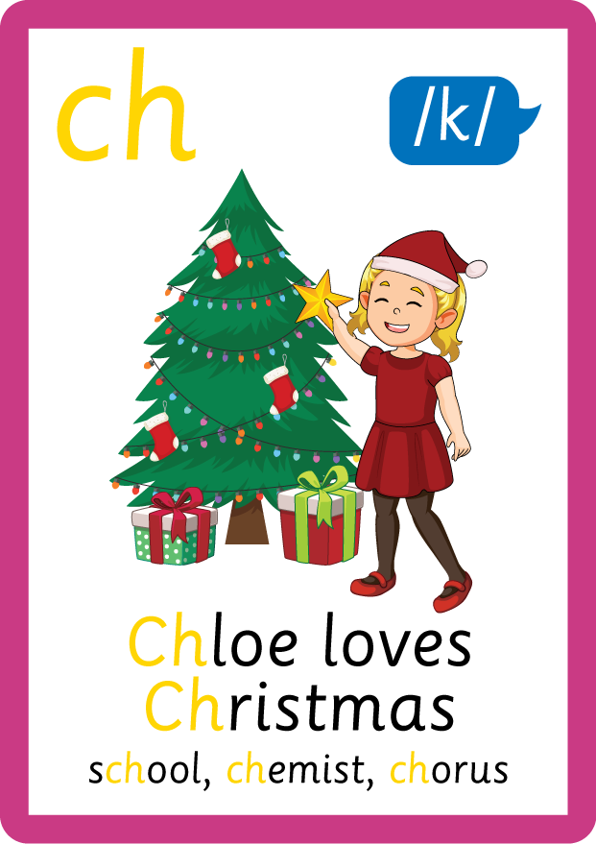








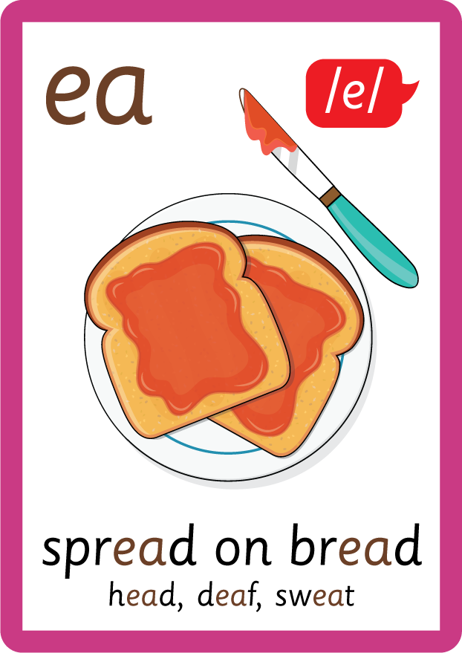




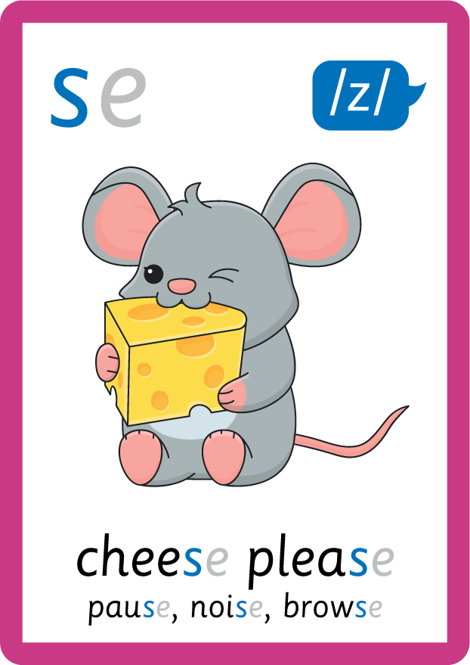



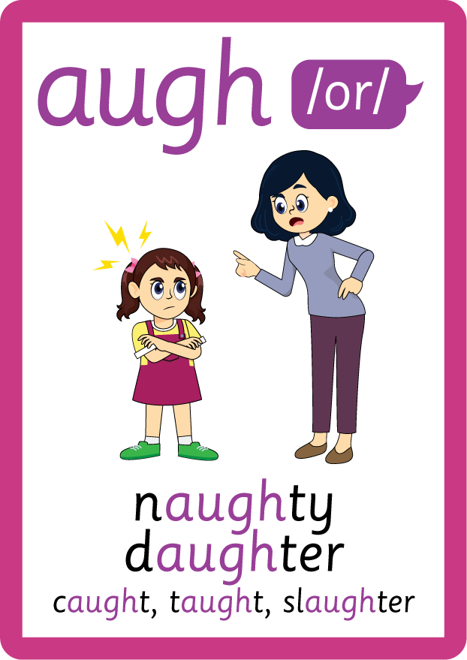





Recall all GPCs learned so far using flashcards.

Slide 7













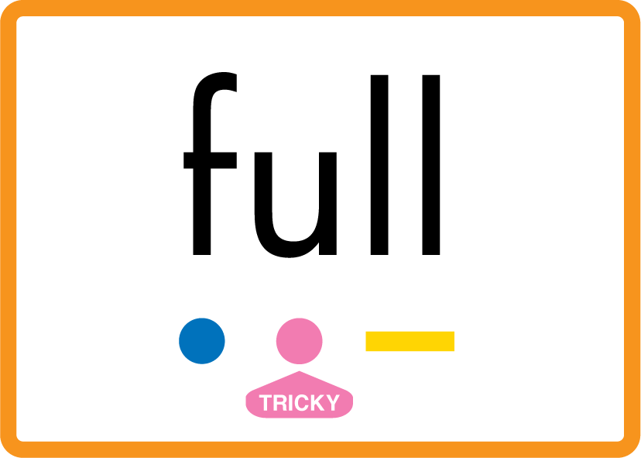
Review Phase 2 Common Exception Words as I is no go to into the put his has of pull full.

Slide 8



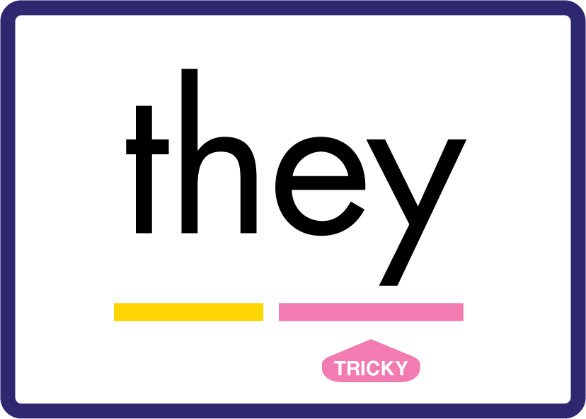










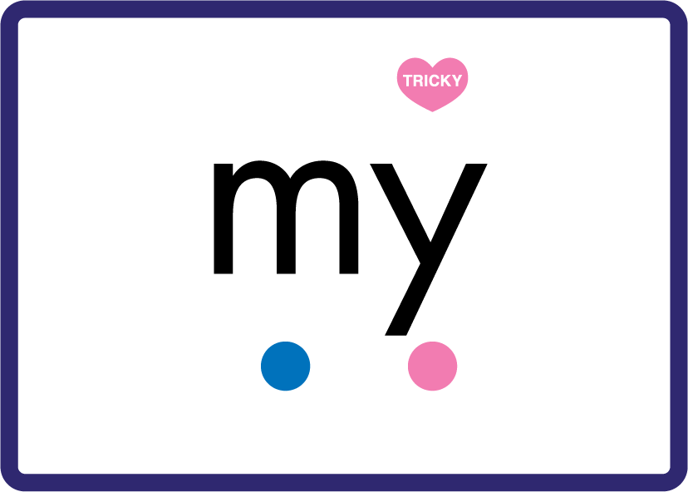






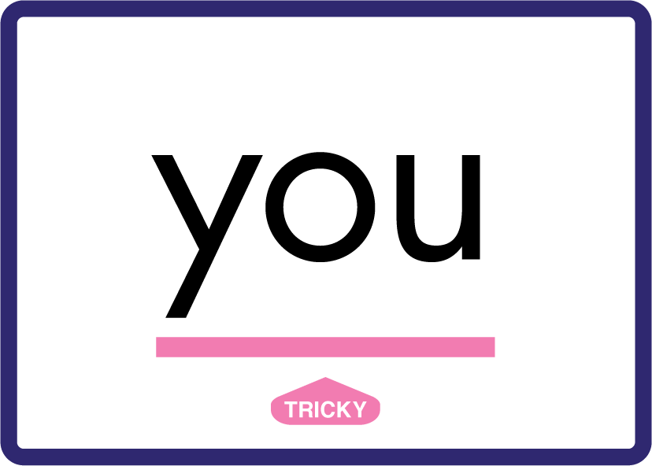






Review Phase 3 Common Exception Words push they me we be he she my by looked you are there here were all sure.

Slide 9









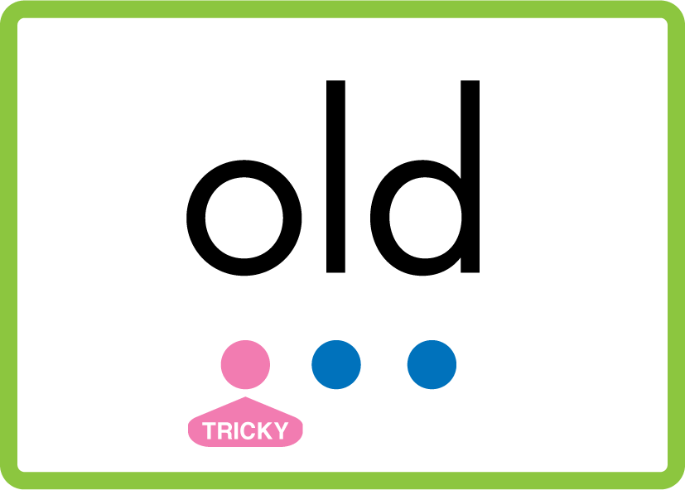



Review Phase 4 Common Exception Words said like out have some come what was so old do little one.

Slide 10














Review Phase 5 Common Exception Words today house mouse hour because Mr Mrs Ms where should could would move use.

Slide 11



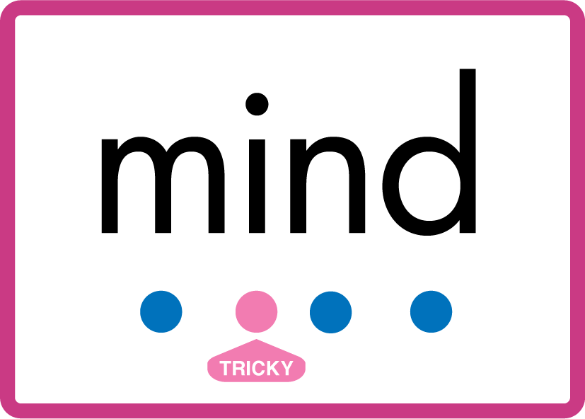


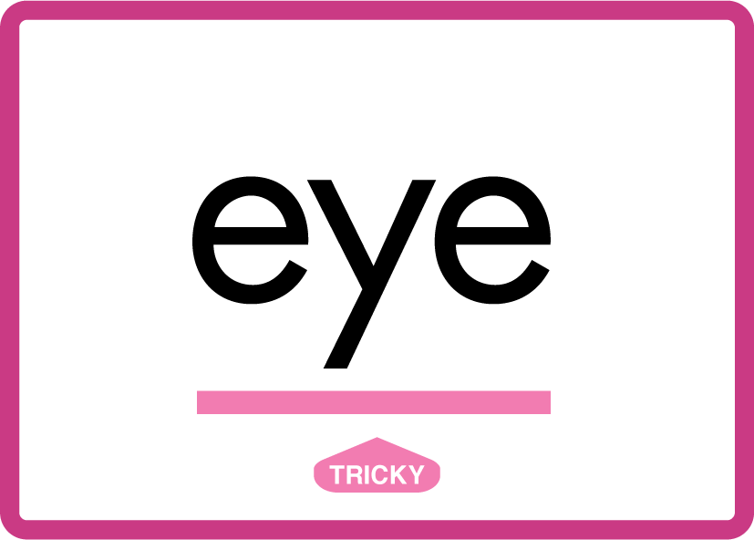








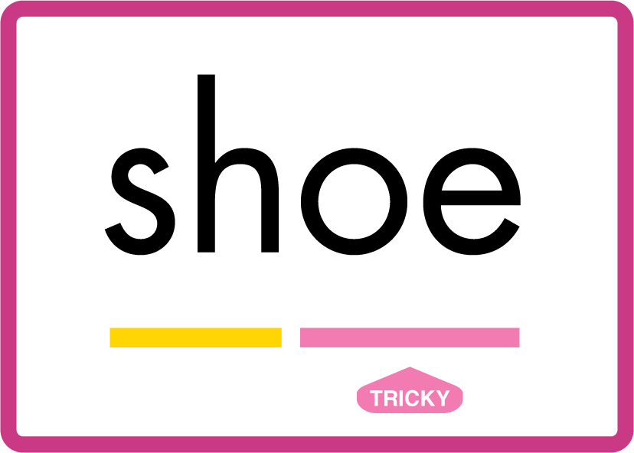






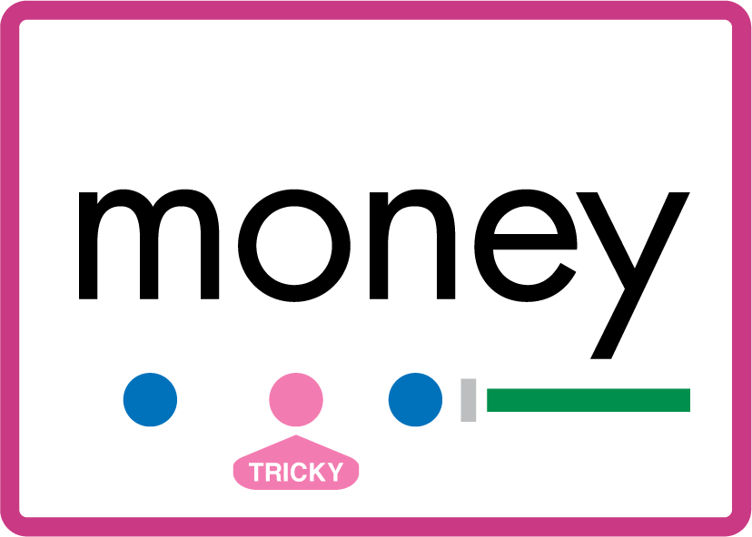

Review Phase 5.5 Common Exception Words people wild child mind kind behind eye oh most only both though through who prove shoe beautiful climb Christmas school sugar love money any…

Slide 12
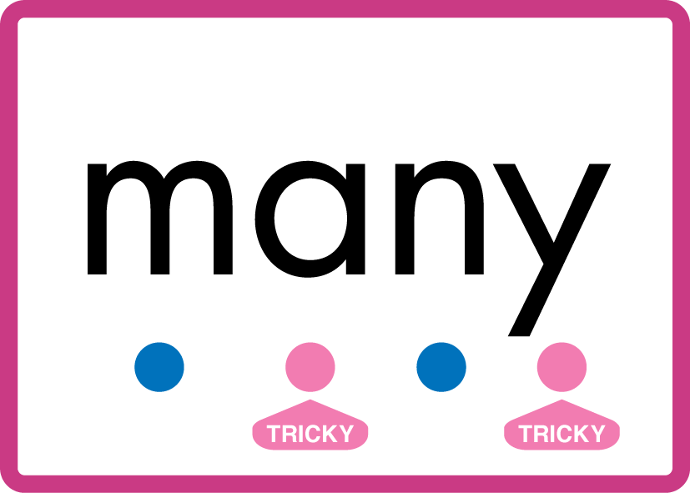


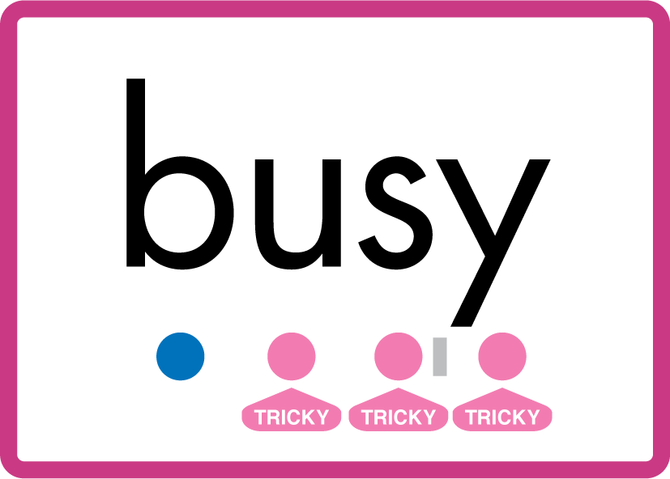
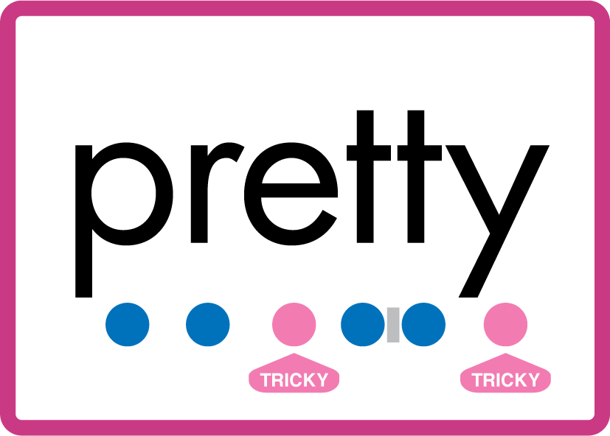


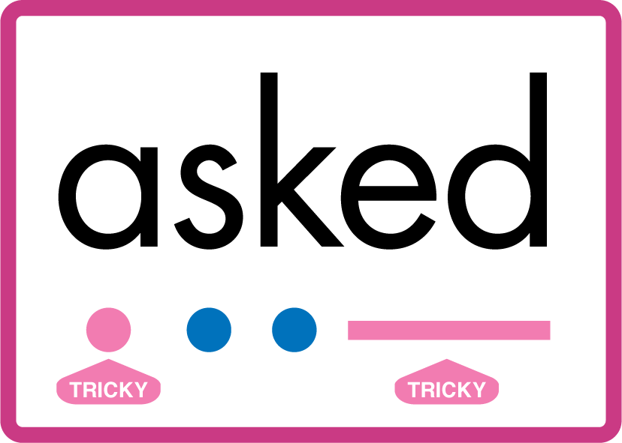


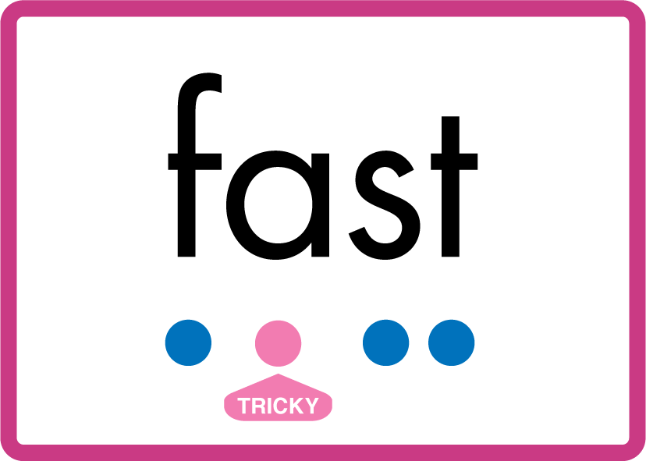


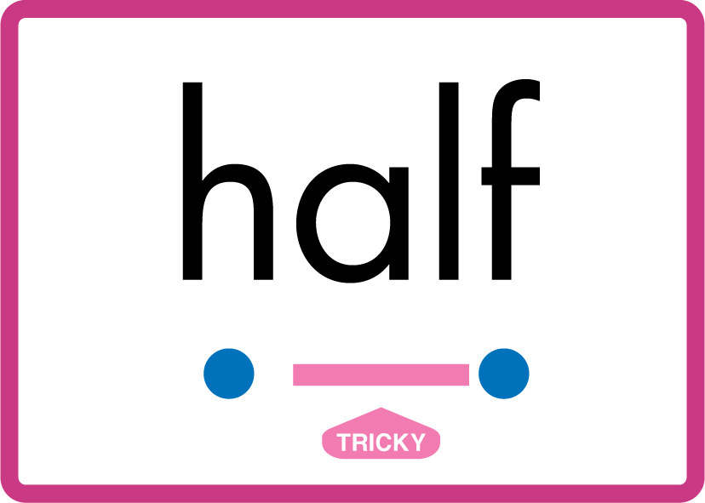
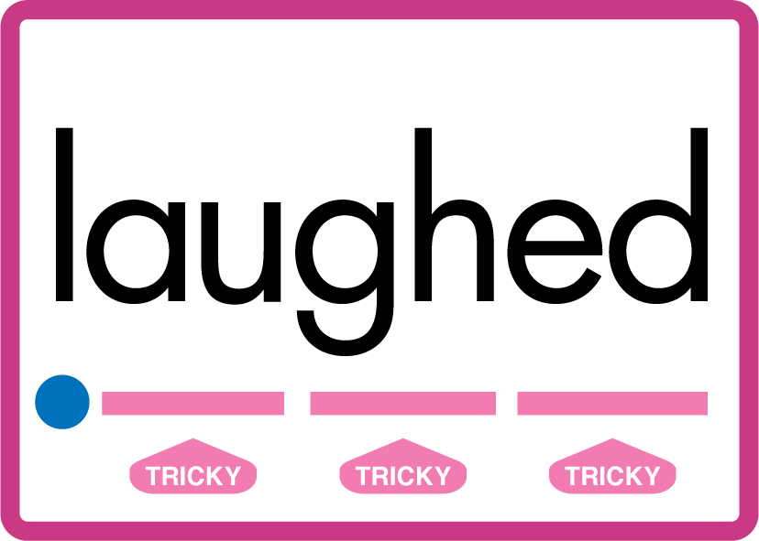
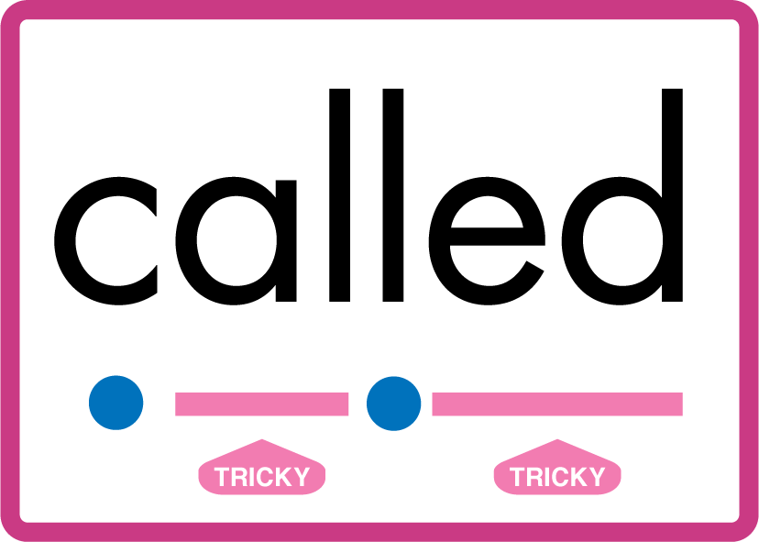

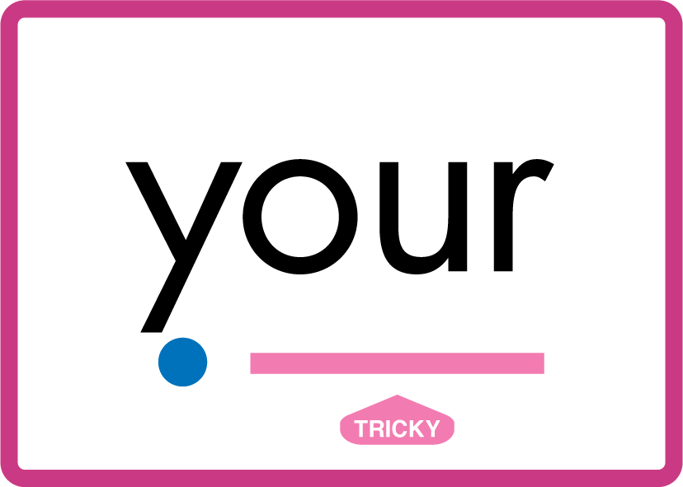

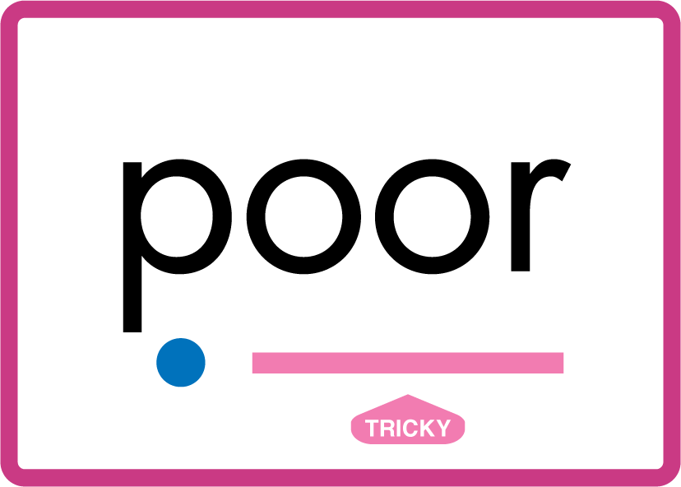
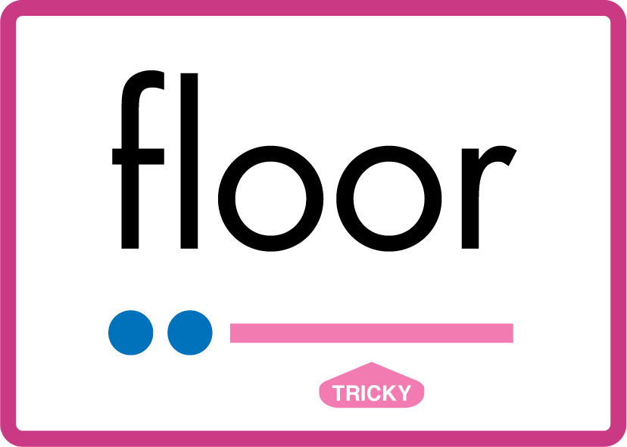
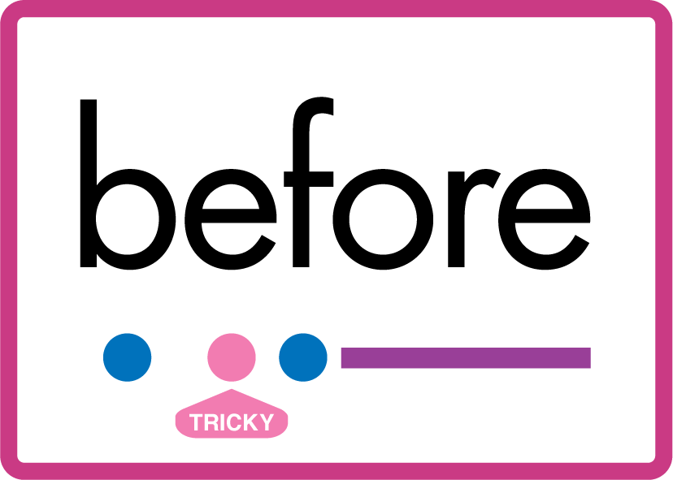
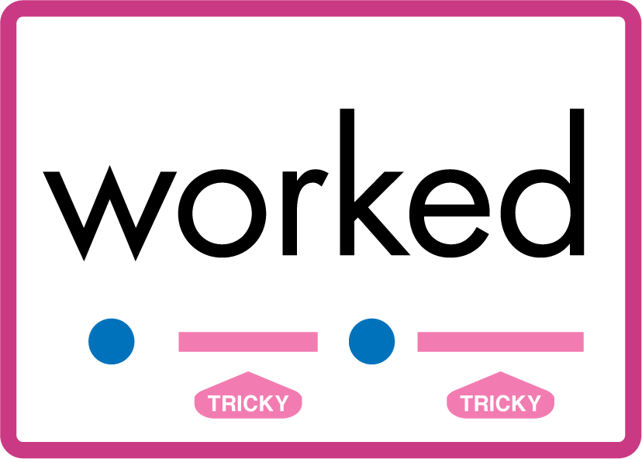
…many friend very busy pretty once please asked bath path fast class after half laughed called water your door poor floor before work worked.

Slide 13
Review Grapheme Caption
USING JNL686
FRONT

Slide 14
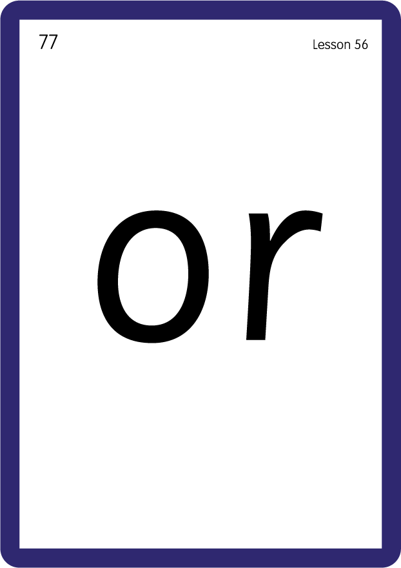
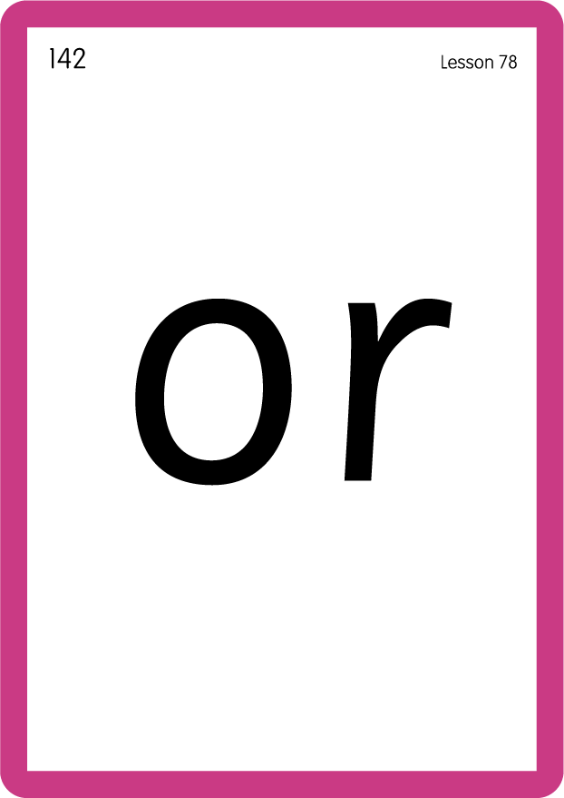
Review Grapheme Caption
USING JNL686
FRONT

Slide 15

Explain Decoding

Slide 16
Model Blending Phonemes
t
or
n
USING SOUND BUTTONS
Sound Buttons
Vowel
Consonant
Consonant Digraph
Multi Sound
Long Vowel Sound
R-controlled Digraph
Split Digraph
Syllable / Silent Letter

Slide 17
Model Blending Phonemes
w
or
k
USING SOUND BUTTONS
Sound Buttons
Vowel
Consonant
Consonant Digraph
Multi Sound
Long Vowel Sound
R-controlled Digraph
Split Digraph
Syllable / Silent Letter

Slide 18

Explain Encoding

Slide 19
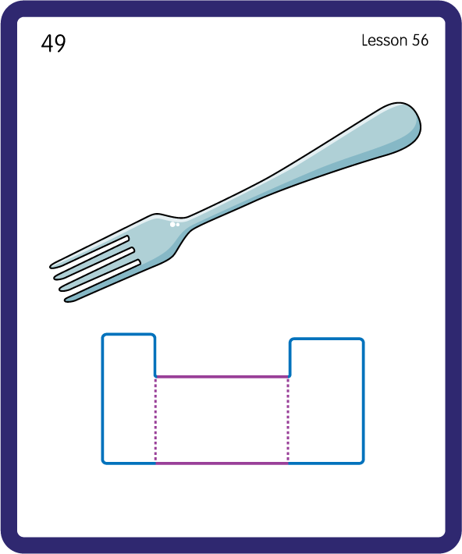
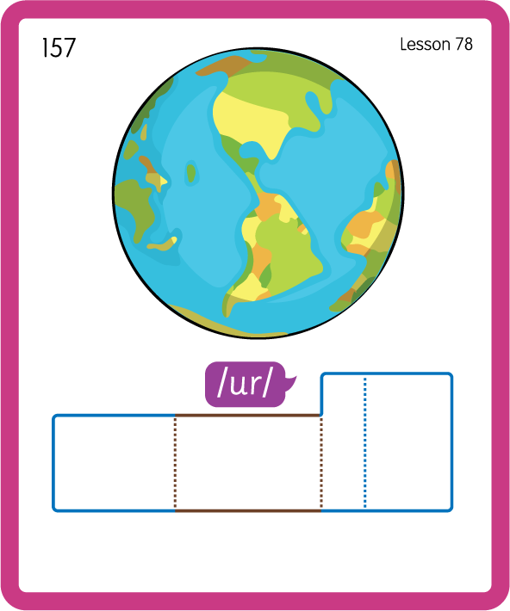
Build a Decodable Word
USING JNL689
BACK

Slide 20

Build a Decodable Word
USING JNL689
FRONT

Slide 21
Practise Common Exception Words
USING JNL687
FRONT

Slide 22
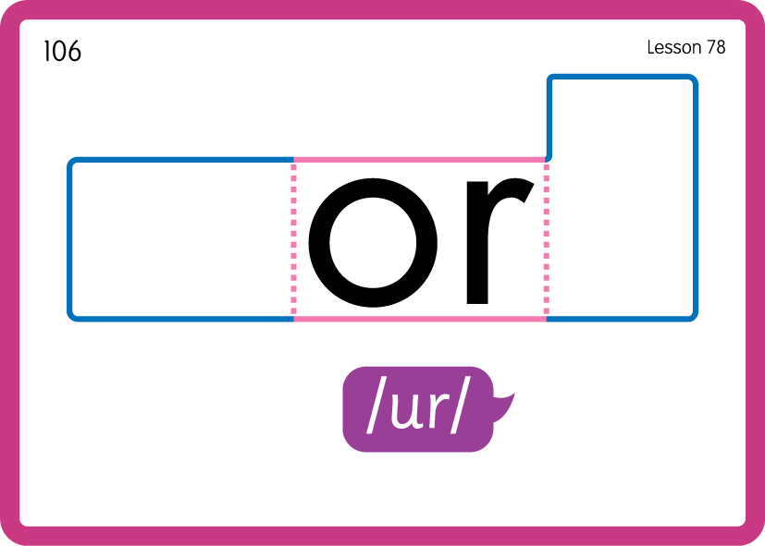
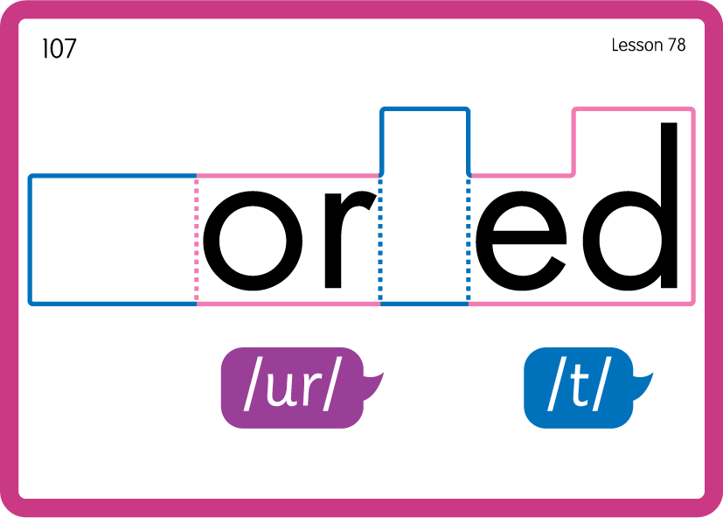
Practise Common Exception Words
USING JNL687
FRONT

Slide 23

Practise Building Words
PRACTISE – 10MINS
c
or
n
f
t
b
w
k
m
d
USING MAGNETIC LETTERS AND A WHITEBOARD
LAYOUT A

Slide 24
Practise Building Words
PRACTISE – 10MINS
c
or
n
f
t
b
w
k
m
d
corn fort born torn work worm word
USING MAGNETIC LETTERS AND A WHITEBOARD
LAYOUT A

