Slide 1




/ai/ | /ee/ | /igh/ | /oa/ | /oo/ | /y-oo/ | /r/
/n/ | /m/ | /ch/ | /k/ | /sh/ | /j/ | /v/
/u/ | /e/ | /i/ | /s/ | /zh/ | /z/ | /ar/
/or/ | /ur/ | /air/ | /ear/
Review Sound Family /ur/
Lesson 80

Slide 2




Learn and practise /ur/ sound family spelling patterns, including homophones and Common Exception Words.
Recall all GPCs learned so far using flashcards.
Homophone Cards
Grapheme to Phoneme Cards
Phoneme Frame Cards
Alien Words
Common Exception Word Cards
JNL693
JNL686
JNL689
JNL692
JNL687

Slide 3























Recall all GPCs learned so far using flashcards.

Slide 4




























Recall all GPCs learned so far using flashcards.

Slide 5








































Recall all GPCs learned so far using flashcards.

Slide 6







































Recall all GPCs learned so far using flashcards.

Slide 7














Review Phase 2 Common Exception Words as I is no go to into the put his has of pull full.

Slide 8



























Review Phase 3 Common Exception Words push they me we be he she my by looked you are there here were all sure.

Slide 9













Review Phase 4 Common Exception Words said like out have some come what was so old do little one.

Slide 10














Review Phase 5 Common Exception Words today house mouse hour because Mr Mrs Ms where should could would move use.

Slide 11
























Review Phase 5.5 Common Exception Words people wild child mind kind behind eye oh most only both though through who prove shoe beautiful climb Christmas school sugar love money any…

Slide 12
























…many friend very busy pretty once please asked bath path fast class after half laughed called water your door poor floor before work worked.

Slide 13
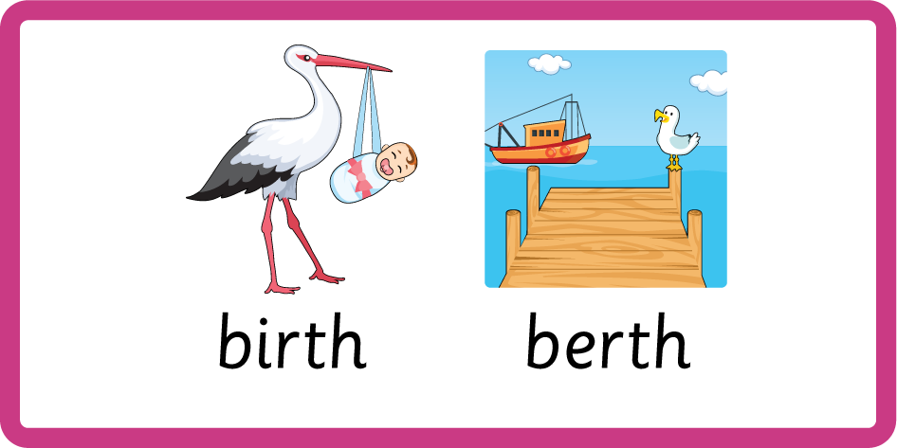

Teach Homophones within /ur/ family: heard / herd, birth / berth, colonel / kernel.

Slide 14
Review Common Exception Words were work worked.

Slide 15
Review Grapheme Captions
USING JNL686
FRONT

Slide 16



Review Grapheme Captions
USING JNL686
BACK

Slide 17
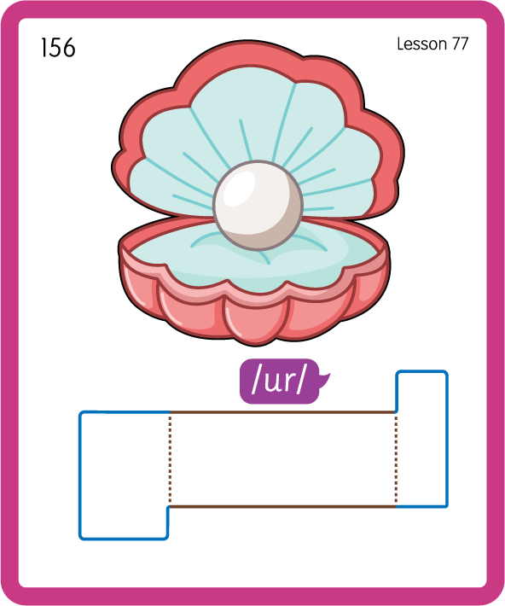
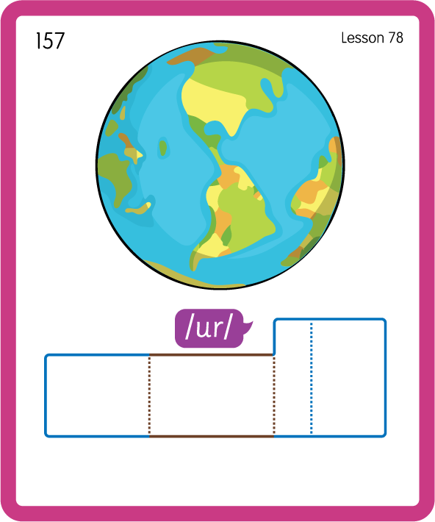
Build a Decodable Word
USING JNL689
BACK

Slide 18

Build a Decodable Word
USING JNL689
FRONT

Slide 19

Practise with Alien Words
USING JNL692
BACK

Slide 20
Practise with Alien Words
USING JNL692
FRONT

Slide 21
Practise Common Exception Words
USING JNL687
FRONT

Slide 22
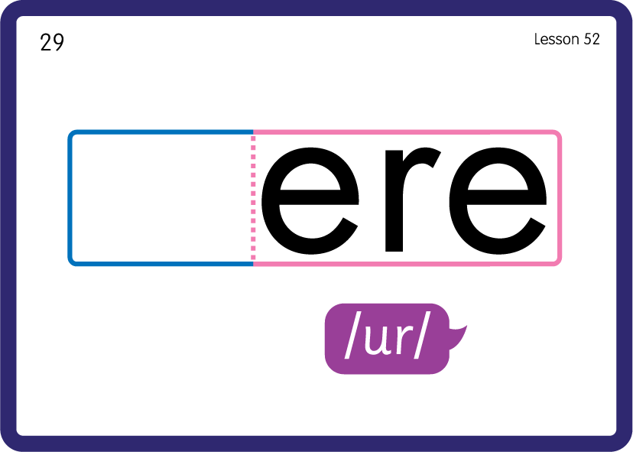
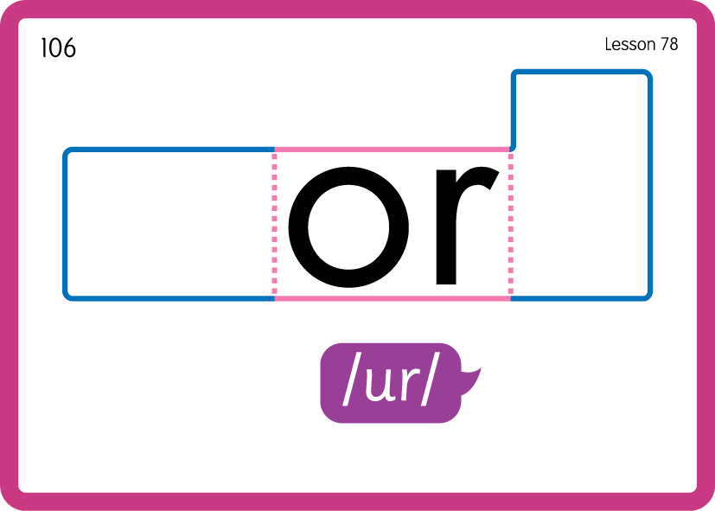
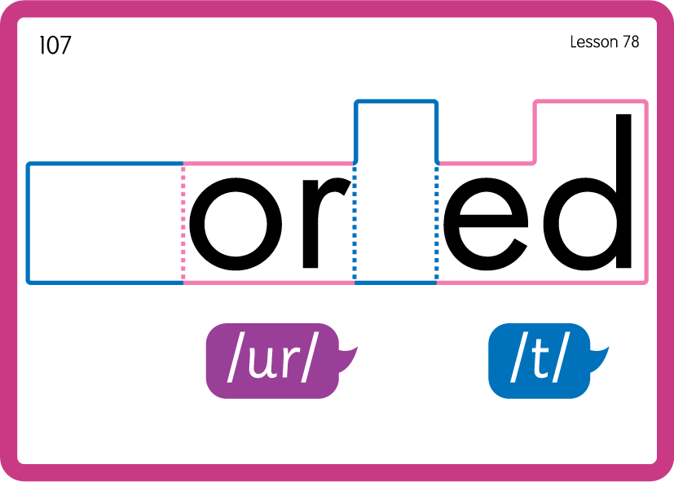
Practise Common Exception Words
USING JNL687
BACK

Slide 23
Practise Common Exception Words
USING JNL687
FRONT

Slide 24

