Slide 1

/ai/ | /ee/ | /igh/ | /oa/ | /oo/ | /y-oo/ | /r/
/n/ | /m/ | /ch/ | /k/ | /sh/ | /j/ | /v/
/u/ | /e/ | /i/ | /s/ | /zh/ | /z/ | /ar/
/or/ | /ur/ | /air/ | /ear/
Sound Family /ear/; ear
Lesson 86

Slide 2



Review and practise /ear/ sound family spelling patterns.
Recall all GPCs learned so far using flashcards.
Grapheme to Phoneme Cards
Phoneme Frame Cards
Alien Word Cards
Common Exception Word Cards
JNL686
JNL689
JNL692
JNL687

Slide 3























Recall all GPCs learned so far using flashcards.

Slide 4




























Recall all GPCs learned so far using flashcards.

Slide 5









































Recall all GPCs learned so far using flashcards.

Slide 6











































Recall all GPCs learned so far using flashcards.

Slide 7














Review Phase 2 Common Exception Words as I is no go to into the put his has of pull full.

Slide 8



























Review Phase 3 Common Exception Words push they me we be he she my by looked you are there here were all sure.

Slide 9













Review Phase 4 Common Exception Words said like out have some come what was so old do little one.

Slide 10














Review Phase 5 Common Exception Words today house mouse hour because Mr Mrs Ms where should could would move use.

Slide 11
























Review Phase 5.5 Common Exception Words people wild child mind kind behind eye oh most only both though through who prove shoe beautiful climb Christmas school sugar love money any…

Slide 12



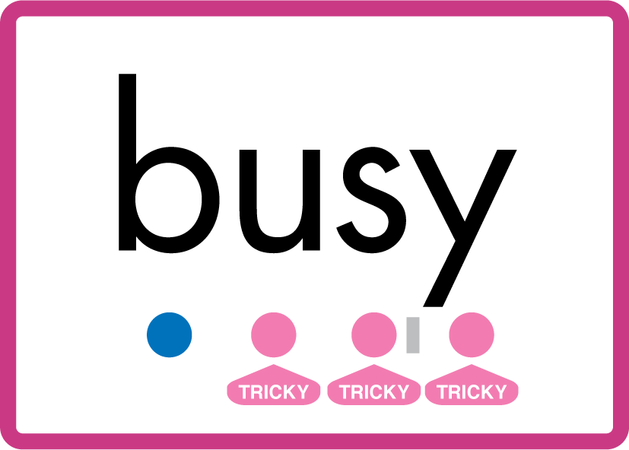









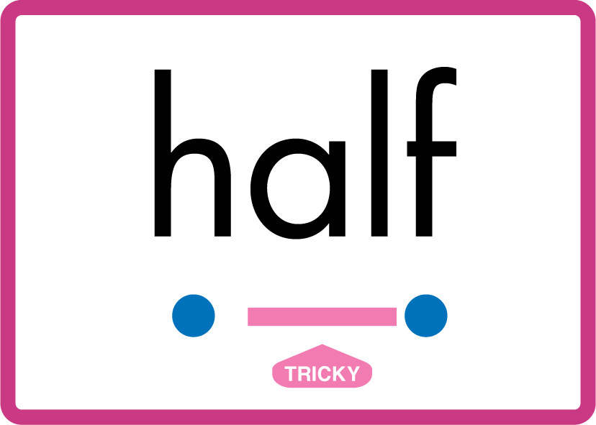

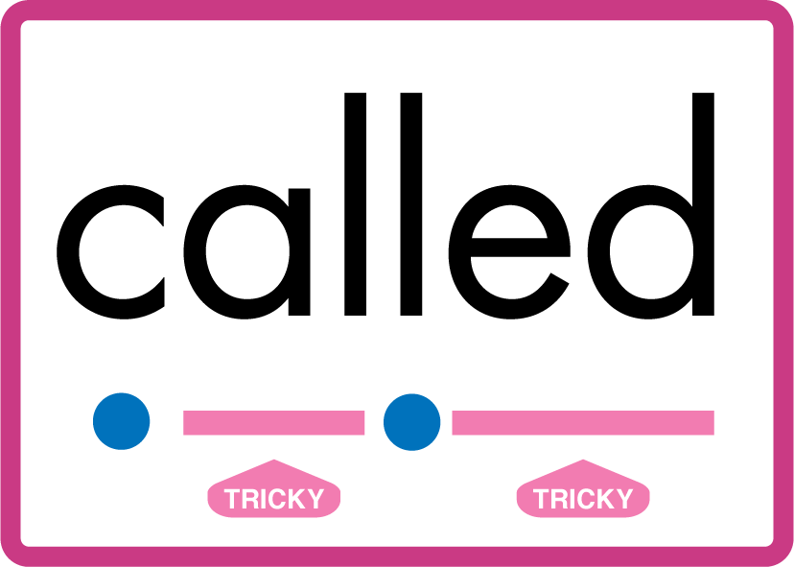








…many friend very busy pretty once please asked bath path fast class after half laughed called water your door poor floor before work worked…

Slide 13
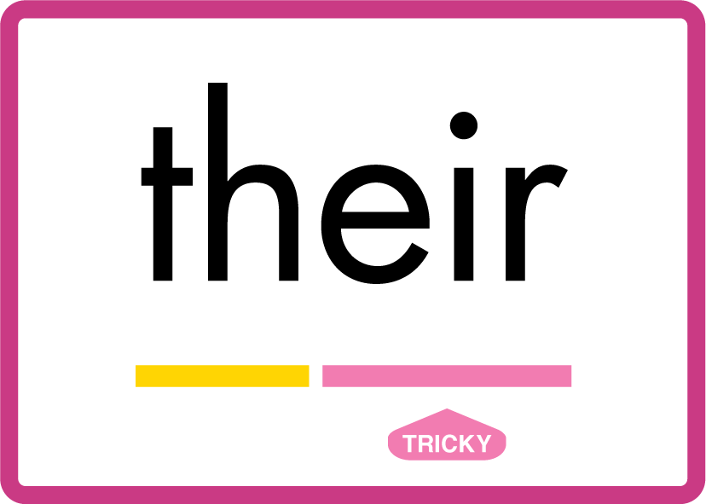

…their parents.

Slide 14
Review Grapheme Caption
hear
year
beard
Phase 3, Lesson 51
USING JNL686
FRONT

Slide 15

Explain Decoding

Slide 16
Model Blending Phonemes
h
ear
USING SOUND BUTTONS
Sound Buttons
Vowel
Consonant
Consonant Digraph
Multi Sound
Long Vowel Sound
R-controlled Digraph
Split Digraph
Syllable / Silent Letter

Slide 17
Model Blending Phonemes
y
ear
USING SOUND BUTTONS
Sound Buttons
Vowel
Consonant
Consonant Digraph
Multi Sound
Long Vowel Sound
R-controlled Digraph
Split Digraph
Syllable / Silent Letter

Slide 18

Explain Encoding

Slide 19
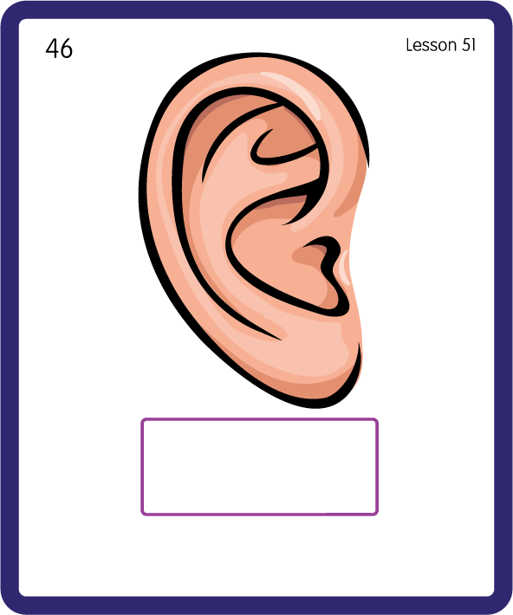
Build a Decodable Word
USING JNL689
BACK

Slide 20
Build a Decodable Word
USING JNL689
FRONT

Slide 21

Practise with Alien Words
USING JNL692
BACK

Slide 22
Practise with Alien Words
USING JNL692
FRONT

Slide 23
Practise Common Exception Words
USING JNL687
FRONT

Slide 24
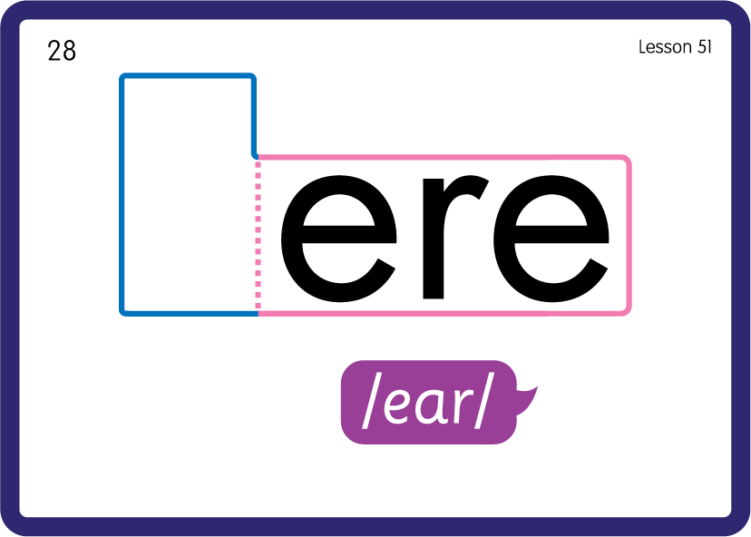
Practise Common Exception Words
USING JNL687
BACK

Slide 25

Practise Building Words
PRACTISE – 10MINS
t
d
f
h
n
g
y
r
ear
c
l
s
m
p
USING MAGNETIC LETTERS AND A WHITEBOARD
LAYOUT A

Slide 26
Practise Building Words
PRACTISE – 10MINS
t
d
f
h
n
g
y
r
ear
c
l
s
m
p
tear dear fear hear near gear year rear clear smear spear
USING MAGNETIC LETTERS AND A WHITEBOARD
LAYOUT A

