Slide 1


/ai/ | /ee/ | /igh/ | /oa/ | /oo/ | /y-oo/ | /r/
/n/ | /m/ | /ch/ | /k/ | /sh/ | /j/ | /v/
/u/ | /e/ | /i/ | /s/ | /zh/ | /z/ | /ar/
/or/ | /ur/ | /air/ | /ear/
Sound Family /ear/; eer
Lesson 87

Slide 2
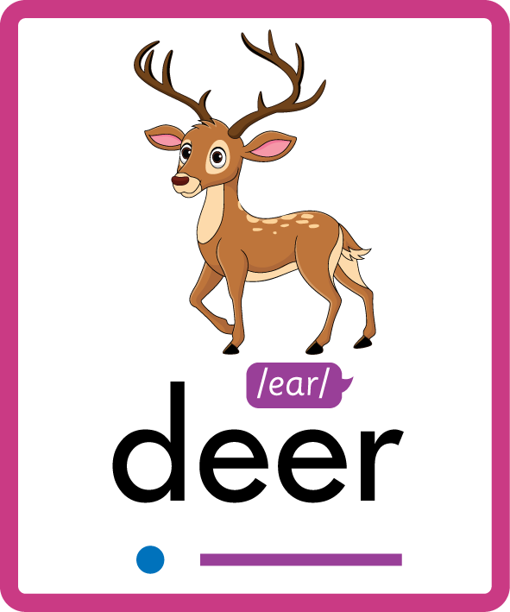
Learn and practise /ear/ sound family spelling patterns.
Recall all GPCs learned so far using flashcards.
Grapheme to Phoneme Cards
Phoneme Frame Cards
JNL686
JNL689

Slide 3























Recall all GPCs learned so far using flashcards.

Slide 4




























Recall all GPCs learned so far using flashcards.

Slide 5









































Recall all GPCs learned so far using flashcards.

Slide 6















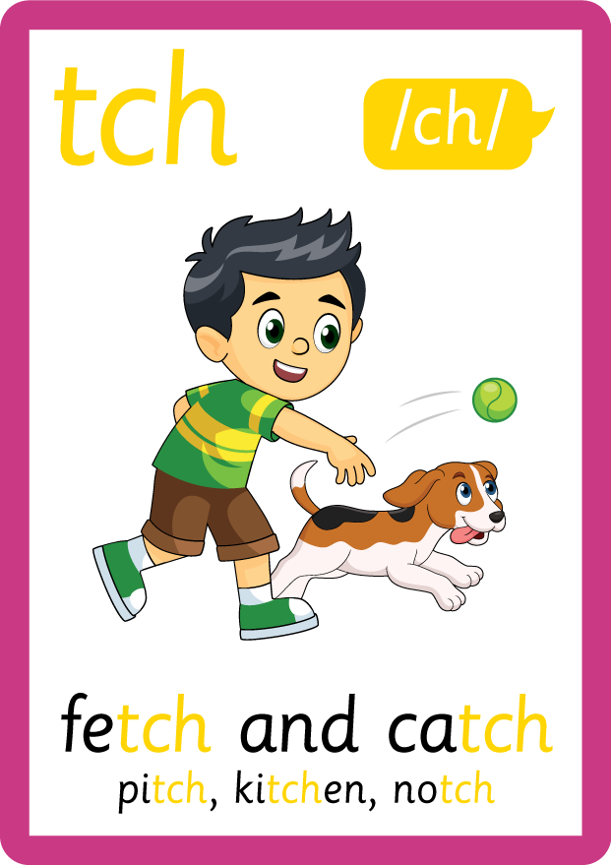
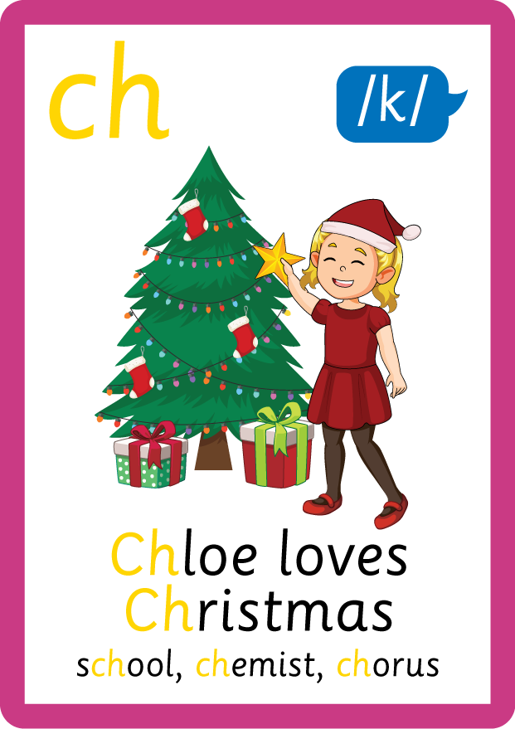

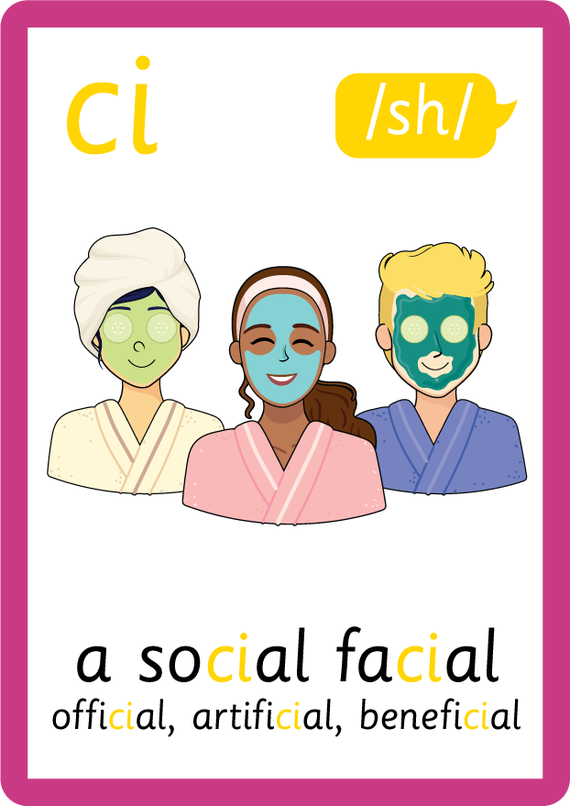





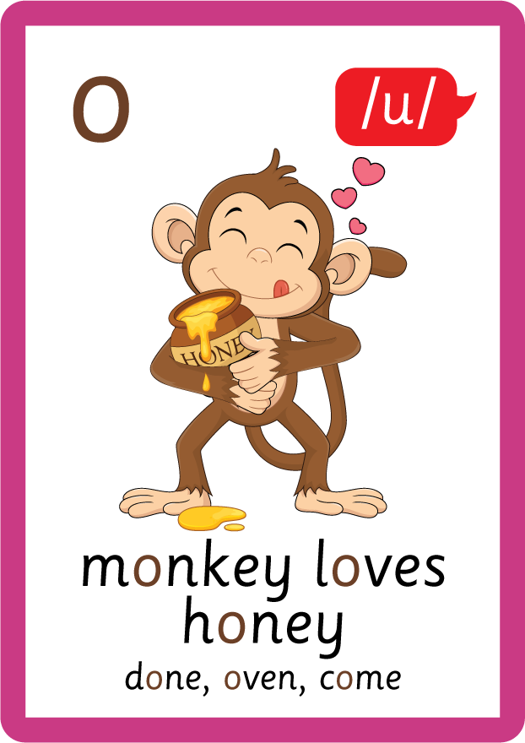






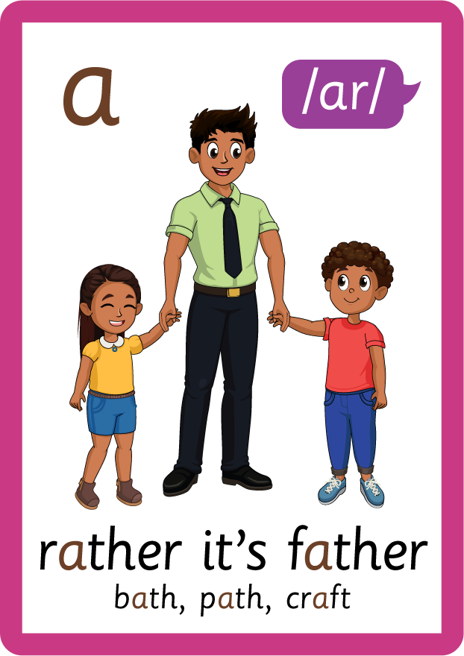


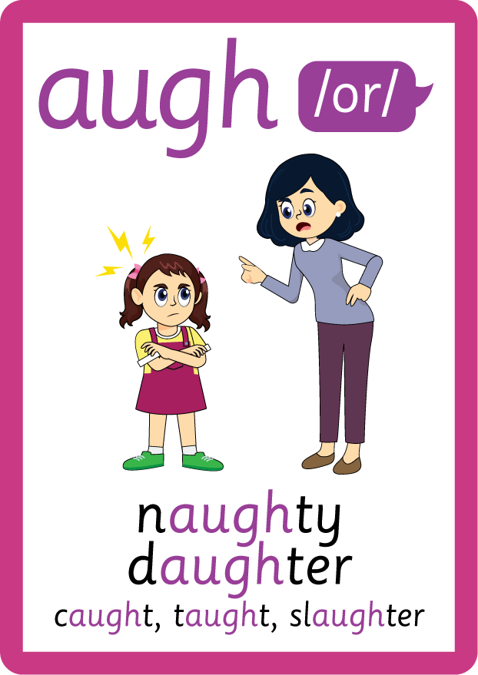





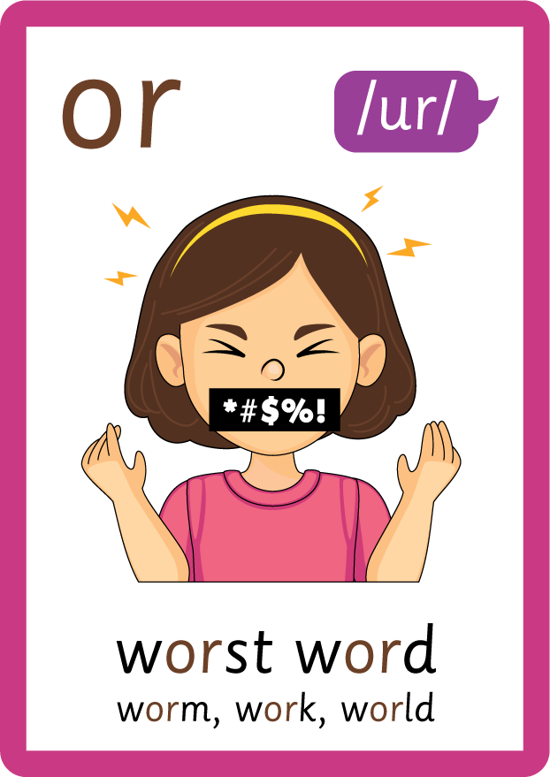


Recall all GPCs learned so far using flashcards.

Slide 7














Review Phase 2 Common Exception Words as I is no go to into the put his has of pull full.

Slide 8




























Review Phase 3 Common Exception Words push they me we be he she my by looked you are there here were all sure.

Slide 9













Review Phase 4 Common Exception Words said like out have some come what was so old do little one.

Slide 10














Review Phase 5 Common Exception Words today house mouse hour because Mr Mrs Ms where should could would move use.

Slide 11



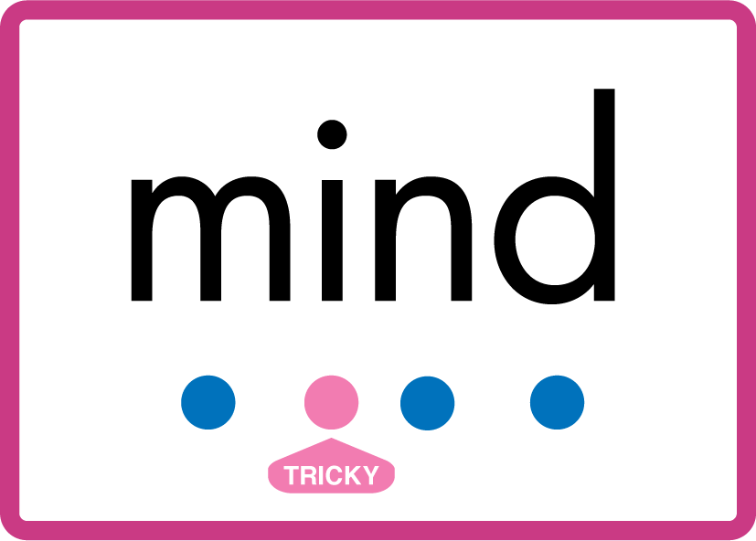











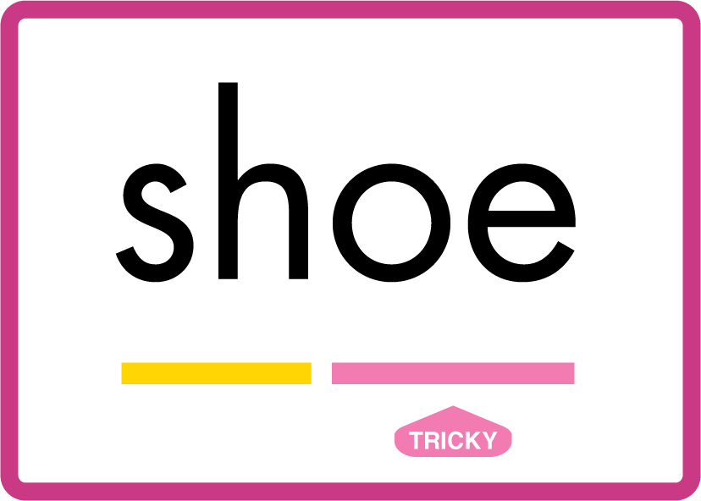






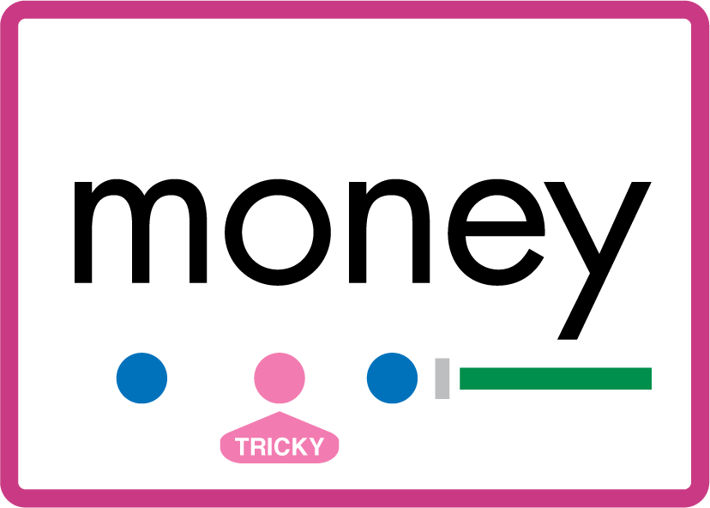

Review Phase 5.5 Common Exception Words people wild child mind kind behind eye oh most only both though through who prove shoe beautiful climb Christmas school sugar love money any…

Slide 12
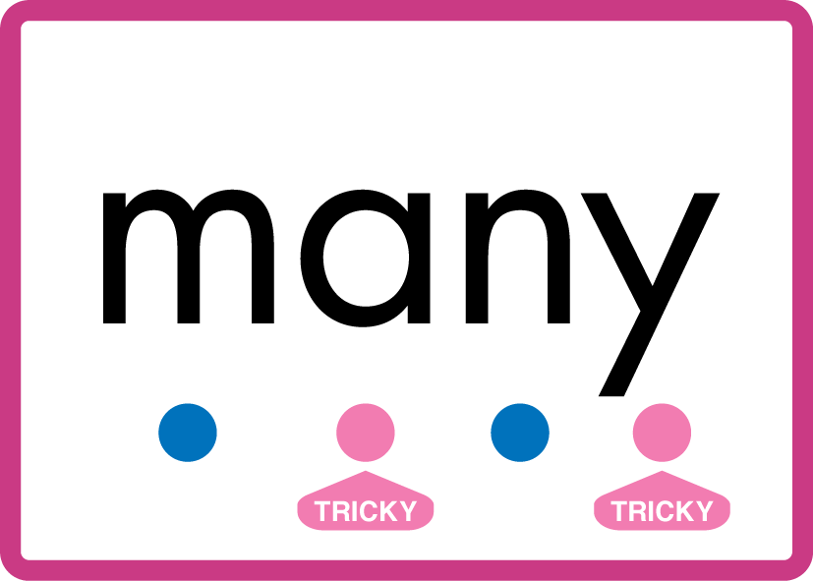


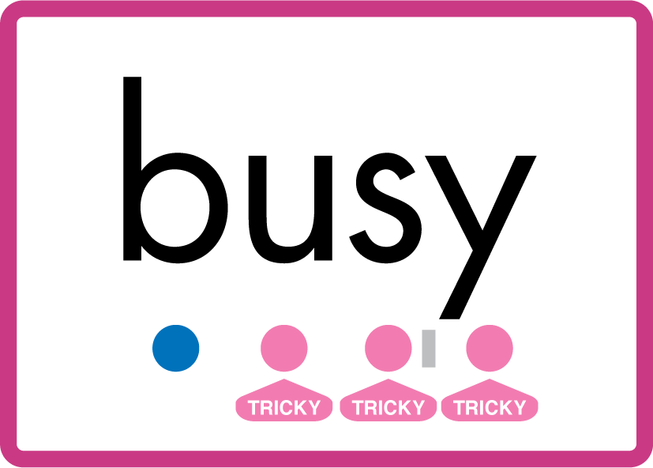
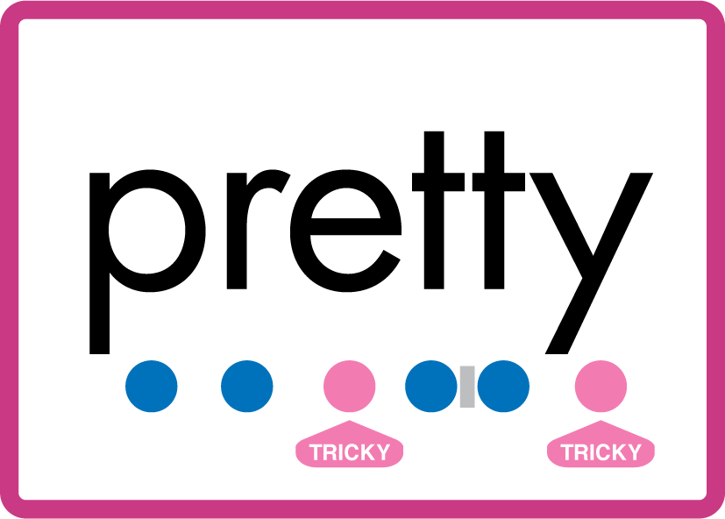





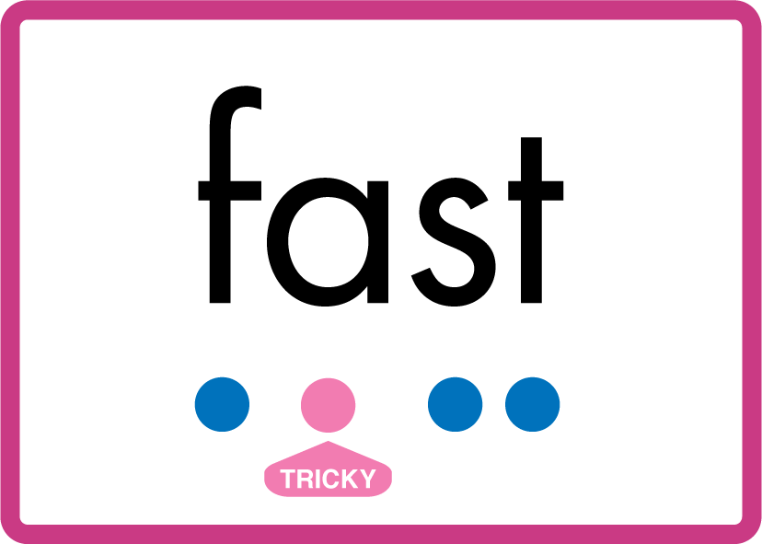


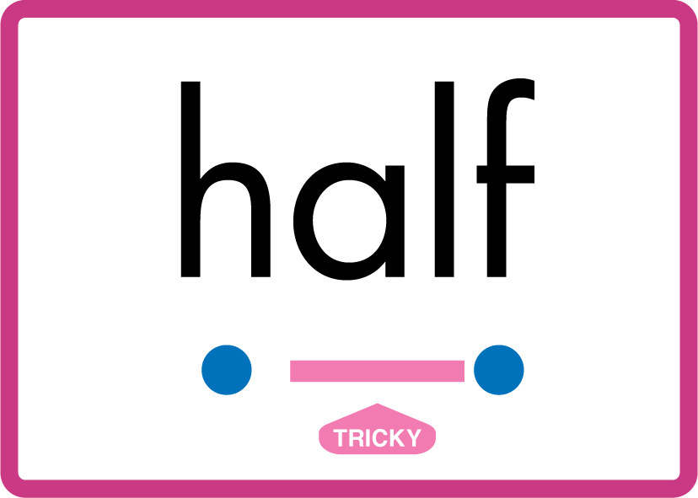

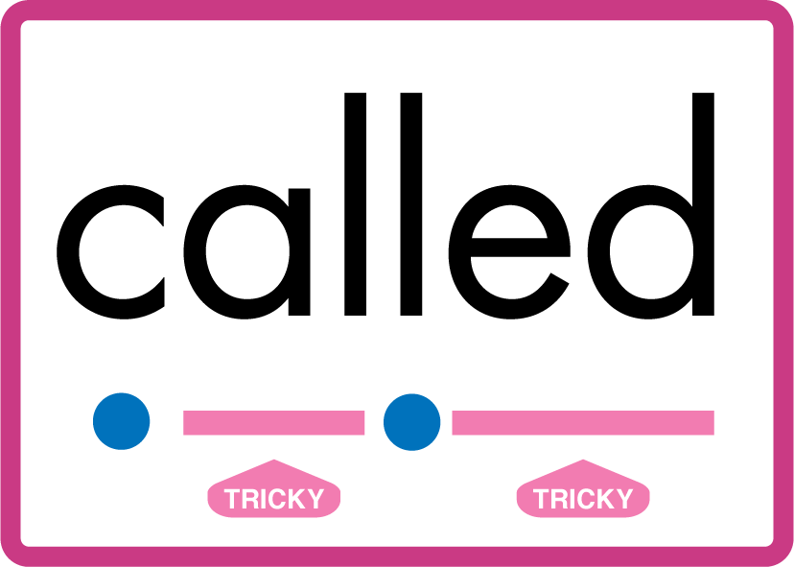

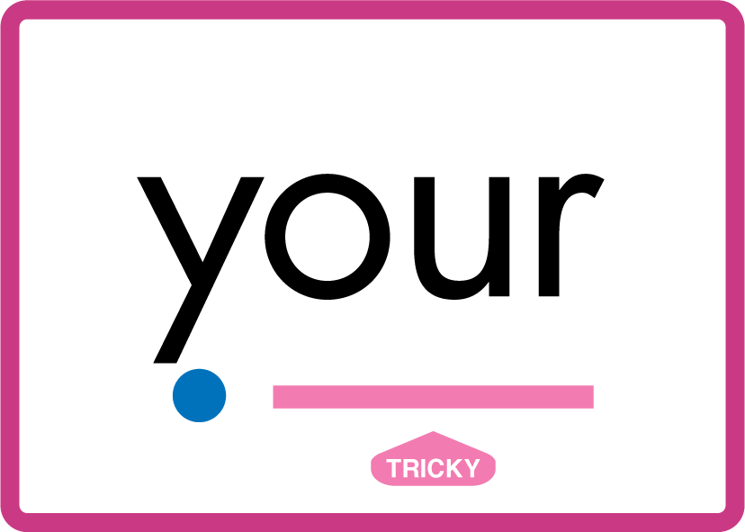


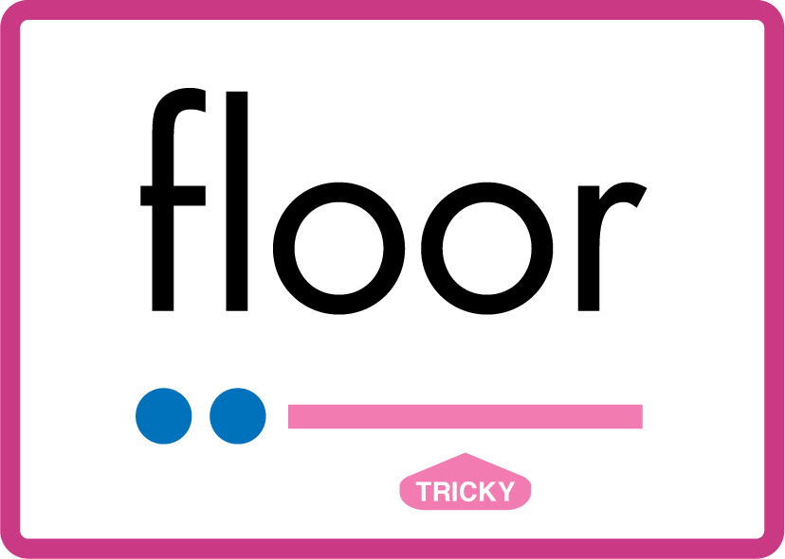


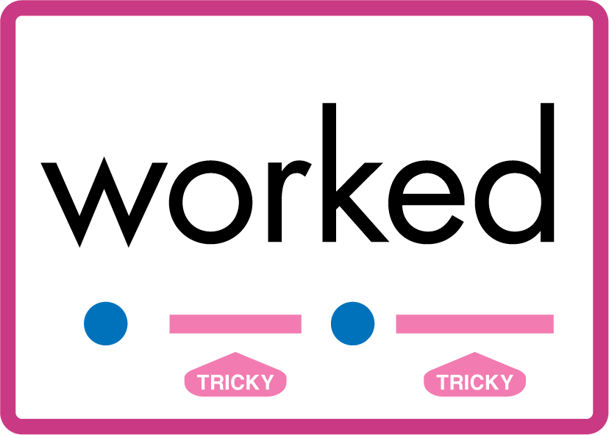
…many friend very busy pretty once please asked bath path fast class after half laughed called water your door poor floor before work worked…

Slide 13
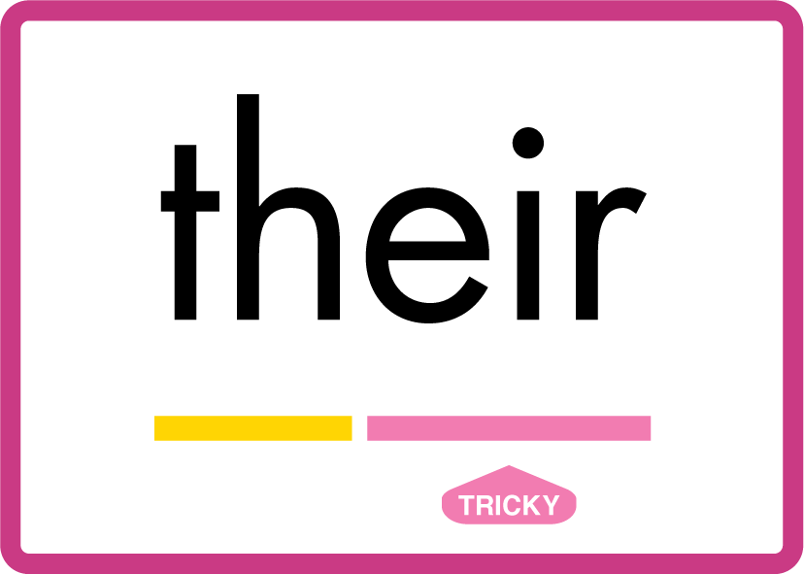

…their parents.

Slide 14
Review Grapheme Caption
hear
year
beard
Phase 3, Lesson 51
USING JNL686
FRONT

Slide 15
Teach Grapheme Caption
career
engineer
deer
Phase 5.5, Lesson 82
USING JNL686
FRONT

Slide 16

Explain Decoding

Slide 17
Model Blending Phonemes
p
eer
USING SOUND BUTTONS
Sound Buttons
Vowel
Consonant
Consonant Digraph
Multi Sound
Long Vowel Sound
R-controlled Digraph
Split Digraph
Syllable / Silent Letter

Slide 18
Model Blending Phonemes
s
t
eer
USING SOUND BUTTONS
Sound Buttons
Vowel
Consonant
Consonant Digraph
Multi Sound
Long Vowel Sound
R-controlled Digraph
Split Digraph
Syllable / Silent Letter

Slide 19

Explain Encoding

Slide 20
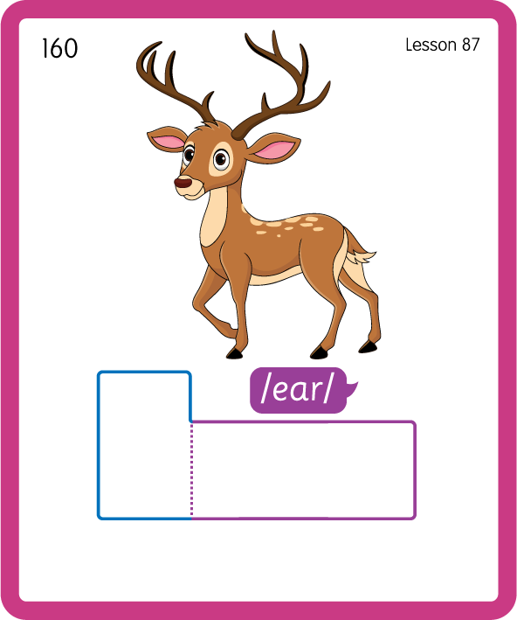
Build a Decodable Word
USING JNL689
BACK

Slide 21
Build a Decodable Word
USING JNL689
FRONT

Slide 22

Practise Building Words
PRACTISE – 10MINS
ch
eer
p
s
t
c
a
r
sh
d
i
o
n
USING MAGNETIC LETTERS AND A WHITEBOARD
LAYOUT A

Slide 23
Practise Building Words
PRACTISE – 10MINS
ch
eer
p
s
t
c
a
r
sh
d
i
o
n
cheer peer steer career sheer deer pioneer
USING MAGNETIC LETTERS AND A WHITEBOARD
LAYOUT A

