Slide 1

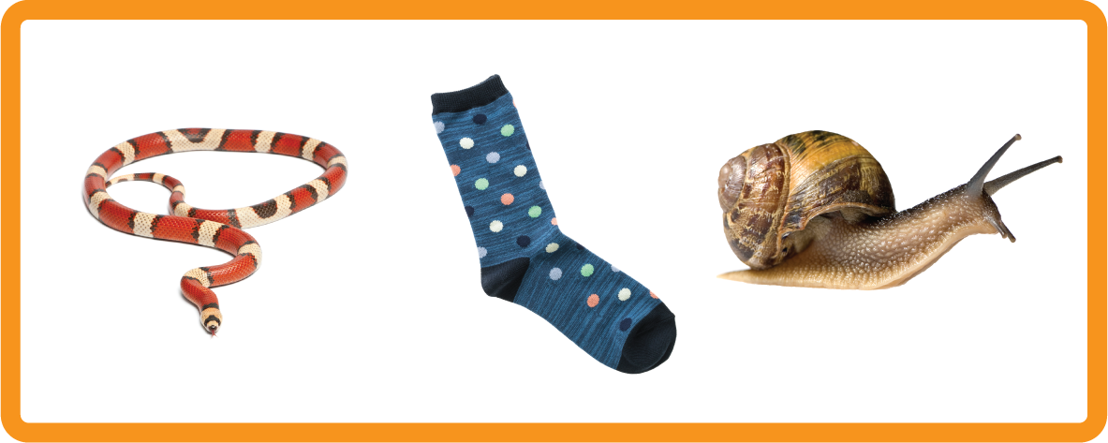
s | a | t | p | i | n | m | d
g | o | c | k | ck | e | u | r
h | b | f | ff | l | ll | ss
Letter Sound 's’
Lesson 1

Slide 2
Learn and practise letter / sound s.
N/A
Phonemic Awareness Cards
Grapheme to Phoneme Cards
JNL691
JNL686

Slide 3

Teach the Alphabet Song
a, b, c, d, e, f, g (pause)
h, i, j, k, l, m, n (pause)
o, p, q (pause) r, s, t (pause)
u v w (pause) x y z (pause)
Now I know my abc's, Next time won't you sing with me.
Notes:
Daily practise of the Alphabet Song is beneficial at the beginning of the school year to help build quick letter recognition and letter sound awareness.

Slide 4
Hear Phonemes
USING JNL691
FRONT

Slide 5
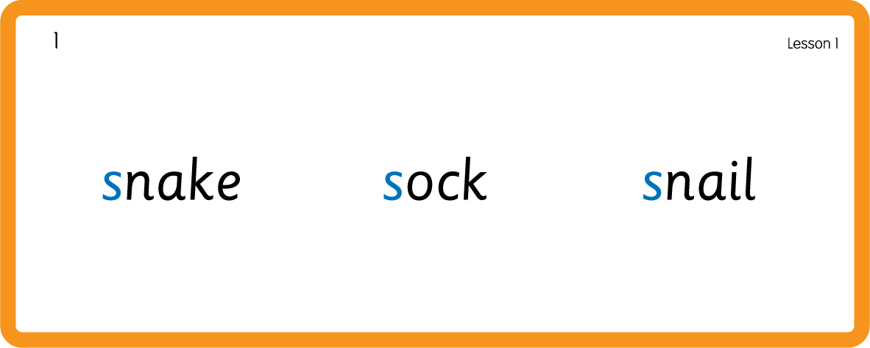
Hear Phonemes
USING JNL691
BACK

Slide 6
Teach Grapheme Caption
USING JNL686
FRONT

Slide 7
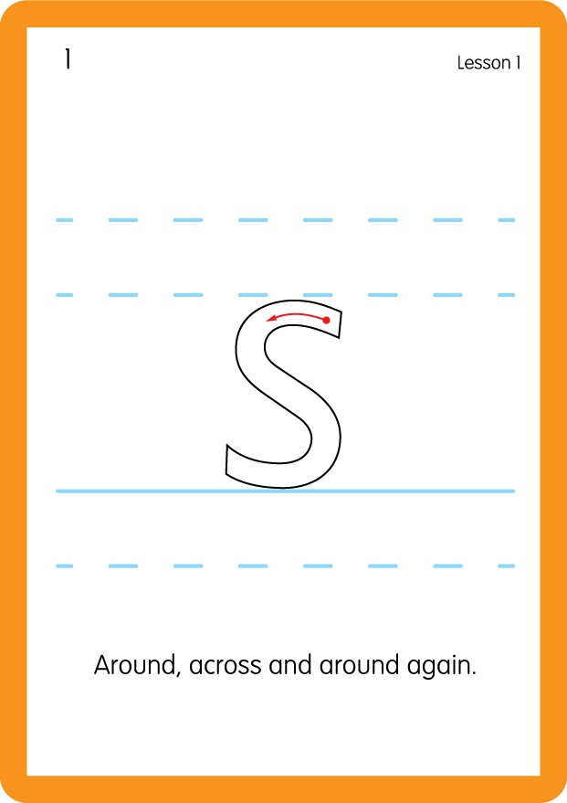
Teach Lowercase Formation
USING JNL686
BACK

Slide 8
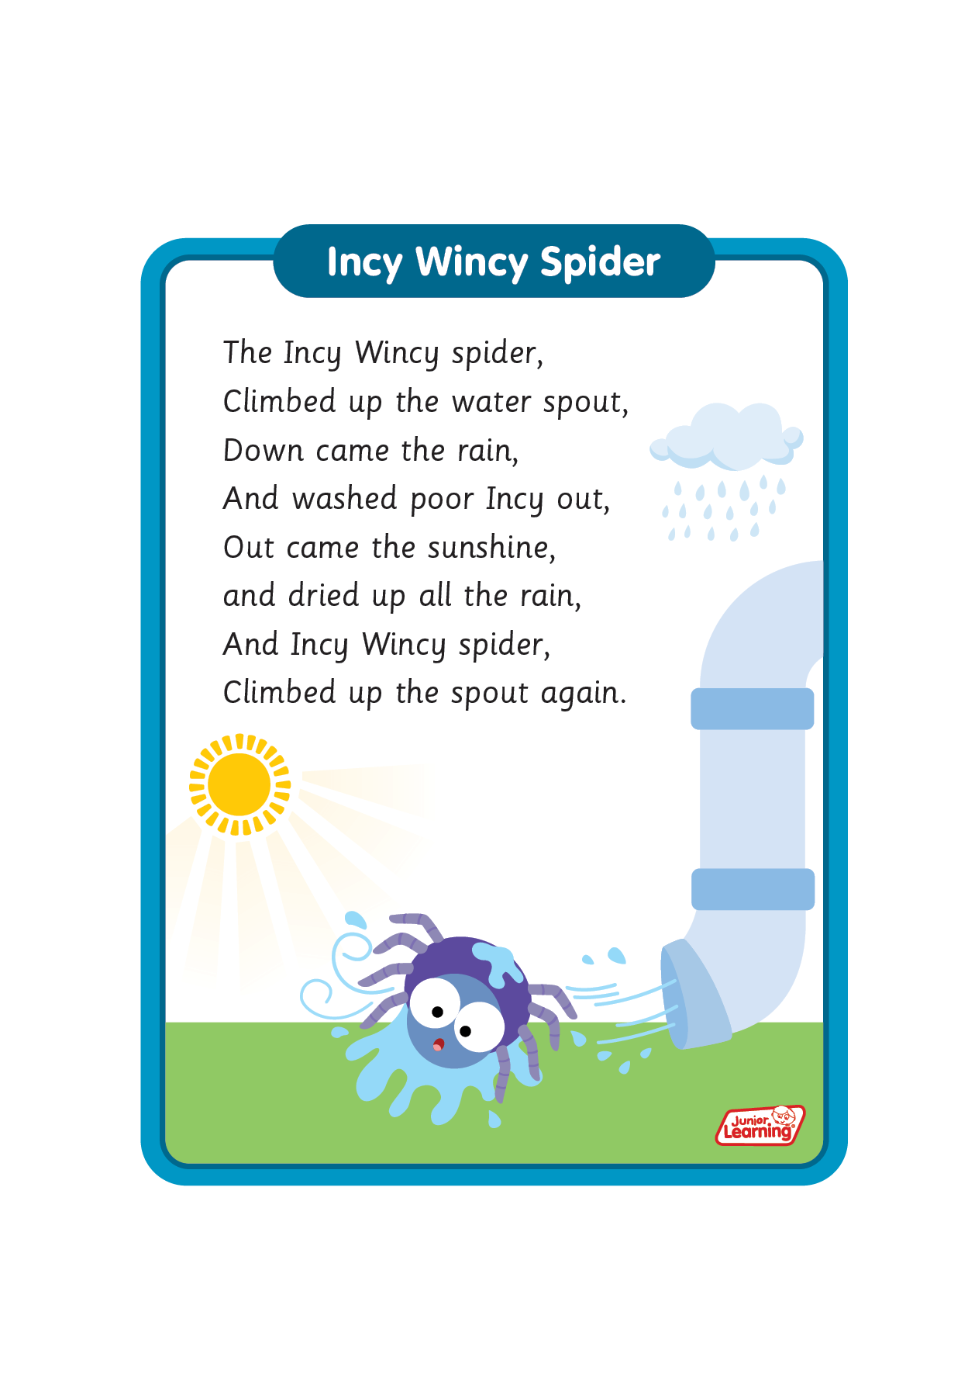
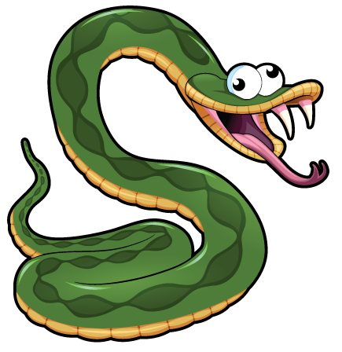
Sing ‘Incy Wincy Spider’.
Draw ‘s’ in a variety of sizes and media, for example using chalk to draw on the ground.
Make grapheme with playdough.
Make coil paper snakes.
s

