Slide 1




s | a | t | p | i | n | m | d
g | o | c | k | ck | e | u | r
h | b | f | ff | l | ll | ss
Review i n m d
Lesson 10

Slide 2


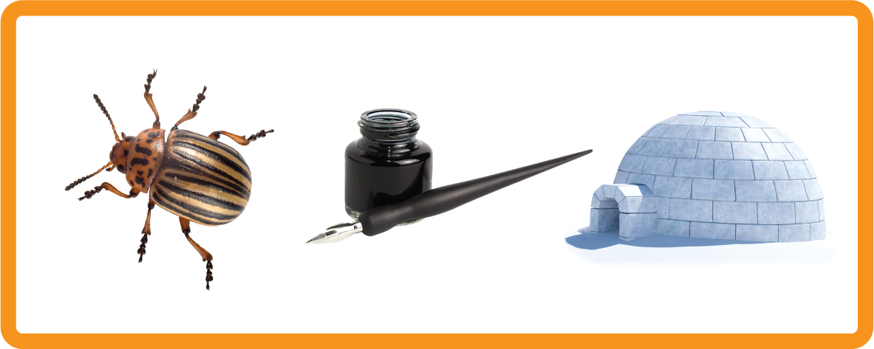


Learn and practise letter / sounds i n m d.
Recall s a t p i n m d using flashcards.
Phonemic Awareness Cards
Grapheme to Phoneme Cards
Phoneme Frame Cards
Alien Word Cards
Common Exception Word Cards
High Frequency Word Cards
JNL691
JNL686
JNL689
JNL692
JNL687
JNL688

Slide 3




Recall s a t p i n m d using flashcards.

Slide 4

Review the Alphabet Song
a, b, c, d, e, f, g (pause)
h, i, j, k, l, m, n (pause)
o, p, q (pause) r, s, t (pause)
u v w (pause) x y z (pause)
Now I know my abc's, Next time won't you sing with me.

Slide 5


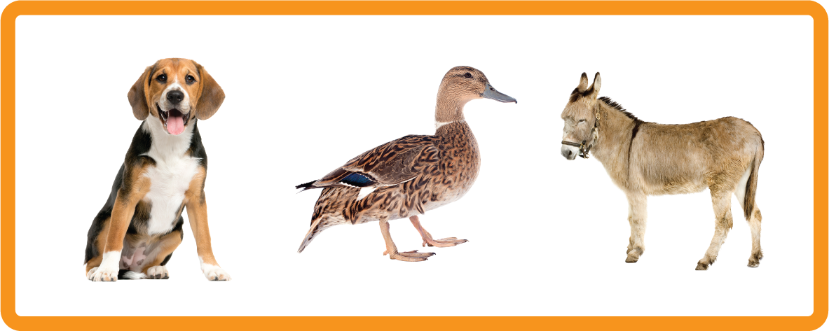
Hear Phonemes
USING JNL691
FRONT

Slide 6
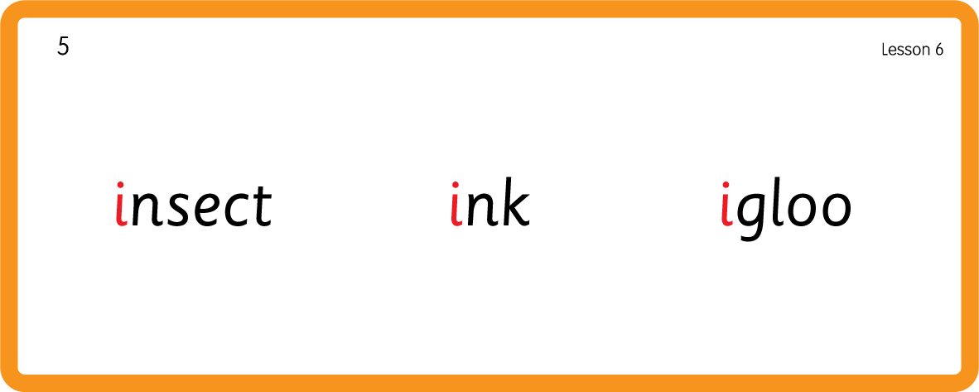
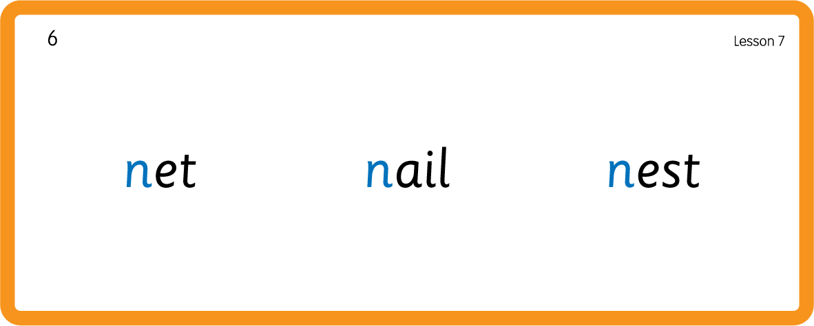
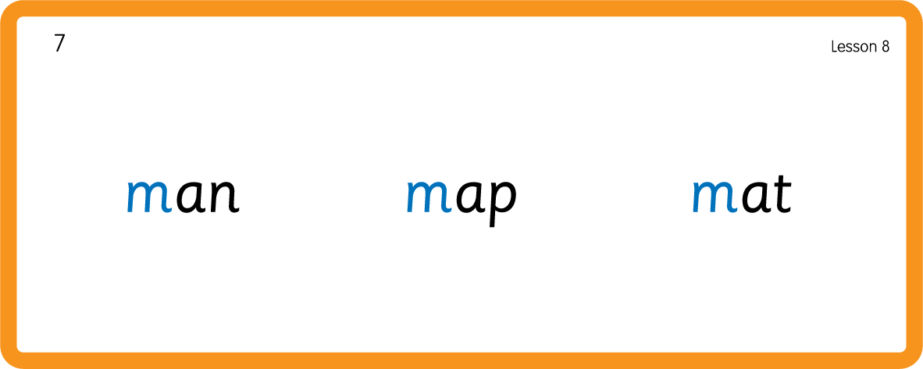
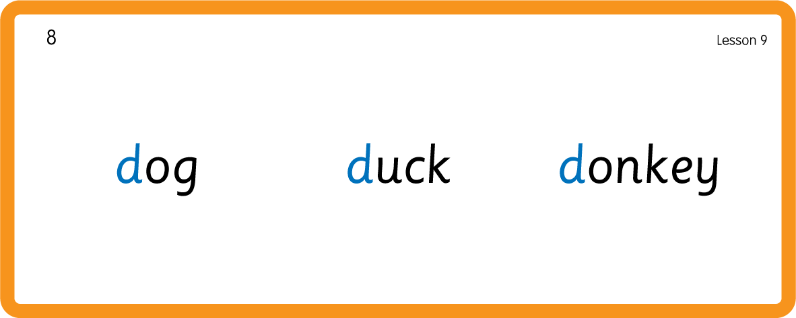
Hear Phonemes
USING JNL691
BACK

Slide 7
Review Grapheme Caption
USING JNL686
FRONT

Slide 8
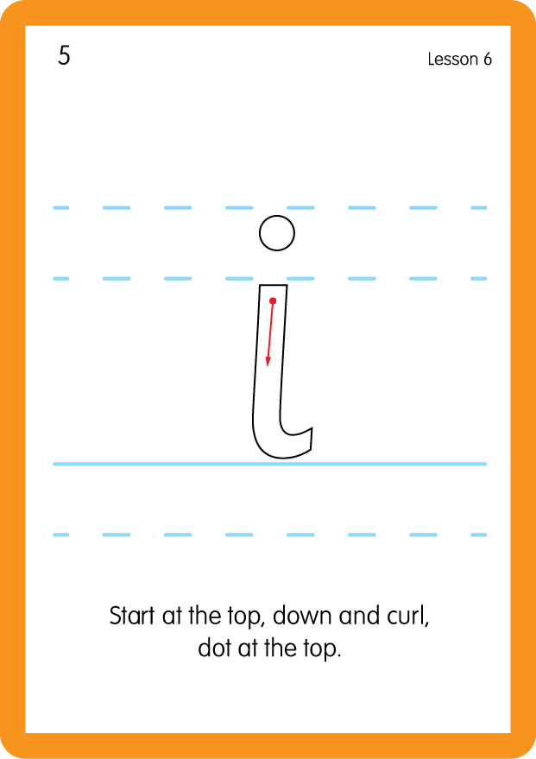
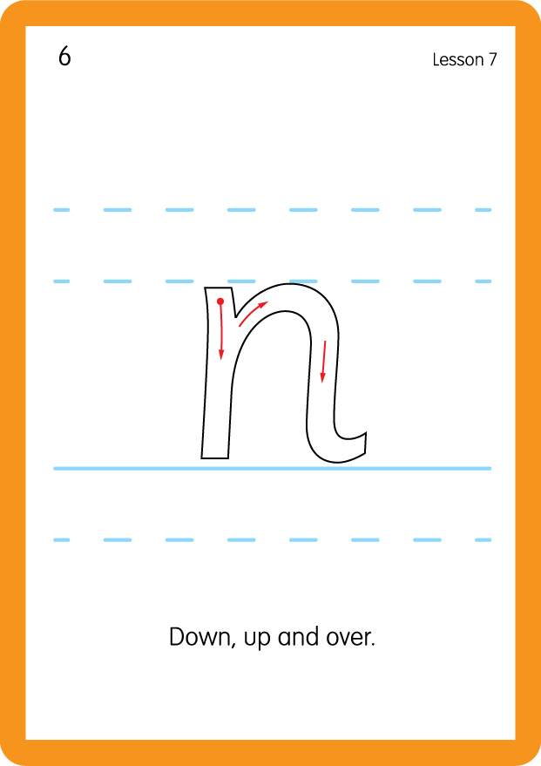
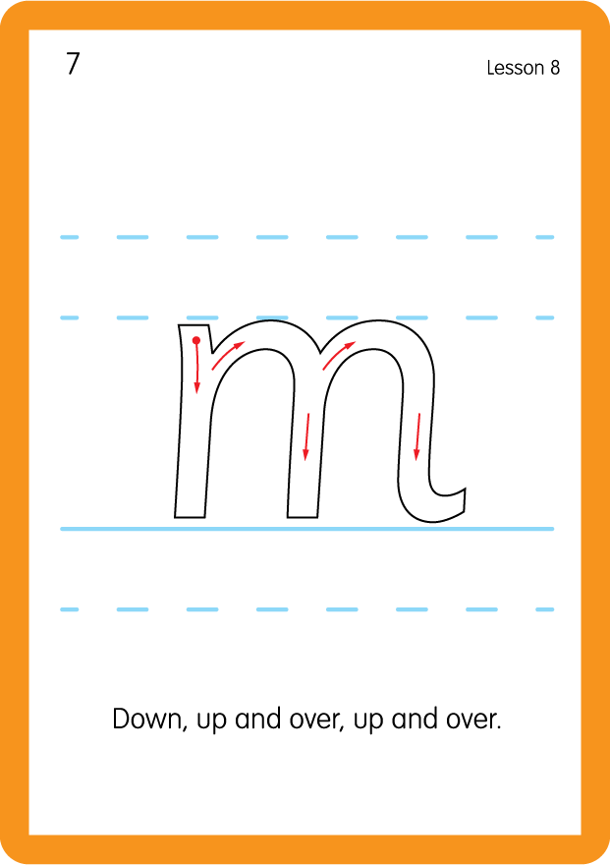
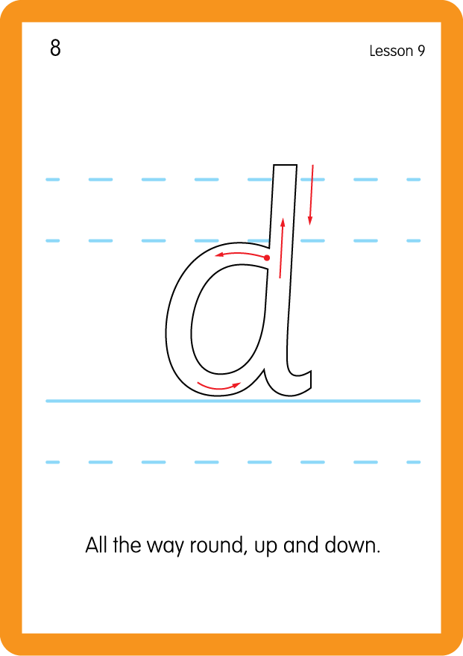
Review Lowercase Formation
USING JNL686
BACK

Slide 9

Explain Decoding

Slide 10
Model Blending Phonemes
s
a
t
USING SOUND BUTTONS
Sound Buttons
Vowel
Consonant
Consonant Digraph
Long Vowel Sound
R-controlled Digraph
Split Digraph
Syllable / Silent Letter

Slide 11
Model Blending Phonemes
t
a
p
USING SOUND BUTTONS
Sound Buttons
Vowel
Consonant
Consonant Digraph
Long Vowel Sound
R-controlled Digraph
Split Digraph
Syllable / Silent Letter

Slide 12
Model Blending Phonemes
p
a
t
USING SOUND BUTTONS
Sound Buttons
Vowel
Consonant
Consonant Digraph
Long Vowel Sound
R-controlled Digraph
Split Digraph
Syllable / Silent Letter

Slide 13

Explain Encoding

Slide 14
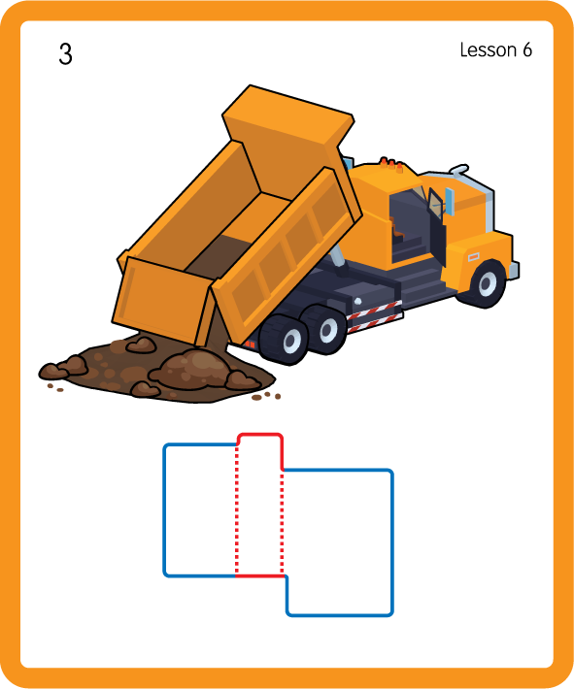
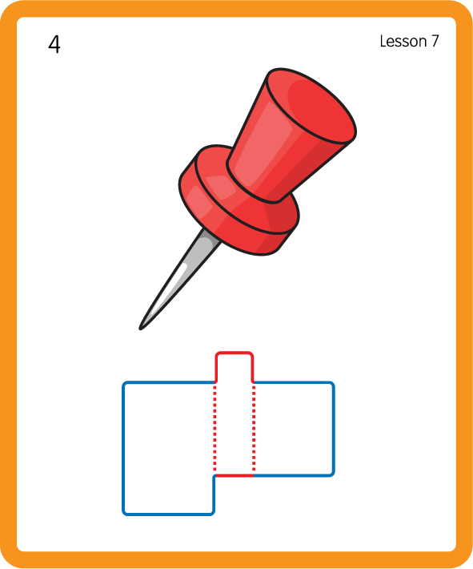
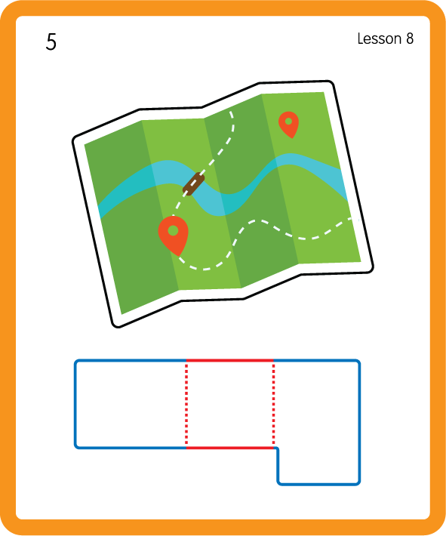
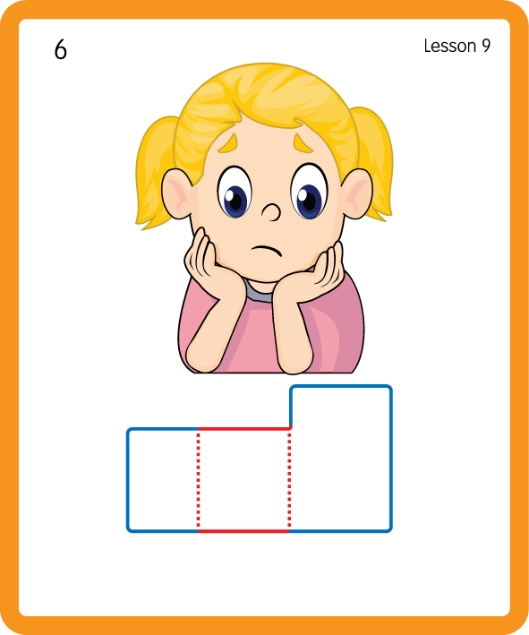
Build a Decodable Word
USING JNL689
BACK

Slide 15



Build a Decodable Word
USING JNL689
FRONT

Slide 16
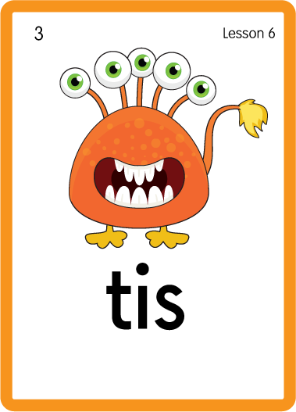
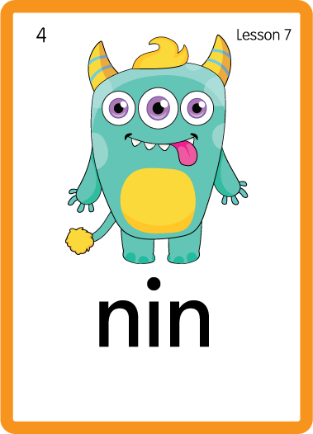
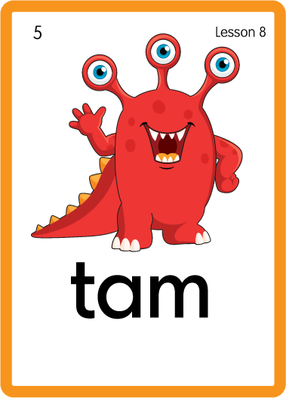
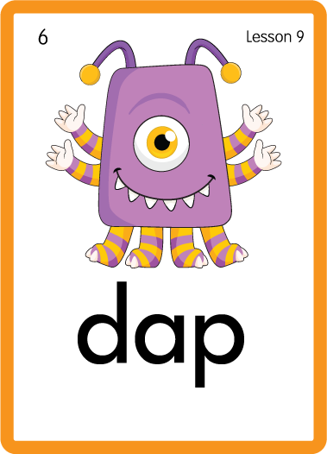
Practise with Alien Words
USING JNL692
BACK

Slide 17
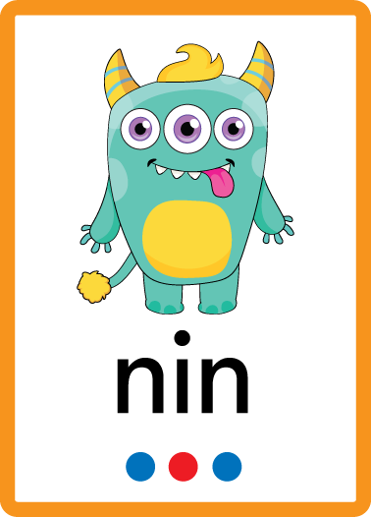


Practise with Alien Words
USING JNL692
FRONT

Slide 18

Practise Common Exception Words
USING JNL687
FRONT

Slide 19
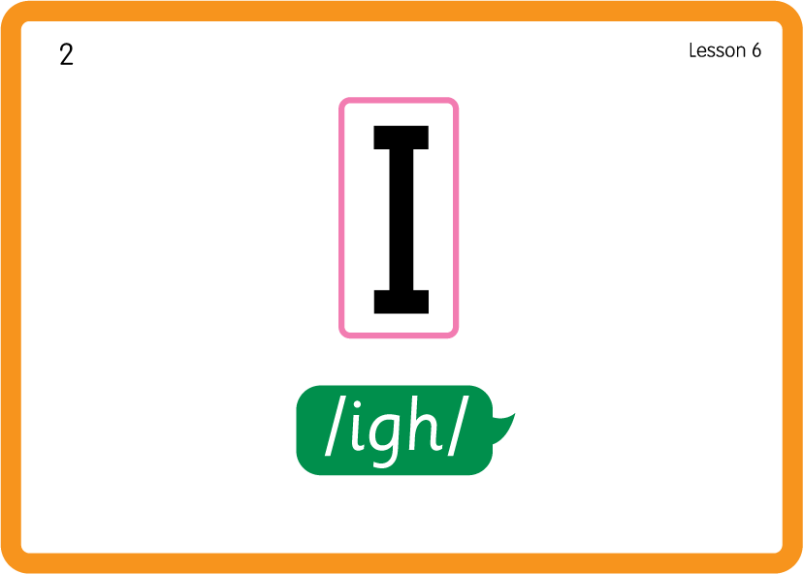
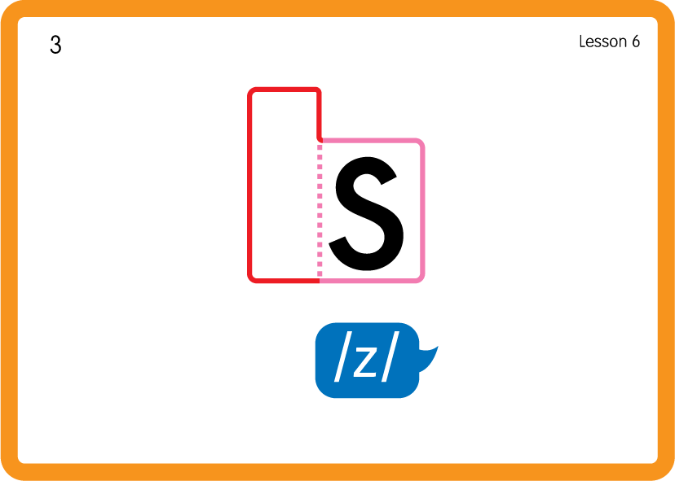
Practise Common Exception Words
USING JNL687
BACK

Slide 20






Practise High Frequency Words
USING JNL688
FRONT

Slide 21
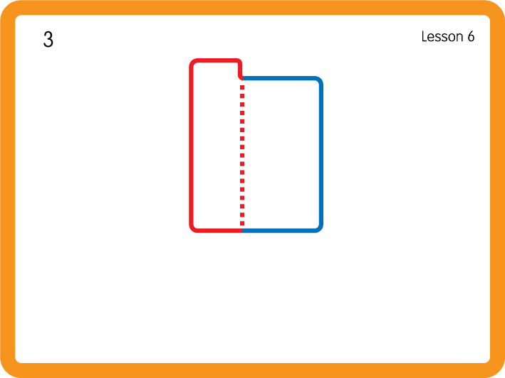
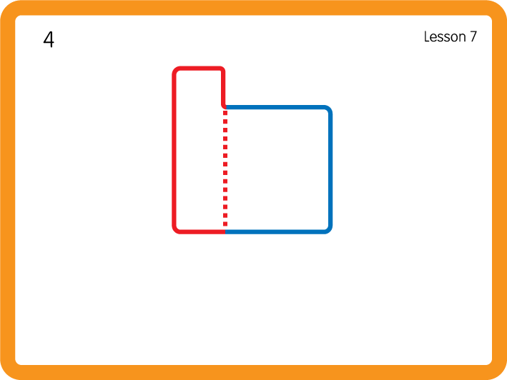
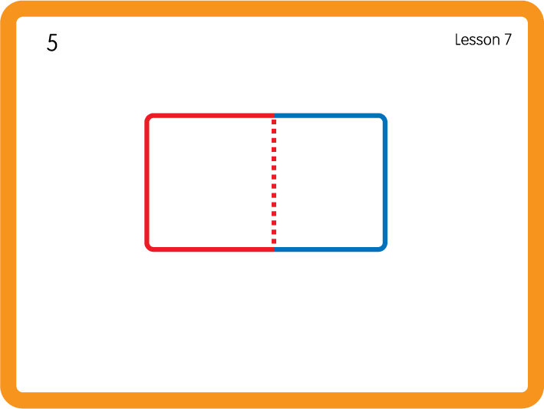
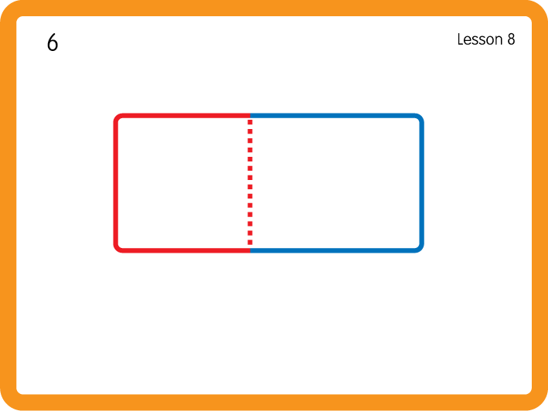
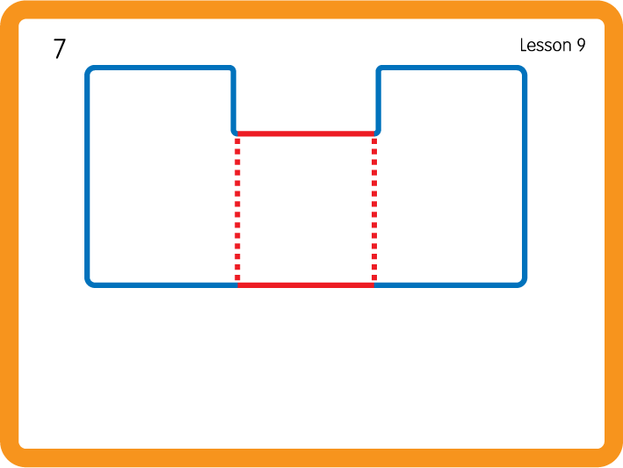
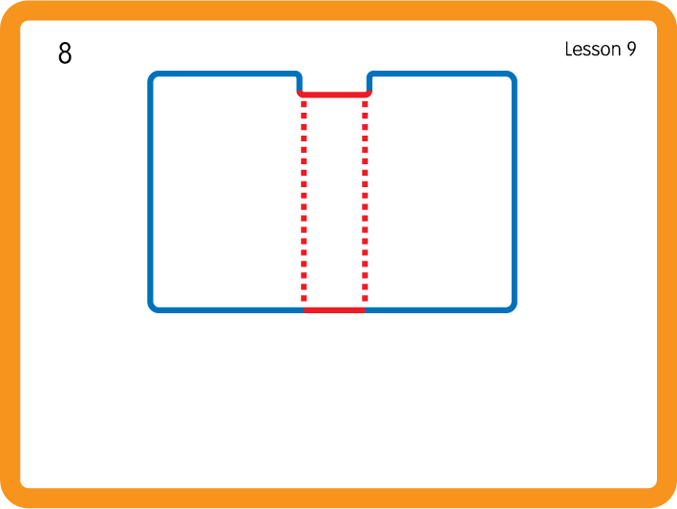
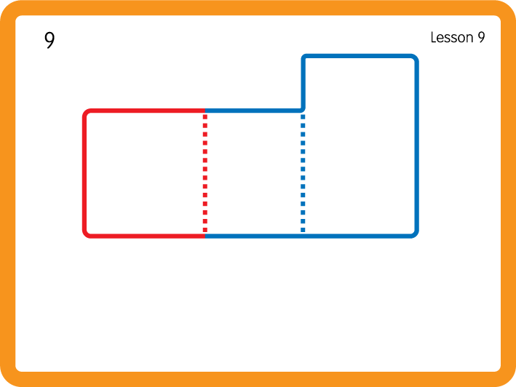
Practise High Frequency Words
USING JNL688
BACK

Slide 22

Practise Building Words
PRACTISE – 10MINS
s
a
t
p
USING A PHONEME FRAME

Slide 23
Practise Building Words
PRACTISE – 10MINS
s
a
t
p
sat tap pat
USING A PHONEME FRAME

Slide 24


m
i
Sorting with Feely bags - i n m d; Have children sort objects beginning with the letter sounds into the correct bags.

Slide 25
