Slide 1



s | a | t | p | i | n | m | d
g | o | c | k | ck | e | u | r
h | b | f | ff | l | ll | ss
Letter Sound 'g'
Lesson 11

Slide 2
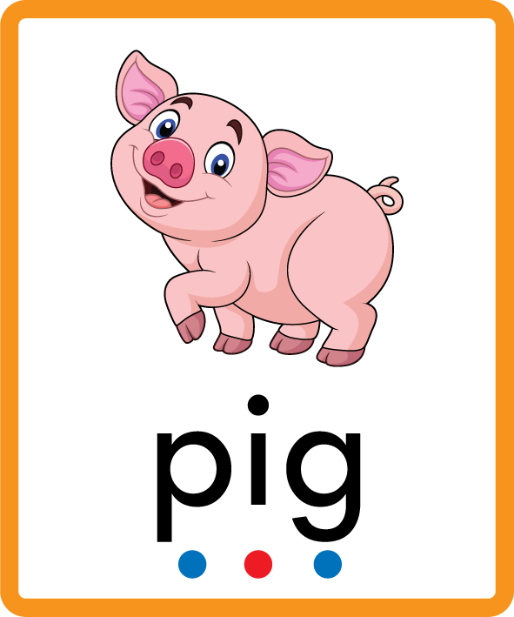
Learn and practise letter / sound g.
Recall s a t p i n m d using flashcards.
Phonemic Awareness Cards
Grapheme to Phoneme Cards
Phoneme Frame Cards
Alien Word Cards
JNL691
JNL686
JNL689
JNL692

Slide 3








Recall s a t p i n m d using flashcards.

Slide 4

Review the Alphabet Song
a, b, c, d, e, f, g (pause)
h, i, j, k, l, m, n (pause)
o, p, q (pause) r, s, t (pause)
u v w (pause) x y z (pause)
Now I know my abc's, Next time won't you sing with me.

Slide 5
Hear Phonemes
USING JNL691
FRONT

Slide 6
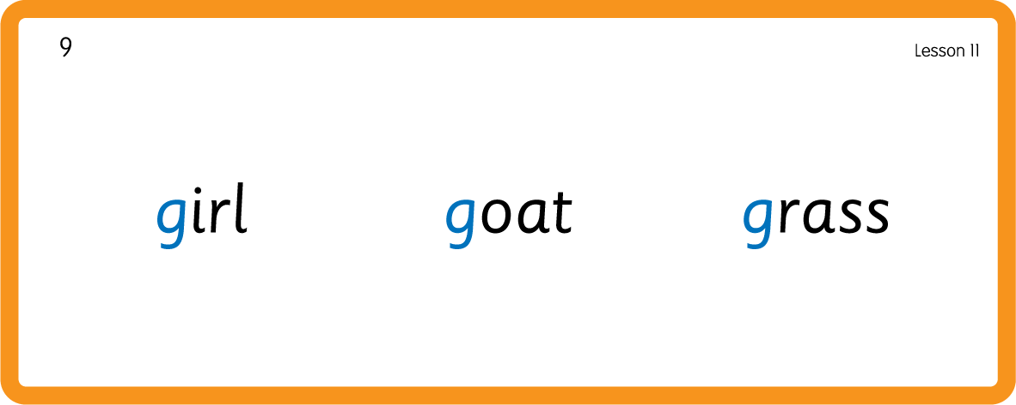
Hear Phonemes
USING JNL691
BACK

Slide 7
Teach Grapheme Caption
USING JNL686
FRONT

Slide 8
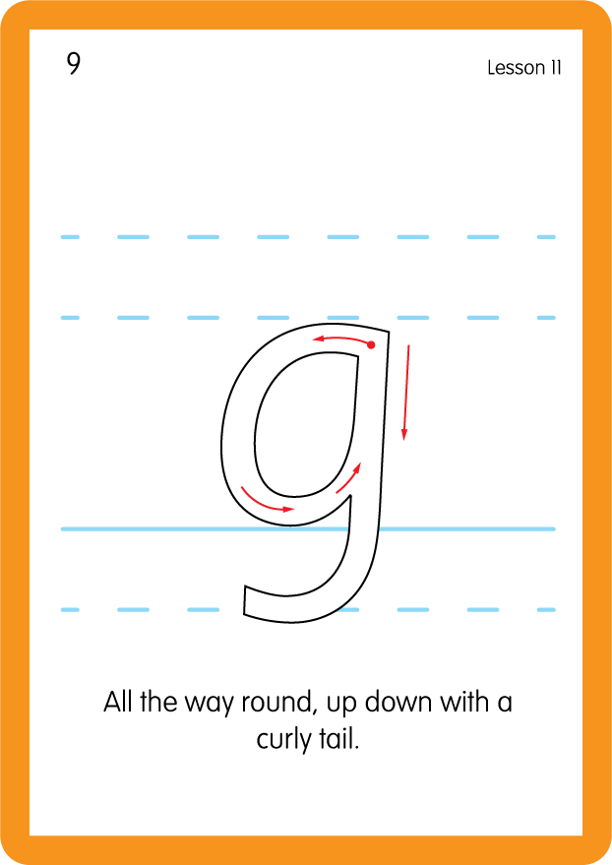
Teach Lowercase Formation
USING JNL686
BACK

Slide 9

Explain Decoding

Slide 10
Model Blending Phonemes
t
a
g
USING SOUND BUTTONS
Sound Buttons
Vowel
Consonant
Consonant Digraph
Long Vowel Sound
R-controlled Digraph
Split Digraph
Syllable / Silent Letter

Slide 11
Model Blending Phonemes
g
a
g
USING SOUND BUTTONS
Sound Buttons
Vowel
Consonant
Consonant Digraph
Long Vowel Sound
R-controlled Digraph
Split Digraph
Syllable / Silent Letter

Slide 12

Explain Encoding

Slide 13
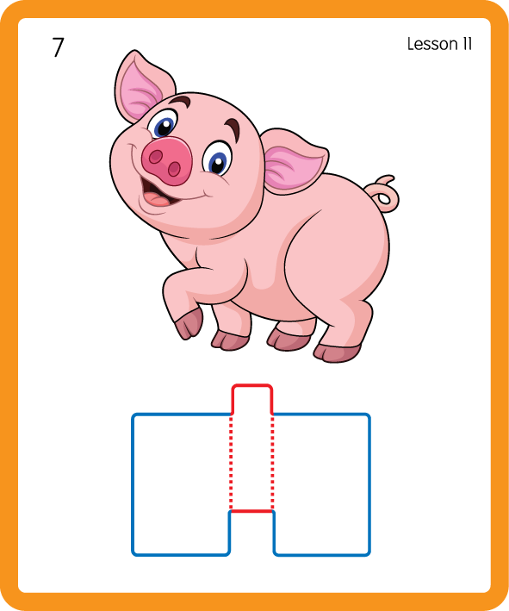
Build a Decodable Word
USING JNL689
BACK

Slide 14
Build a Decodable Word
USING JNL689
FRONT

Slide 15
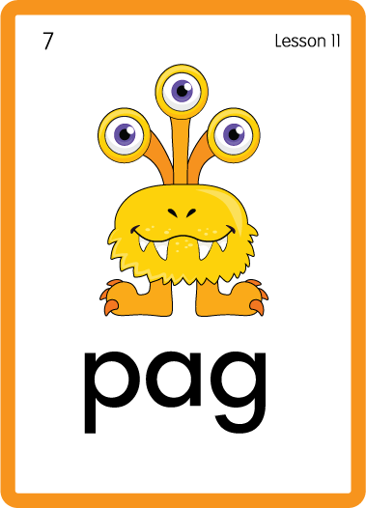
Practise with Alien Words
USING JNL692
BACK

Slide 16
Practise with Alien Words
USING JNL692
FRONT

Slide 17

Practise Building Words
PRACTISE – 10MINS
s
a
t
p
i
n
d
g
USING MAGNETIC LETTERS AND A WHITEBOARD

Slide 18
Practise Building Words
PRACTISE – 10MINS
s
a
t
p
i
n
d
g
gas sag pig dig tag nag gap
USING MAGNETIC LETTERS AND A WHITEBOARD

Slide 19

Sing ‘Goosey, Goosey Gander’.
Draw ‘g’ in a variety of sizes and media, for example using chalk to
draw on the ground.
Make grapheme with playdough.
Explore words in environment for decoding.
Use letters for building words and encoding.
Print letters using ink stamps.
g

