Slide 1
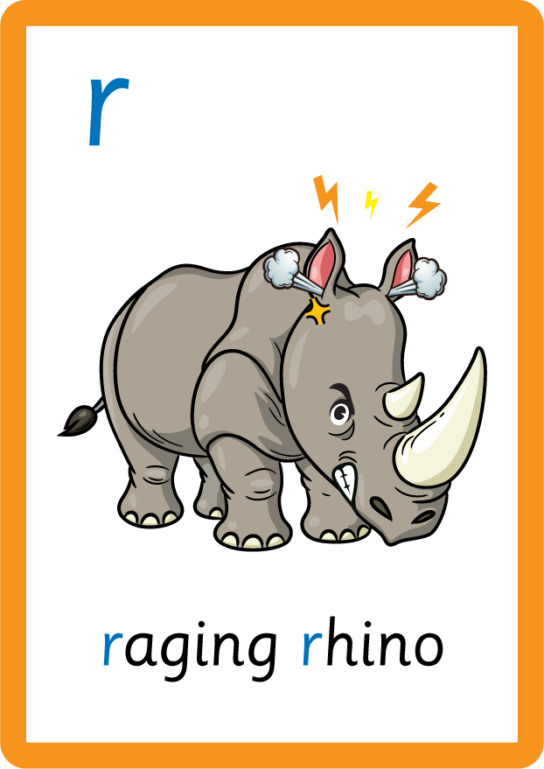
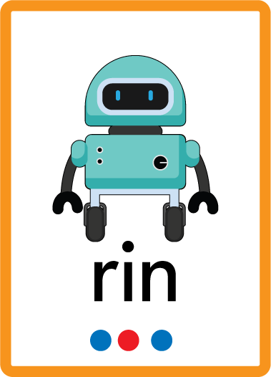
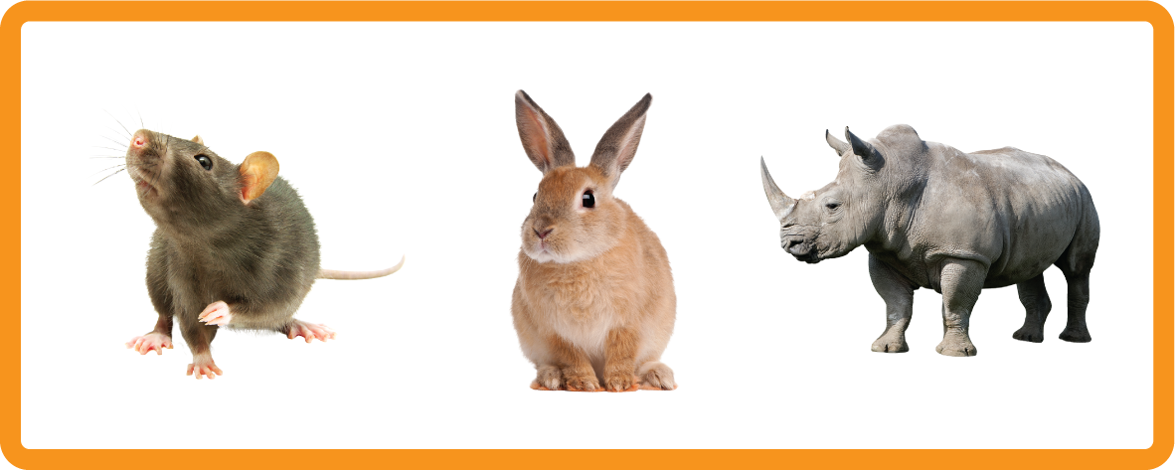
s | a | t | p | i | n | m | d
g | o | c | k | ck | e | u | r
h | b | f | ff | l | ll | ss
Letter Sound 'r'
Lesson 19

Slide 2
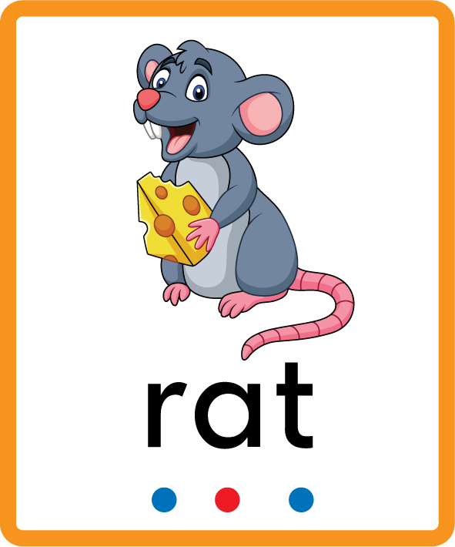
Learn and practise letter / sound r.
Recall s a t p i n m d g o c k ck e u using flashcards.
Phonemic Awareness Cards
Grapheme to Phoneme Cards
Phoneme Frame Cards
Alien Word Cards
JNL691
JNL686
JNL689
JNL692

Slide 3


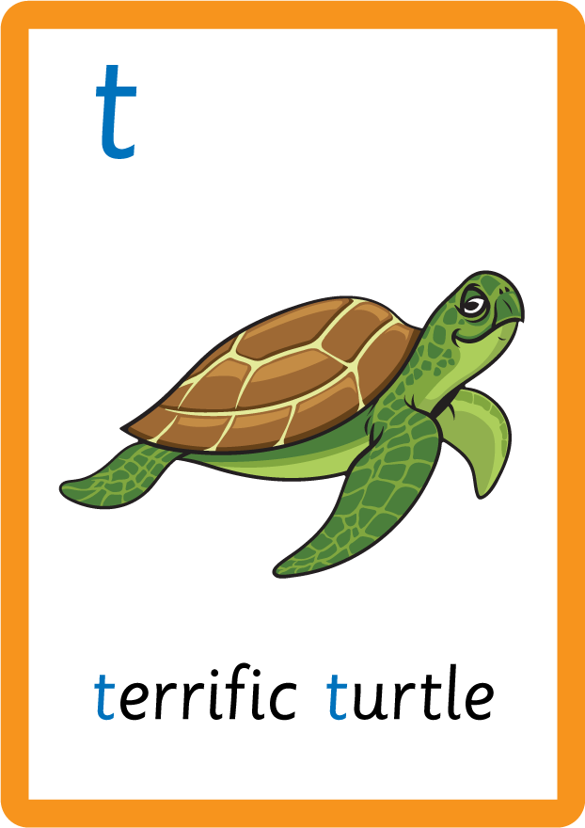












Recall s a t p i n m d g o c k ck e u using flashcards.

Slide 4

Review the Alphabet Song
a, b, c, d, e, f, g (pause)
h, i, j, k, l, m, n (pause)
o, p, q (pause) r, s, t (pause)
u v w (pause) x y z (pause)
Now I know my abc's, Next time won't you sing with me.

Slide 5
Hear Phonemes
USING JNL691
FRONT

Slide 6
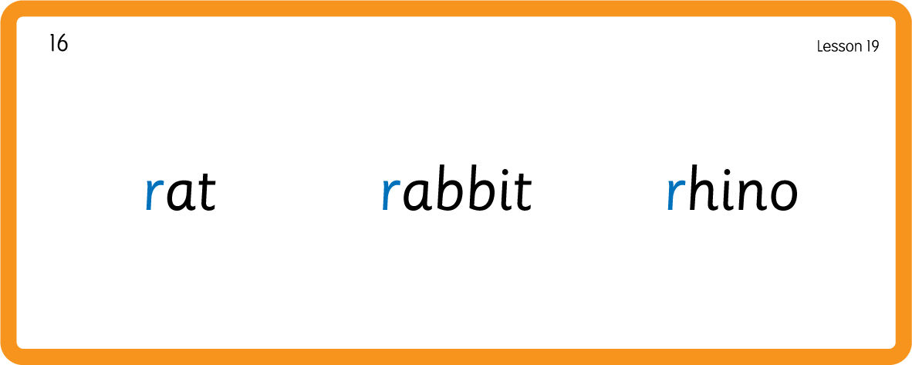
Hear Phonemes
USING JNL691
BACK

Slide 7
Teach Grapheme Caption
USING JNL686
FRONT

Slide 8
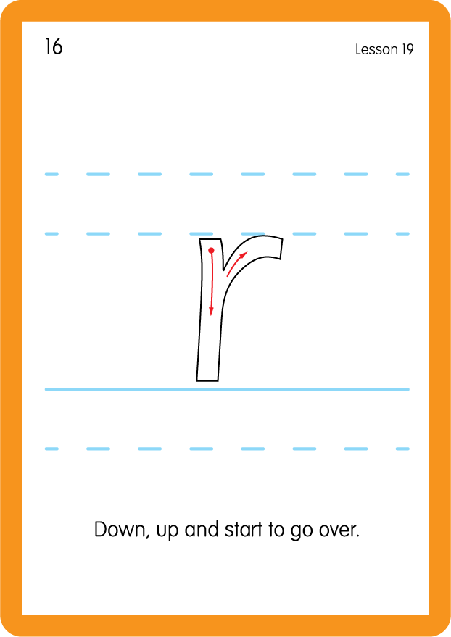
Teach Lowercase Formation
USING JL686
BACK

Slide 9

Explain Decoding

Slide 10
Model Blending Phonemes
r
a
t
USING SOUND BUTTONS
Sound Buttons
Vowel
Consonant
Consonant Digraph
Long Vowel Sound
R-controlled Digraph
Split Digraph
Syllable / Silent Letter

Slide 11
Model Blending Phonemes
r
u
n
USING SOUND BUTTONS
Sound Buttons
Vowel
Consonant
Consonant Digraph
Long Vowel Sound
R-controlled Digraph
Split Digraph
Syllable / Silent Letter

Slide 12
Model Blending Phonemes
r
i
p
USING SOUND BUTTONS
Sound Buttons
Vowel
Consonant
Consonant Digraph
Long Vowel Sound
R-controlled Digraph
Split Digraph
Syllable / Silent Letter

Slide 13

Explain Encoding

Slide 14
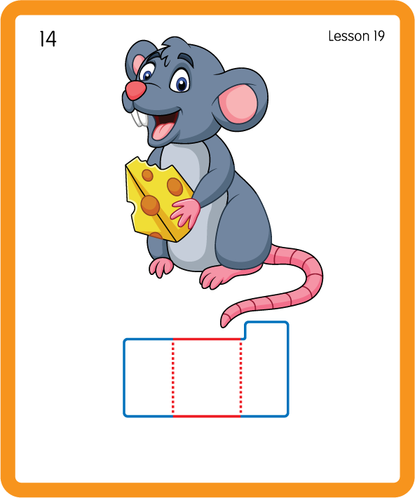
Build a Decodable Word
USING JNL689
BACK

Slide 15
Build a Decodable Word
USING JNL689
FRONT

Slide 16
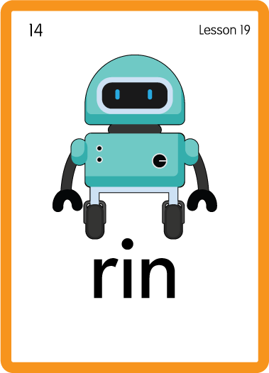
Practise with Alien Words
USING JNL692
BACK

Slide 17
Practise with Alien Words
USING JNL692
FRONT

Slide 18

Practise Building Words
PRACTISE – 10MINS
t
p
i
a
n
m
g
r
ck
o
USING MAGNETIC LETTERS AND A WHITEBOARD

Slide 19
Practise Building Words
PRACTISE – 10MINS
t
p
i
a
n
m
g
r
ck
o
rat ran rot rap rock rag ram rip
USING MAGNETIC LETTERS AND A WHITEBOARD

Slide 20
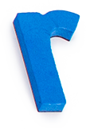
Sing ‘Round and Round the garden…' or 'Row, Row, Row your boat'.
Draw ‘r’ in a variety of sizes and media, for example using chalk to draw on the ground.
Paint or draw animals beginning with ‘r’ e.g. rhino, rat, rabbit.
Draw a large ‘r’ and decorate with sequins and buttons.
r

