Slide 1


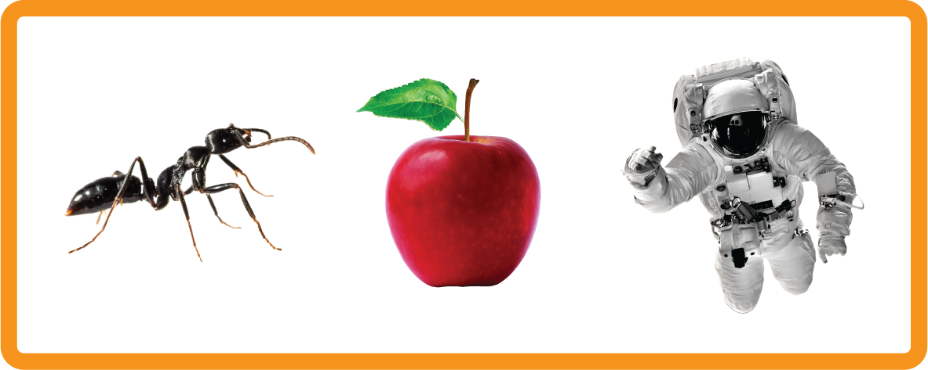
s | a | t | p | i | n | m | d
g | o | c | k | ck | e | u | r
h | b | f | ff | l | ll | ss
Letter Sound 'a'
Lesson 2

Slide 2

Learn and practise letter / sound a.
Recall ‘s’ using flashcards.
Phonemic Awareness Cards
Grapheme to Phoneme Cards
Common Exception Word Cards
High Frequency Word Cards
JNL691
JNL686
JNL687
JNL688

Slide 3

Recall ‘s’ using flashcards.

Slide 4

Review the Alphabet Song
a, b, c, d, e, f, g (pause)
h, i, j, k, l, m, n (pause)
o, p, q (pause) r, s, t (pause)
u v w (pause) x y z (pause)
Now I know my abc's, Next time won't you sing with me.

Slide 5
Hear Phonemes
USING JNL691
FRONT

Slide 6
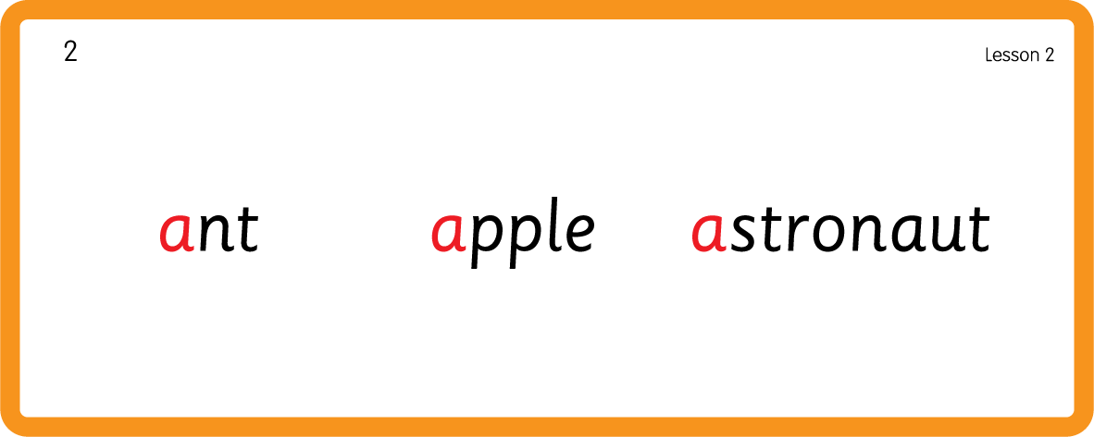
Hear Phonemes
USING JNL691
BACK

Slide 7
Teach Grapheme Caption
USING JNL686
FRONT

Slide 8
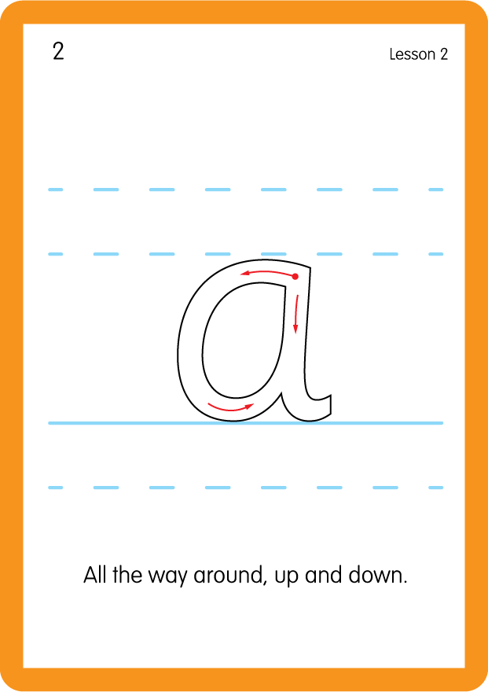
Teach Lowercase Formation
USING JNL686
BACK

Slide 9
Practise Common Exception Words
USING JNL687
FRONT

Slide 10
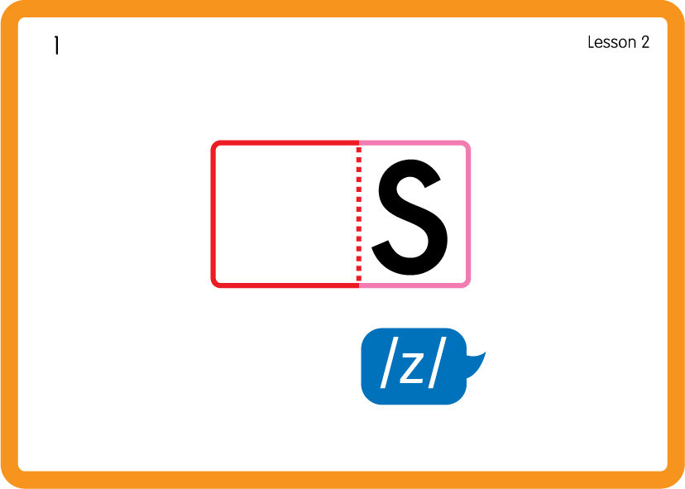
Practise Common Exception Words
USING JNL687
BACK

Slide 11
Practise High Frequency Words
USING JNL688
FRONT

Slide 12
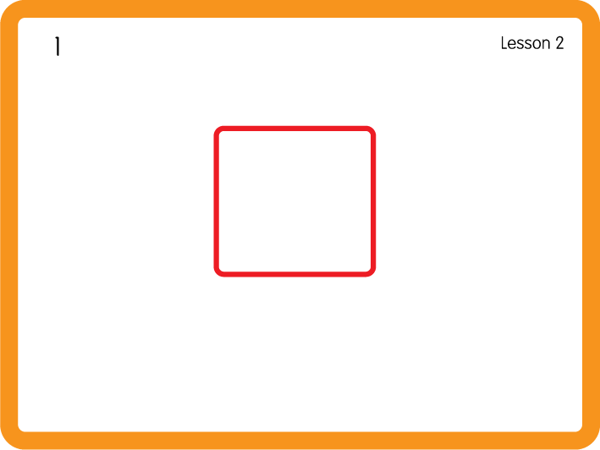
Practise High Frequency Words
USING JNL688
BACK

Slide 13
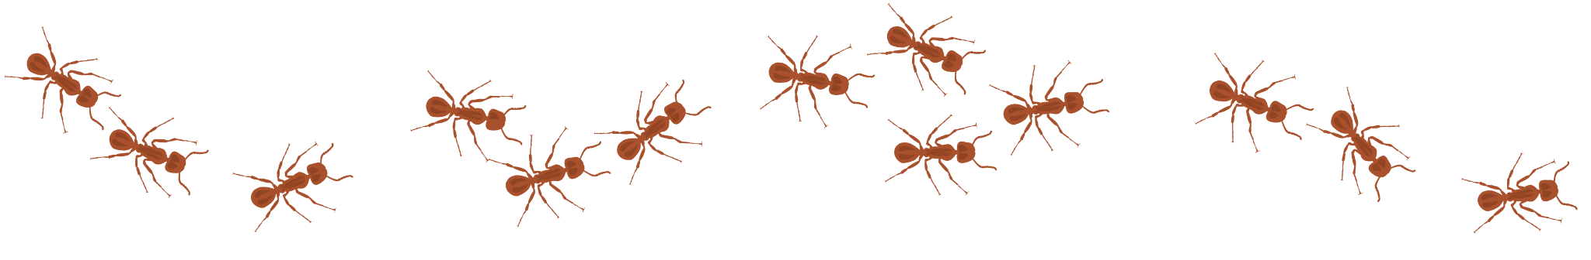
Sing ‘The Ants Go Marching’.
Draw ‘a’ in a variety of sizes and media, for example using chalk to draw on the ground.
Make grapheme with playdough.
Sort objects/pictures which start with ‘a’ or ‘s’ and distinguish between the two.

