Slide 1




s | a | t | p | i | n | m | d
g | o | c | k | ck | e | u | r
h | b | f | ff | l | ll | ss
Review ck e u r and Short Vowels
Lesson 20

Slide 2


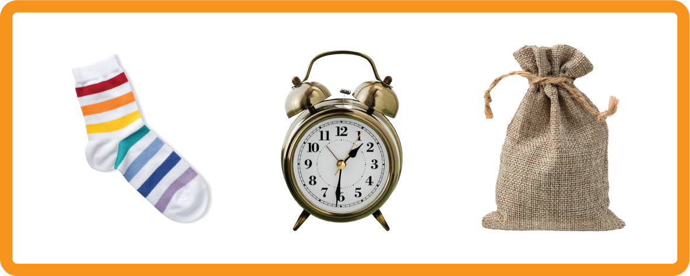


Review and practise letter / sounds a e i o u.
Recall s a t p i n m d g o c k ck e u r using flashcards.
Phonemic Awareness Cards
Grapheme to Phoneme Cards
Phoneme Frame Cards
Alien Word Cards
Common Exception Word Cards
High Frequency Word Cards
JNL691
JNL686
JNL689
JNL692
JNL687
JNL688

Slide 3












Recall s a t p i n m d g o c k ck e u r using flashcards.

Slide 4
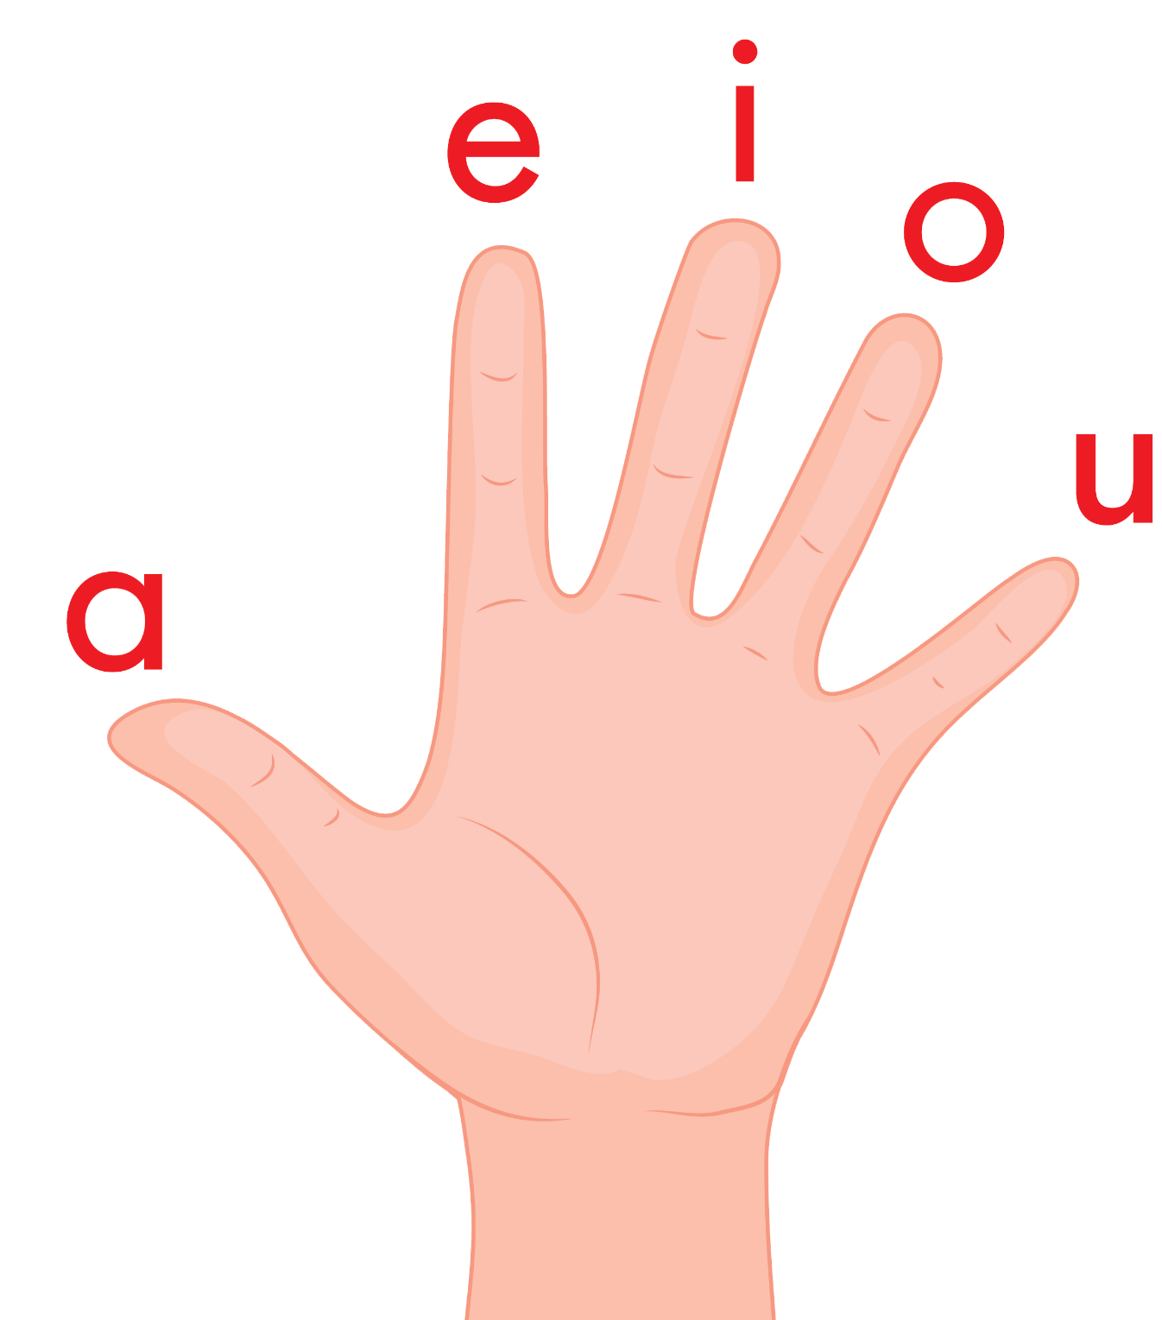
Introduce the Vowel Hand Song
a, e, i, o, u a, e, i, o, u a, e, i, o, u (short sounds only)
are short vowels that we use
a vowel is in every word, a vowel is in every word,
a vowel is in every word that we read or write.

Slide 5

Review the Alphabet Song
a, b, c, d, e, f, g (pause)
h, i, j, k, l, m, n (pause)
o, p, q (pause) r, s, t (pause)
u v w (pause) x y z (pause)
Now I know my abc's, Next time won't you sing with me.

Slide 6



Hear Phonemes
USING JNL691
FRONT

Slide 7
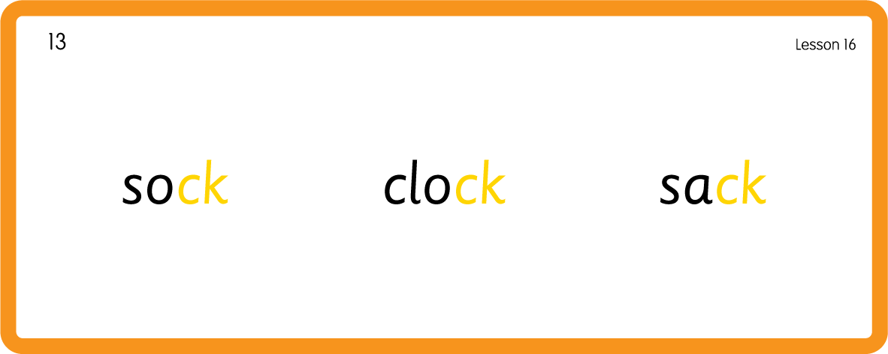
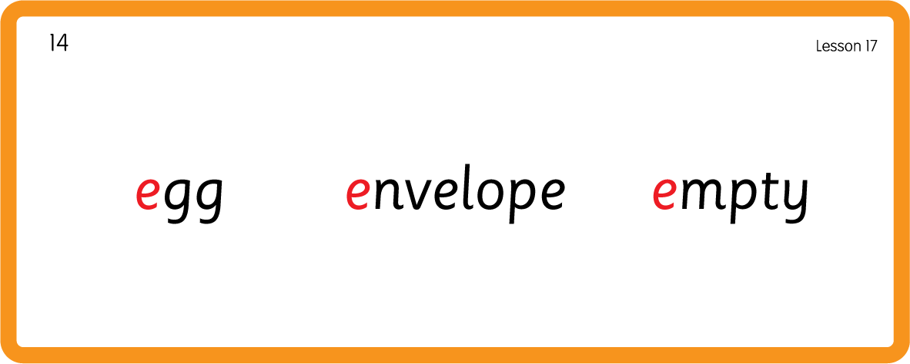
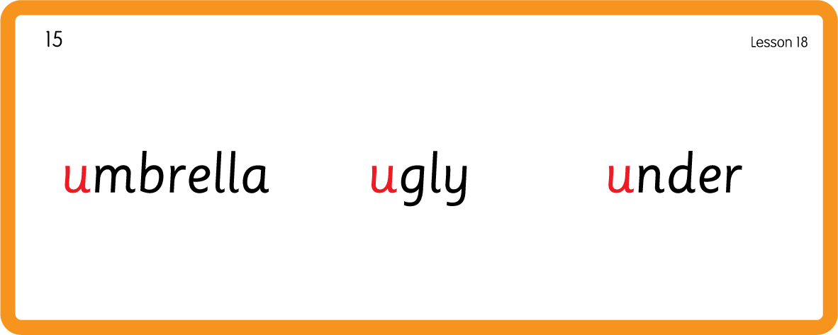
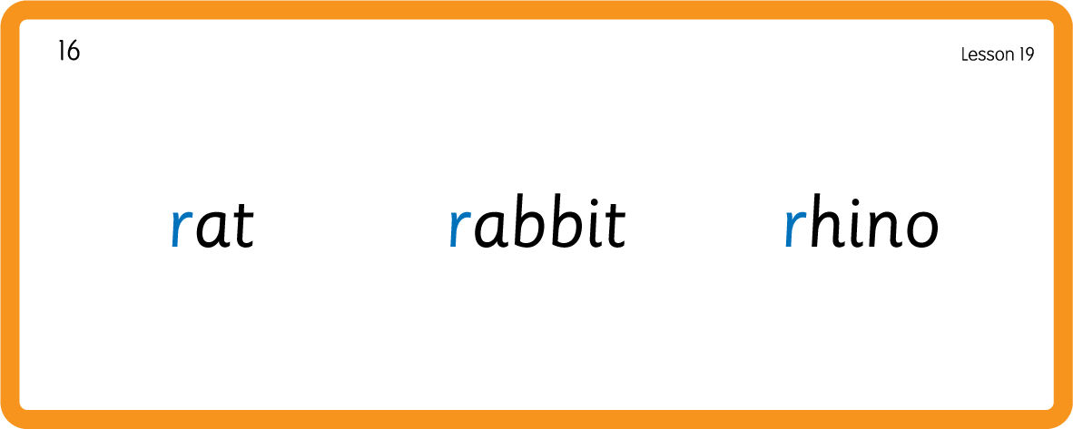
Hear Phonemes
USING JNL691
BACK

Slide 8
Review Grapheme Caption
USING JNL686
FRONT

Slide 9

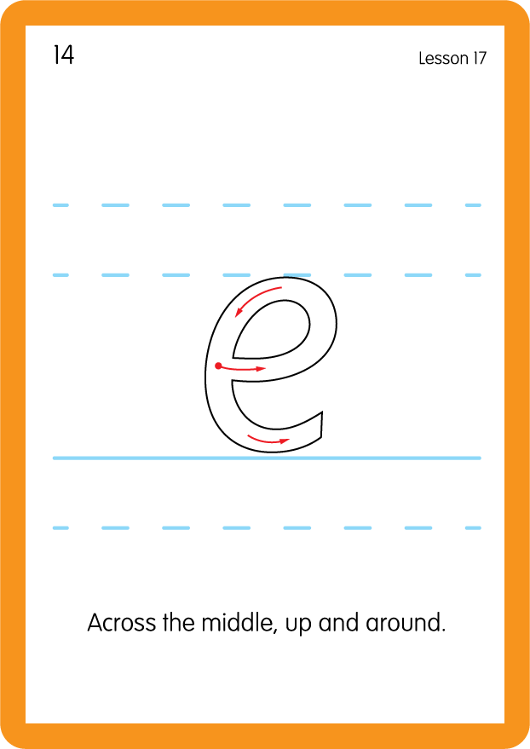
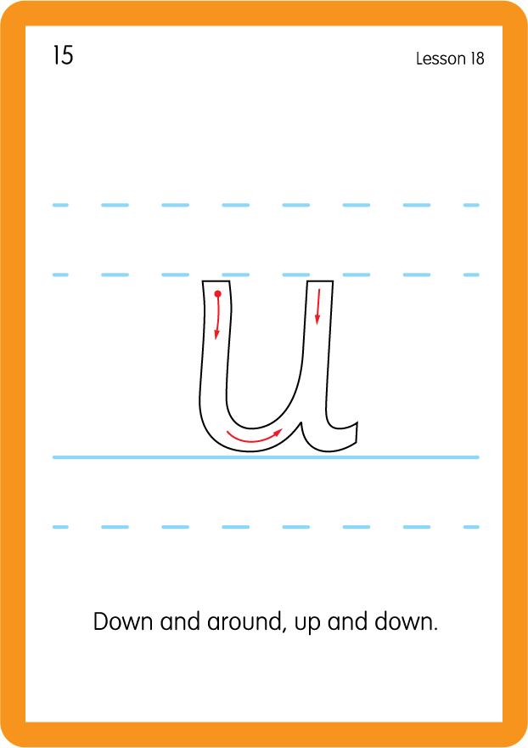
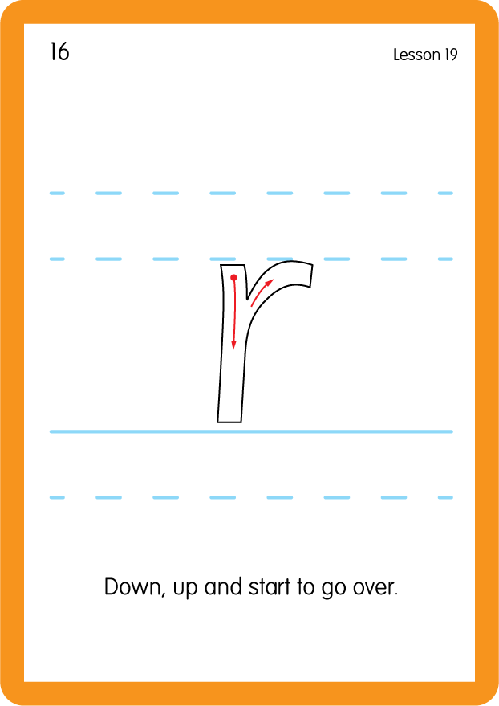
Review Lowercase Formation
USING JNL686
BACK

Slide 10

Explain Decoding

Slide 11
Spot and Say the Vowel
c
a
p
USING SOUND BUTTONS
Sound Buttons
Vowel
Consonant
Consonant Digraph
Long Vowel Sound
R-controlled Digraph
Split Digraph
Syllable / Silent Letter

Slide 12
Spot and Say the Vowel
p
e
g
USING SOUND BUTTONS
Sound Buttons
Vowel
Consonant
Consonant Digraph
Long Vowel Sound
R-controlled Digraph
Split Digraph
Syllable / Silent Letter

Slide 13
Spot and Say the Vowel
t
i
p
USING SOUND BUTTONS
Sound Buttons
Vowel
Consonant
Consonant Digraph
Long Vowel Sound
R-controlled Digraph
Split Digraph
Syllable / Silent Letter

Slide 14
Spot and Say the Vowel
p
o
p
USING SOUND BUTTONS
Sound Buttons
Vowel
Consonant
Consonant Digraph
Long Vowel Sound
R-controlled Digraph
Split Digraph
Syllable / Silent Letter

Slide 15
Spot and Say the Vowel
m
u
d
USING SOUND BUTTONS
Sound Buttons
Vowel
Consonant
Consonant Digraph
Long Vowel Sound
R-controlled Digraph
Split Digraph
Syllable / Silent Letter

Slide 16

Explain Encoding

Slide 17
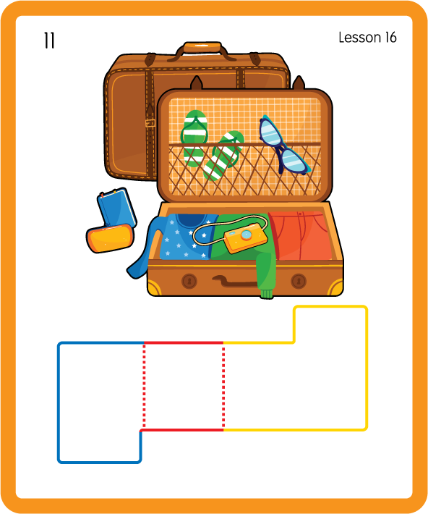
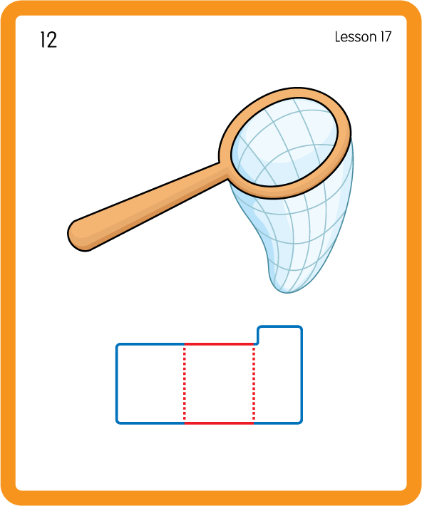
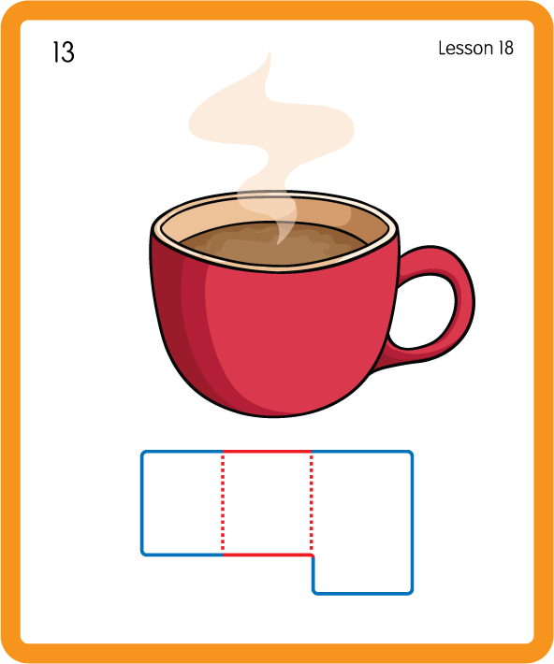
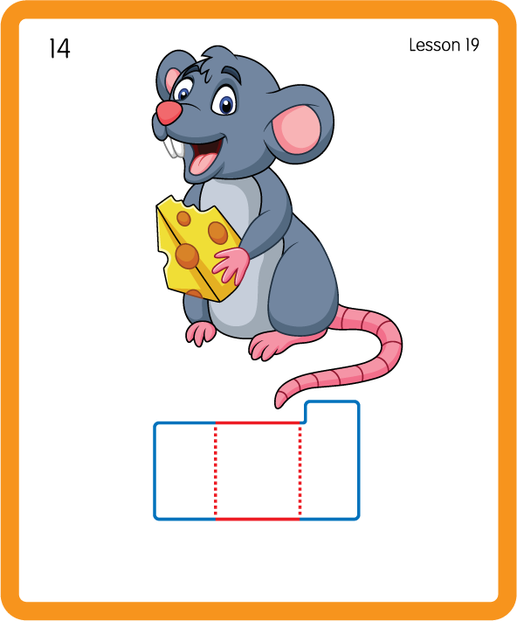
Build a Decodable Word
USING JNL689
BACK

Slide 18


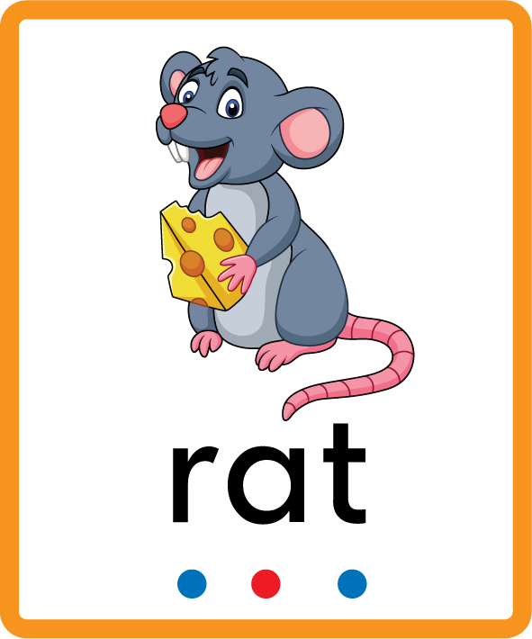
Build a Decodable Word
USING JNL689
FRONT

Slide 19

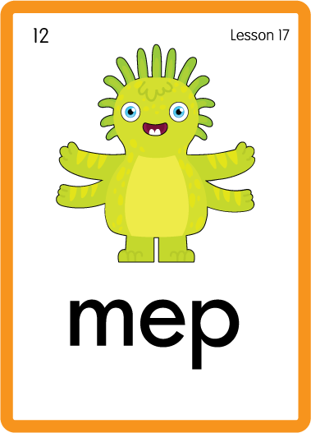


Practise with Alien Words
USING JNL692
BACK

Slide 20



Practise with Alien Words
USING JNL692
FRONT

Slide 21
Practise Common Exception Words
USING JNL687
FRONT

Slide 22
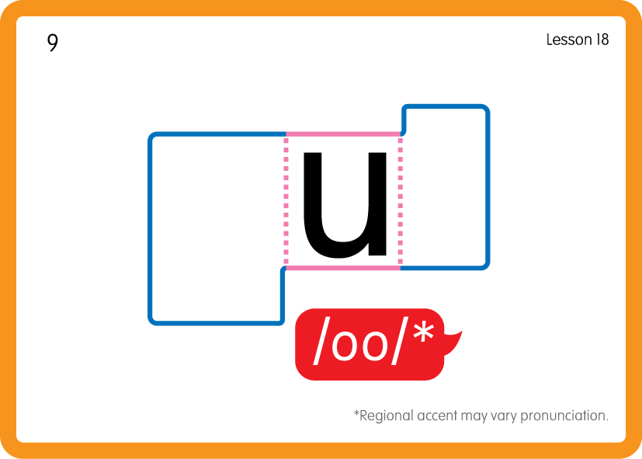
Practise Common Exception Words
USING JNL687
BACK

Slide 23


Practise High Frequency Words
USING JNL688
FRONT

Slide 24
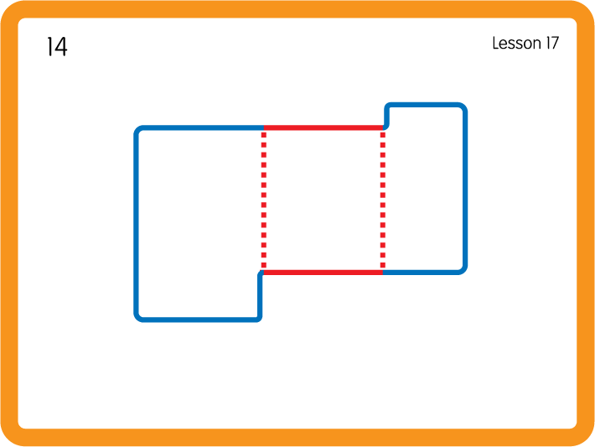
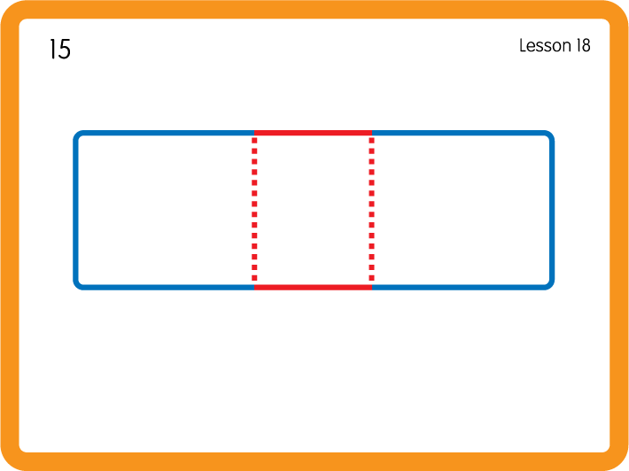
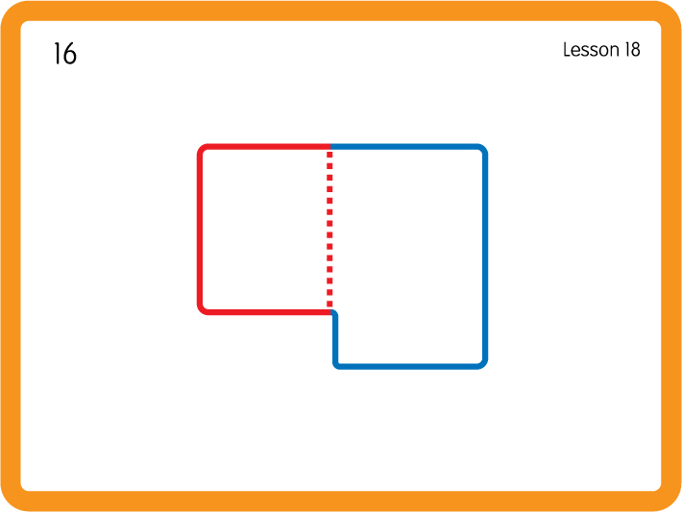
Practise High Frequency Words
USING JNL688
BACK

Slide 25


?
?
Sorting with Feely bags - e u r; Have children sort objects beginning with the letter sounds into the correct bags.

Slide 26
