Slide 1




s | a | t | p | i | n | m | d
g | o | c | k | ck | e | u | r
h | b | f | ff | l | ll | ss
Letter Sound 'h'
Lesson 21

Slide 2


Learn and practise letter / sound h.
Recall s a t p i n m d g o c k ck e u r using flashcards.
Phonemic Awareness Cards
Grapheme to Phoneme Cards
Phoneme Frame Cards
Alien Word Cards
Common Exception Word Cards
High Frequency Word Cards
JNL691
JNL686
JNL689
JNL692
JNL687
JNL688

Slide 3
















Recall s a t p i n m d g o c k ck e u r using flashcards.

Slide 4

Review the Alphabet Song
a, b, c, d, e, f, g (pause)
h, i, j, k, l, m, n (pause)
o, p, q (pause) r, s, t (pause)
u v w (pause) x y z (pause)
Now I know my abc's, Next time won't you sing with me.

Slide 5
Hear Phonemes
USING JNL691
FRONT

Slide 6

Hear Phonemes
USING JNL691
BACK

Slide 7
Teach Grapheme Caption
USING JNL686
FRONT

Slide 8
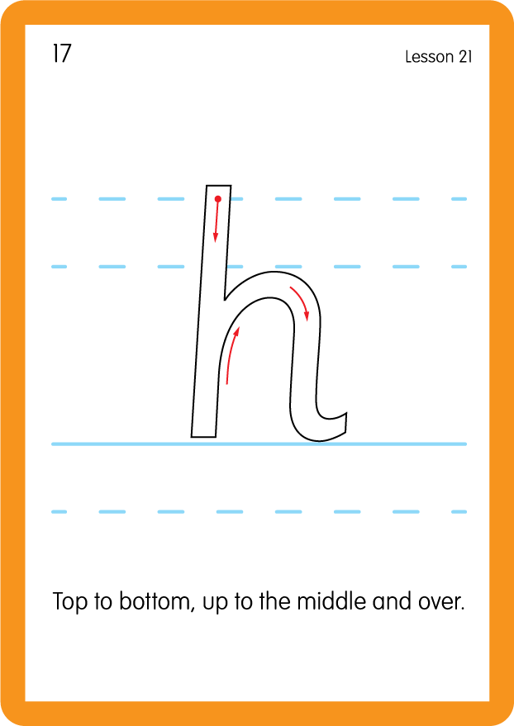
Teach Lowercase Formation
USING JNL686
BACK

Slide 9

Explain Decoding

Slide 10
Model Blending Phonemes
h
i
m
USING SOUND BUTTONS
Sound Buttons
Vowel
Consonant
Consonant Digraph
Long Vowel Sound
R-controlled Digraph
Split Digraph
Syllable / Silent Letter

Slide 11
Model Blending Phonemes
h
a
d
USING SOUND BUTTONS
Sound Buttons
Vowel
Consonant
Consonant Digraph
Long Vowel Sound
R-controlled Digraph
Split Digraph
Syllable / Silent Letter

Slide 12
Model Blending Phonemes
h
u
t
USING SOUND BUTTONS
Sound Buttons
Vowel
Consonant
Consonant Digraph
Long Vowel Sound
R-controlled Digraph
Split Digraph
Syllable / Silent Letter

Slide 13

Explain Encoding

Slide 14
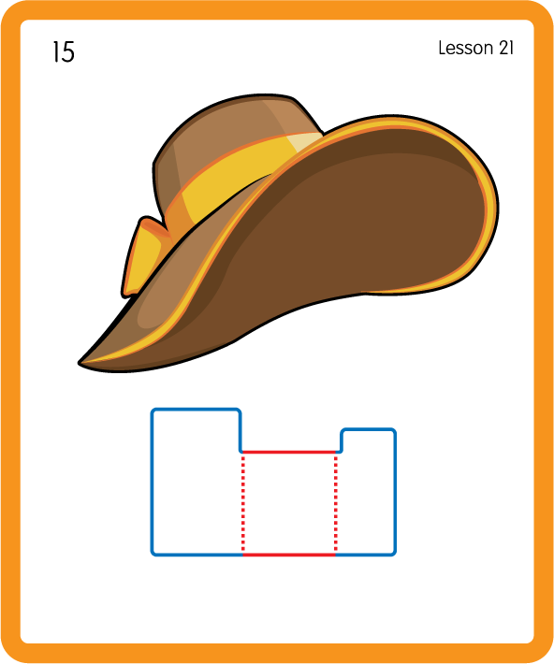
Build a Decodable Word
USING JNL689
BACK

Slide 15
Build a Decodable Word
USING JNL689
FRONT

Slide 16

Practise with Alien Words
USING JNL692
BACK

Slide 17
Practise with Alien Words
USING JNL692
FRONT

Slide 18
Practise Common Exception Words
USING JNL687
FRONT

Slide 19
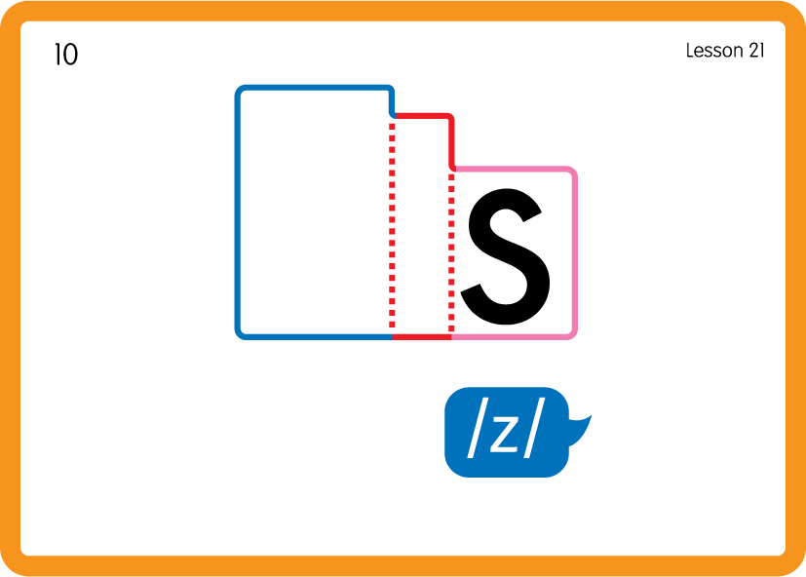
Practise Common Exception Words
USING JNL687
BACK

Slide 20

Practise Common Exception Words
USING JNL687
FRONT

Slide 21
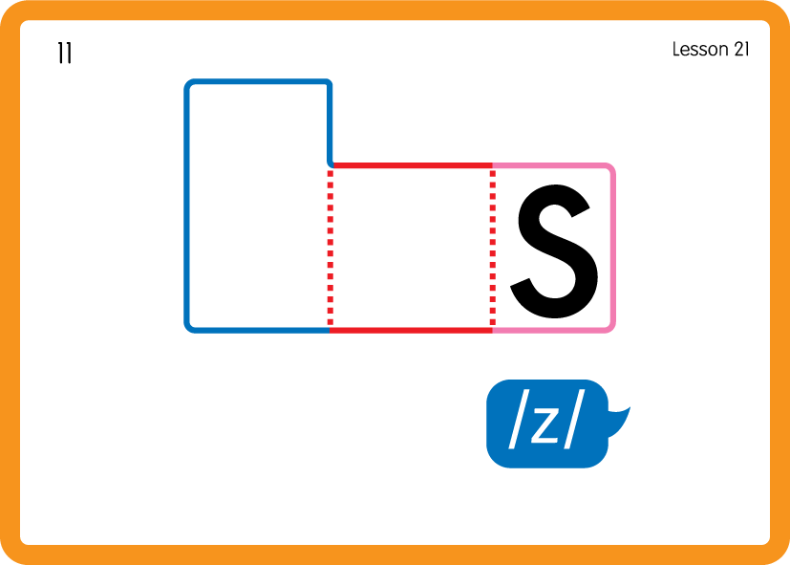
Practise Common Exception Words
USING JNL687
BACK

Slide 22
Practise High Frequency Words
USING JNL688
FRONT

Slide 23
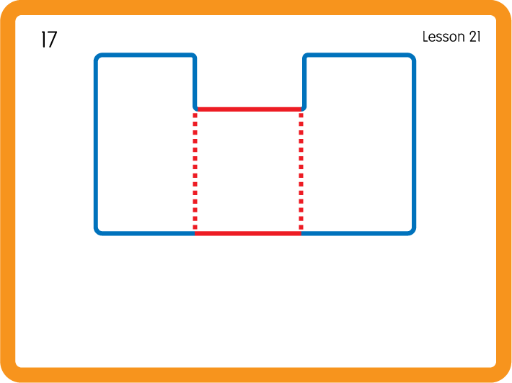
Practise High Frequency Words
USING JNL688
BACK

Slide 24

Practise High Frequency Words
USING JNL688
FRONT

Slide 25
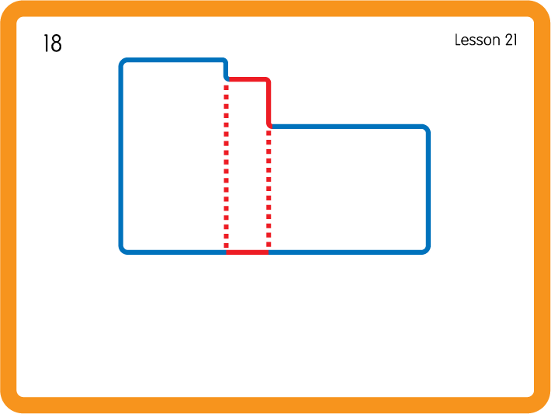
Practise High Frequency Words
USING JNL688
BACK

Slide 26

Practise Building Words
PRACTISE – 10MINS
b
t
i
m
o
h
USING MAGNETIC LETTERS AND A WHITEBOARD

Slide 27
Practise Building Words
PRACTISE – 10MINS
b
t
i
m
o
h
him hot hob
USING MAGNETIC LETTERS AND A WHITEBOARD

Slide 28
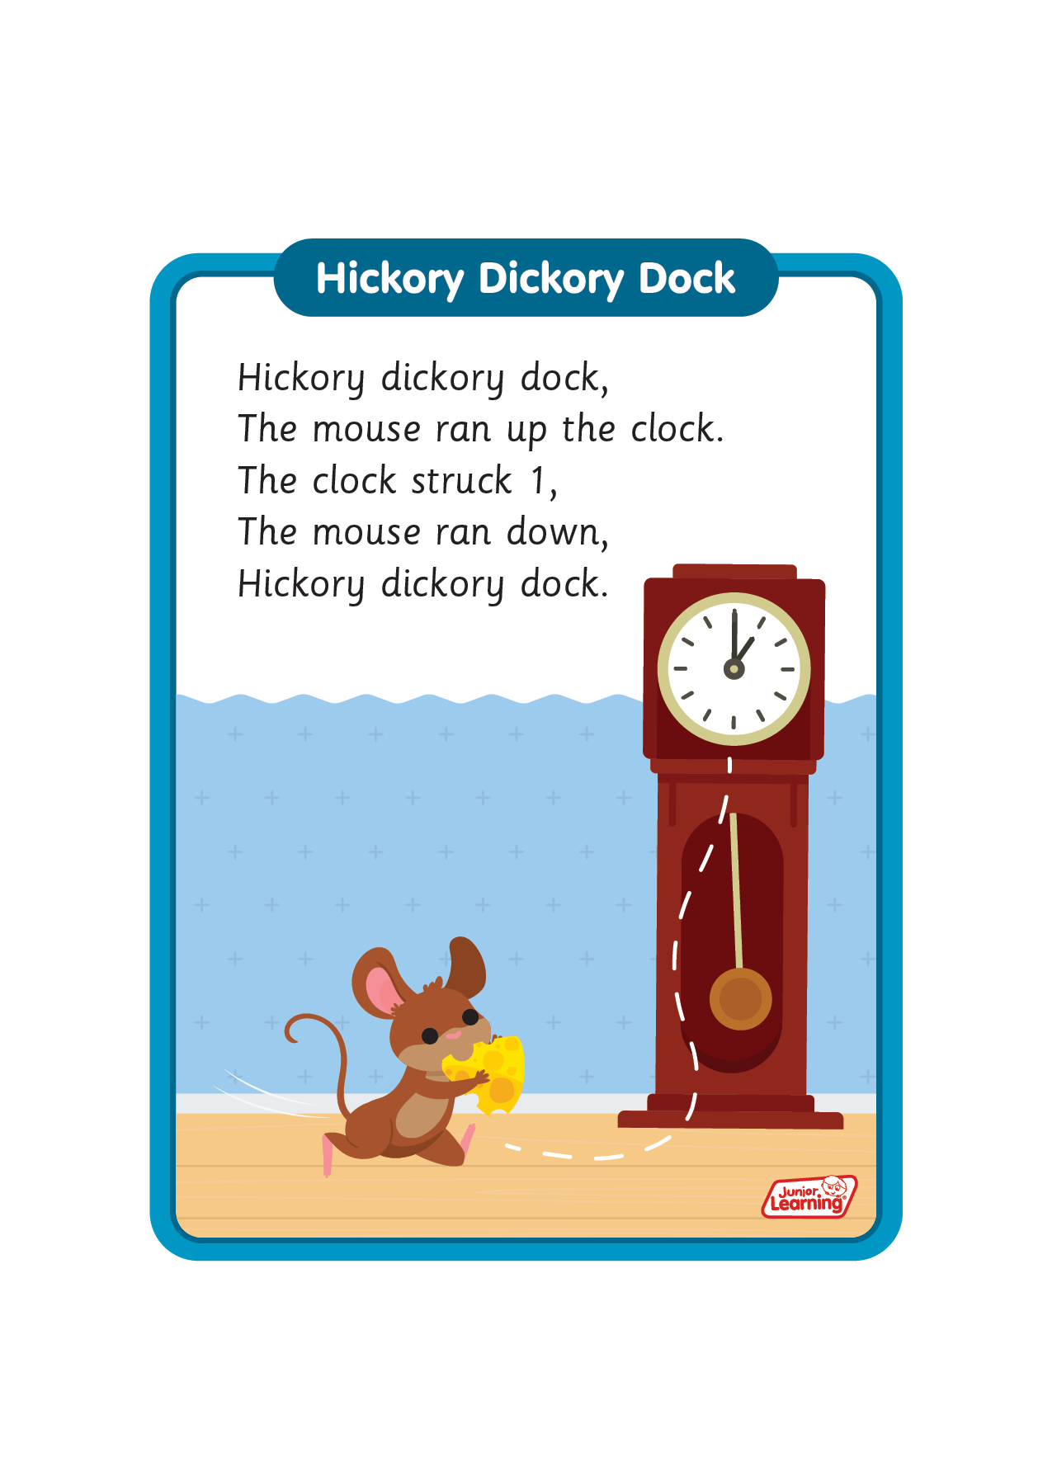
Sing ‘Hickory Dickory Dock’.
Draw ‘h’ in a variety of sizes and media, for example using chalk to
draw on the ground.
Make grapheme with playdough.
Explore words in environment for decoding.
Use letters for building words and encoding.
Make paper hats.
h

