Slide 1




s | a | t | p | i | n | m | d
g | o | c | k | ck | e | u | r
h | b | f | ff | l | ll | ss
Review h b f ff
Lesson 25

Slide 2


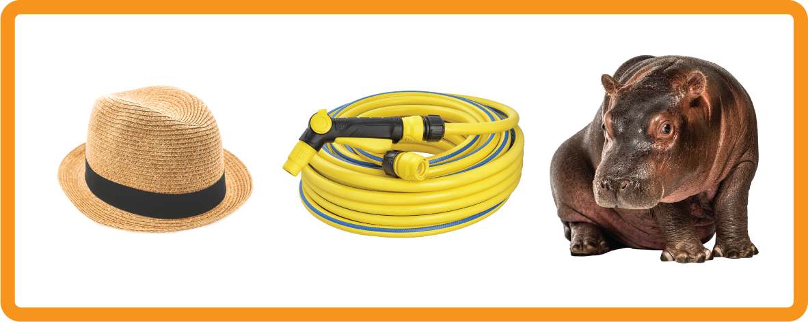


Learn and practise letter / sounds and digraph h b f ff.
Recall s a t p i n m d g o c k ck e u r h b f ff.
Recall Common Exception Words as I is no go to into the put.
Phonemic Awareness Cards
Grapheme to Phoneme Cards
Phoneme Frame Cards
Alien Word Cards
Common Exception Word Cards
High Frequency Word Cards
JNL691
JNL686
JNL689
JNL692
JNL687
JNL688

Slide 3
















Recall s a t p i n m d g o c k ck e u r h b f ff.

Slide 4









Review Phase 2 Common Exception Words as I is no go to into the put.

Slide 5

Review the Alphabet Song
a, b, c, d, e, f, g (pause)
h, i, j, k, l, m, n (pause)
o, p, q (pause) r, s, t (pause)
u v w (pause) x y z (pause)
Now I know my abc's, Next time won't you sing with me.

Slide 6
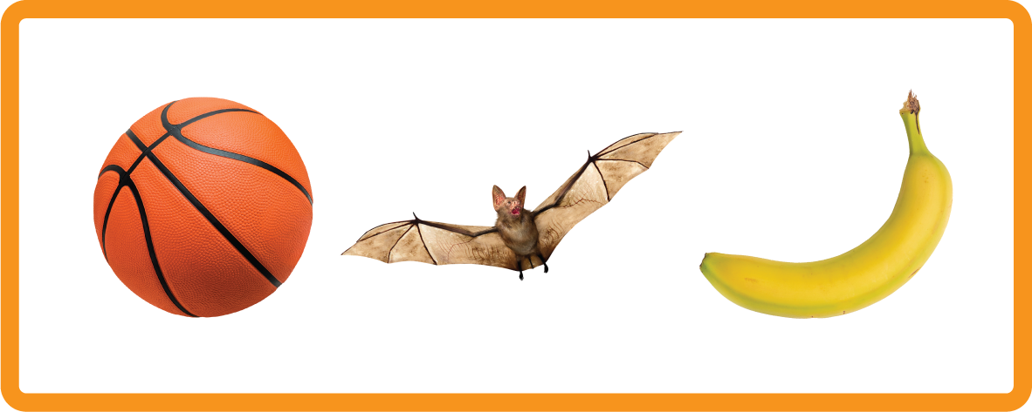

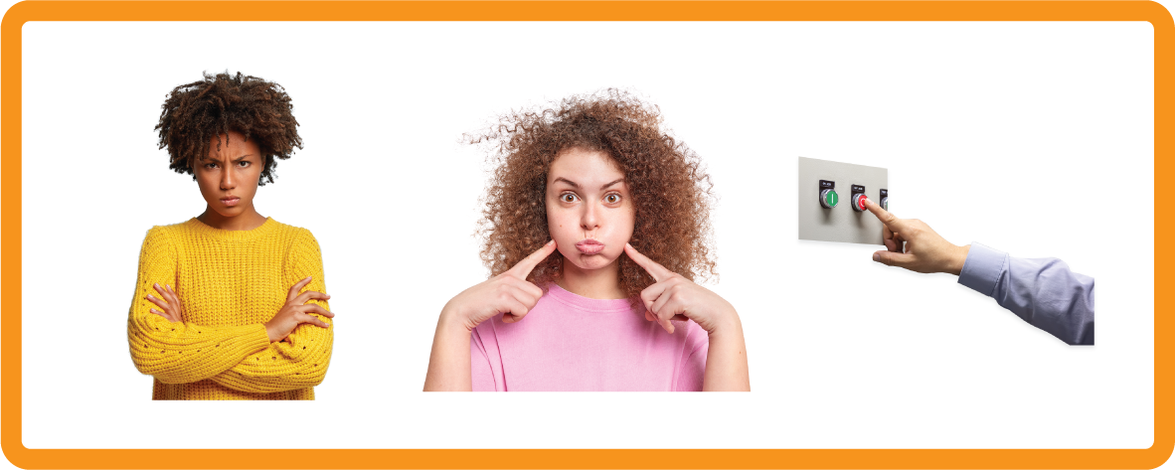
Hear Phonemes
USING JNL691
FRONT

Slide 7

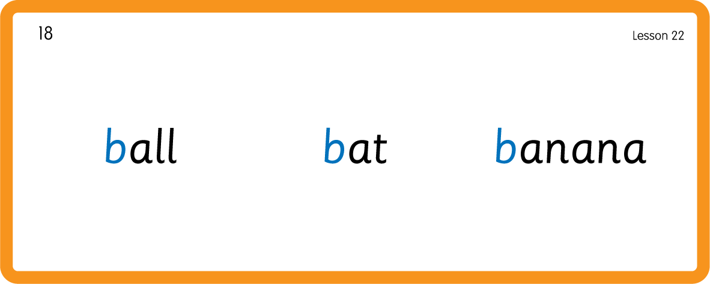
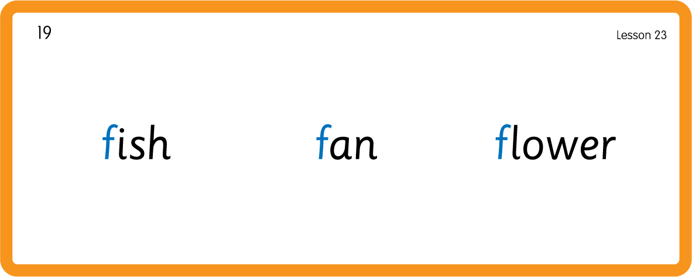
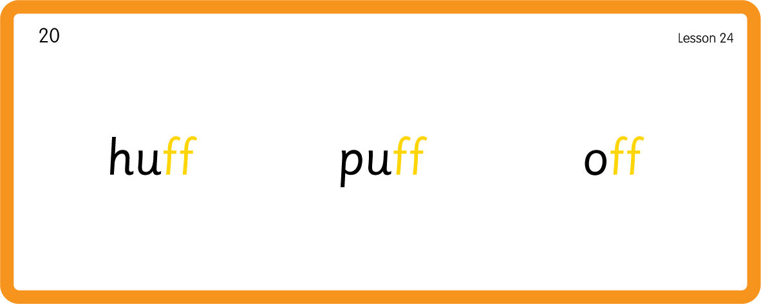
Hear Phonemes
USING JNL691
BACK

Slide 8
Review Grapheme Caption
USING JNL686
FRONT

Slide 9
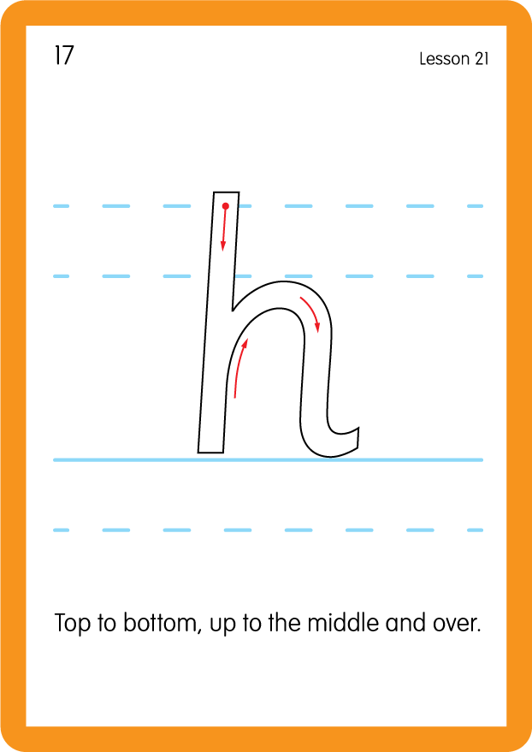
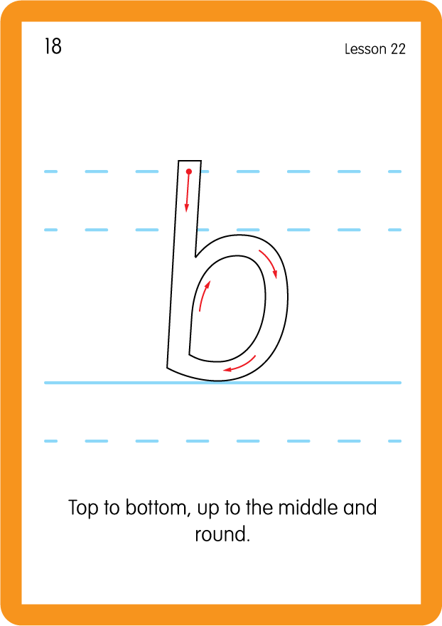
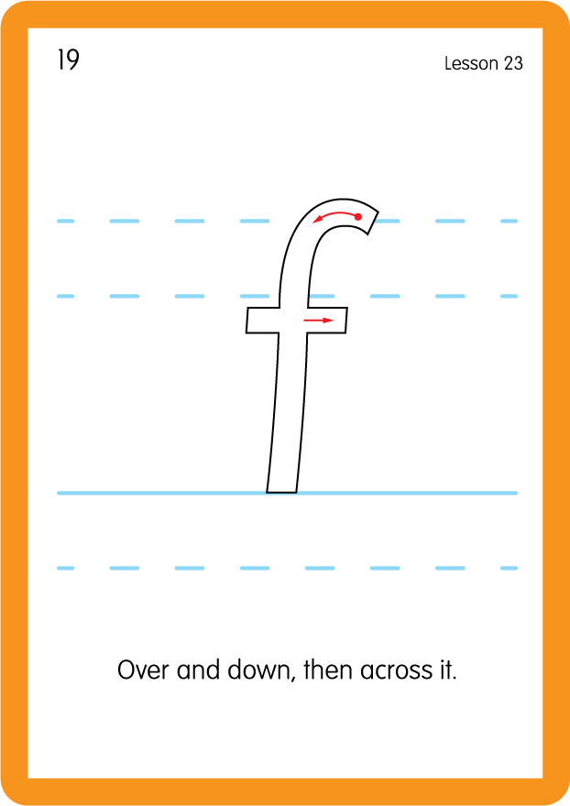
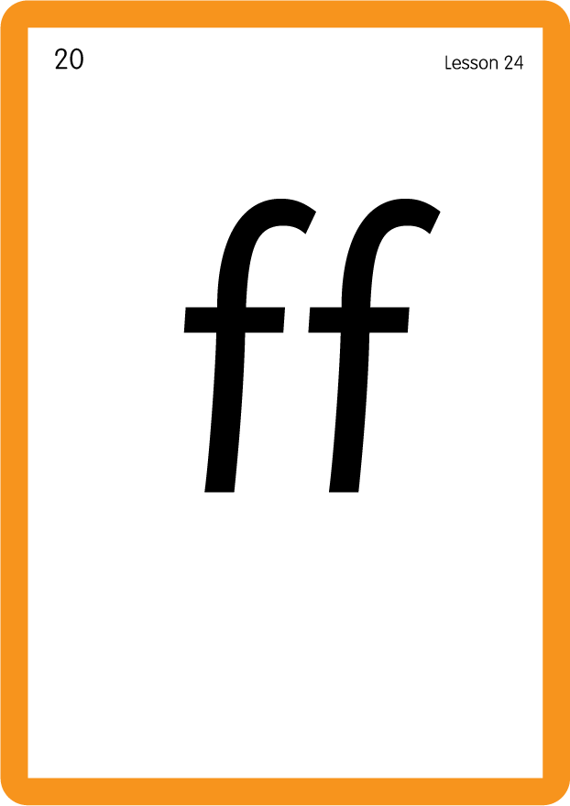
Review Lowercase Formation
USING JNL686
BACK

Slide 10
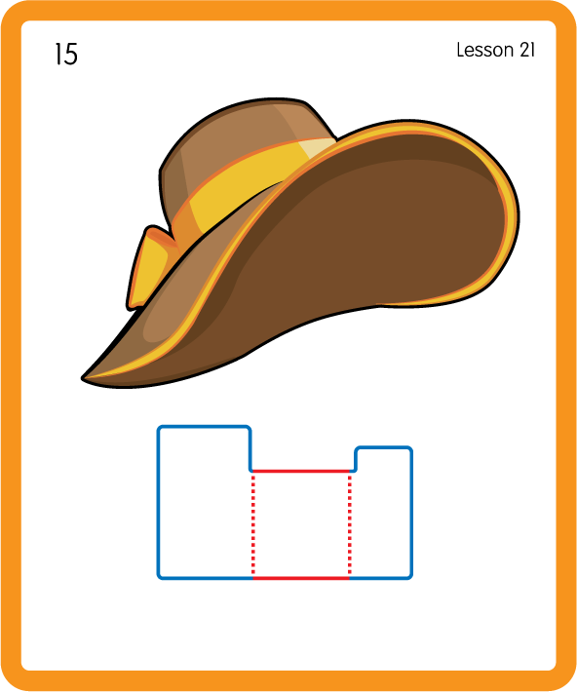
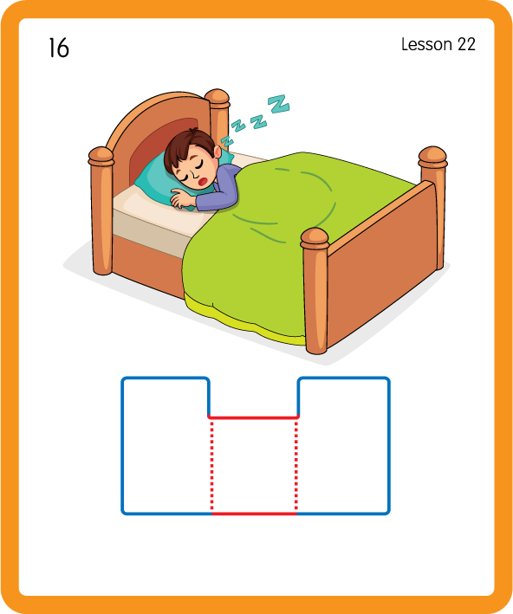
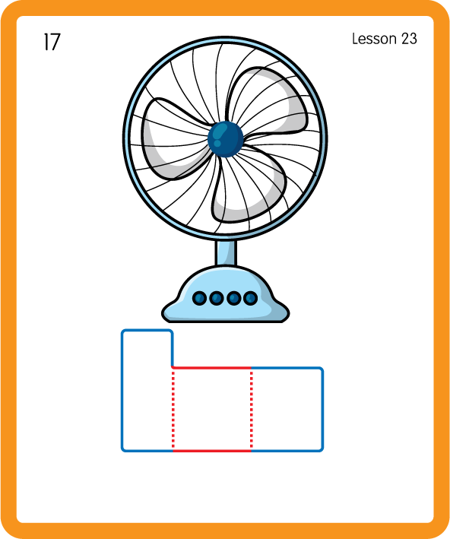
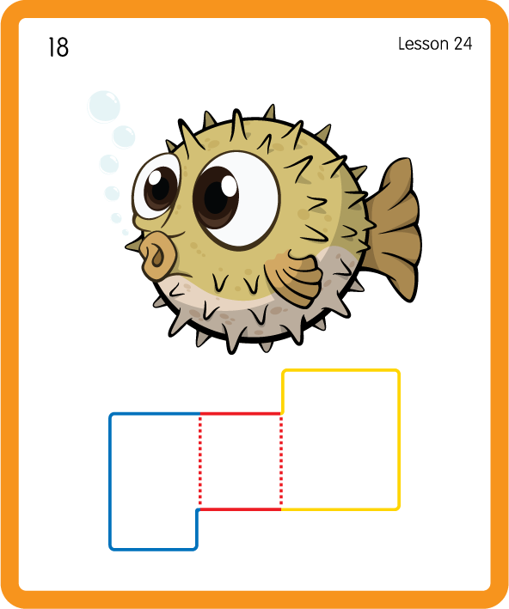
Build a Decodable Word
USING JNL689
BACK

Slide 11
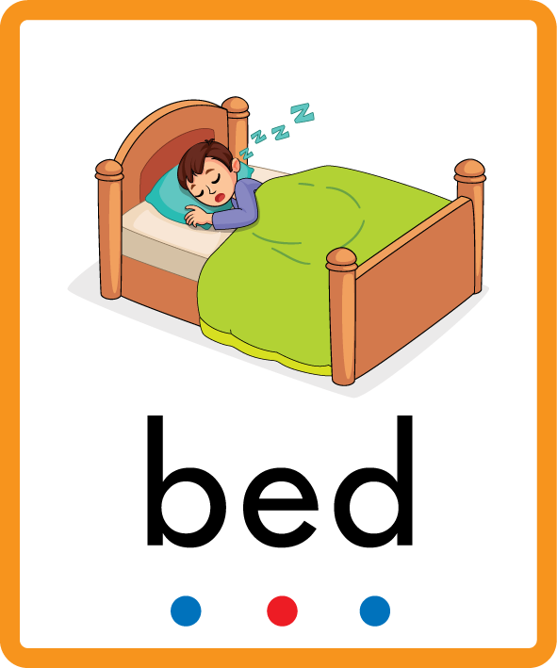
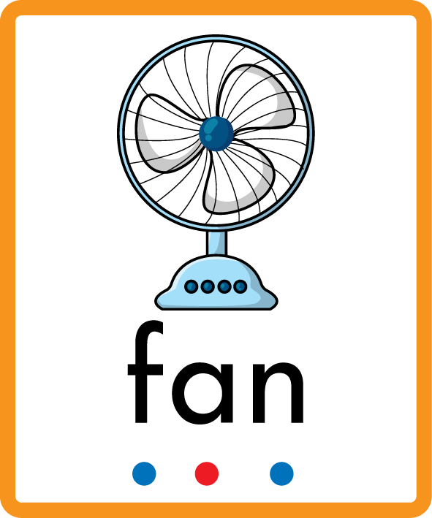

Build a Decodable Word
USING JNL689
FRONT

Slide 12
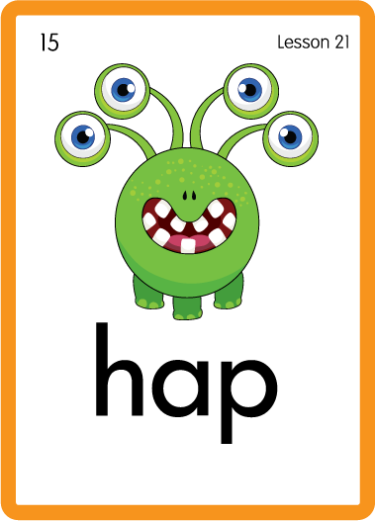
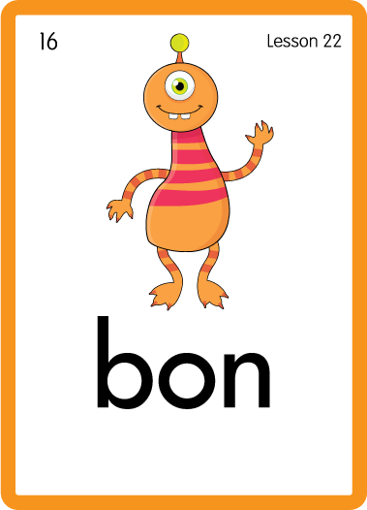
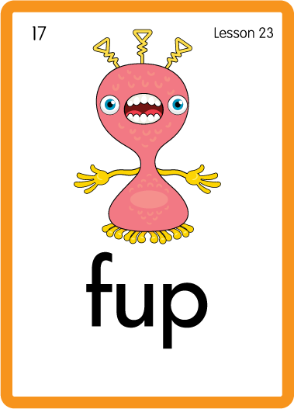
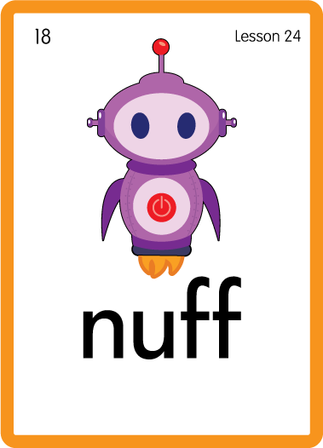
Practise with Alien Words
USING JNL692
BACK

Slide 13
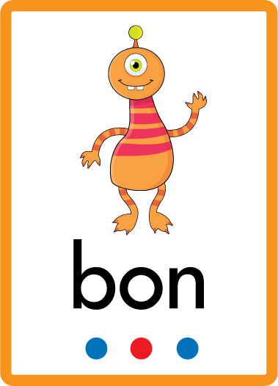


Practise with Alien Words
USING JNL692
FRONT

Slide 14


Practise Common Exception Words
USING JNL687
FRONT

Slide 15
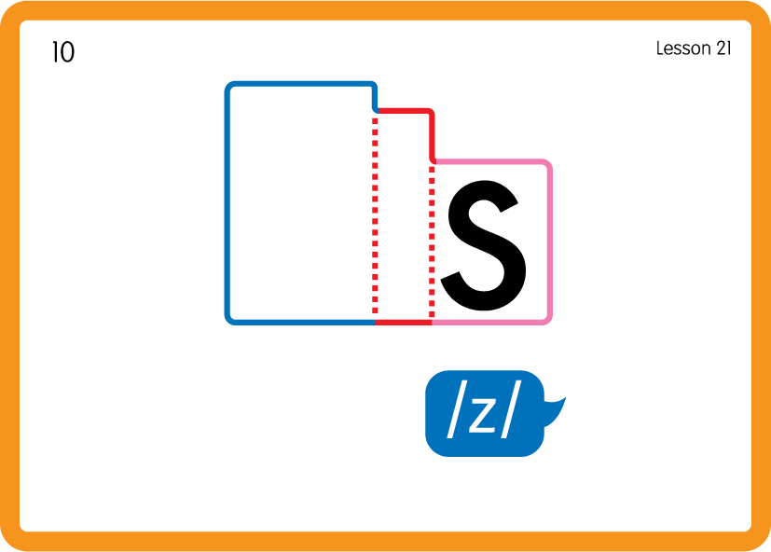
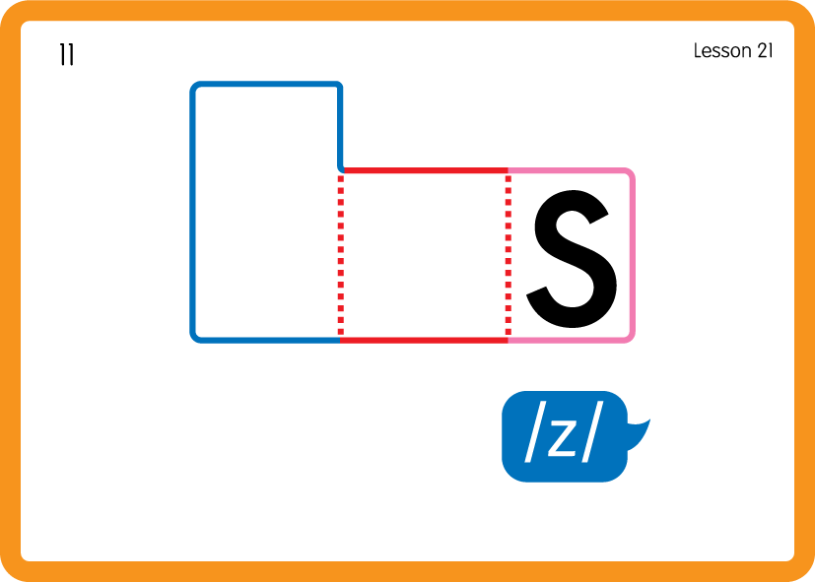
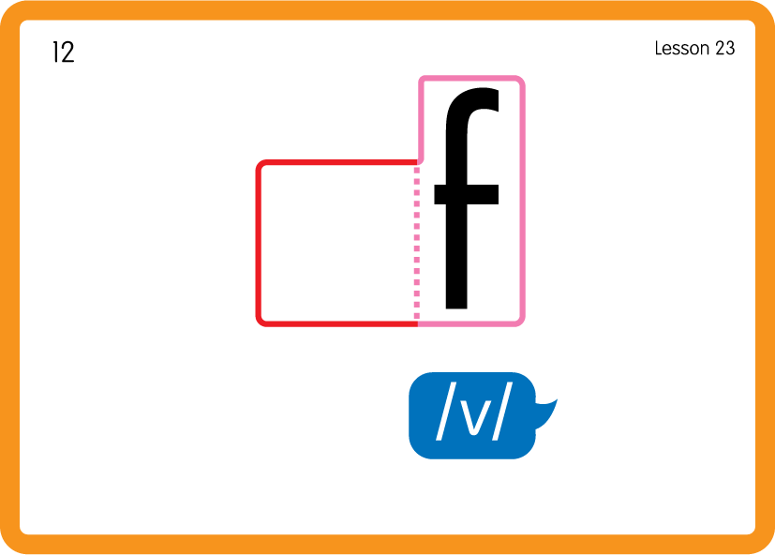
Practise Common Exception Words
USING JNL687
FRONT

Slide 16






Practise High Frequency Words
USING JNL688
FRONT

Slide 17
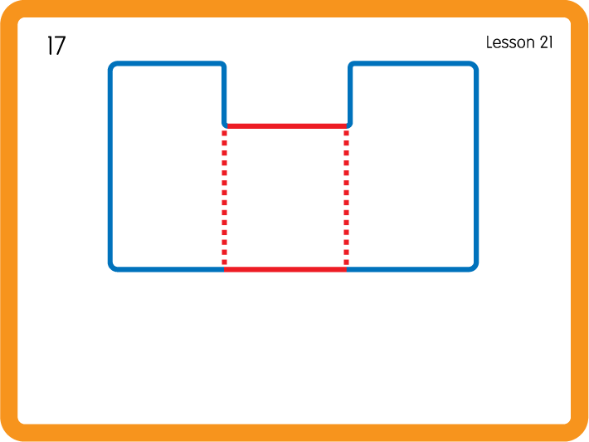
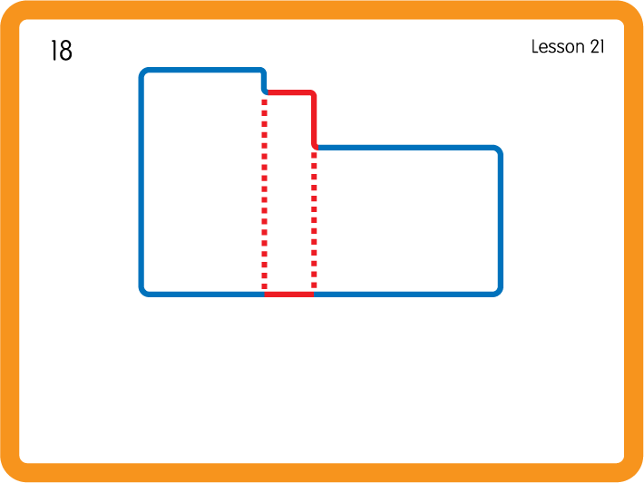
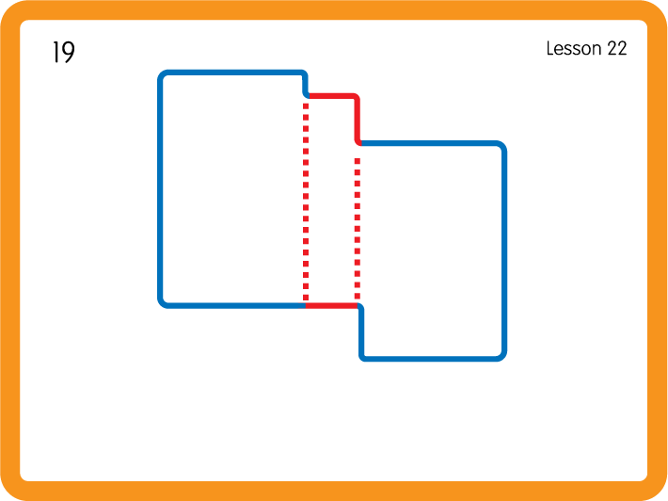
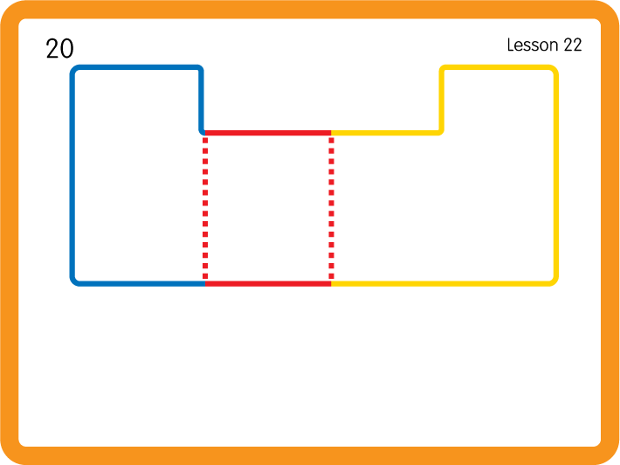
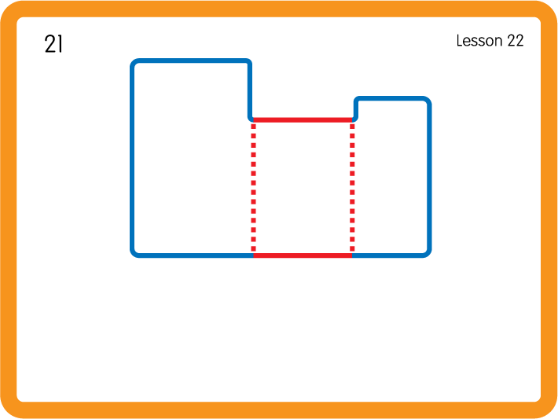
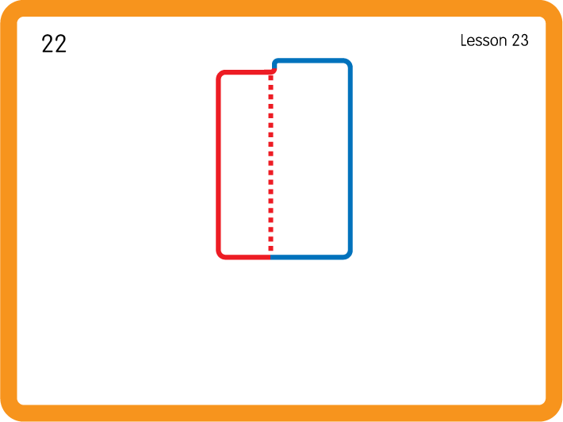
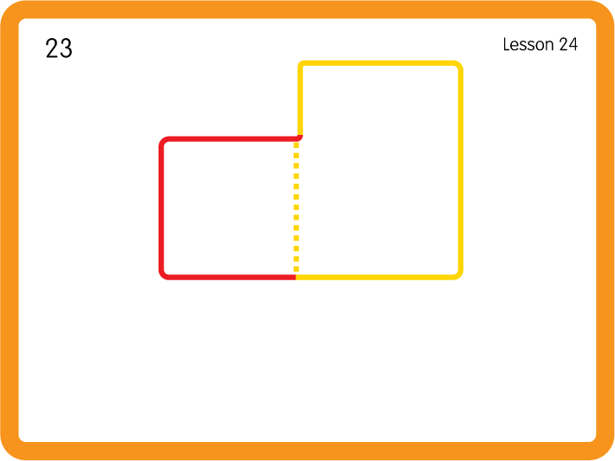
Practise High Frequency Words
USING JNL688
BACK

Slide 18


b
h
Sorting with Feely bags - h b f; Have children sort objects beginning with the letter sounds into the correct bags.

