Slide 1




s | a | t | p | i | n | m | d
g | o | c | k | ck | e | u | r
h | b | f | ff | l | ll | ss
Letter Sound 'll'
Lesson 27

Slide 2

Learn and practise consonant digraph ll.
Recall s a t p i n m d g o c k ck e u r h b f ff l using flashcards.
Recall Common Exception Words as I is no go to into the put has his of.
Phonemic Awareness Cards
Grapheme to Phoneme Cards
Phoneme Frame Cards
Alien Word Cards
Common Exception Word Cards
JNL691
JNL686
JNL689
JNL692
JNL687

Slide 3





















Recall s a t p i n m d g o c k ck e u r h b f ff l using flashcards.

Slide 4












Recall Common Exception Words as I is no go to into the put has his of.

Slide 5

Review the Alphabet Song
a, b, c, d, e, f, g (pause)
h, i, j, k, l, m, n (pause)
o, p, q (pause) r, s, t (pause)
u v w (pause) x y z (pause)
Now I know my abc's, Next time won't you sing with me.

Slide 6
Hear Phonemes
USING JNL691
FRONT

Slide 7
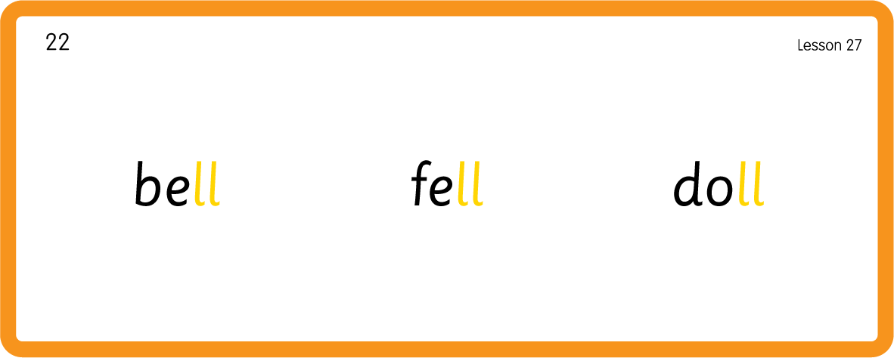
Hear Phonemes
USING JNL691
BACK

Slide 8
Teach Grapheme Caption
USING JNL686
FRONT

Slide 9
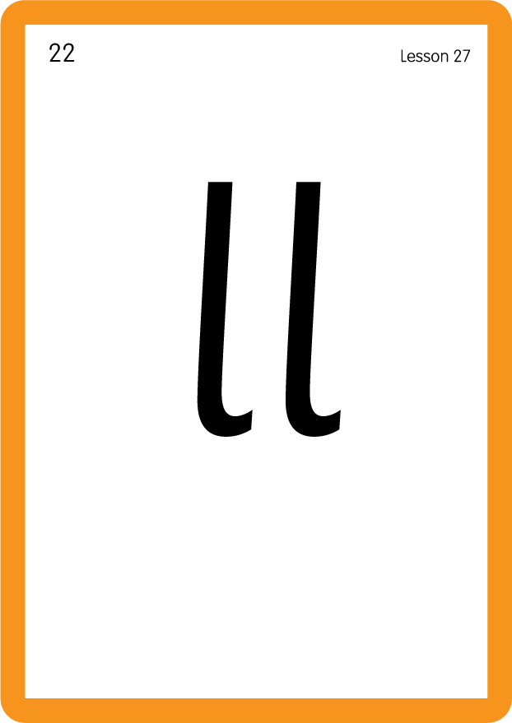
Review Lowercase Formation
USING JL686
BACK

Slide 10

Explain Decoding

Slide 11
Model Blending Phonemes
t
e
ll
USING SOUND BUTTONS
Sound Buttons
Vowel
Consonant
Consonant Digraph
Long Vowel Sound
R-controlled Digraph
Split Digraph
Syllable / Silent Letter

Slide 12
Model Blending Phonemes
b
e
ll
USING SOUND BUTTONS
Sound Buttons
Vowel
Consonant
Consonant Digraph
Long Vowel Sound
R-controlled Digraph
Split Digraph
Syllable / Silent Letter

Slide 13
Model Blending Phonemes
p
u
ll
USING SOUND BUTTONS
Sound Buttons
Vowel
Consonant
Consonant Digraph
Long Vowel Sound
R-controlled Digraph
Split Digraph
Syllable / Silent Letter

Slide 14

Explain Encoding

Slide 15
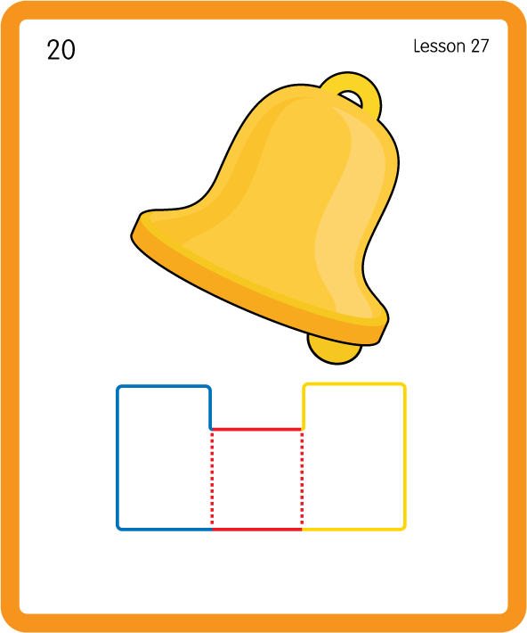
Build a Decodable Word
USING JNL689
BACK

Slide 16
Build a Decodable Word
USING JNL689
FRONT

Slide 17

Practise with Alien Words
USING JNL692
BACK

Slide 18
Practise with Alien Words
USING JNL692
FRONT

Slide 19
Practise Common Exception Words
USING JNL687
FRONT

Slide 20
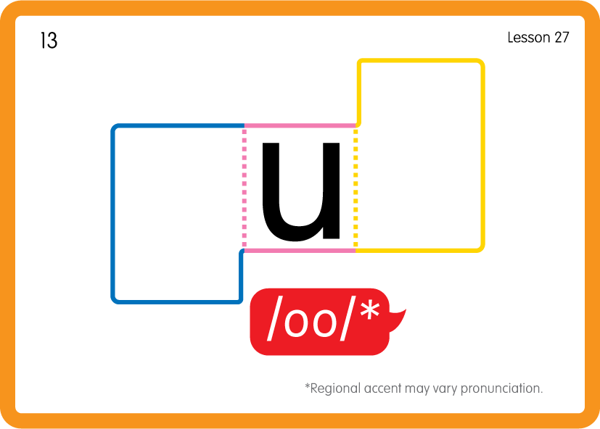
Practise Common Exception Words
USING JNL687
BACK

Slide 21

Practise Common Exception Words
USING JNL687
FRONT

Slide 22
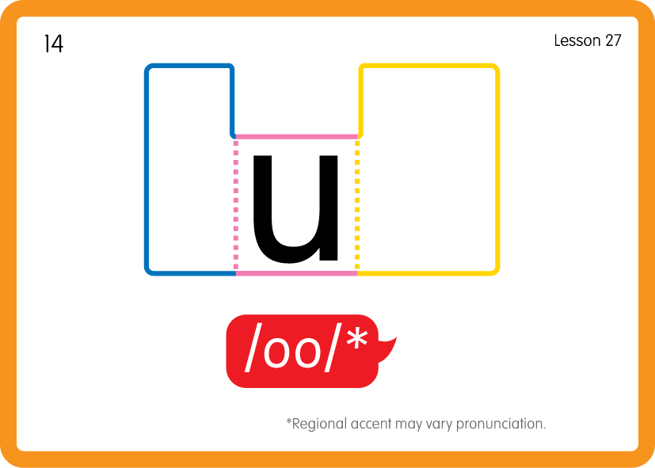
Practise Common Exception Words
USING JNL687
BACK

Slide 23

Practise Building Words
PRACTISE – 10MINS
t
p
i
a
e
u
f
b
ll
o
d
USING MAGNETIC LETTERS AND A WHITEBOARD

Slide 24
Practise Building Words
PRACTISE – 10MINS
t
p
i
a
e
u
f
b
ll
o
d
bell tell pull fell bull doll pill
USING MAGNETIC LETTERS AND A WHITEBOARD

Slide 25
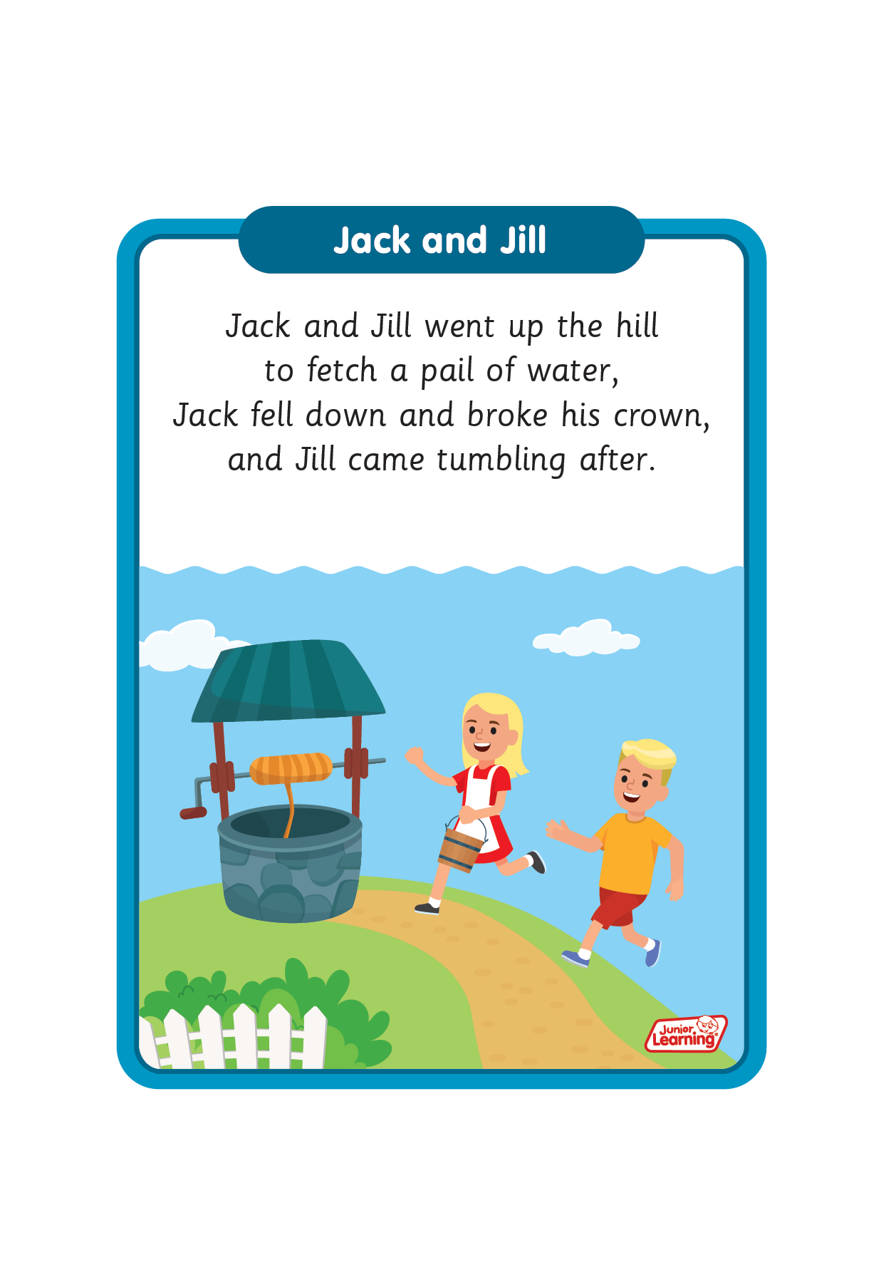
Sing ‘Jack and Jill’.
Draw ‘ll’ in a variety of sizes and media, for example using chalk to draw on the ground.
Make grapheme with playdough.
Explore words in environment for decoding.
ll

