Slide 1



s | a | t | p | i | n | m | d
g | o | c | k | ck | e | u | r
h | b | f | ff | l | ll | ss
Letter Sound 'ss'
Lesson 28

Slide 2

Learn and practise consonant digraph ss.
Recall s a t p i n m d g o c k ck e u r h b f ff l ll using flashcards.
Recall Common Exception Word as I is no go to into the put his of pull full.
Phonemic Awareness Cards
Grapheme to Phoneme Cards
Phoneme Frame Cards
Alien Word Cards
JNL691
JNL686
JNL689
JNL692

Slide 3






















Recall s a t p i n m d g o c k ck e u r h b f ff l ll using flashcards.

Slide 4














Review Phase 2 Common Exception Words as I is no go to into the put his of pull full.

Slide 5

Review the Alphabet Song
a, b, c, d, e, f, g (pause)
h, i, j, k, l, m, n (pause)
o, p, q (pause) r, s, t (pause)
u v w (pause) x y z (pause)
Now I know my abc's, Next time won't you sing with me.

Slide 6
Hear Phonemes
USING JNL691
FRONT

Slide 7
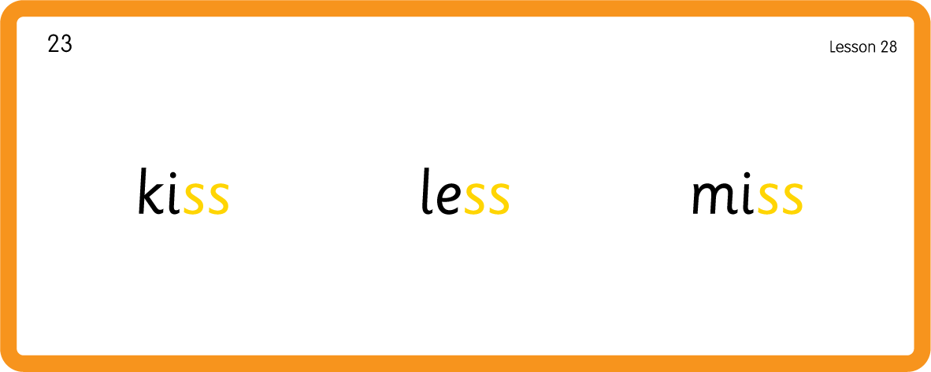
Hear Phonemes
USING JNL691
BACK

Slide 8
Teach Grapheme Caption
USING JNL686
FRONT

Slide 9

Review Lowercase Formation
USING JNL686
BACK

Slide 10

Explain Decoding

Slide 11
Model Blending Phonemes
m
e
ss
USING SOUND BUTTONS
Sound Buttons
Vowel
Consonant
Consonant Digraph
Long Vowel Sound
R-controlled Digraph
Split Digraph
Syllable / Silent Letter

Slide 12
Model Blending Phonemes
b
o
ss
USING SOUND BUTTONS
Sound Buttons
Vowel
Consonant
Consonant Digraph
Long Vowel Sound
R-controlled Digraph
Split Digraph
Syllable / Silent Letter

Slide 13
Model Blending Phonemes
l
e
ss
USING SOUND BUTTONS
Sound Buttons
Vowel
Consonant
Consonant Digraph
Long Vowel Sound
R-controlled Digraph
Split Digraph
Syllable / Silent Letter

Slide 14

Explain Encoding

Slide 15
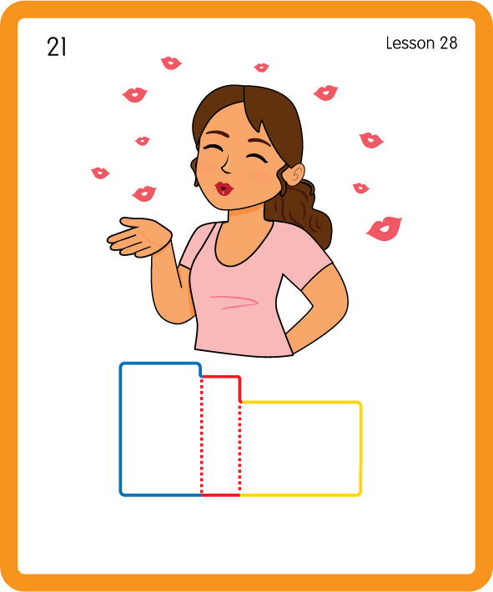
Build a Decodable Word
USING JNL689
BACK

Slide 16
Build a Decodable Word
USING JNL689
FRONT

Slide 17
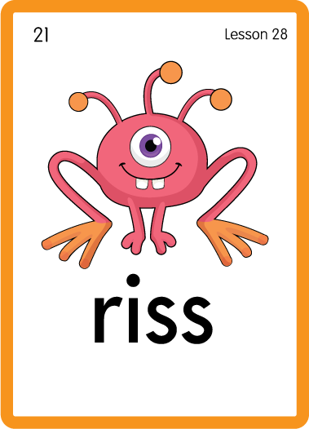
Practise with Alien Words
USING JNL692
BACK

Slide 18
Practise with Alien Words
USING JNL692
FRONT

Slide 19

Practise Building Words
PRACTISE – 10MINS
l
h
m
k
o
b
u
f
ss
e
i
USING MAGNETIC LETTERS AND A WHITEBOARD

Slide 20
Practise Building Words
PRACTISE – 10MINS
l
h
m
k
o
b
u
f
ss
e
i
kiss fuss mess boss less hiss
USING MAGNETIC LETTERS AND A WHITEBOARD

Slide 21
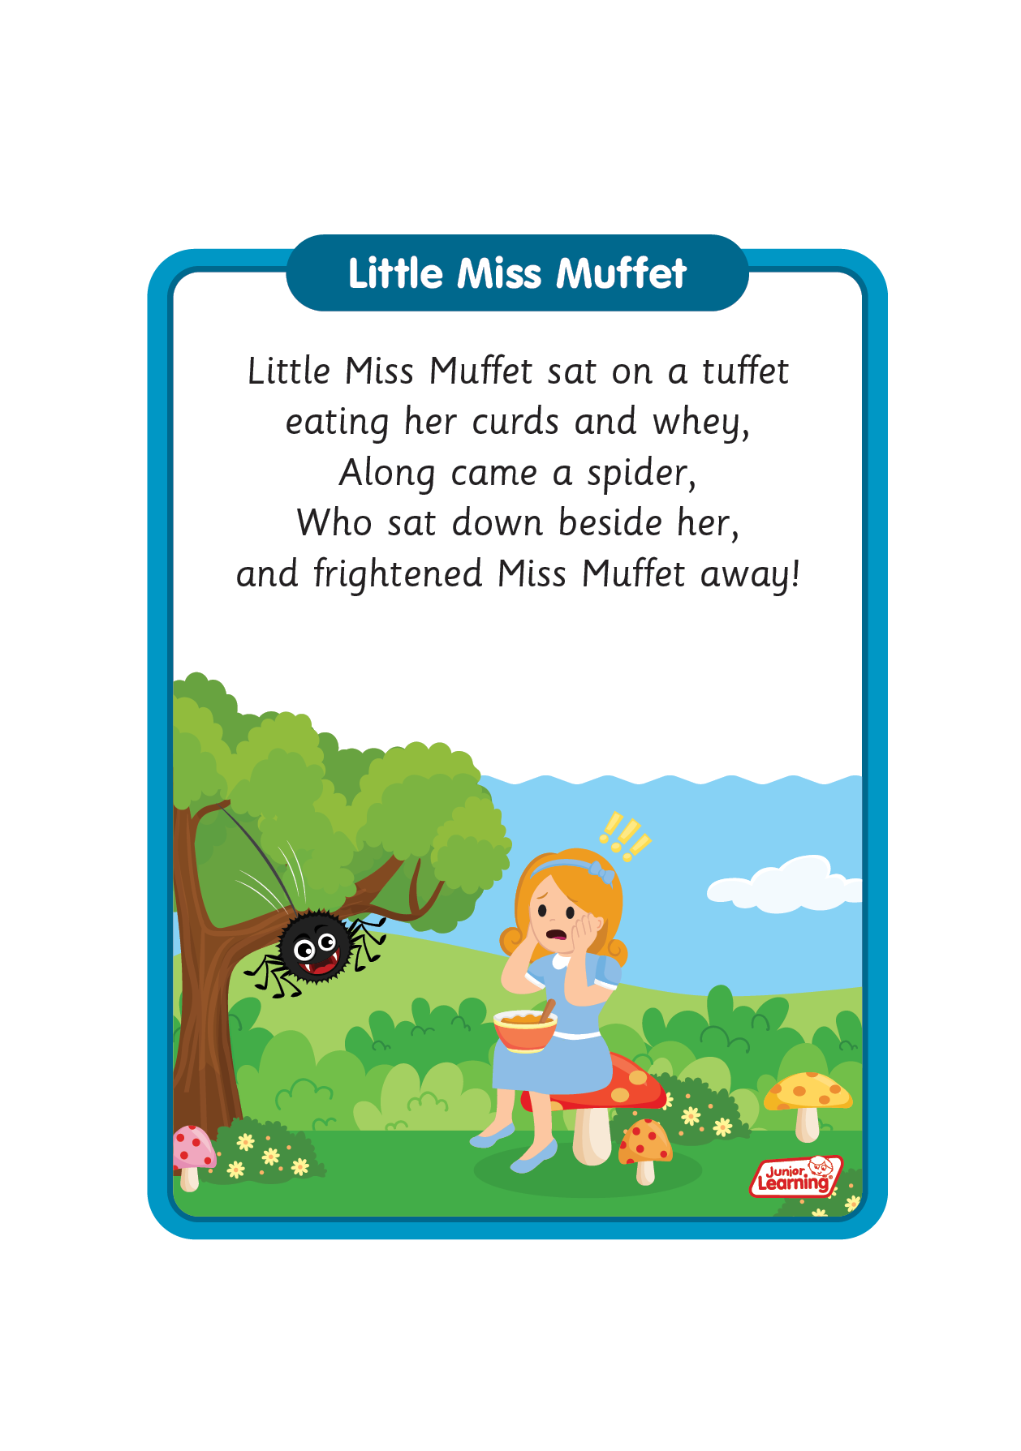
Sing ‘Little Miss Muffet'.
Draw ‘ss’ in a variety of sizes and media, for example using chalk to draw on the ground.
Use letters for building words and encoding.
Using pipe cleaners make a ‘s’ shape.
Draw or paint a snake and label it ‘hiss!’.
ss

