Slide 1

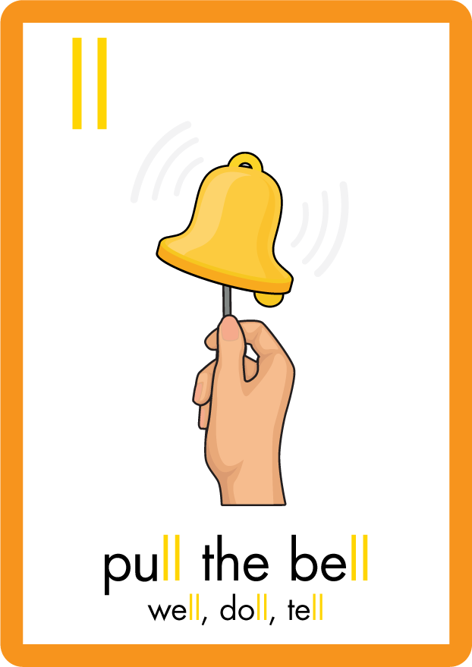
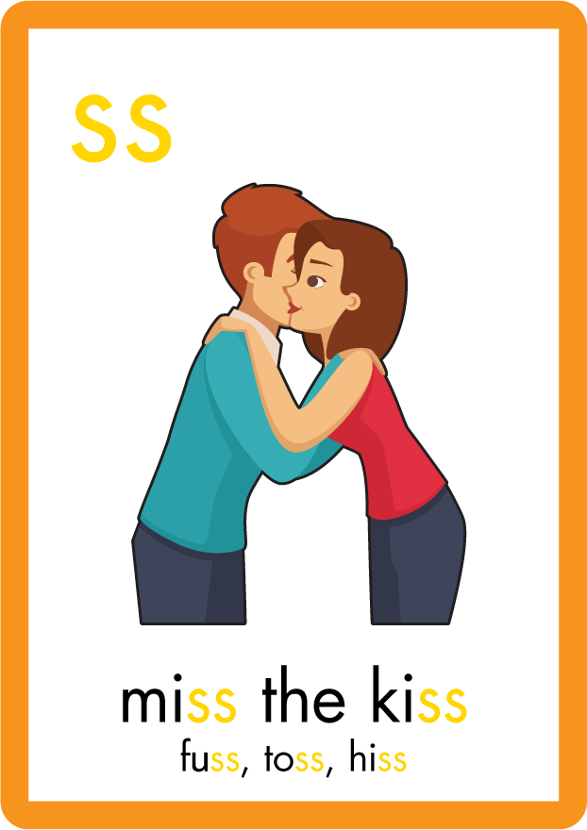
s | a | t | p | i | n | m | d
g | o | c | k | ck | e | u | r
h | b | f | ff | l | ll | ss
Review l ll ss
Lesson 29

Slide 2



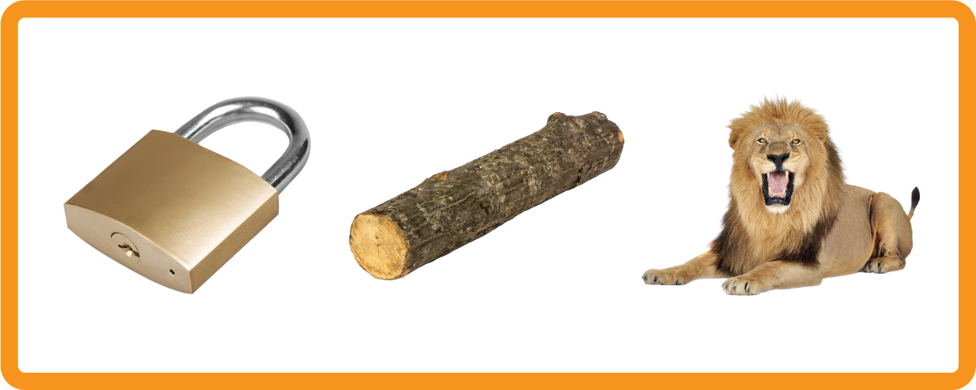


Learn and practise letter / sound and digraphs l ll ss.
Recall s a t p i n m d g o c k ck e u r h b f ff.
Recall Common Exception Words as I is no go to into put has his of pull full.
Phonemic Awareness Cards
Grapheme to Phoneme Cards
Phoneme Frame Cards
Alien Word Cards
Common Exception Word Cards
High Frequency Word Cards
JNL691
JNL686
JNL689
JNL692
JNL687
JNL688

Slide 3






















Recall s a t p i n m d g o c k ck e u r h b f ff l ll ss.

Slide 4













Review Phase 2 Common Exception Words as I is no go to into the put his of pull full.

Slide 5

Review the Alphabet Song
a, b, c, d, e, f, g (pause)
h, i, j, k, l, m, n (pause)
o, p, q (pause) r, s, t (pause)
u v w (pause) x y z (pause)
Now I know my abc's, Next time won't you sing with me.

Slide 6


Hear Phonemes
USING JNL691
FRONT

Slide 7
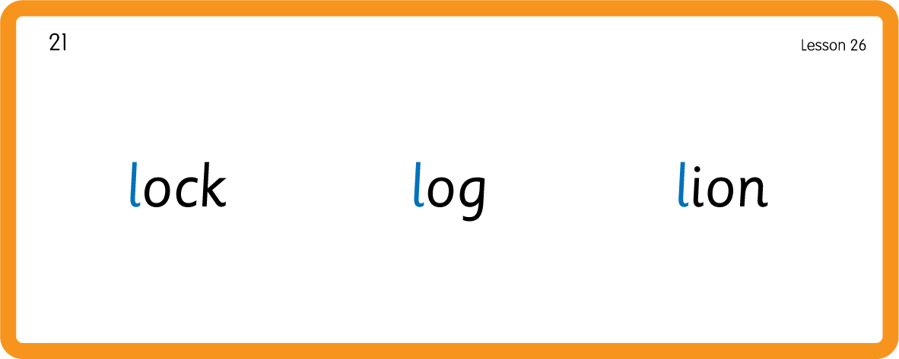
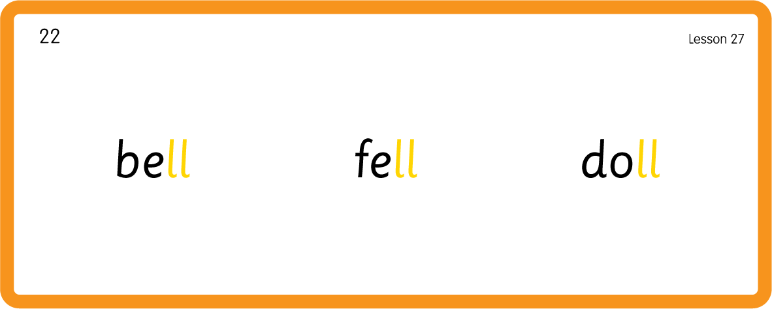
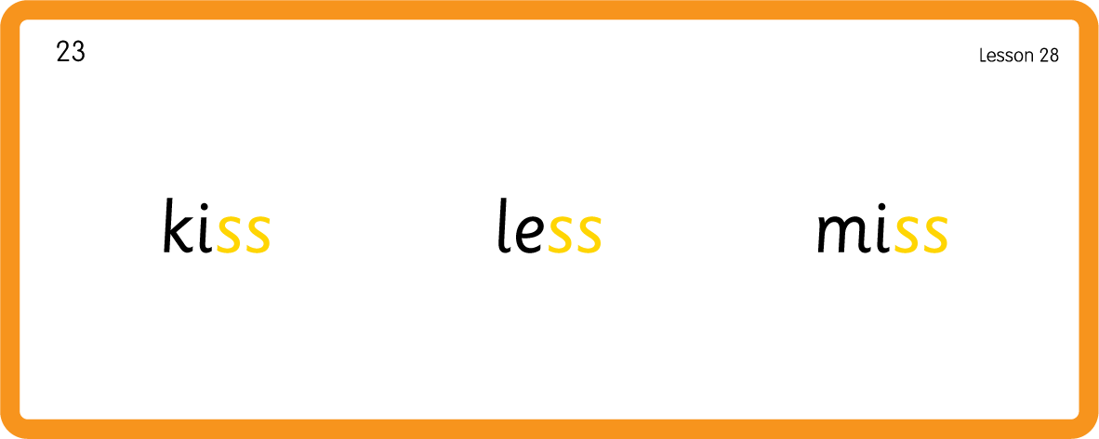
Hear Phonemes
USING JNL691
BACK

Slide 8
Review Grapheme Caption
USING JNL686
FRONT

Slide 9
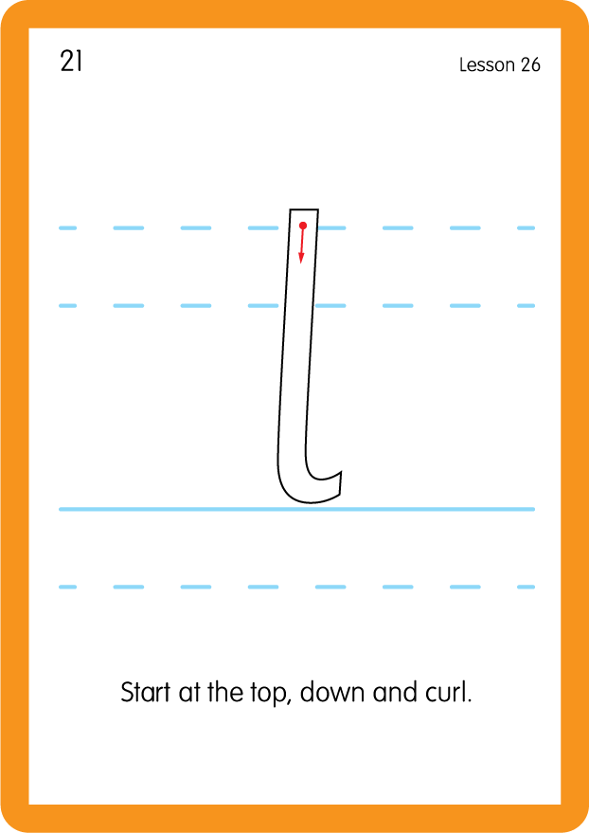
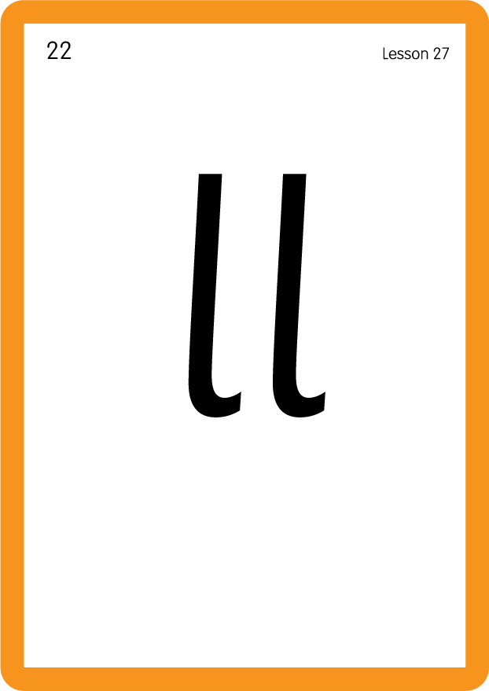

Review Lowercase Formation
USING JNL686
BACK

Slide 10
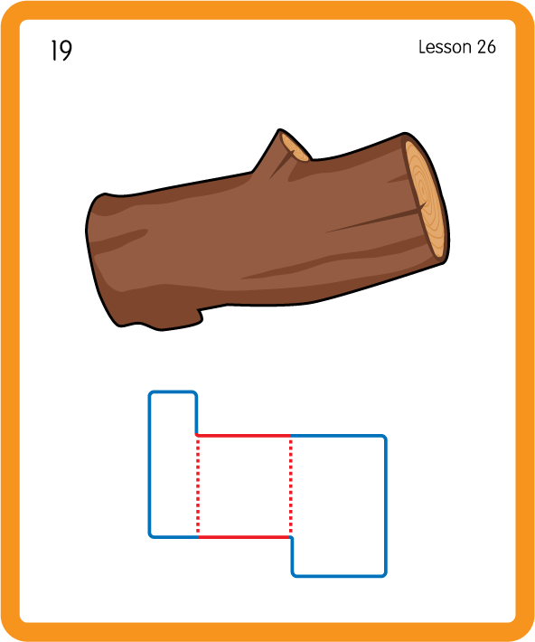
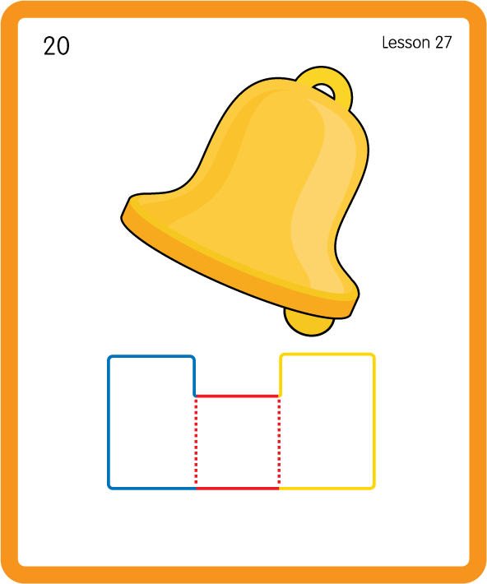
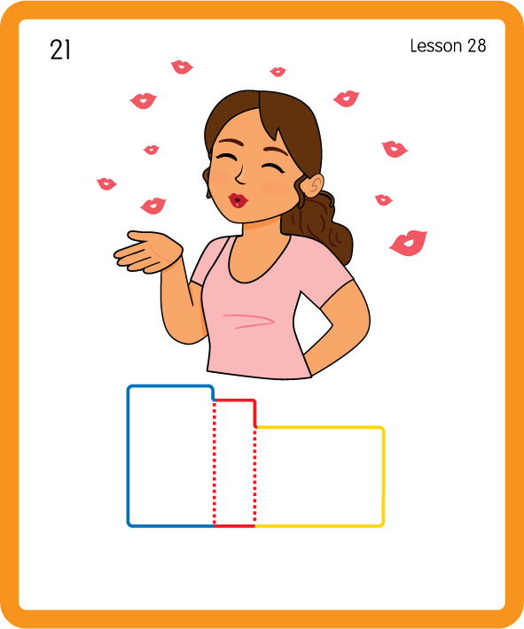
Build a Decodable Word
USING JNL689
BACK

Slide 11


Build a Decodable Word
USING JNL689
FRONT

Slide 12
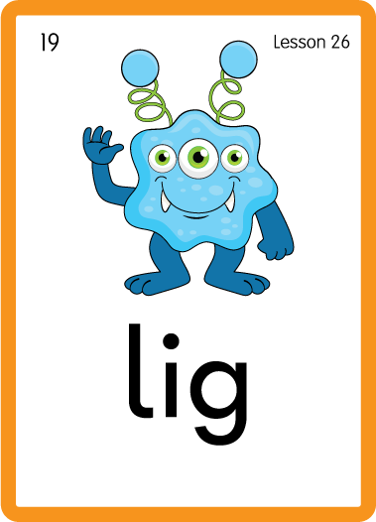


Practise with Alien Words
USING JNL692
BACK

Slide 13


Practise with Alien Words
USING JNL692
FRONT

Slide 14
Practise Common Exception Words
USING JNL687
FRONT

Slide 15
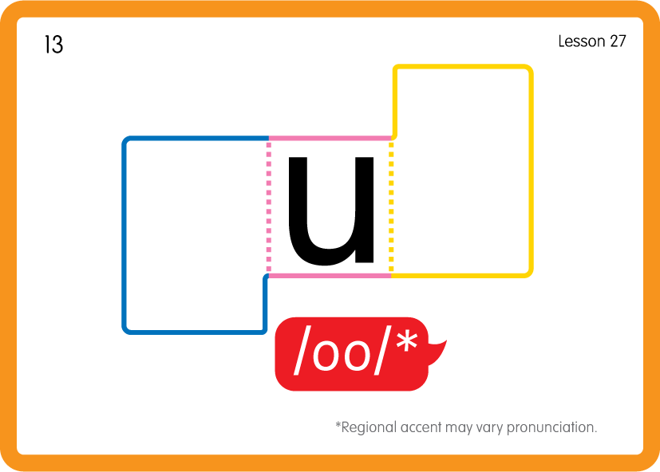
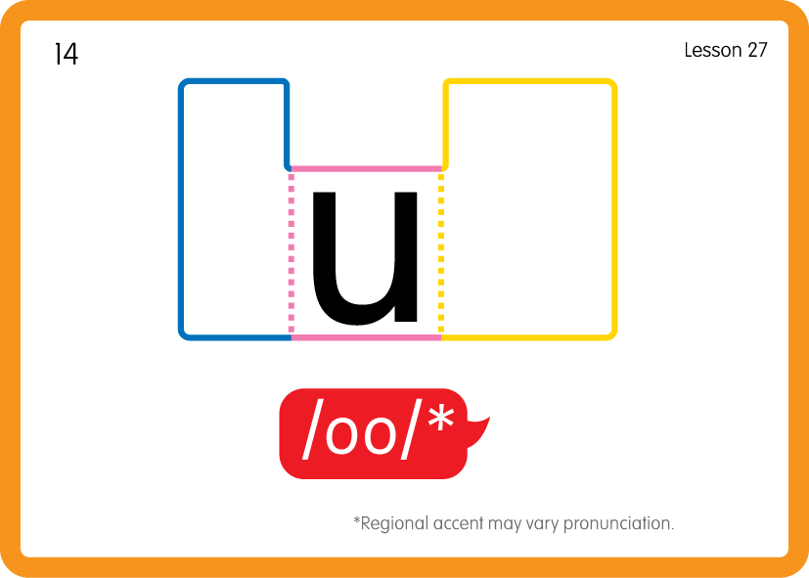
Practise Common Exception Words
USING JNL687
BACK

Slide 16
Practise High Frequency Words
USING JNL688
FRONT

Slide 17
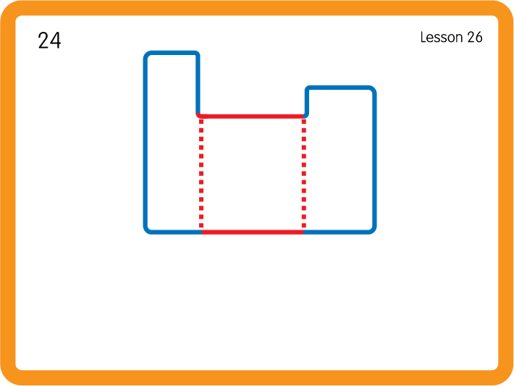
Practise High Frequency Words
USING JNL688
BACK

