Slide 1























s | a | t | p | i | n | m | d
g | o | c | k | ck | e | u | r
h | b | f | ff | l | ll | ss
Review Phase 2
Lesson 30 (Note: due to the amount of content in Phase 2, an additional lesson can be used for consolidating learning)

Slide 2
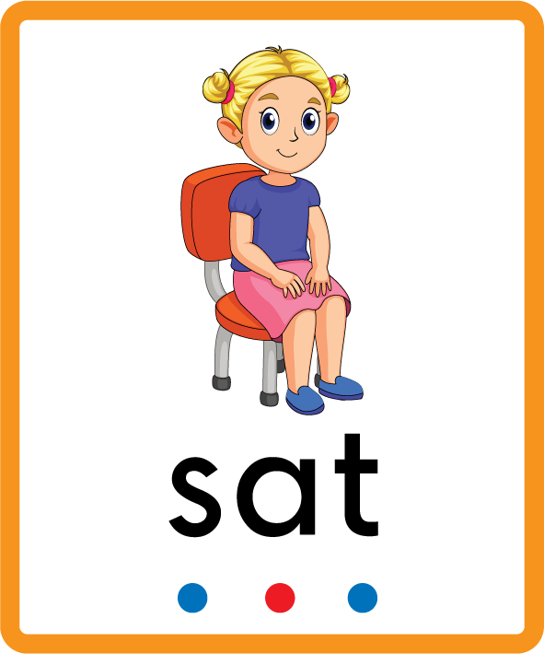
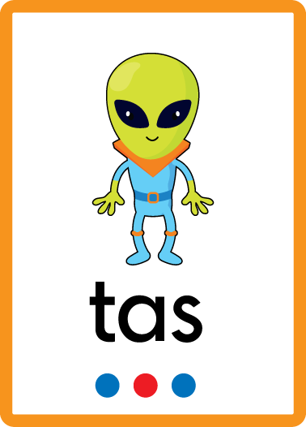
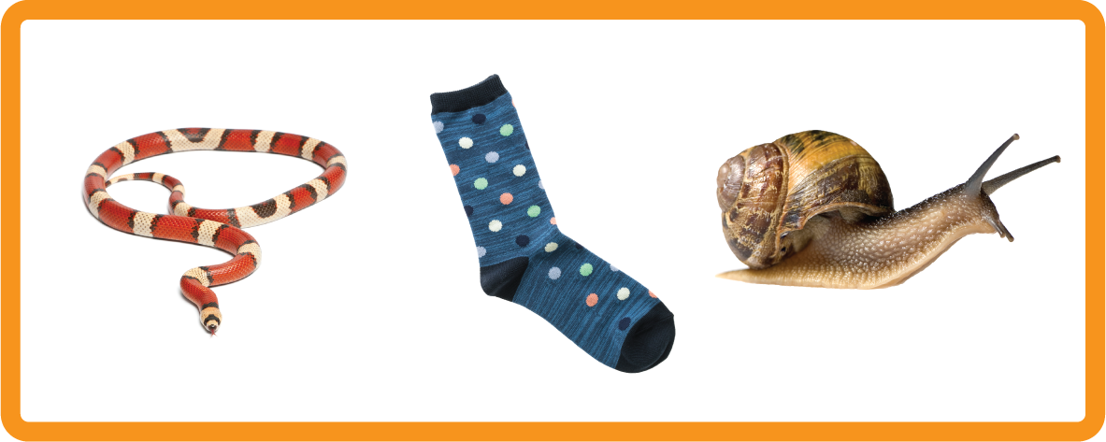

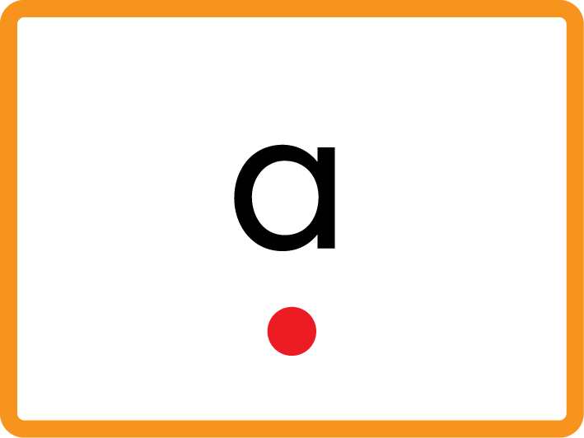
Learn and practise Phase 2 letter sounds.
Recall s a t p i n m d g o c k ck e u r h b f ff l ll ss using flashcards.
Recall Common Exception Words as I is no go to into the put his of pull full.
All Phase 2 Supplementary Resources can be used as part of Review.
Phonemic Awareness Cards
Grapheme to Phoneme Cards
Phoneme Frame Cards
Alien Word Cards
Common Exception Word Cards
High Frequency Word Cards
JNL691
JNL686
JNL689
JNL692
JNL687
JNL688

Slide 3
Recall s a t p i n m d g o c k ck e u r h b f ff l ll ss using flashcards.

Slide 4

Review the Alphabet Song
a, b, c, d, e, f, g (pause)
h, i, j, k, l, m, n (pause)
o, p, q (pause) r, s, t (pause)
u v w (pause) x y z (pause)
Now I know my abc's, Next time won't you sing with me.

Slide 5





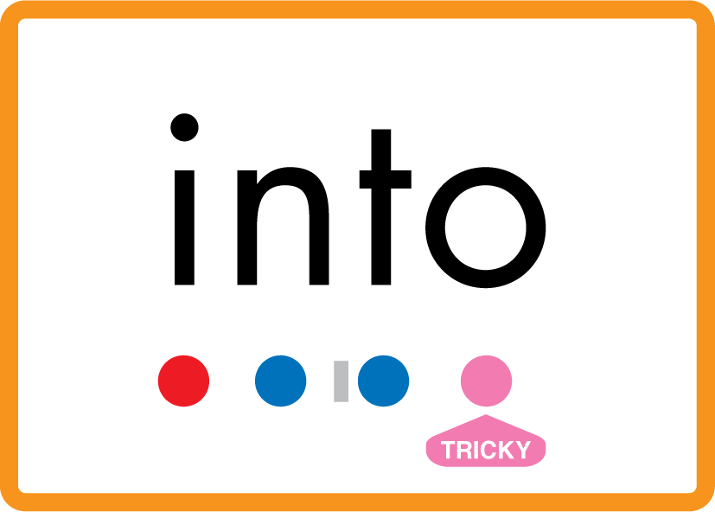


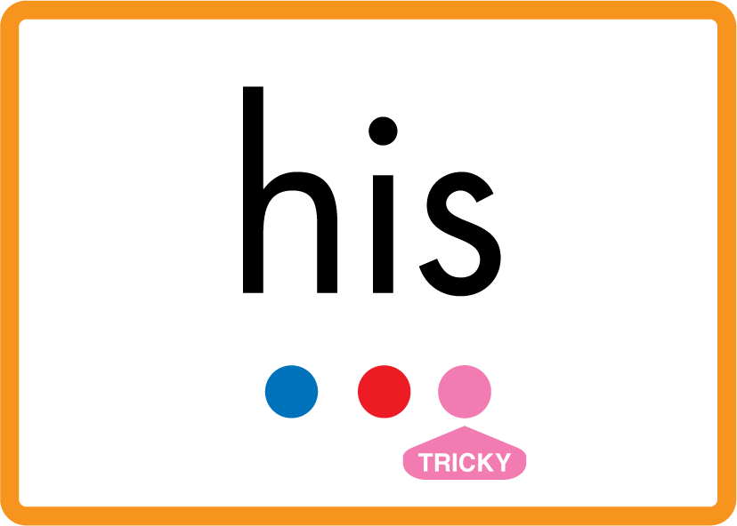



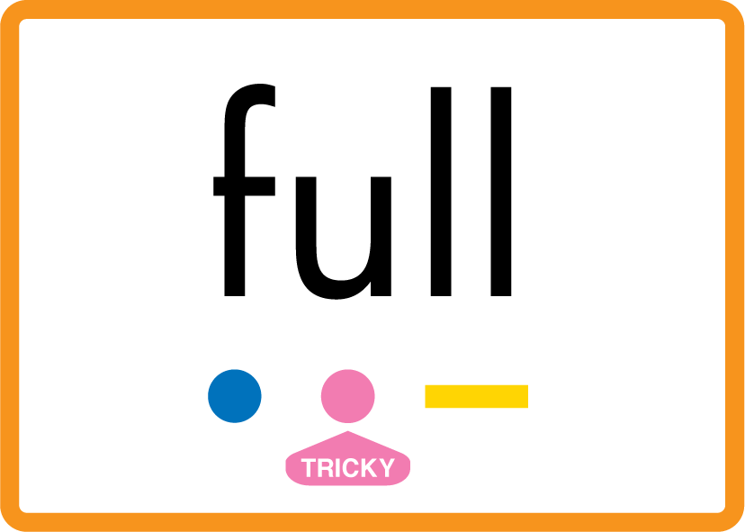
Review Phase 2 Common Exception Words as I is no go to into the put his has of pull full.

Slide 6























Review Phase 2 Decodable High Frequency Words a at it in an am dad did and got on not can get mum up had him big back but if off let.

Slide 7
Find a Letter
s | a | t | p | i | n | m | d
g | o | c | k | ck | e | u | r
h | b | f | ff | l | ll | ss
WHEN GIVEN A LETTER SOUND

Slide 8
Find a Letter
s | a | t | p | i | n | m | d
g | o | c | k | ck | e | u | r
h | b | f | ff | l | ll | ss
WHEN GIVEN A LETTER NAME

Slide 9
Model Blending Phonemes
i
f
USING SOUND BUTTONS
Sound Buttons
Vowel
Consonant
Consonant Digraph
Long Vowel Sound
R-controlled Digraph
Split Digraph
Syllable / Silent Letter

Slide 10
Model Blending Phonemes
a
m
USING SOUND BUTTONS
Sound Buttons
Vowel
Consonant
Consonant Digraph
Long Vowel Sound
R-controlled Digraph
Split Digraph
Syllable / Silent Letter

Slide 11
Model Blending Phonemes
o
n
USING SOUND BUTTONS
Sound Buttons
Vowel
Consonant
Consonant Digraph
Long Vowel Sound
R-controlled Digraph
Split Digraph
Syllable / Silent Letter

Slide 12
Model Blending Phonemes
u
p
USING SOUND BUTTONS
Sound Buttons
Vowel
Consonant
Consonant Digraph
Long Vowel Sound
R-controlled Digraph
Split Digraph
Syllable / Silent Letter

Slide 13
Model Blending Phonemes
i
p
USING SOUND BUTTONS
Sound Buttons
Vowel
Consonant
Consonant Digraph
Long Vowel Sound
R-controlled Digraph
Split Digraph
Syllable / Silent Letter

Slide 14
Model Blending Phonemes
o
ck
USING SOUND BUTTONS
Sound Buttons
Vowel
Consonant
Consonant Digraph
Long Vowel Sound
R-controlled Digraph
Split Digraph
Syllable / Silent Letter

