Slide 1


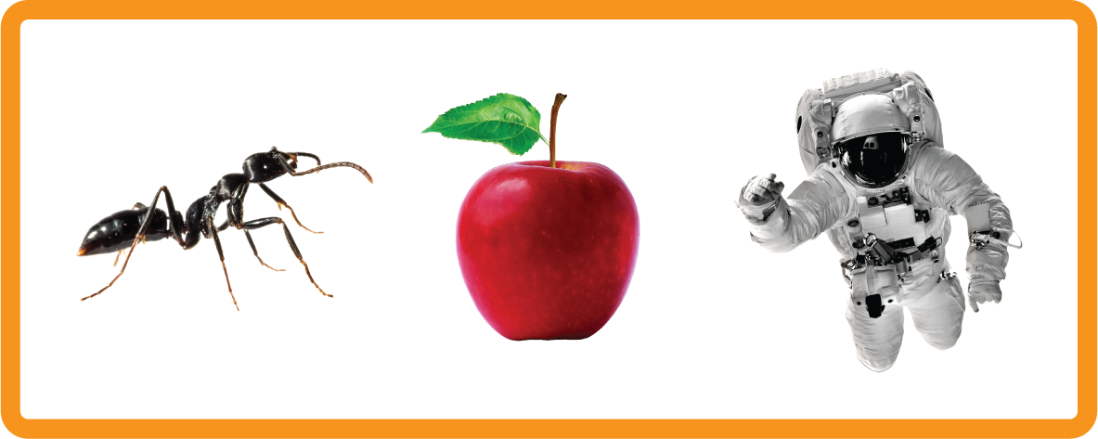
a | e | i | o | u
Review - 'a'
Lesson 31

Slide 2


Review short vowel a.
Recall all GPCs learned so far using flashcards.
Review Phase 2 Common Exception Words as I is no go to into the put has his of pull full.
Phonemic Awareness Cards
Grapheme to Phoneme Cards
Phoneme Frame Cards
Alien Word Cards
High Frequency Word Cards
JNL691
JNL686
JNL689
JNL692
JNL688

Slide 3






















Recall all GPCs learned so far using flashcards.

Slide 4














Review Phase 2 Common Exception Words as I is no go to into the put his has of pull full.

Slide 5
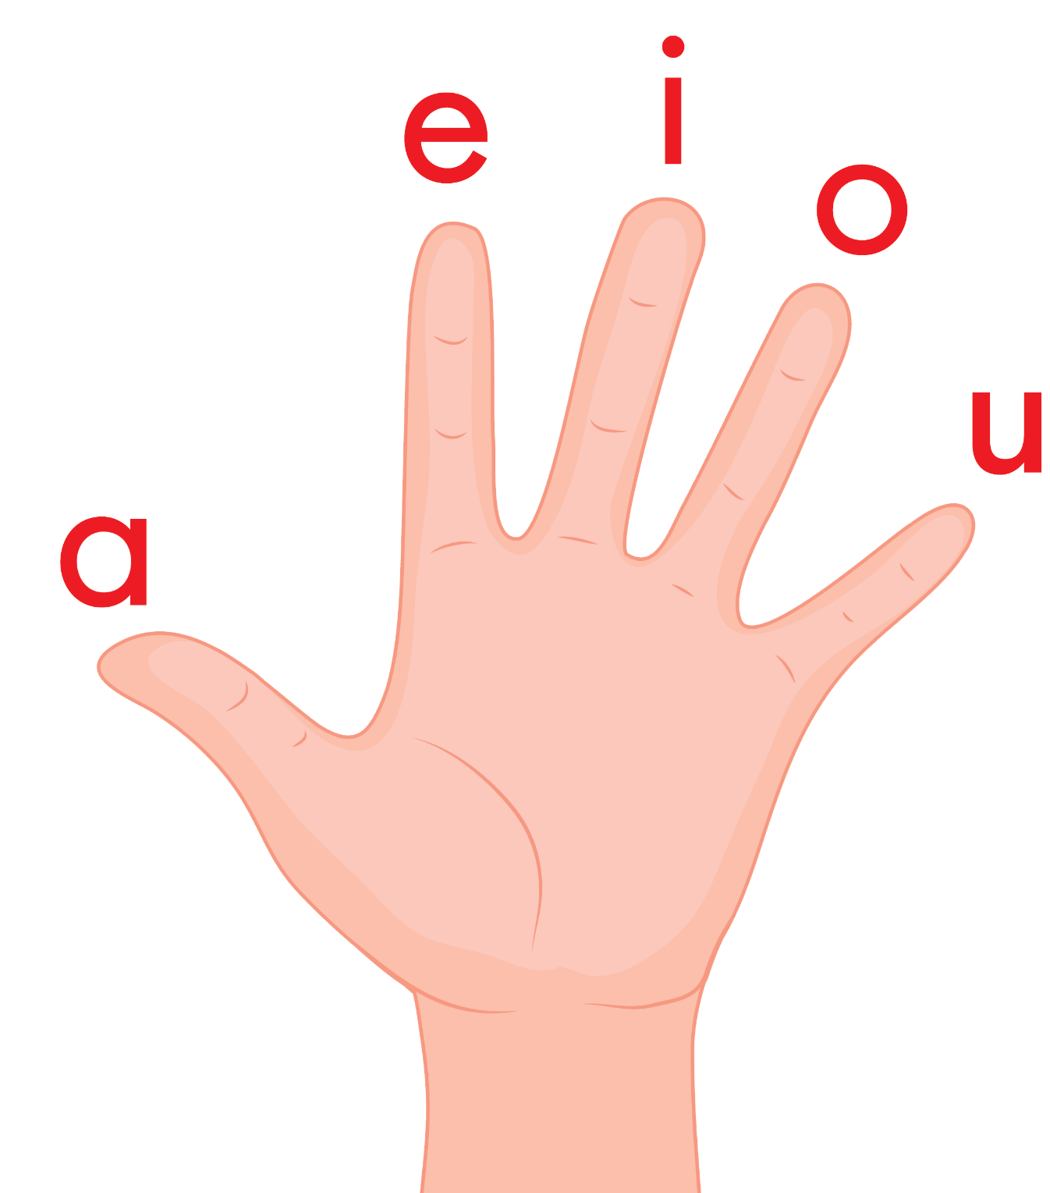
Review the Vowel Hand Song
a, e, i, o, u a, e, i, o, u a, e, i, o, u (short sounds only)
are short vowels that we use
a vowel is in every word, a vowel is in every word,
a vowel is in every word that we read or write.

Slide 6

Review the Alphabet Song
a, b, c, d, e, f, g (pause)
h, i, j, k, l, m, n (pause)
o, p, q (pause) r, s, t (pause)
u v w (pause) x y z (pause)
Now I know my abc's, Next time won't you sing with me.

Slide 7
Hear Phonemes
USING JNL691
FRONT

Slide 8
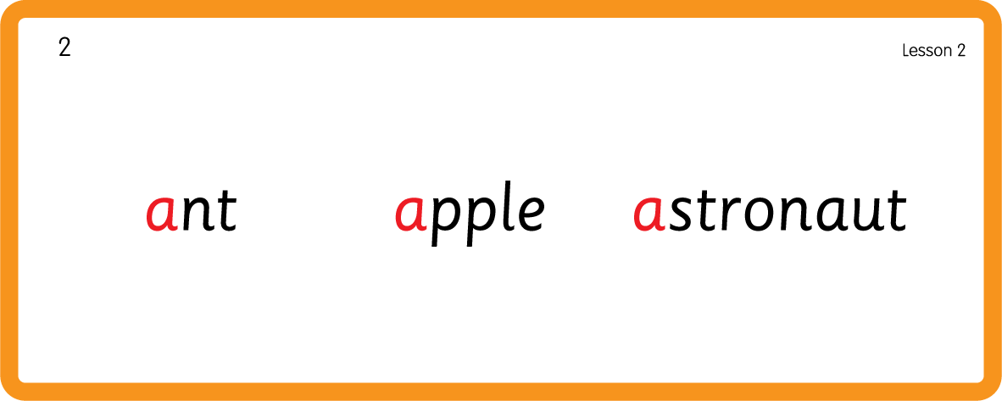
Hear Phonemes
USING JNL691
BACK

Slide 9
Review Grapheme Caption
USING JNL686
FRONT

Slide 10
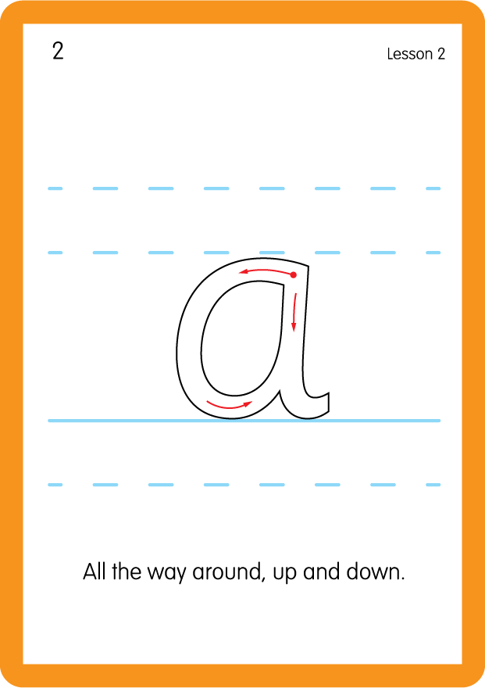
Review Lowercase Formation
USING JNL686
BACK

Slide 11

Explain Decoding

Slide 12
Model Blending Phonemes
c
a
t
USING SOUND BUTTONS
Sound Buttons
Vowel
Consonant
Consonant Digraph
Long Vowel Sound
R-controlled Digraph
Split Digraph
Syllable / Silent Letter

Slide 13
Model Blending Phonemes
p
a
ck
USING SOUND BUTTONS
Sound Buttons
Vowel
Consonant
Consonant Digraph
Long Vowel Sound
R-controlled Digraph
Split Digraph
Syllable / Silent Letter

Slide 14
Model Blending Phonemes
p
a
n
USING SOUND BUTTONS
Sound Buttons
Vowel
Consonant
Consonant Digraph
Long Vowel Sound
R-controlled Digraph
Split Digraph
Syllable / Silent Letter

Slide 15

Explain Encoding

Slide 16
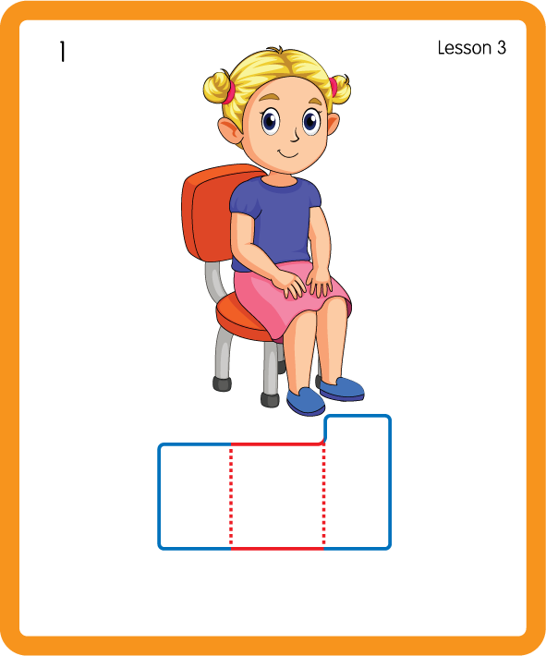
Build a Decodable Word
USING JNL689
BACK

Slide 17
Build a Decodable Word
USING JNL689
FRONT

Slide 18
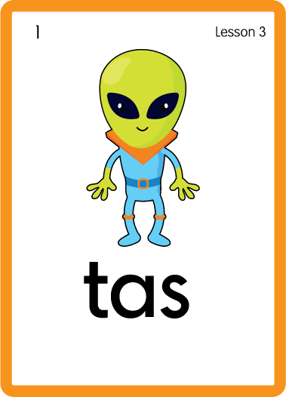
Practise with Alien Words
USING JNL692
BACK

Slide 19
Practise with Alien Words
USING JNL692
FRONT

Slide 20




Practise High Frequency Words
USING JNL688
FRONT

Slide 21
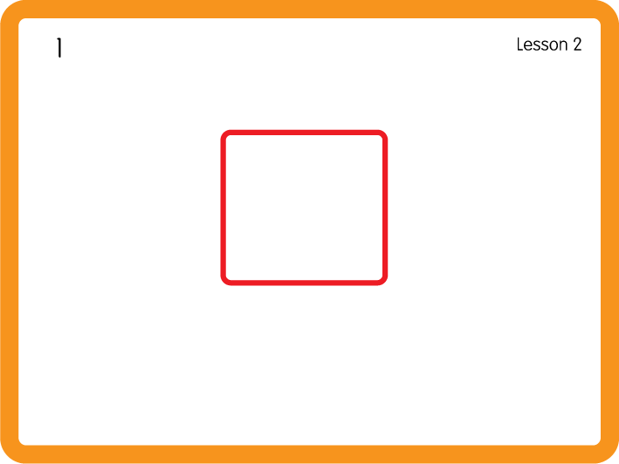
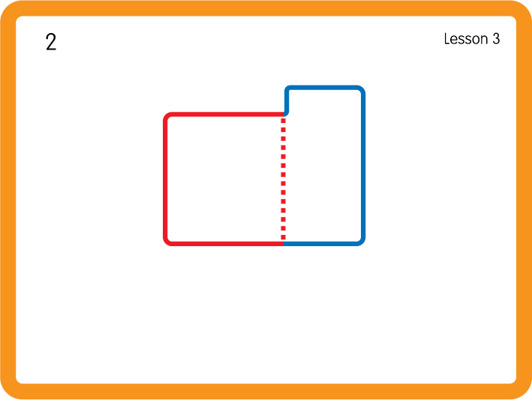
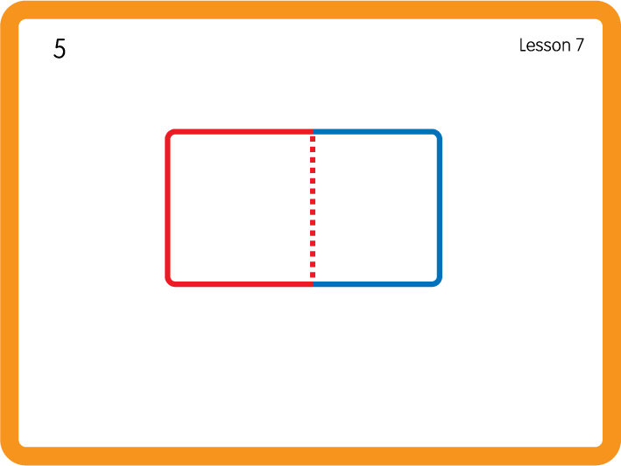
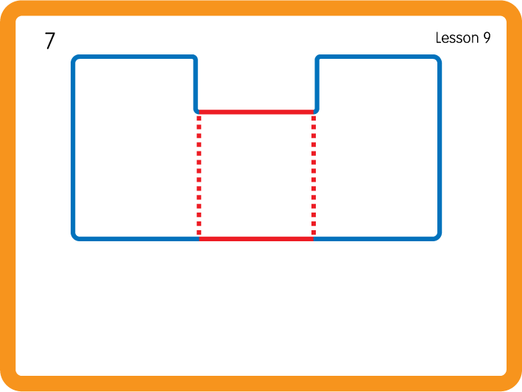
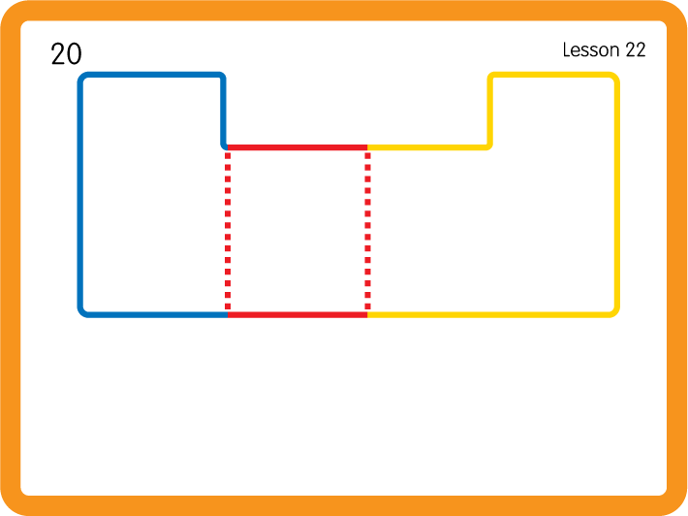
Practise High Frequency Words
USING JNL688
BACK

Slide 22

Practise Building Words
PRACTISE – 10MINS
s
a
t
p
n
m
d
ck
r
b
c
USING MAGNETIC LETTERS AND A WHITEBOARD

Slide 23
Practise Building Words
PRACTISE – 10MINS
s
a
t
p
n
m
d
ck
r
b
c
sat pat pan map mad can pack ran bat
USING MAGNETIC LETTERS AND A WHITEBOARD

