Slide 1


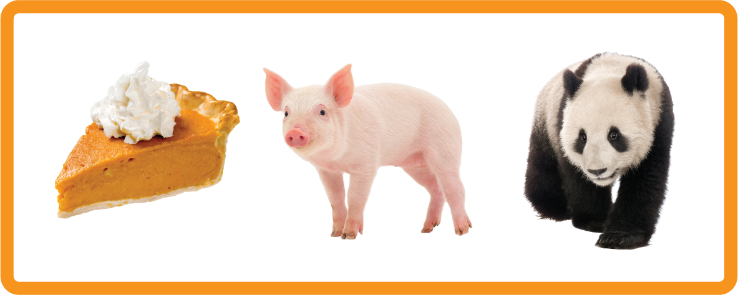
s | a | t | p | i | n | m | d
g | o | c | k | ck | e | u | r
h | b | f | ff | l | ll | ss
Letter Sound 'p'
Lesson 4

Slide 2

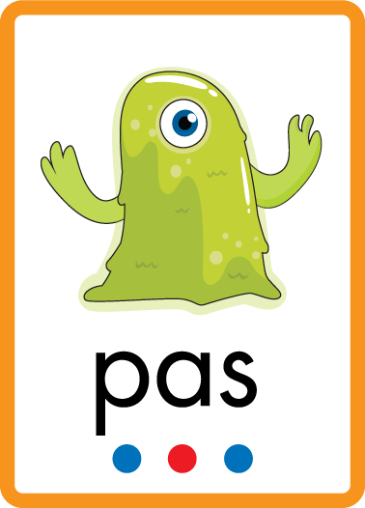
Learn and practise letter / sound p.
Recall s a t.
Phonemic Awareness Cards
Grapheme to Phoneme Cards
Phoneme Frame Cards
Alien Word Cards
JNL691
JNL686
JNL689
JNL692

Slide 3



Recall s a t.

Slide 4

Review the Alphabet Song
a, b, c, d, e, f, g (pause)
h, i, j, k, l, m, n (pause)
o, p, q (pause) r, s, t (pause)
u v w (pause) x y z (pause)
Now I know my abc's, Next time won't you sing with me.

Slide 5
Hear Phonemes
USING JNL691
FRONT

Slide 6
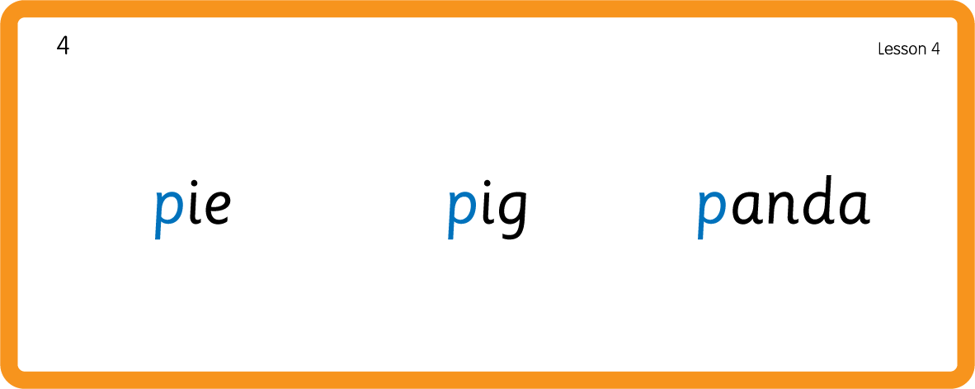
Hear Phonemes
USING JNL691
BACK

Slide 7
Teach Grapheme Caption
USING JNL686
FRONT

Slide 8
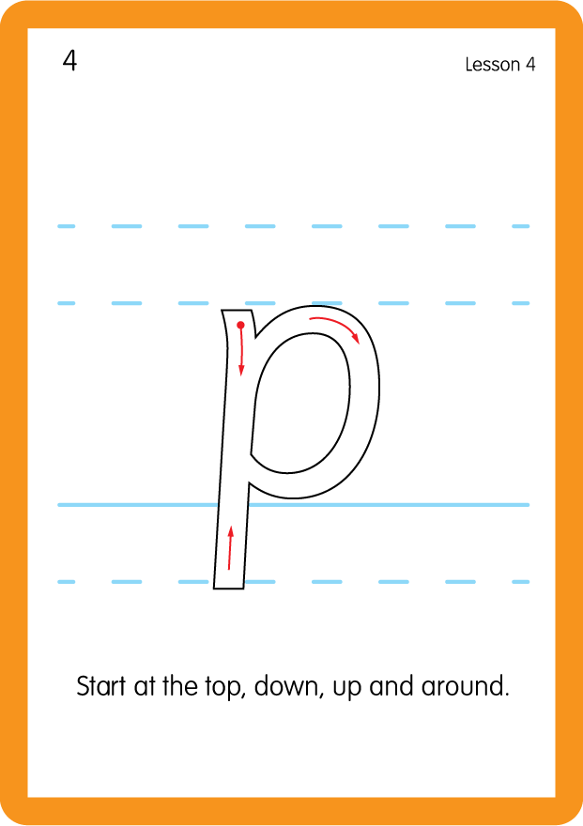
Teach Lowercase Formation
USING JNL686
BACK

Slide 9

Explain Decoding

Slide 10
Model Blending Phonemes
a
t
USING SOUND BUTTONS
Sound Buttons
Vowel
Consonant
Consonant Digraph
Long Vowel Sound
R-controlled Digraph
Split Digraph
Syllable / Silent Letter

Slide 11
Model Blending Phonemes
s
a
t
USING SOUND BUTTONS
Sound Buttons
Vowel
Consonant
Consonant Digraph
Long Vowel Sound
R-controlled Digraph
Split Digraph
Syllable / Silent Letter

Slide 12
Model Blending Phonemes
p
a
t
USING SOUND BUTTONS
Sound Buttons
Vowel
Consonant
Consonant Digraph
Long Vowel Sound
R-controlled Digraph
Split Digraph
Syllable / Silent Letter

Slide 13

Explain Encoding

Slide 14
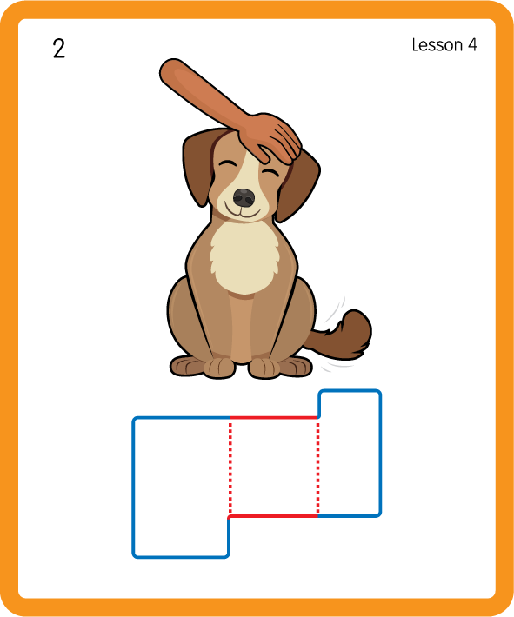
Build a Decodable Word
USING JNL689
BACK

Slide 15

Build a Decodable Word
USING JNL689
FRONT

Slide 16
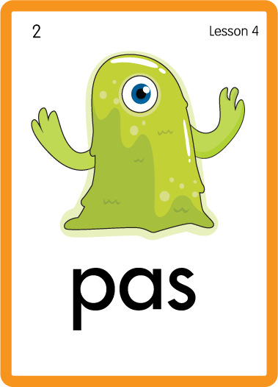
Practise with Alien Words
USING JNL692
BACK

Slide 17
Practise with Alien Words
USING JNL692
FRONT

Slide 18

Practise Building Words
PRACTISE – 10MINS
s
a
t
p
USING MAGNETIC LETTERS AND A WHITEBOARD

Slide 19
Practise Building Words
PRACTISE – 10MINS
s
a
t
p
pat tap sap
USING MAGNETIC LETTERS AND A WHITEBOARD

Slide 20

Sing 'Pop Goes the Weasel'.
Draw ‘p’ in a variety of sizes and media, for example using chalk to draw on the ground.
Make grapheme with playdough.
Collect together a tray of fruit for children to taste the p words; sections of peach, pear, plum.
p

