Slide 1


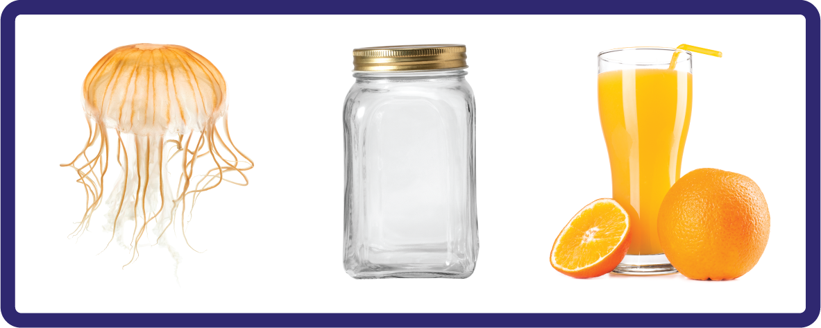
j | v | w | x | y | z | zz | qu | ch
sh | th | ng | ai | ee | igh | oa | oi | oo
ow | ar | air | ear | er | ur | or | ure
Letter Sound 'j'
Lesson 1

Slide 2

Learn and practise letter / sound j.
Recall all GPCs learned so far using flashcards.
Review Phase 2 Common Exception Words as I is no go to into the put his has of pull full.
Phonemic Awareness Cards
Grapheme to Phoneme Cards
Phoneme Frame Cards
Alien Word Cards
JNL691
JNL686
JNL689
JNL692

Slide 3























Recall all GPCs learned so far using flashcards.

Slide 4














Review Phase 2 Common Exception Words as I is no go to into the put his has of pull full.

Slide 5
Hear Phonemes
USING JNL691
FRONT

Slide 6
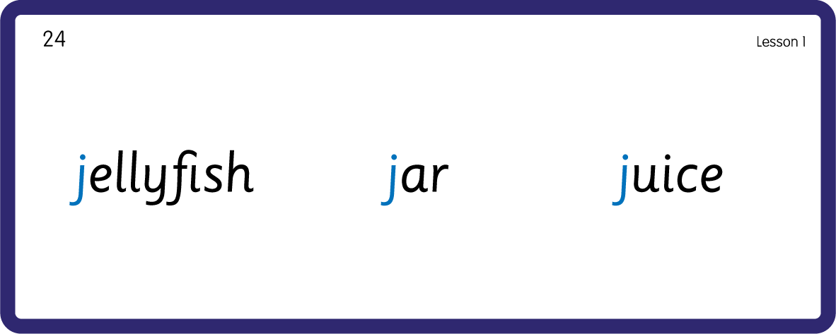
Hear Phonemes
USING JNL691
BACK

Slide 7
Teach Grapheme Caption
USING JNL686
FRONT

Slide 8
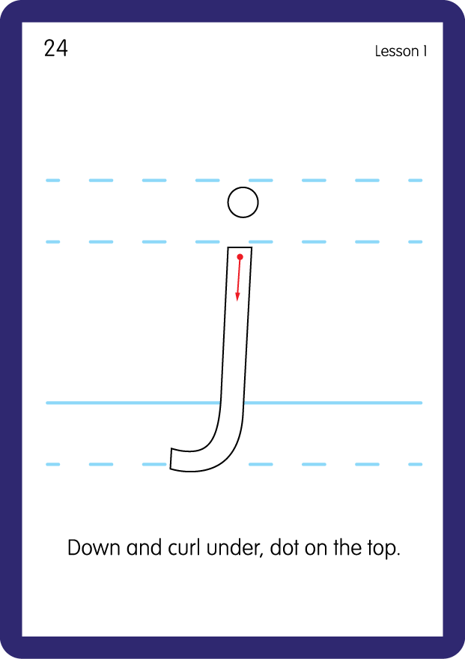
Teach Lowercase Formation
USING JNL686
BACK

Slide 9

Explain Decoding

Slide 10
Model Blending Phonemes
j
a
m
USING SOUND BUTTONS
Sound Buttons
Vowel
Consonant
Consonant Digraph
Long Vowel Sound
R-controlled Digraph
Split Digraph
Syllable / Silent Letter

Slide 11
Model Blending Phonemes
j
o
t
USING SOUND BUTTONS
Sound Buttons
Vowel
Consonant
Consonant Digraph
Long Vowel Sound
R-controlled Digraph
Split Digraph
Syllable / Silent Letter

Slide 12

Explain Encoding

Slide 13
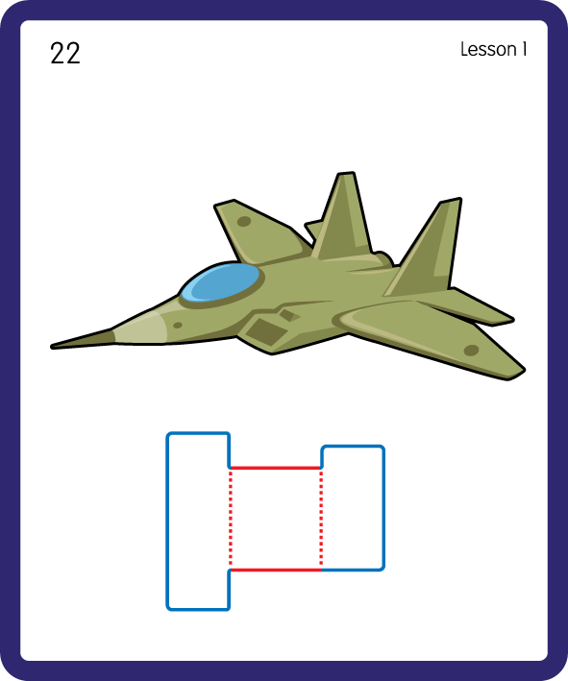
Build a Decodable Word
USING JNL689
BACK

Slide 14
Build a Decodable Word
USING JNL689
FRONT

Slide 15

Practise with Alien Words
USING JNL692
BACK

Slide 16
Practise with Alien Words
USING JNL692
FRONT

Slide 17

Practise Building Words
PRACTISE – 10MINS
o
a
t
g
u
e
b
j
m
USING MAGNETIC LETTERS AND A WHITEBOARD

Slide 18
Practise Building Words
PRACTISE – 10MINS
o
a
t
g
u
e
b
j
m
jam jab jug job jet
USING MAGNETIC LETTERS AND A WHITEBOARD

Slide 19

Draw ‘j’ in a variety of sizes and media, for example using chalk to draw on the ground.
Make grapheme with playdough.
Explore words in environment for decoding.
Play with jigsaws.
j

