Slide 1







j | v | w | x | y | z | zz | qu | ch
sh | th | ng | ai | ee | igh | oa | oi | oo
ow | ar | air | ear | er | ur | or | ure
Review Common Exception Words and Phase 3 Letter Sounds
Lesson 10

Slide 2




Learn and practise Phase 3 Letter Sounds and Common Exception Words.
Recall all GPCs learned so far using flashcards.
Review Phase 2 Common Exception Words as I is no go to into the put his has of pull full.
Phonemic Awareness Cards
Grapheme to Phoneme Cards
Phoneme Frame Cards
Alien Word Cards
High Frequency Word Cards
JNL691
JNL686
JNL689
JNL692
JNL688

Slide 3























Recall all GPCs learned so far using flashcards.

Slide 4
Recall all GPCs learned so far using flashcards.

Slide 5














Review Phase 2 Common Exception Words as I is no go to into the put his has of pull full.

Slide 6

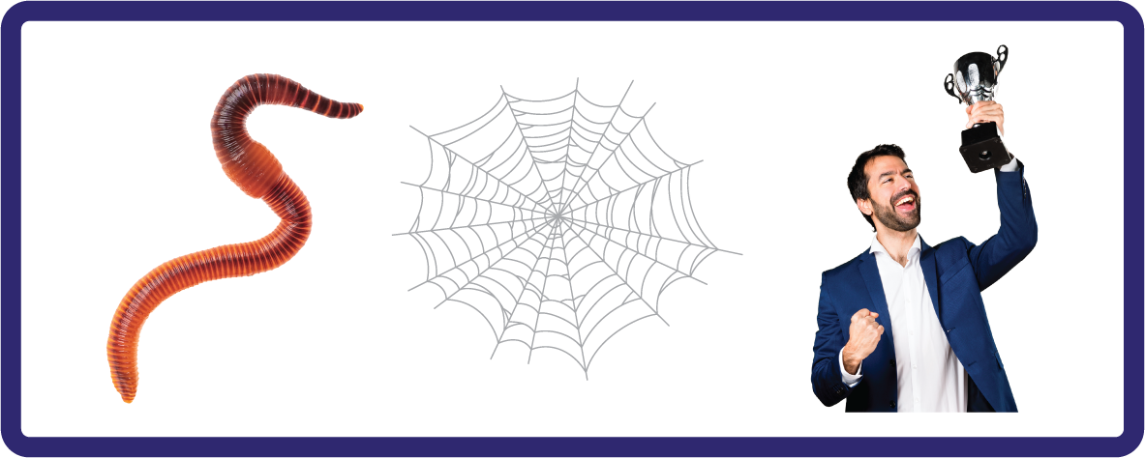
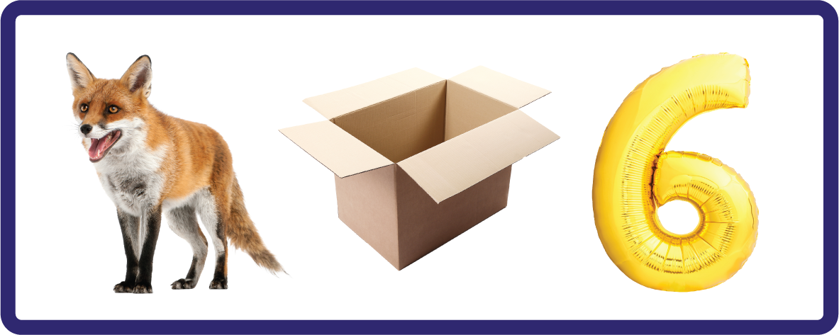


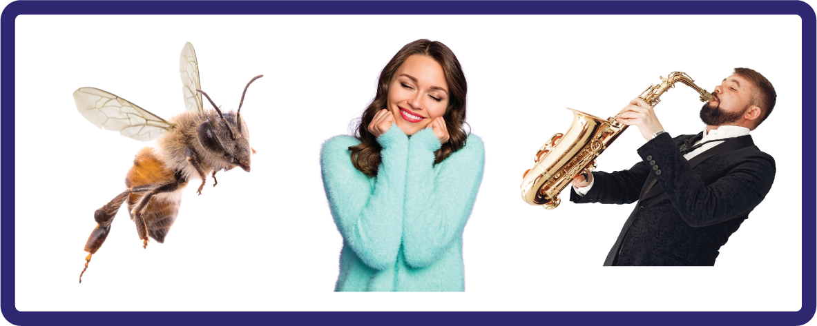
Hear Phonemes
USING JNL691
FRONT

Slide 7
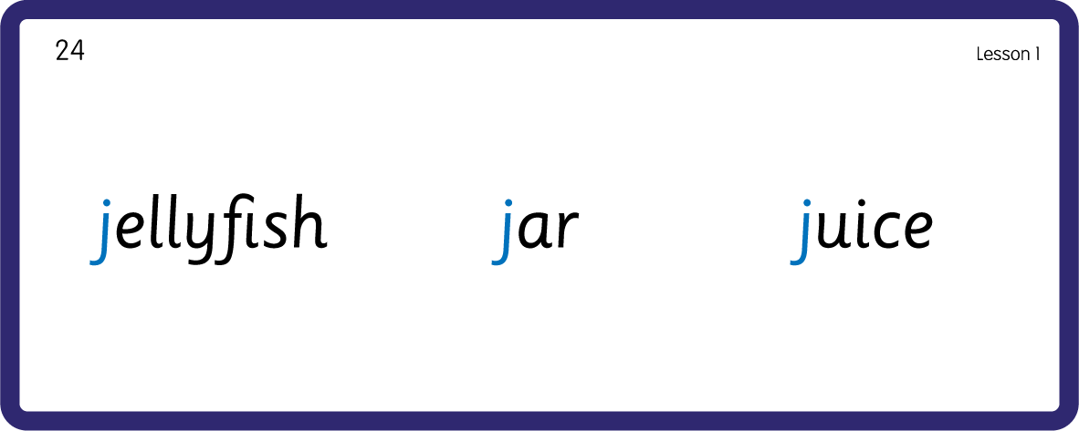
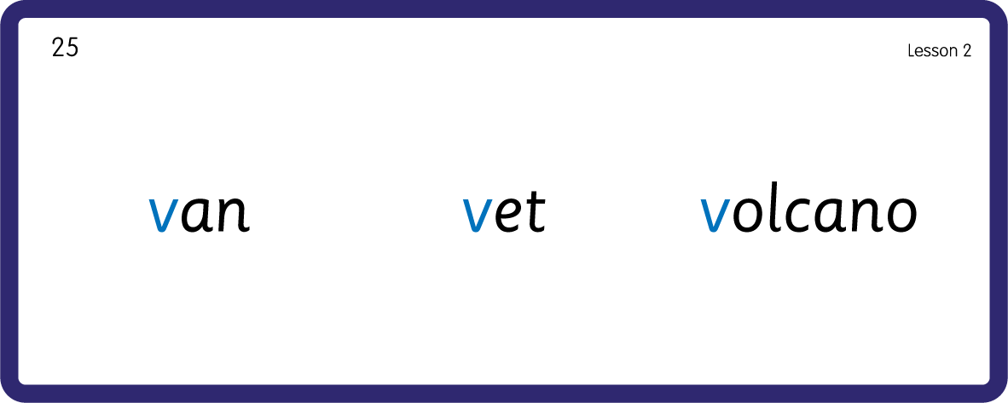
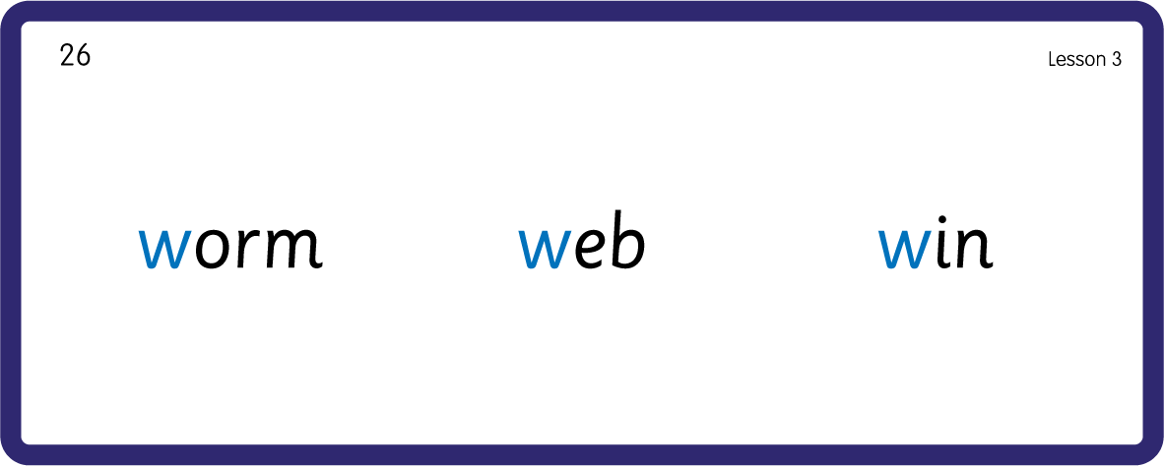
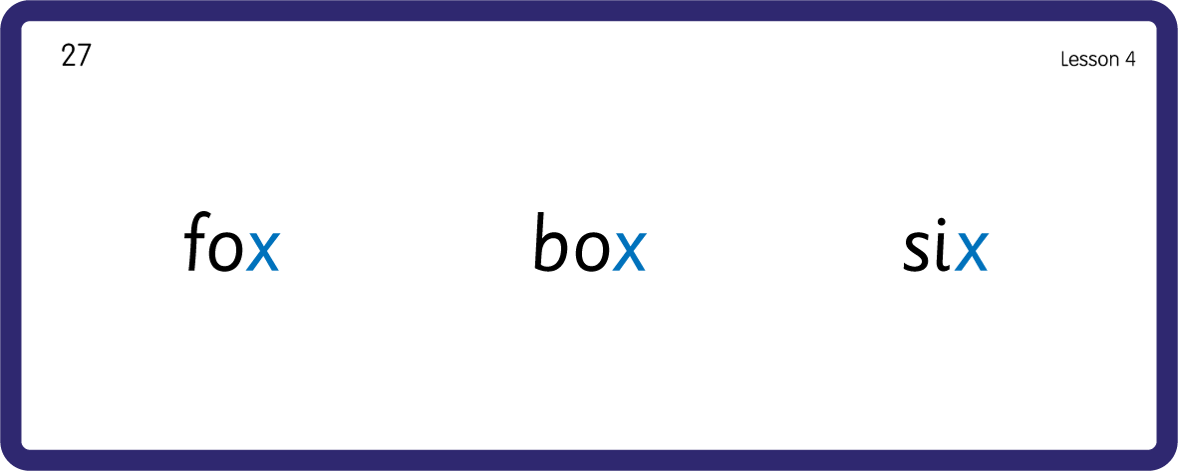
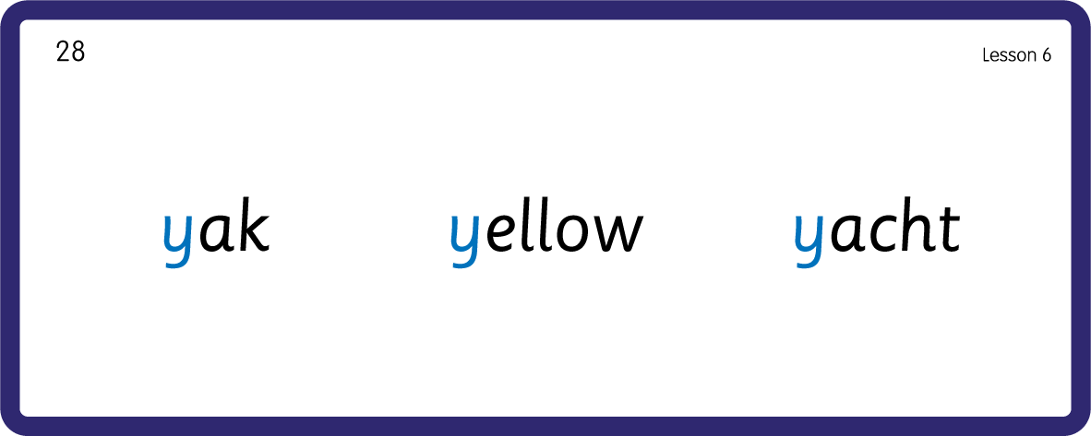
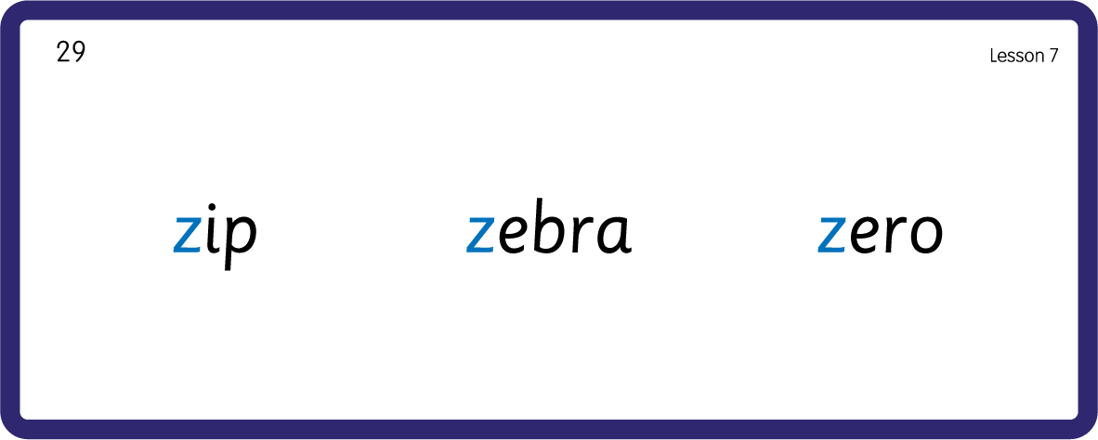
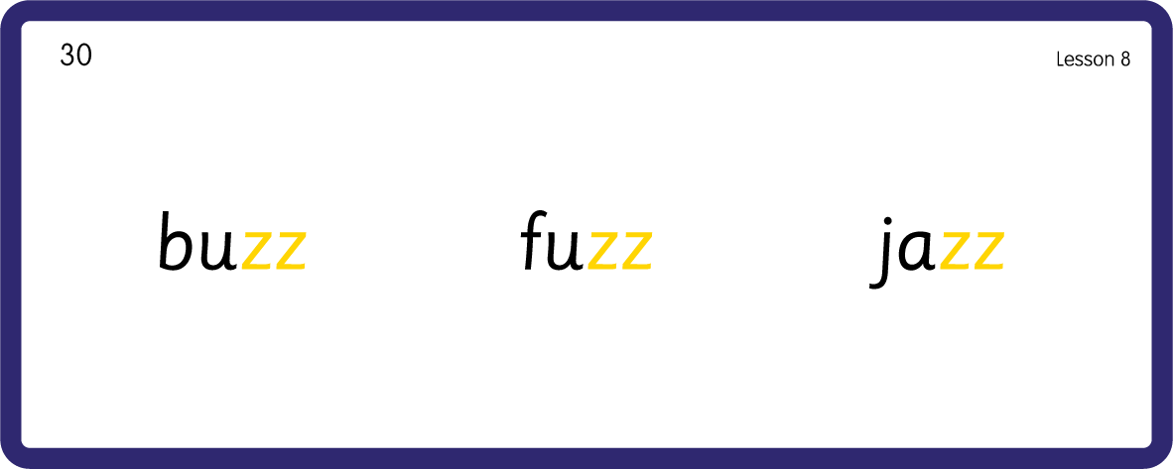
Hear Phonemes
USING JNL691
BACK

Slide 8
Review Grapheme Caption
USING JNL686
FRONT

Slide 9
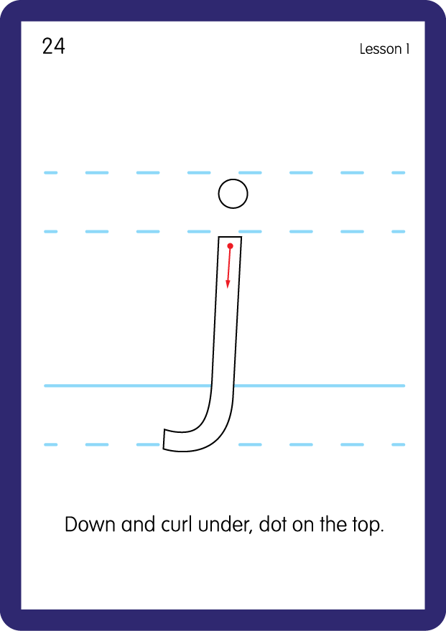
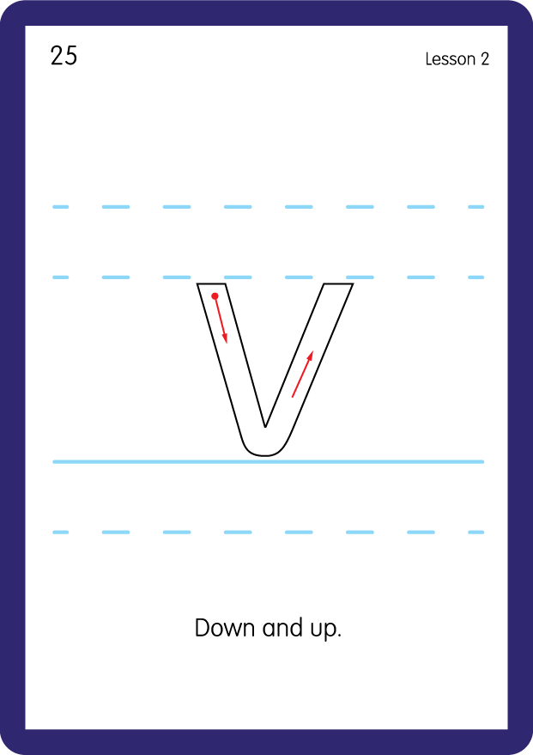
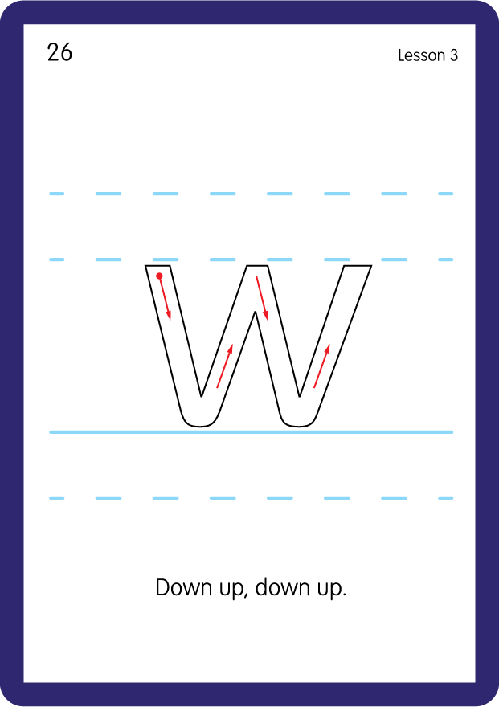
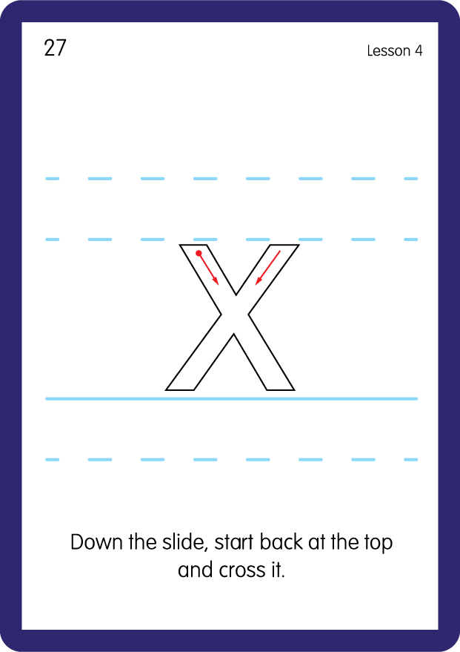
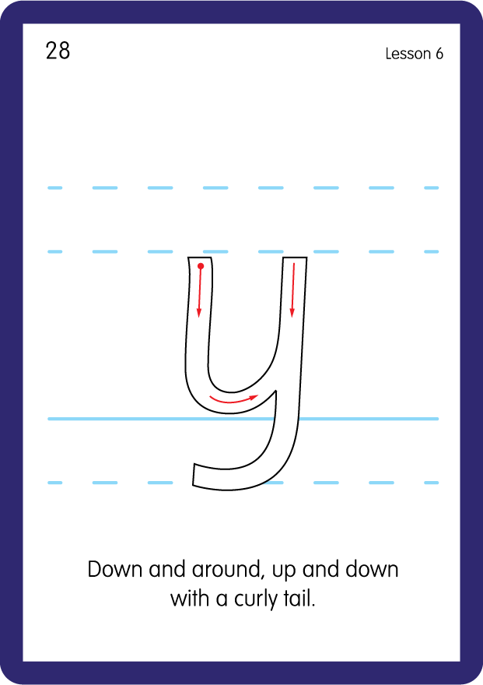
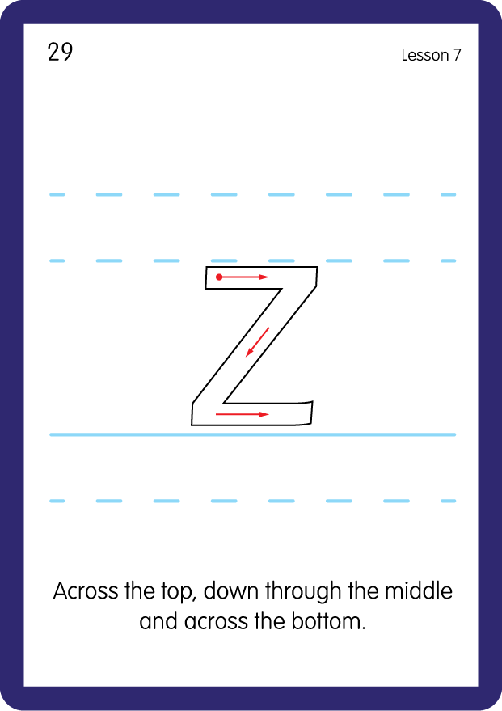
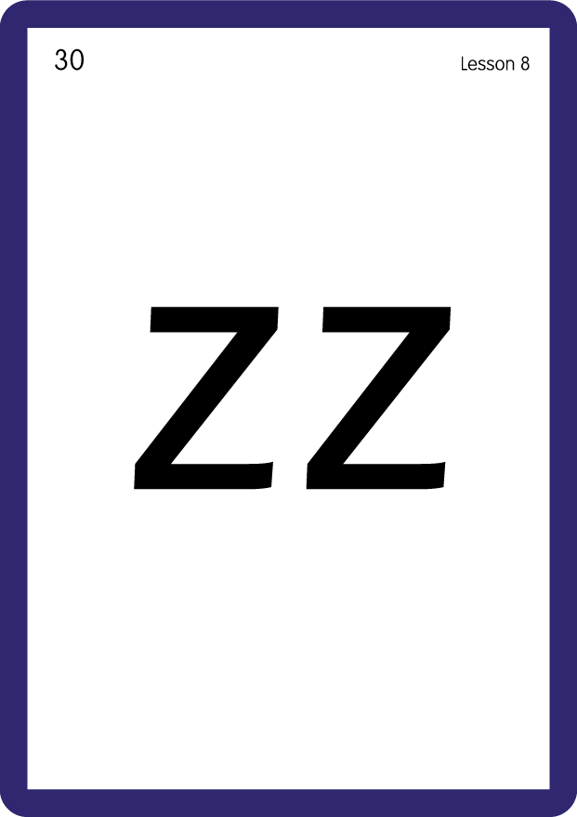
Review Lowercase Formation
USING JNL686
BACK

Slide 10
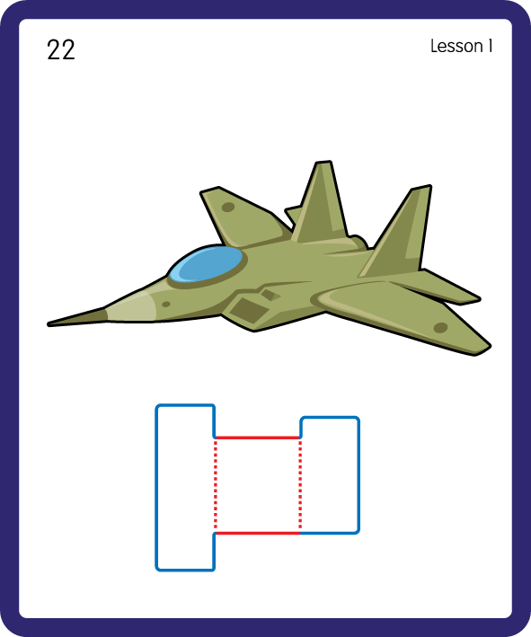
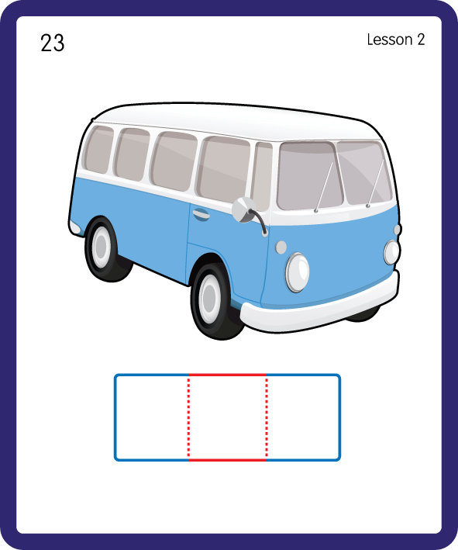
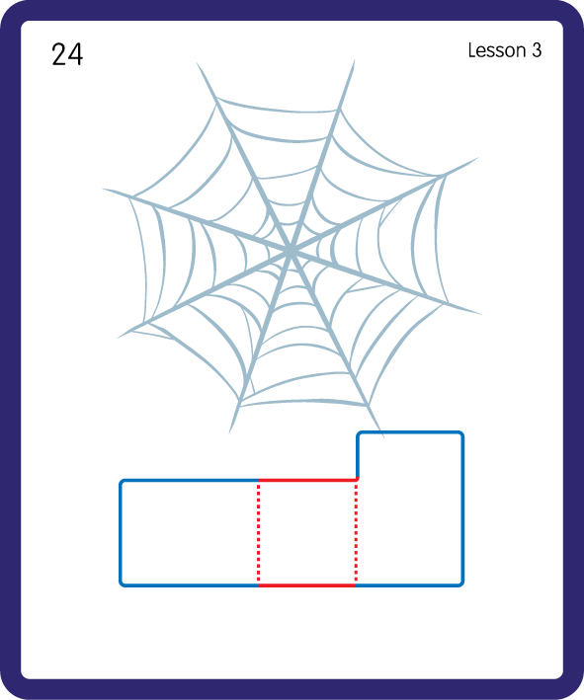
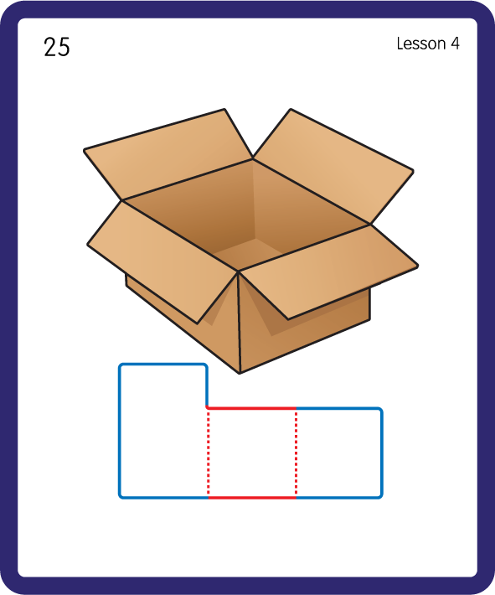
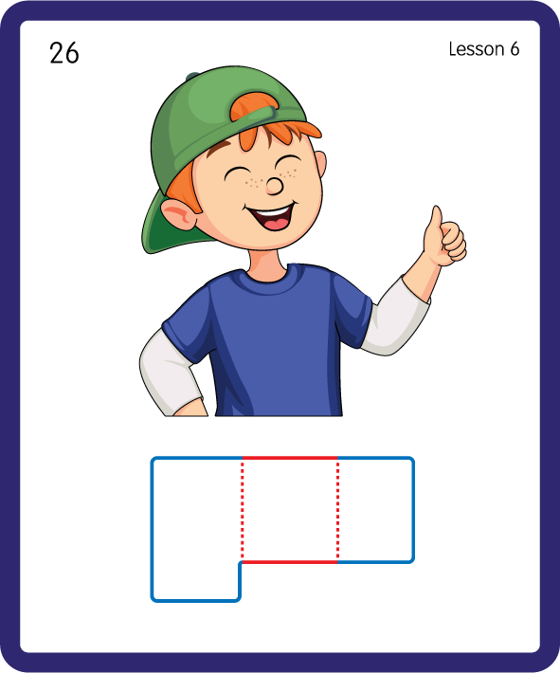
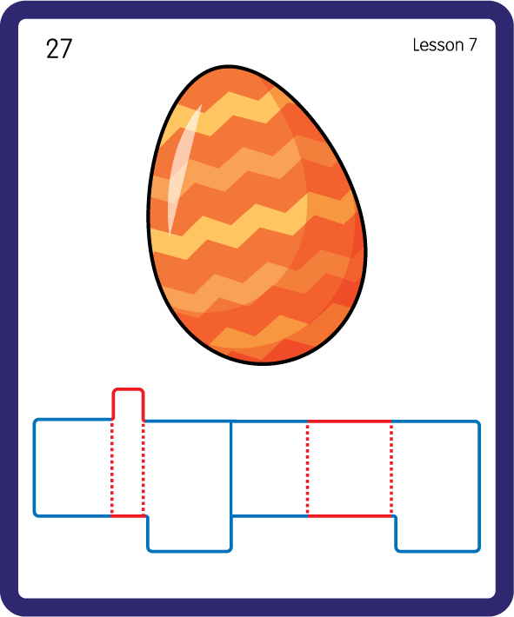
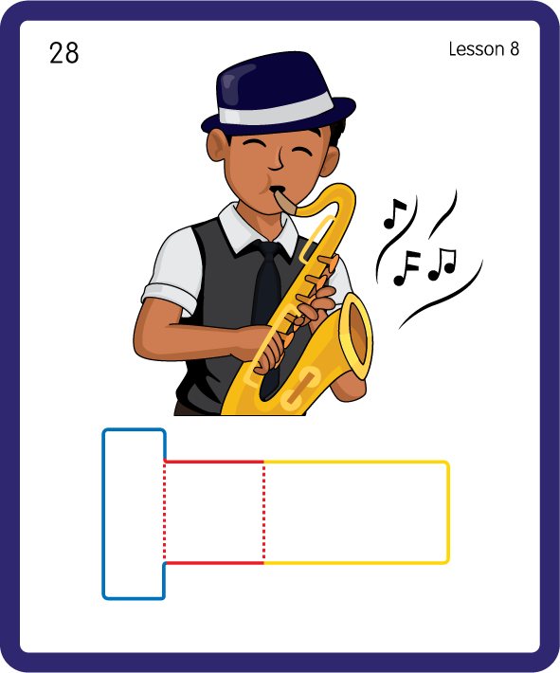
Build a Decodable Word
USING JNL689
BACK

Slide 11
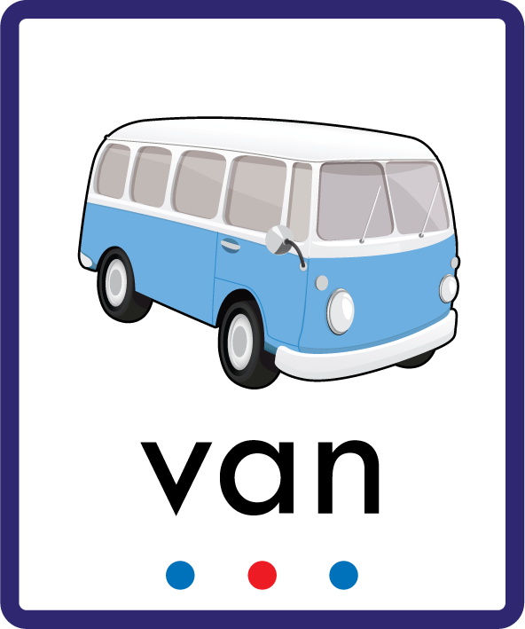





Build a Decodable Word
USING JNL689
FRONT

Slide 12

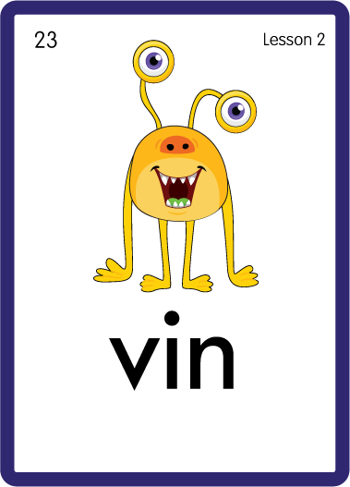

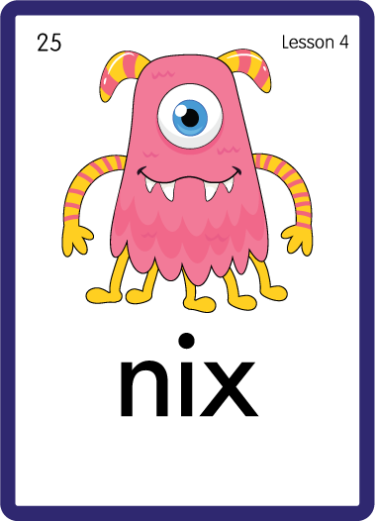
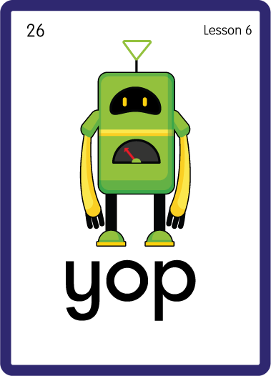
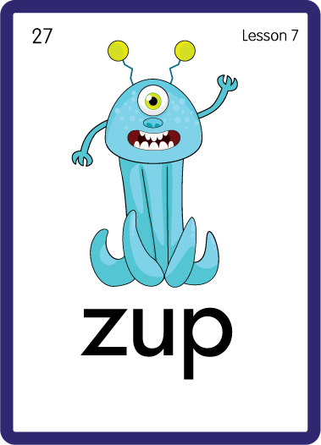
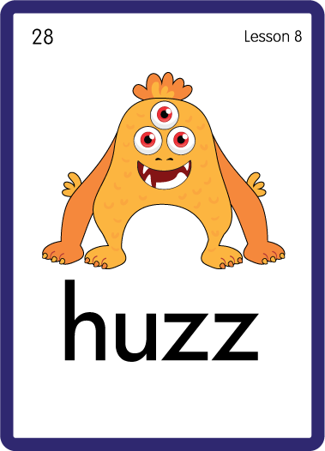
Practise with Alien Words
USING JNL692
BACK

Slide 13






Practise with Alien Words
USING JNL692
FRONT

Slide 14
Practise High Frequency Words
USING JNL688
FRONT

Slide 15
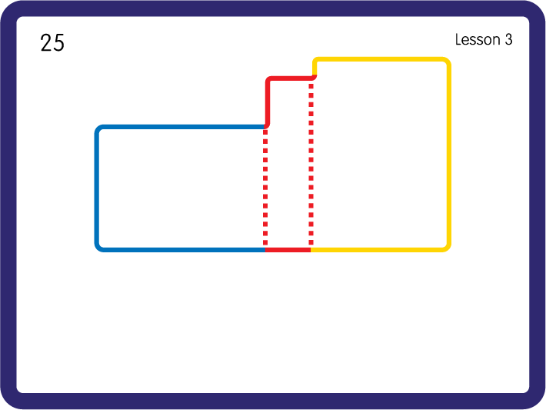
Practise High Frequency Words
USING JNL688
BACK

Slide 16


Sorting with Feely bags - j v w x y z; Have children sort objects beginning with the letter sounds into the correct bags.
Review lowercase letter forms before beginning uppercase letter forms in the next lessons.
j
y

