Slide 1
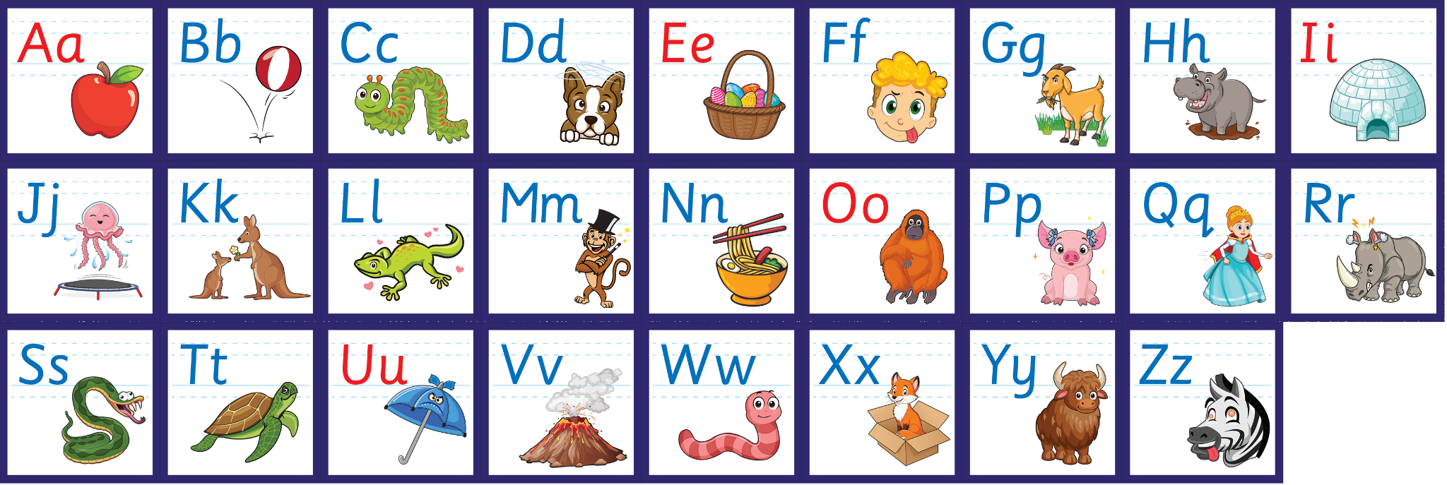
j | v | w | x | y | z | zz | qu | ch
sh | th | ng | ai | ee | igh | oa | oi | oo
ow | ar | air | ear | er | ur | or | ure
Reviewing the Alphabet
Lesson 11

Slide 2
Learn and practise the alphabet.
Recall all GPCs learned so far.
Review Phase 2 Common Exception Words as I is no go to into the put his has of pull full.
Review Vowel song.
A large display that has the letters of the alphabet on it. This could be an Alphabet Arc, poster, magnetic letters on a whiteboard etc. Visit www.teaching.com to shop teaching resources.

Slide 3


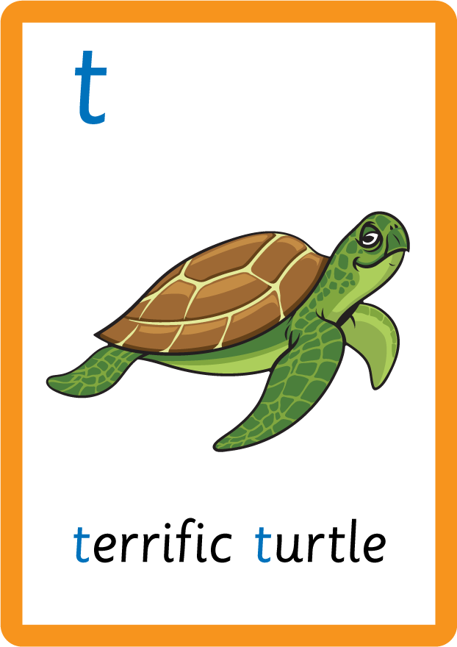

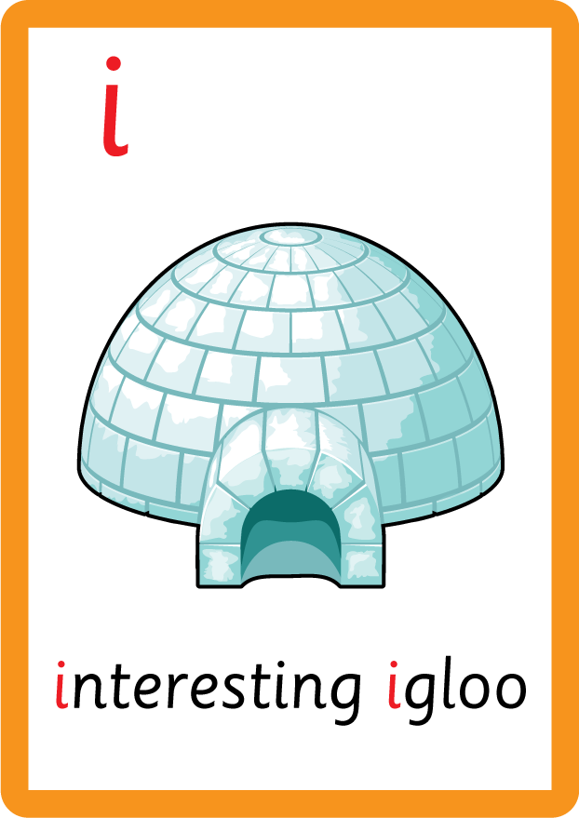

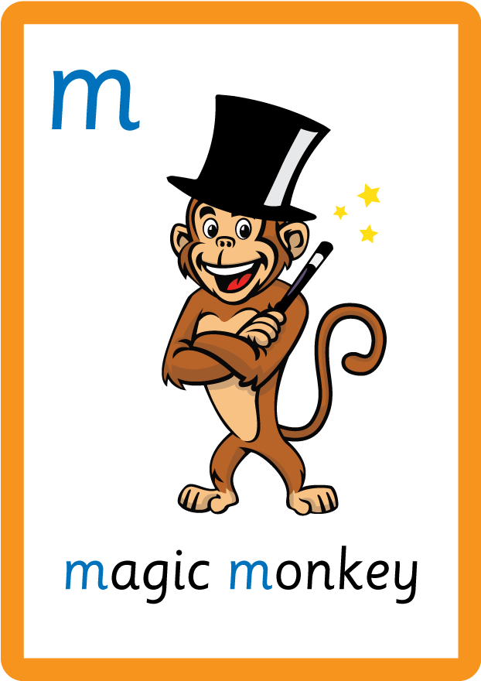







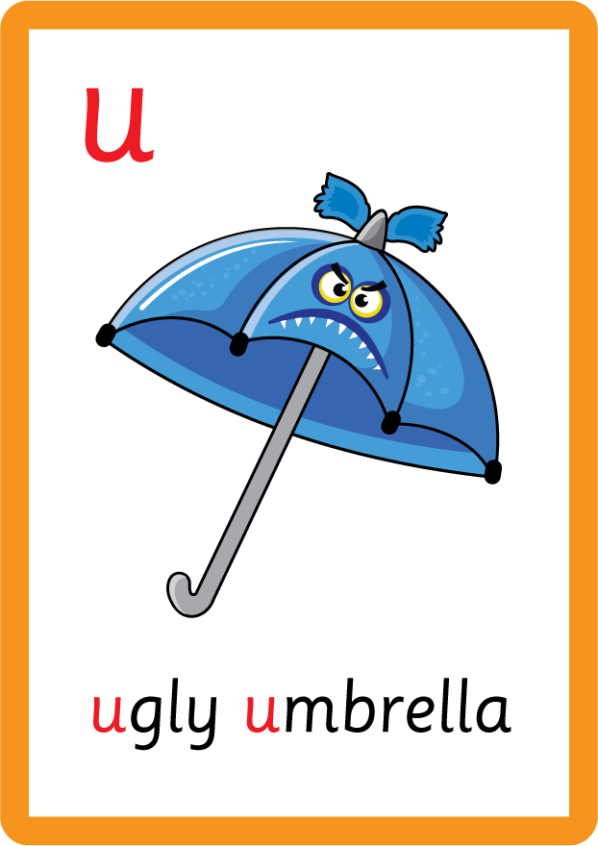
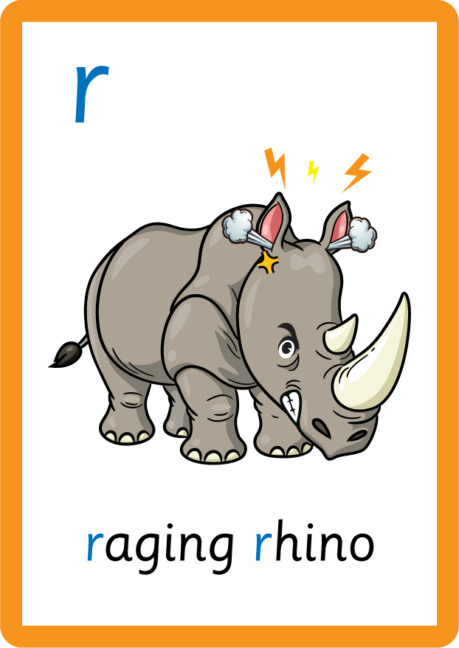







Recall all GPCs learned so far using flashcards.

Slide 4






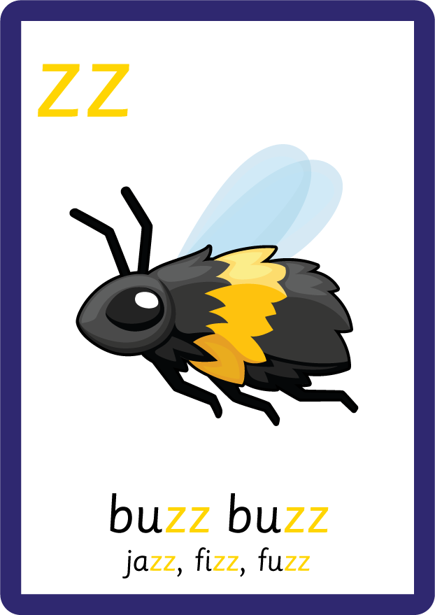
Recall all GPCs learned so far using flashcards.

Slide 5




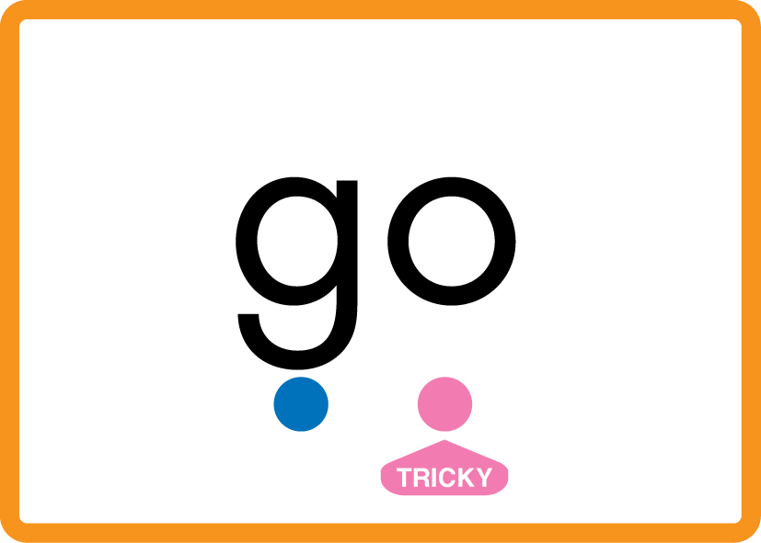

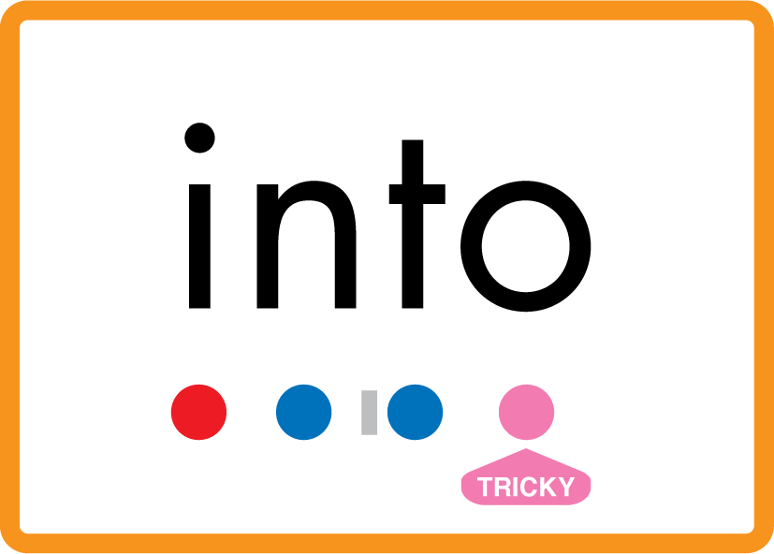
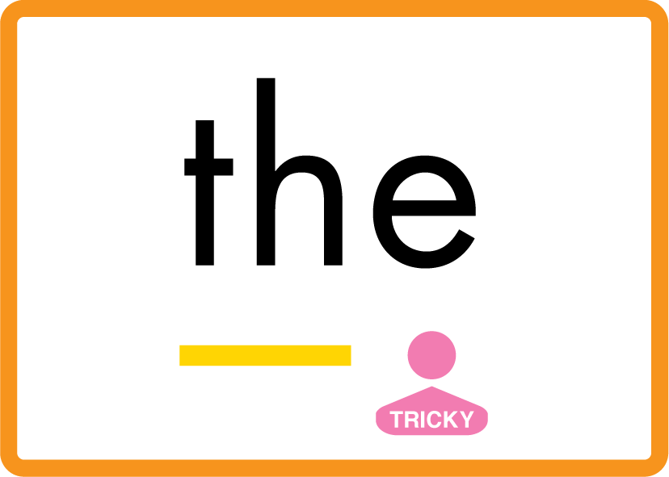
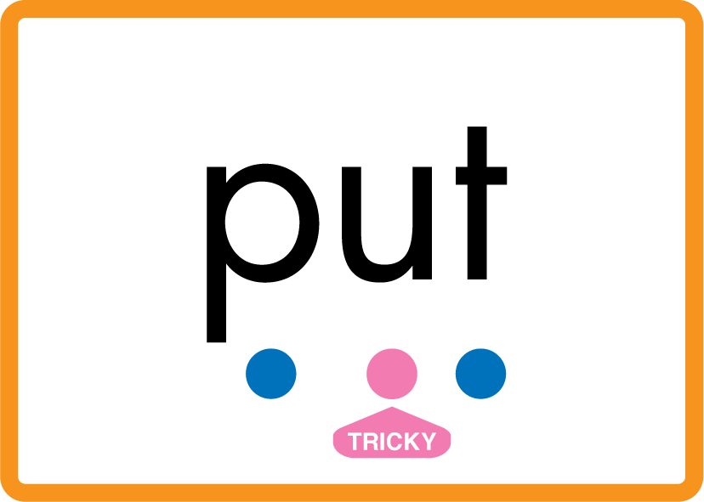
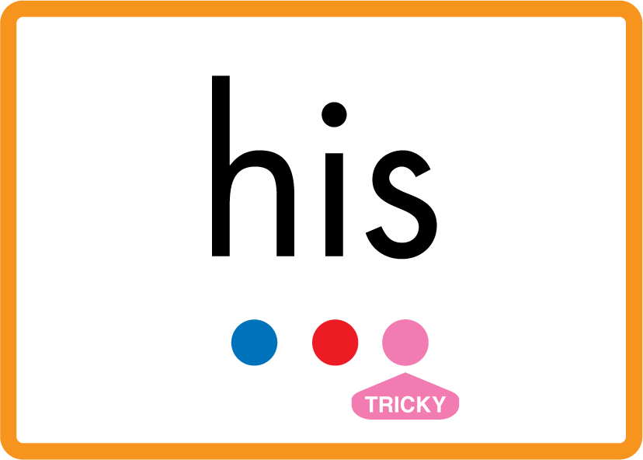


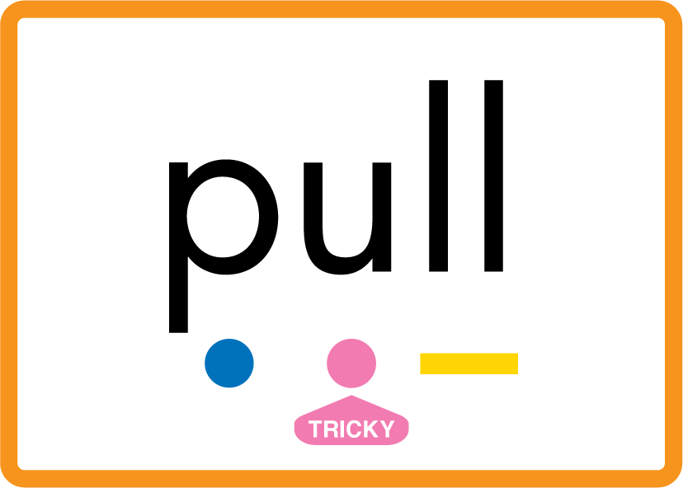
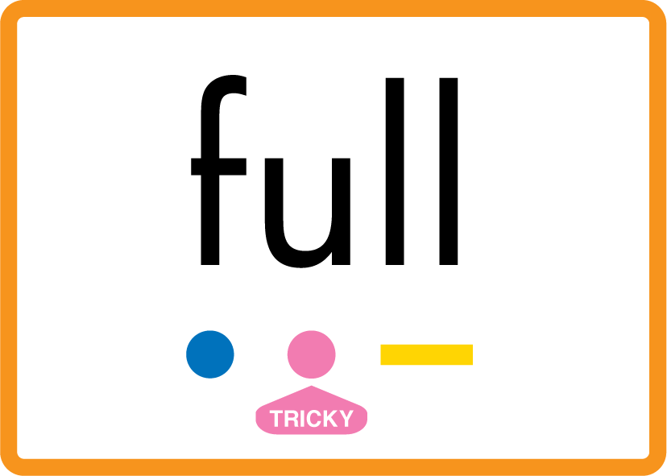
Review Phase 2 Common Exception Words as I is no go to into the put his has of pull full.

Slide 6
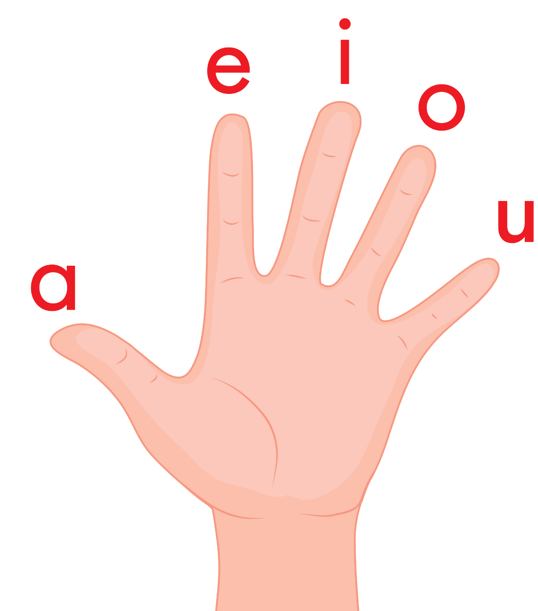
Review the Vowel Hand Song.
a, e, i, o, u a, e, i, o, u a, e, i, o, u (short sounds only)
are short vowels that we use
a vowel is in every word, a vowel is in every word,
a vowel is in every word that we read or write.

Slide 7
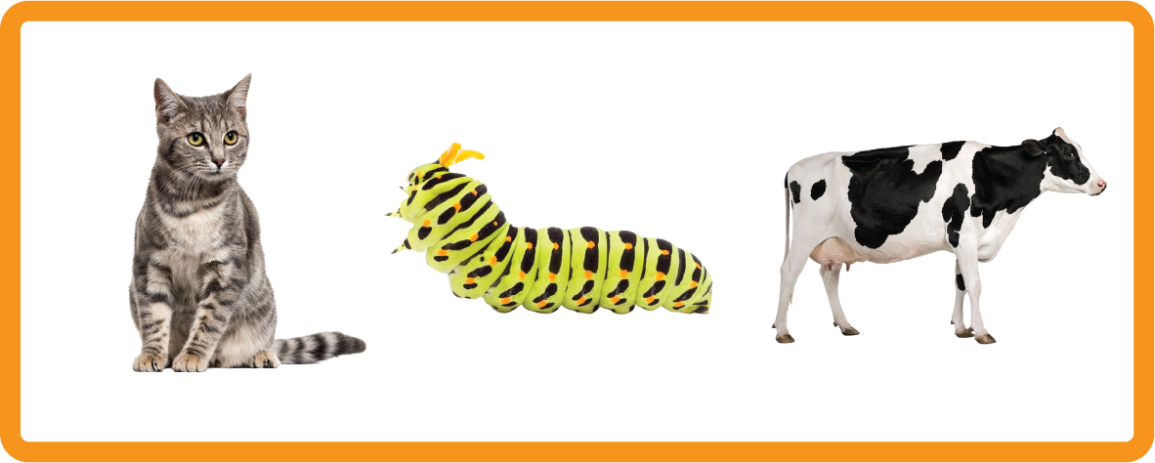
Name the Animal
USING JNL691
FRONT

Slide 8

Name the Animal
meow!
USING JNL691
FRONT

Slide 9
Name the Animal
moo!
USING JNL691
FRONT

Slide 10
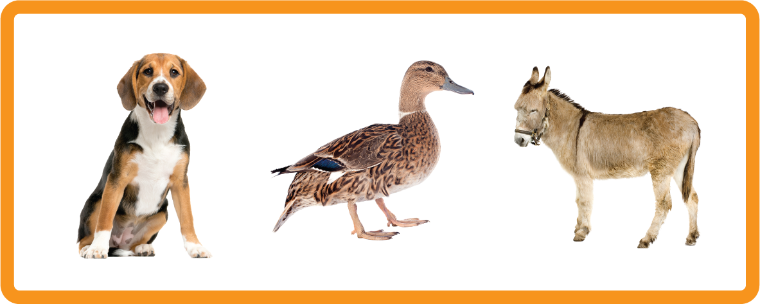
Name the Animal
USING JNL691
FRONT

Slide 11
Name the Animal
woof!
USING JNL691
FRONT

Slide 12
Lowercase Letters
a
SAY THE LOWERCASE LETTER NAME

Slide 13
Lowercase Letters
b
SAY THE LOWERCASE LETTER NAME

Slide 14
Lowercase Letters
c
SAY THE LOWERCASE LETTER NAME

Slide 15
Lowercase Letters
d
SAY THE LOWERCASE LETTER NAME

Slide 16

Display the Alphabet in order
PRACTISE – 10MINS
a b c d e f g h i j k l m n o p q r s t u v w x y z
USING MAGNETIC LETTERS AND A WHITEBOARD

Slide 17

Introduce the Alphabet Song.
ɑ, b, c, d, e, f, g (pause)
h, i, j, k, l, m, n (pause)
o, p, q (pause) r, s, t (pause)
u v w (pause) x y z (pause)
Now I know my abc's, Next time won't you sing with me.

Slide 18

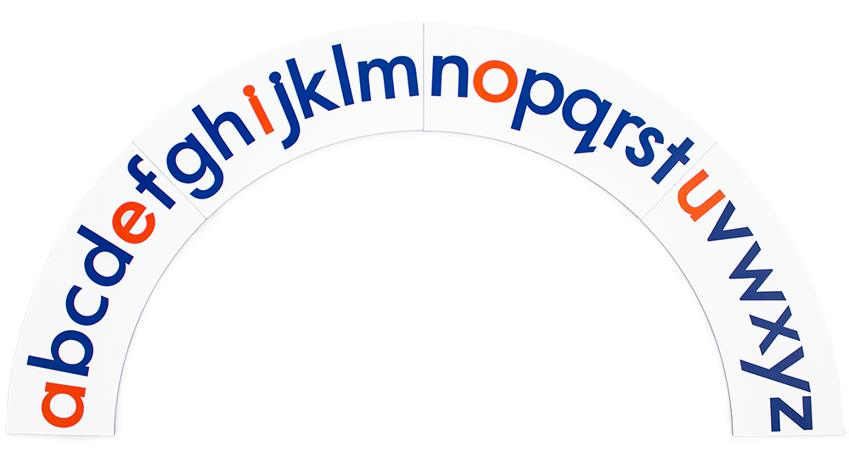

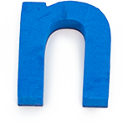

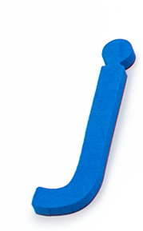
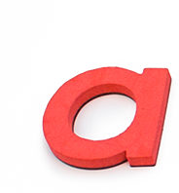
Provide lowercase letters on paper or lowercase magnetic letters, mix them up and provide the children with an alphabet arc. Invite the children to put the letters in the order of the alphabet.

