Slide 1
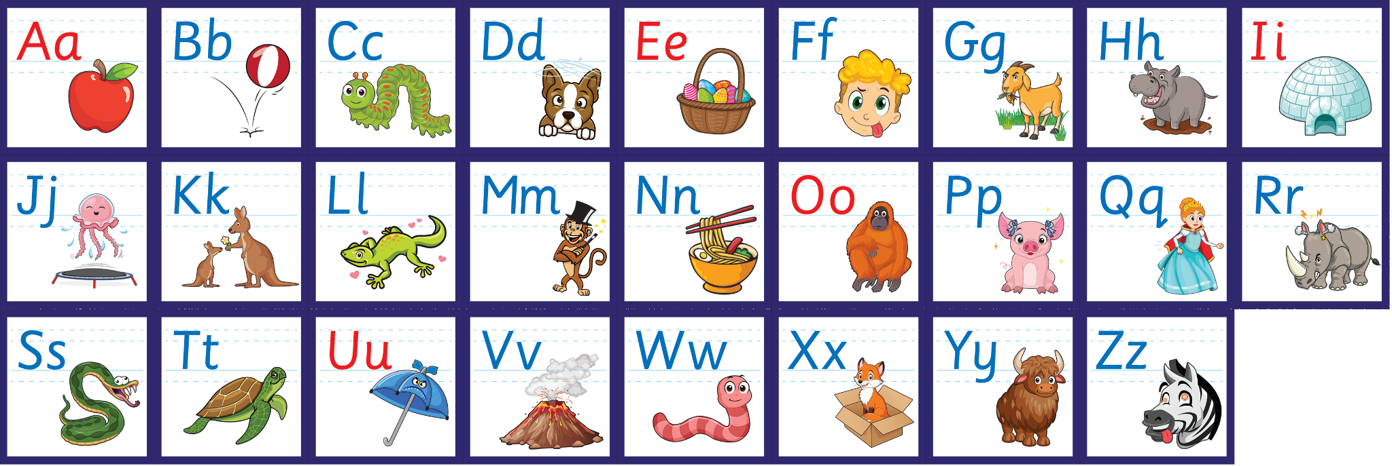
j | v | w | x | y | z | zz | qu | ch
sh | th | ng | ai | ee | igh | oa | oi | oo
ow | ar | air | ear | er | ur | or | ure
Alphabet - Upper & Lower Case
Lesson 12

Slide 2
Learn and practise the alphabet (uppercase and lowercase).
Recall all GPCs learned so far.
Review Alphabet song.
A large display that has the letters of the alphabet on it. This could be an Alphabet Arc, poster, magnetic letters on a whiteboard etc. Visit www.teaching.com.au to shop teaching resources.

Slide 3


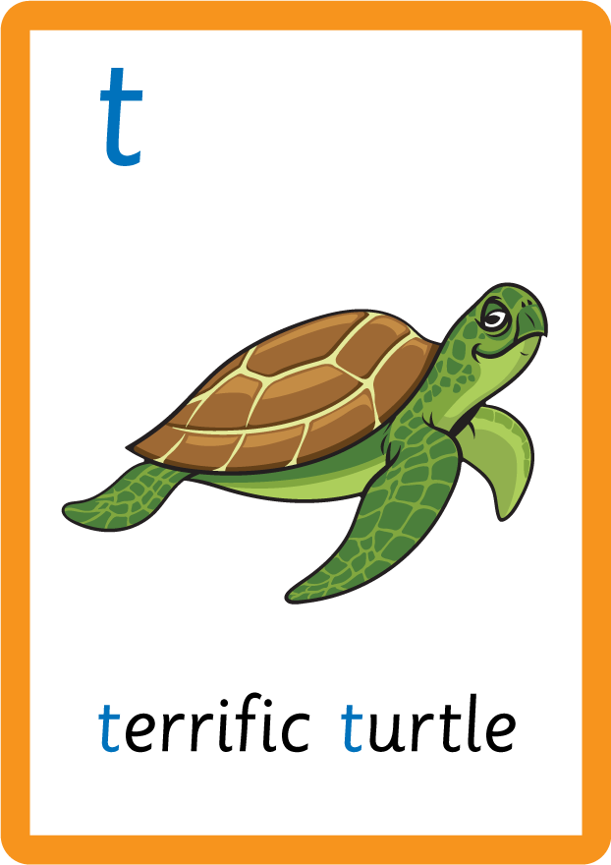

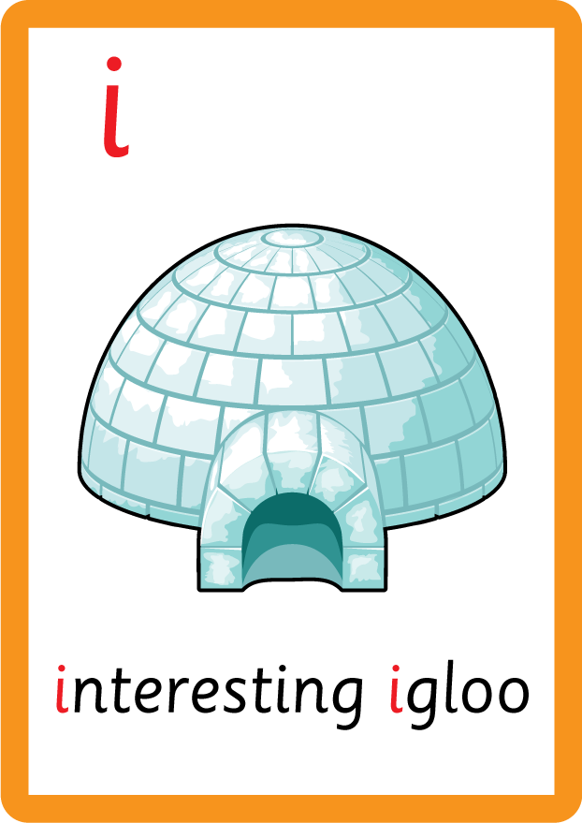

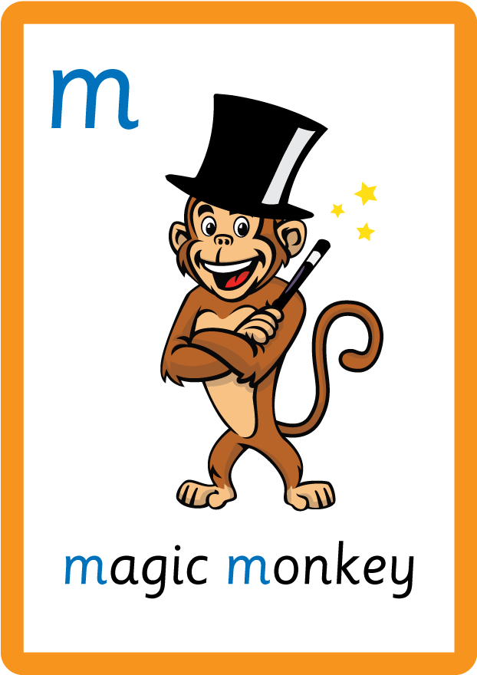



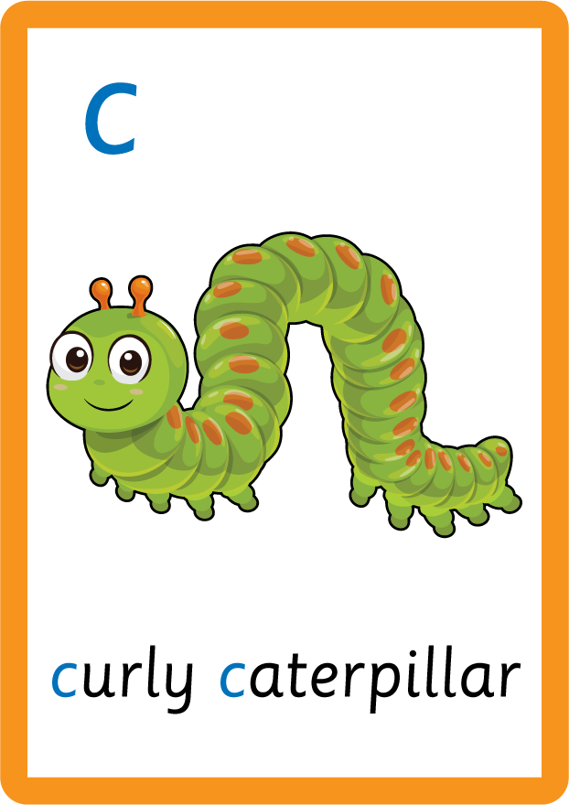



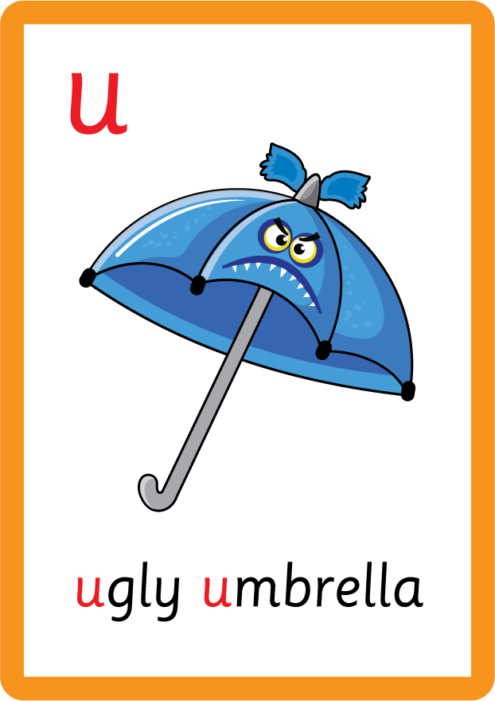
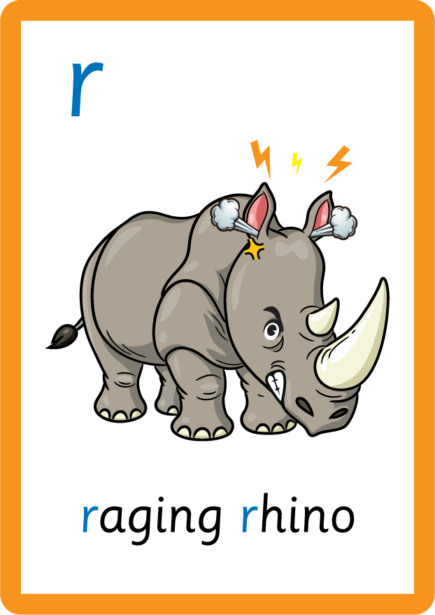







Recall all GPCs learned so far using flashcards.

Slide 4






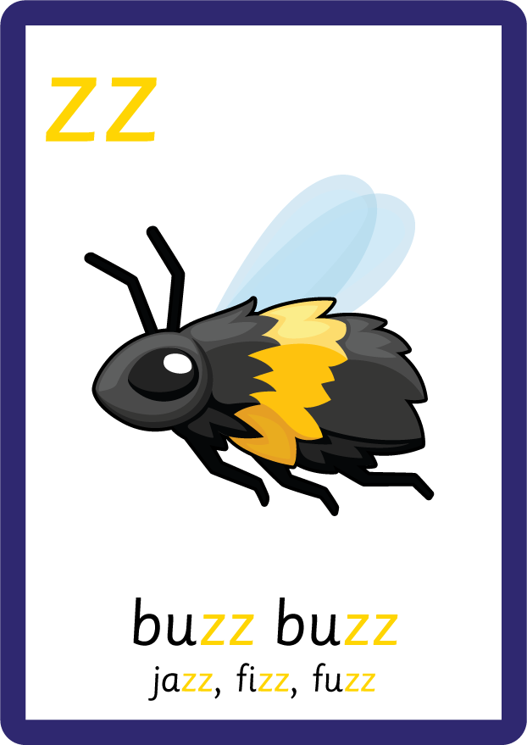
Recall all GPCs learned so far using flashcards.

Slide 5

Review the Alphabet Song.
a, b, c, d, e, f, g (pause)
h, i, j, k, l, m, n (pause)
o, p, q (pause) r, s, t (pause)
u v w (pause) x y z (pause)
Now I know my abc's, Next time won't you sing with me.

Slide 6
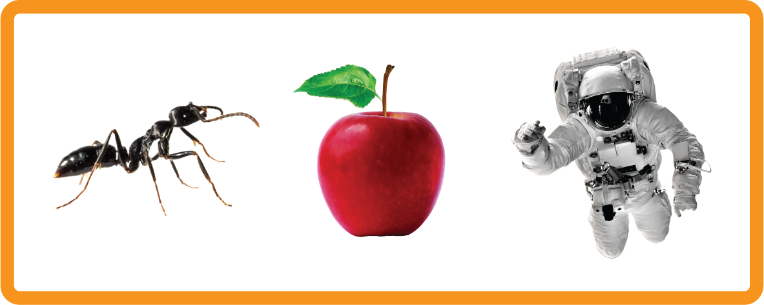
This letter is called ‘a’ and makes an /ă/ sound; "a, a, a apple”
Hear Phonemes
USING JNL691
FRONT

Slide 7
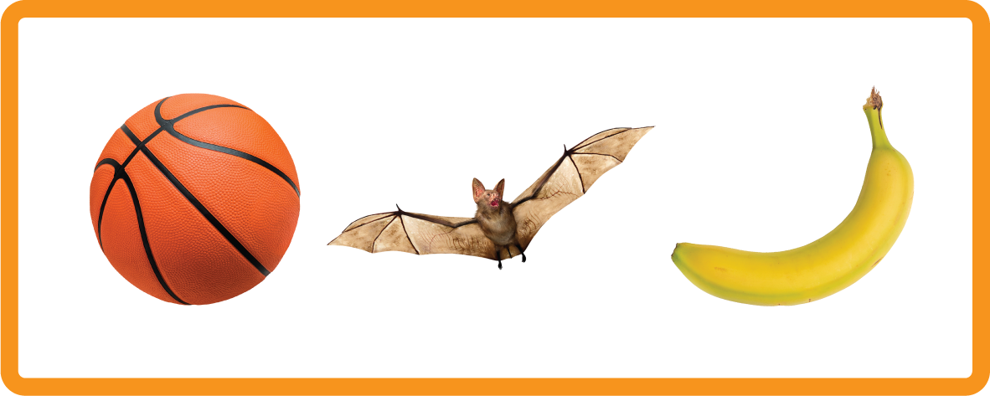
This letter is called ‘b’ and makes an /b/ sound; "b, b, b ball”
Hear Phonemes
USING JNL691
FRONT

Slide 8
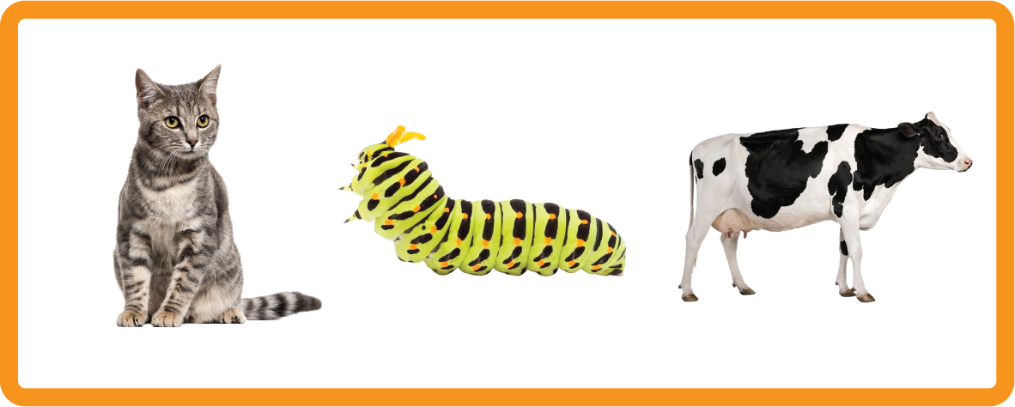
This letter is called ‘c’ and makes an /k/ sound; "c, c, c cat”
Hear Phonemes
USING JNL691
FRONT

Slide 9

Display the Alphabet in order
PRACTISE – 10MINS
a b c d e f g h i j k l m n o p q r s t u v w x y z
A B C D E F G H I J K L M N O P Q R S T U V W X Y Z
USING MAGNETIC LETTERS AND A WHITEBOARD

Slide 10
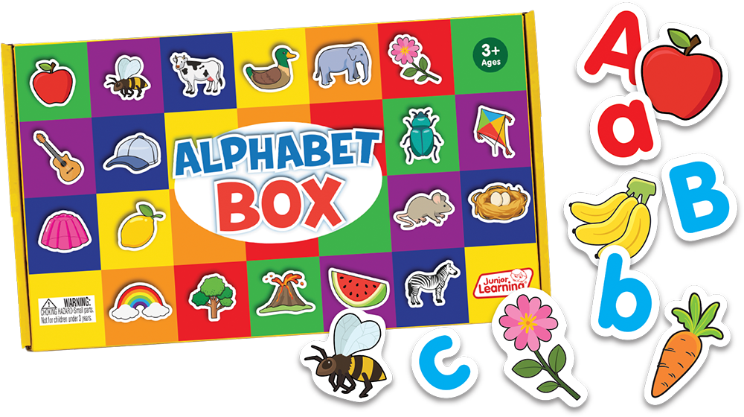
Provide uppercase letters and lowercase letters, mix them up and invite the children to match them up.

