Slide 1
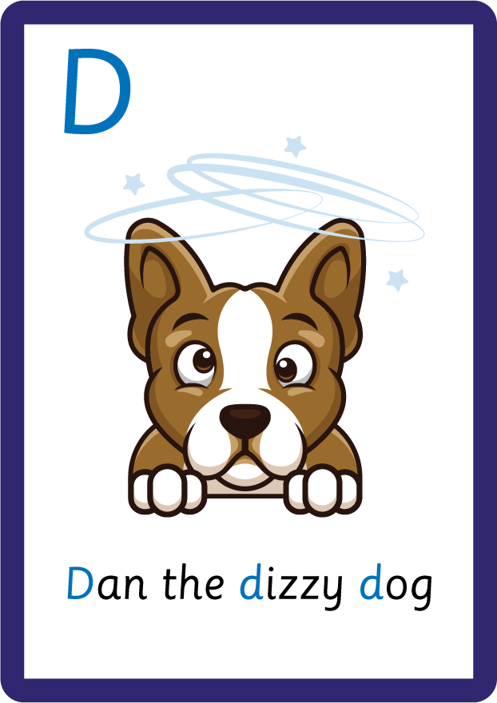
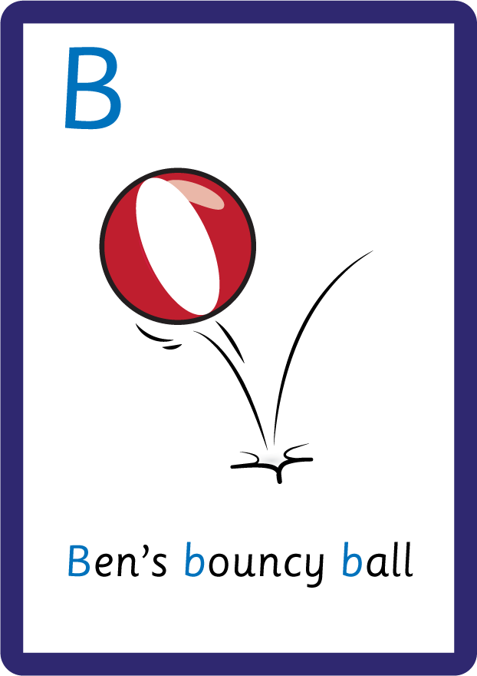
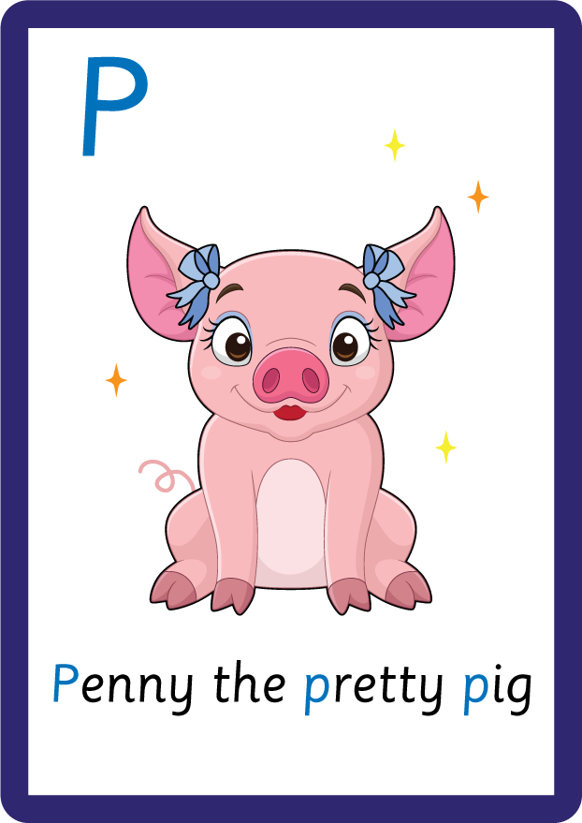
j | v | w | x | y | z | zz | qu | ch
sh | th | ng | ai | ee | igh | oa | oi | oo
ow | ar | air | ear | er | ur | or | ure
Uppercase Letters; D B P
Lesson 15

Slide 2
Learn and practise uppercase letters D B P.
Recall all GPCs learned so far.
Review Phase 2 Common Exception Words as I is no go to into the put his has of pull full.
Review Vowel song.
A large display that has the letters of the alphabet on it. This could be an Alphabet Arc, poster, magnetic letters on a whiteboard etc. Visit www.teaching.com.au to shop teaching resources.

Slide 3















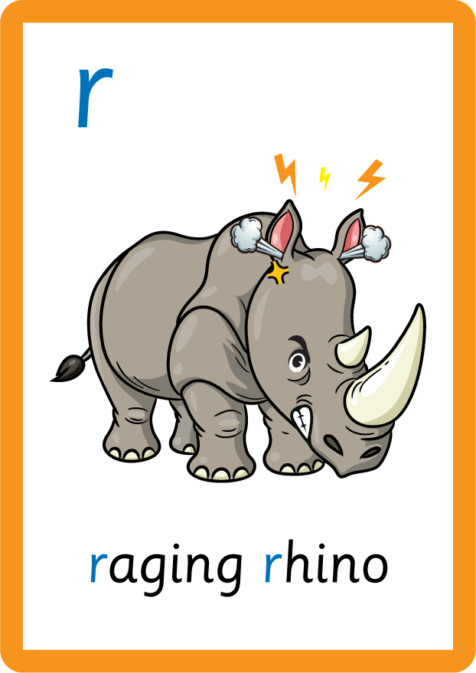







Recall all GPCs learned so far using flashcards.

Slide 4







Recall all GPCs learned so far using flashcards.

Slide 5














Review Phase 2 Common Exception Words as I is no go to into the put his has of pull full.

Slide 6

Review the Alphabet Song.
a, b, c, d, e, f, g (pause)
h, i, j, k, l, m, n (pause)
o, p, q (pause) r, s, t (pause)
u v w (pause) x y z (pause)
Now I know my abc's, Next time won't you sing with me.

Slide 7
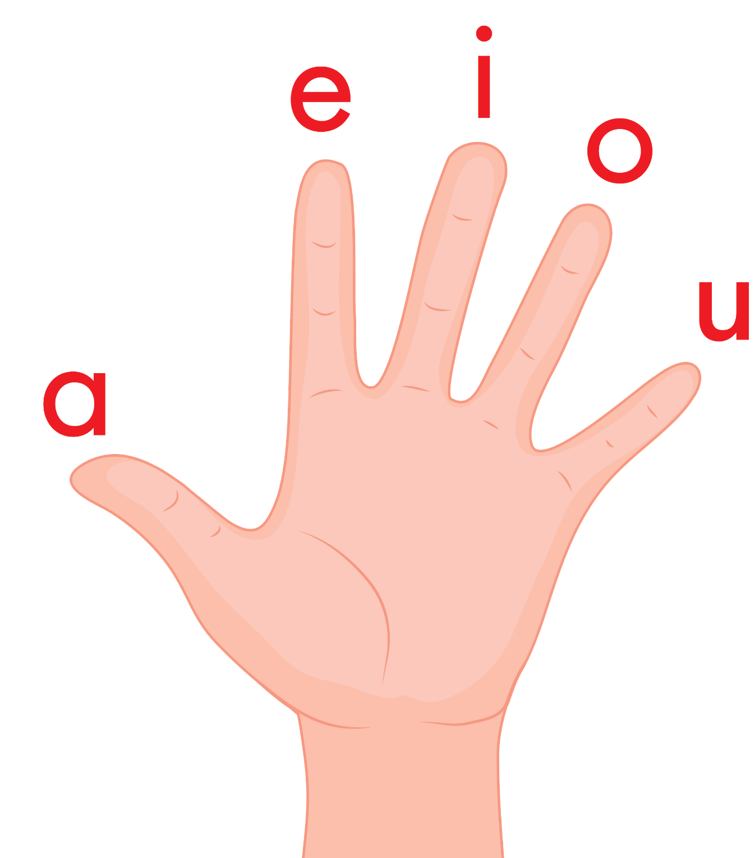
Review the Vowel Hand Song.
a, e, i, o, u a, e, i, o, u a, e, i, o, u (short sounds only)
are short vowels that we use
a vowel is in every word, a vowel is in every word,
a vowel is in every word that we read or write.

Slide 8
Teach Grapheme Caption
USING JNL686
FRONT

Slide 9
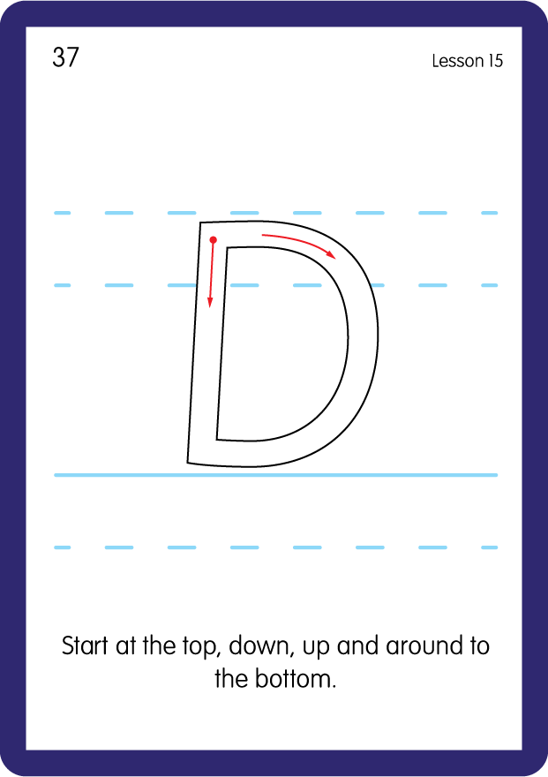
Teach Uppercase Formation
USING JNL686
BACK

Slide 10
Teach Grapheme Caption
USING JNL686
FRONT

Slide 11
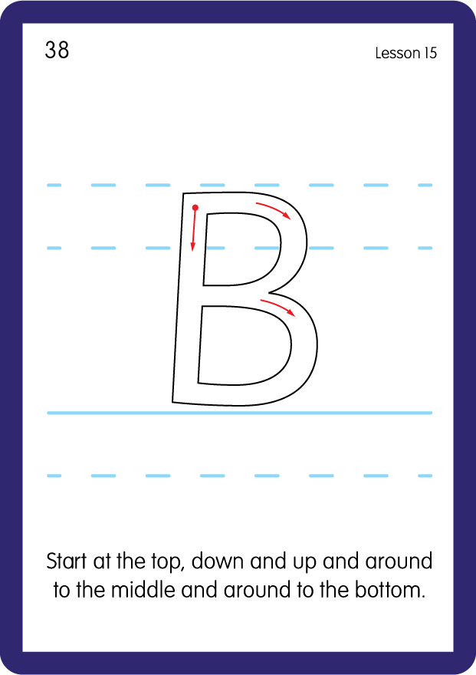
Teach Uppercase Formation
USING JNL686
BACK

Slide 12
Teach Grapheme Caption
USING JNL686
FRONT

Slide 13
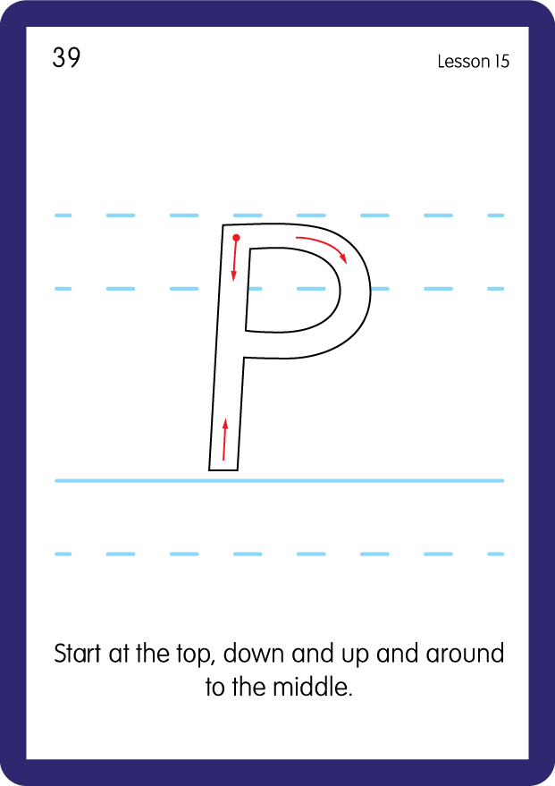
Teach Uppercase Formation
USING JNL686
BACK

Slide 14

Display the Alphabet in order
PRACTISE – 10MINS
a b c d e f g h i j k l m n o p q r s t u v w x y z
A B C D E F G H I J K L M N O P Q R S T U V W X Y Z
USING MAGNETIC LETTERS AND A WHITEBOARD

Slide 15


Provide children with a paper plate with the uppercase alphabet written round the edges and then lowercase letter written on wooden pegs. Children match the lowercase peg to the uppercase letter.
Practise both lowercase and uppercase formation.
c
w
m
k

