Slide 1

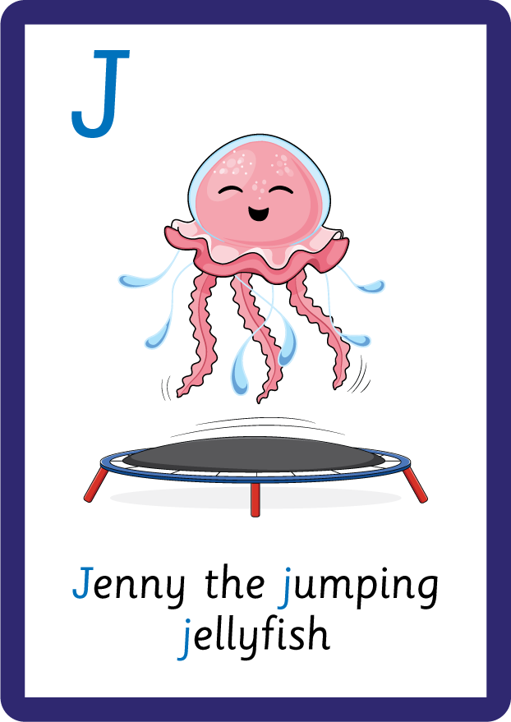
j | v | w | x | y | z | zz | qu | ch
sh | th | ng | ai | ee | igh | oa | oi | oo
ow | ar | air | ear | er | ur | or | ure
Uppercase Letters; U J
Lesson 16

Slide 2
Learn and practise uppercase letters U J.
Recall all GPCs learned so far.
Review Phase 2 Common Exception Words as I is no go to into the put his has of pull full.
Review Alphabet Song.
A large display that has the letters of the alphabet on it. This could be an Alphabet Arc, poster, magnetic letters on a whiteboard etc. Visit www.teaching.com.au to shop teaching resources.

Slide 3


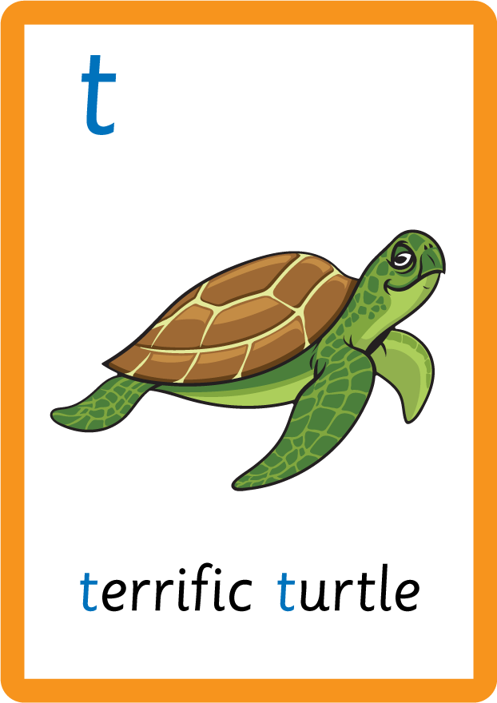

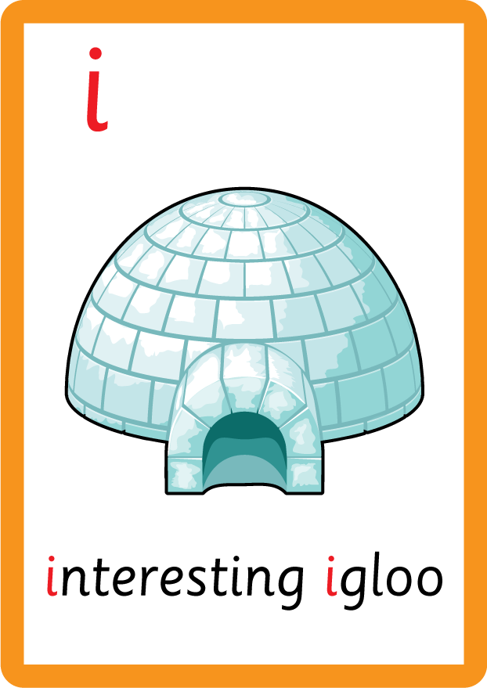

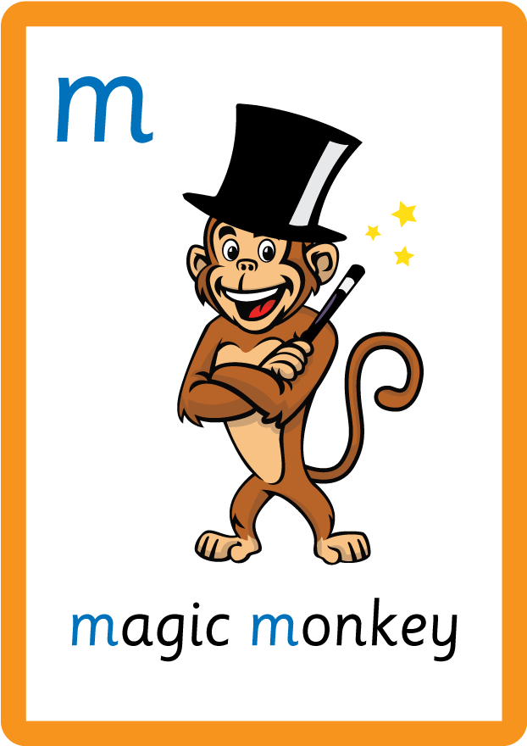



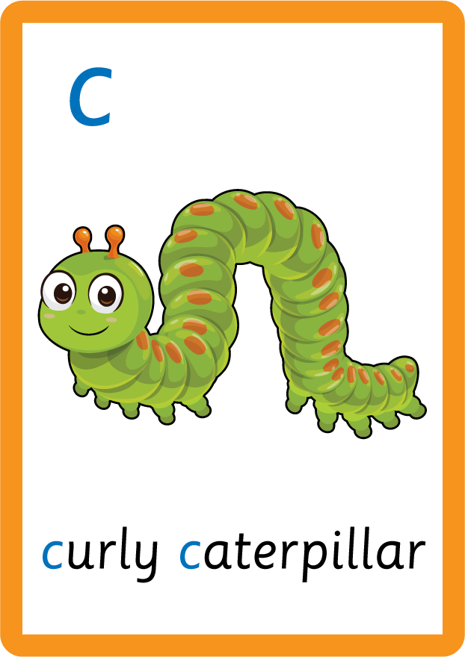




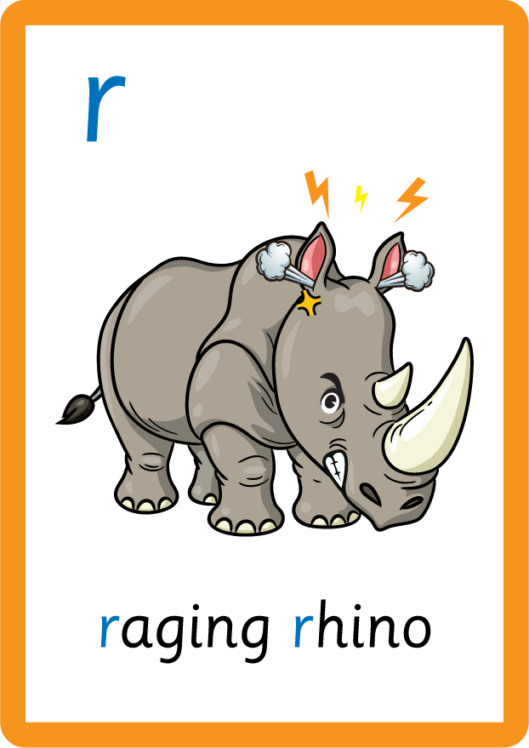







Recall all GPCs learned so far using flashcards.

Slide 4






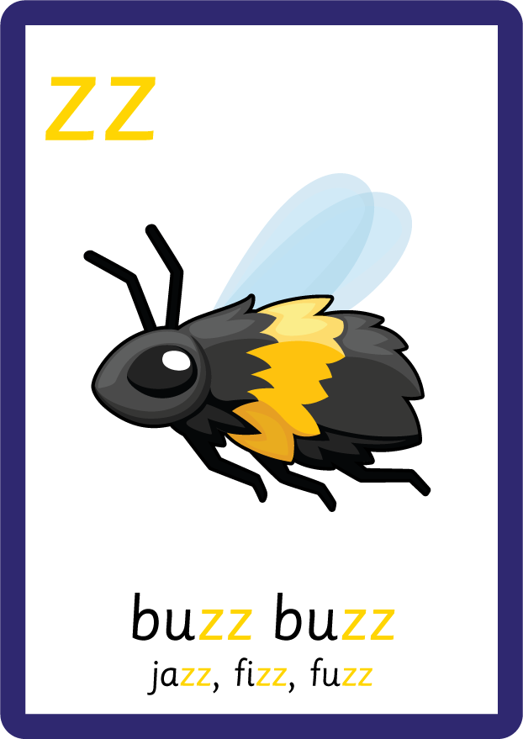
Recall all GPCs learned so far using flashcards.

Slide 5






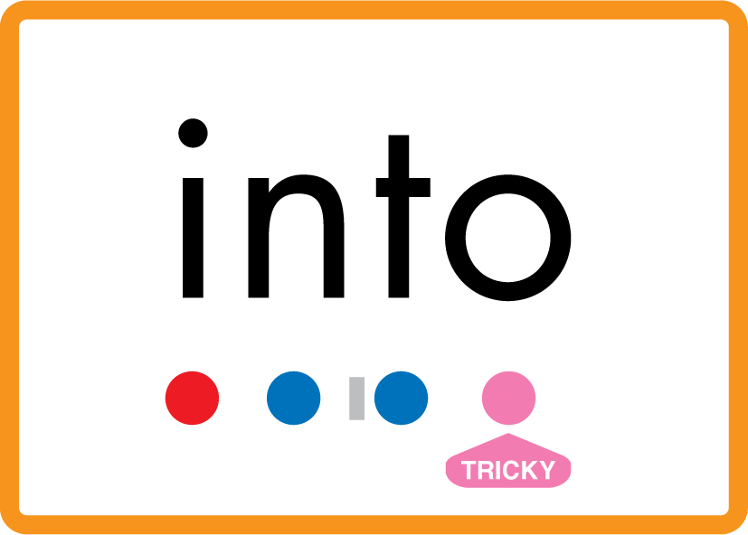


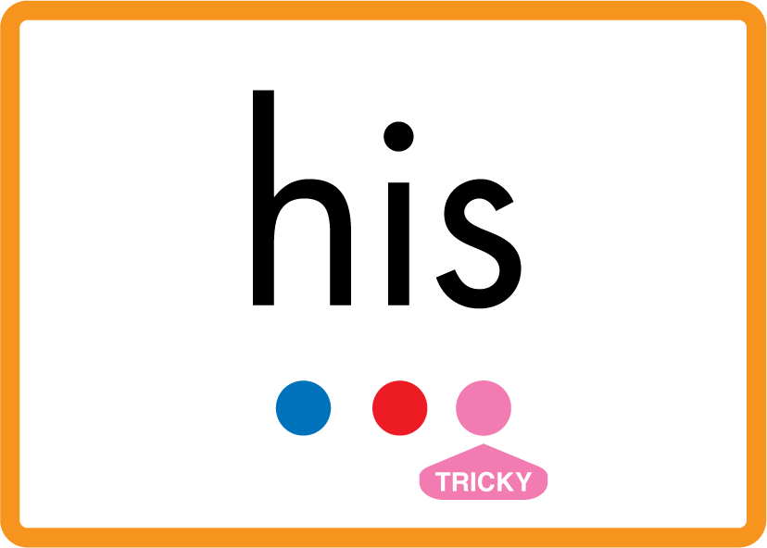


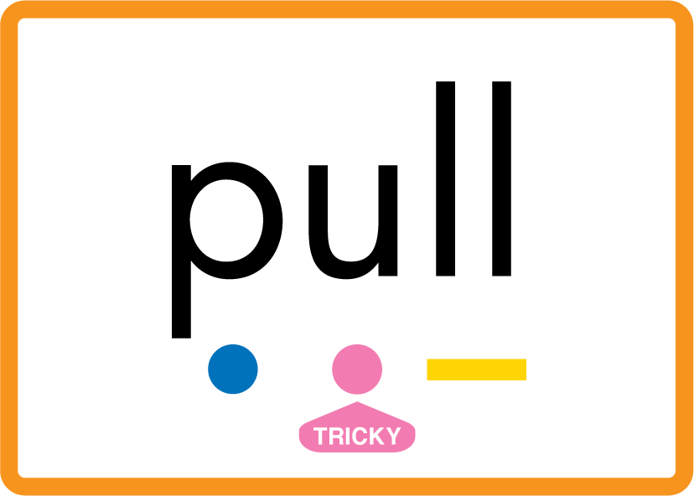

Review Phase 2 Common Exception Words as I is no go to into the put his has of pull full.

Slide 6

Review the Alphabet Song.
a, b, c, d, e, f, g (pause)
h, i, j, k, l, m, n (pause)
o, p, q (pause) r, s, t (pause)
u v w (pause) x y z (pause)
Now I know my abc's, Next time won't you sing with me.

Slide 7
Teach Grapheme Caption
USING JNL686
FRONT

Slide 8
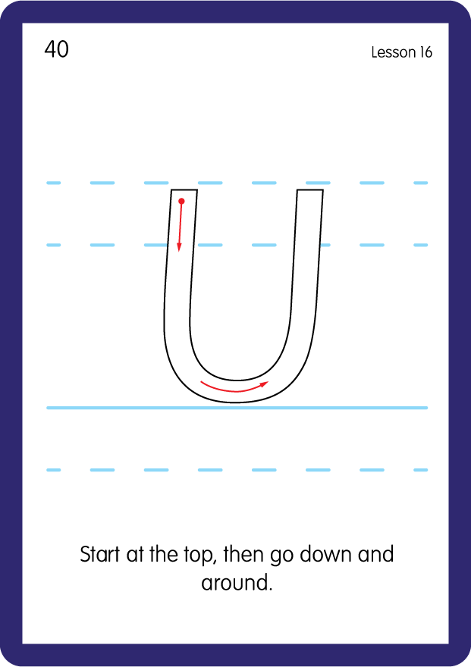
Teach Uppercase Formation
USING JNL686
BACK

Slide 9
Teach Grapheme Caption
USING JNL686
FRONT

Slide 10
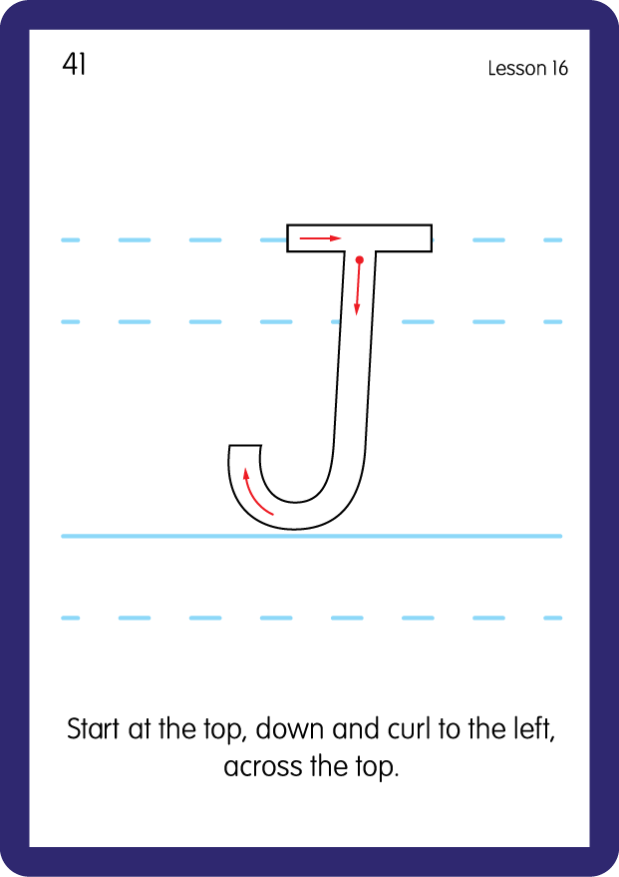
Teach Uppercase Formation
USING JNL686
BACK

Slide 11

Display the Alphabet in order
PRACTISE – 10MINS
a b c d e f g h i j k l m n o p q r s t u v w x y z
A B C D E F G H I J K L M N O P Q R S T U V W X Y Z
USING MAGNETIC LETTERS AND A WHITEBOARD

Slide 12

Provide children with a paper ice cream cone with the uppercase alphabet written on the center of the cone, then match up to the ice cream toppings with a lowercase letter written on.
Practise both lowercase and uppercase formation.
D
B
d
b
U
u

