Slide 1
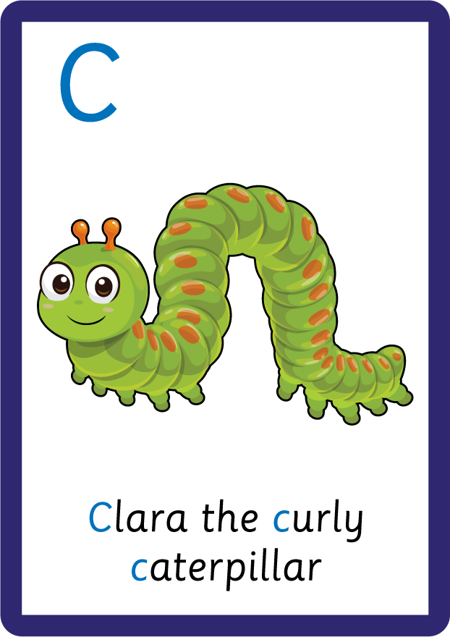
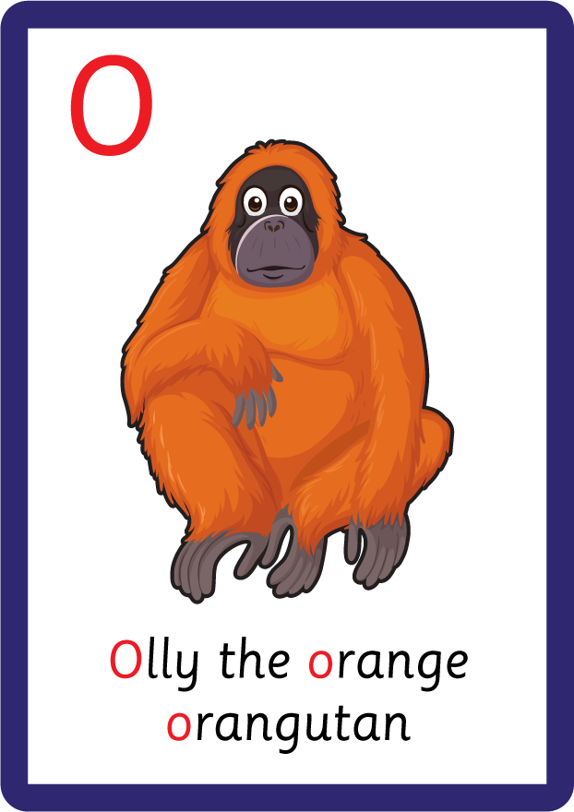
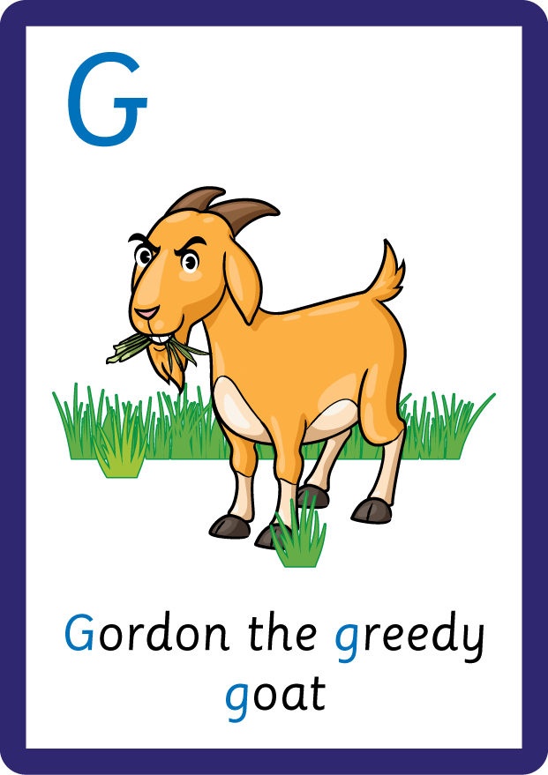
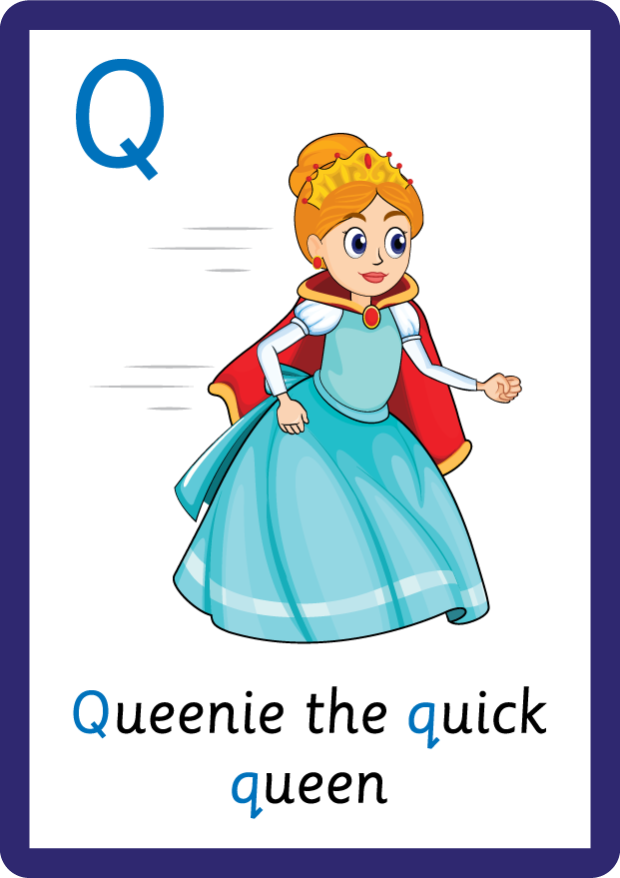
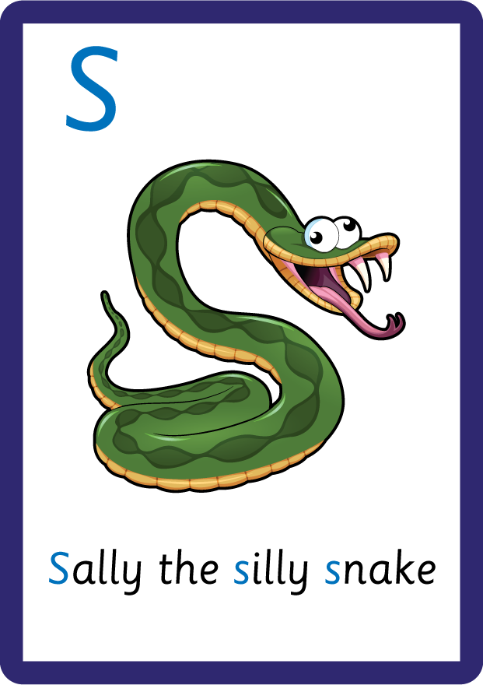
j | v | w | x | y | z | zz | qu | ch
sh | th | ng | ai | ee | igh | oa | oi | oo
ow | ar | air | ear | er | ur | or | ure
Uppercase Letters; C O G Q S
Lesson 17

Slide 2
Learn and practise uppercase letters C O G Q S.
Recall all GPCs learned so far.
Review Phase 2 Common Exception Words as I is no go to into the put his has of pull full.
Review Alphabet Song.
A large display that has the letters of the alphabet on it. This could be an Alphabet Arc, poster, magnetic letters on a whiteboard etc. Visit www.teaching.com.au to shop teaching resources.

Slide 3










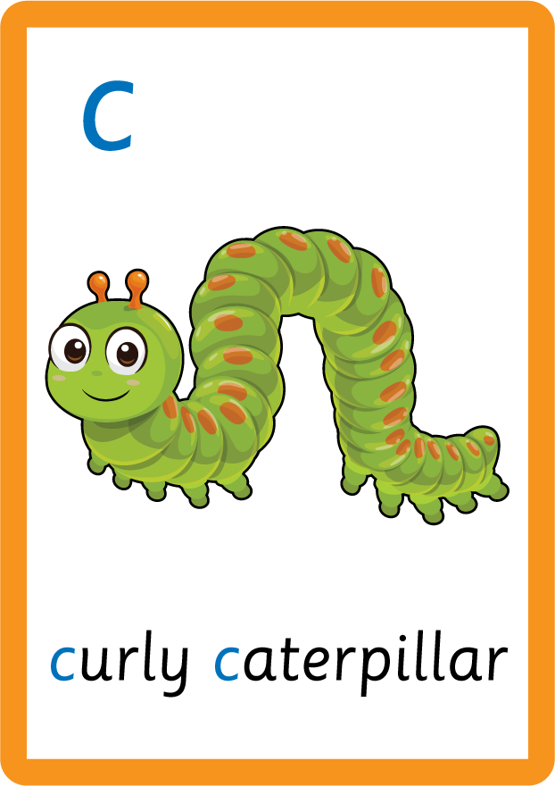












Recall all GPCs learned so far using flashcards.

Slide 4







Recall all GPCs learned so far using flashcards.

Slide 5














Review Phase 2 Common Exception Words as I is no go to into the put his has of pull full.

Slide 6

Review the Alphabet Song.
a, b, c, d, e, f, g (pause)
h, i, j, k, l, m, n (pause)
o, p, q (pause) r, s, t (pause)
u v w (pause) x y z (pause)
Now I know my abc's, Next time won't you sing with me.

Slide 7
Teach Grapheme Caption
USING JNL686
FRONT

Slide 8
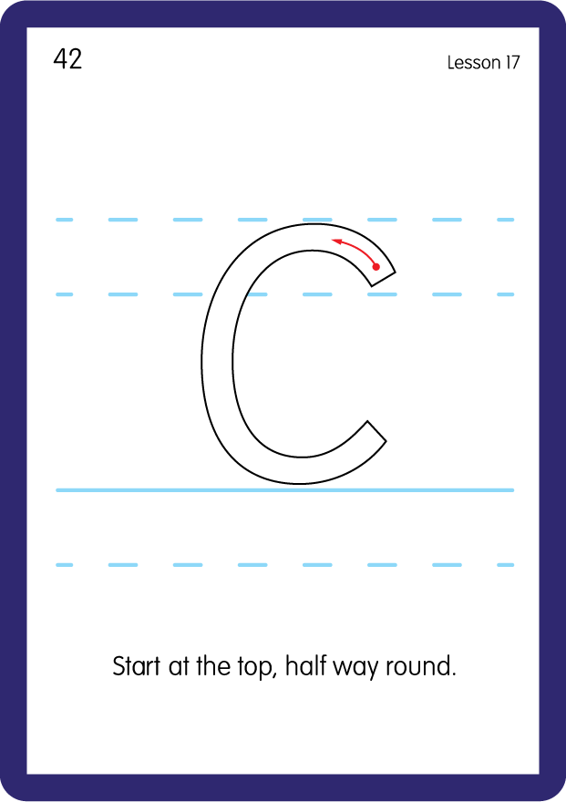
Teach Uppercase Formation
USING JNL686
BACK

Slide 9
Teach Grapheme Caption
USING JNL686
FRONT

Slide 10
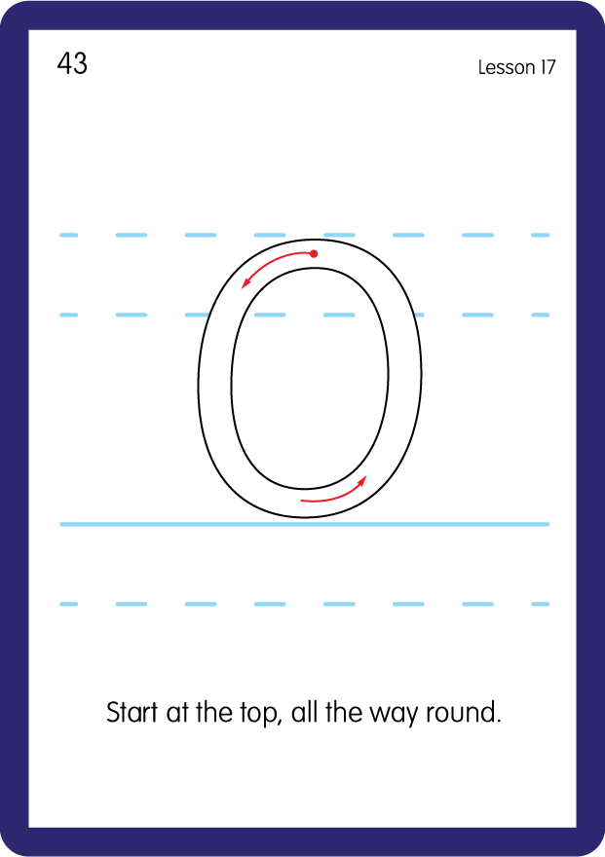
Teach Uppercase Formation
USING JNL686
BACK

Slide 11
Teach Grapheme Caption
USING JNL686
FRONT

Slide 12
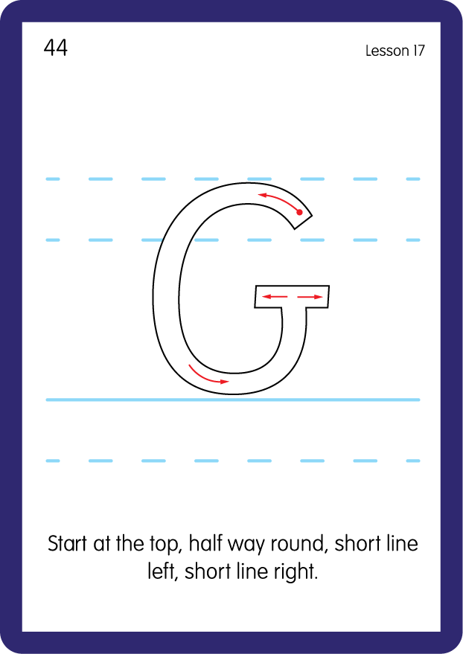
Teach Uppercase Formation
USING JNL686
BACK

Slide 13
Teach Grapheme Caption
USING JNL686
FRONT

Slide 14
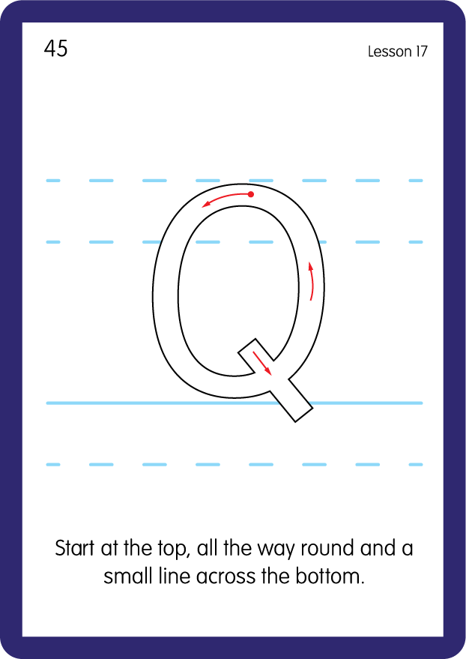
Teach Uppercase Formation
USING JNL686
BACK

Slide 15
Teach Grapheme Caption
USING JNL686
FRONT

Slide 16
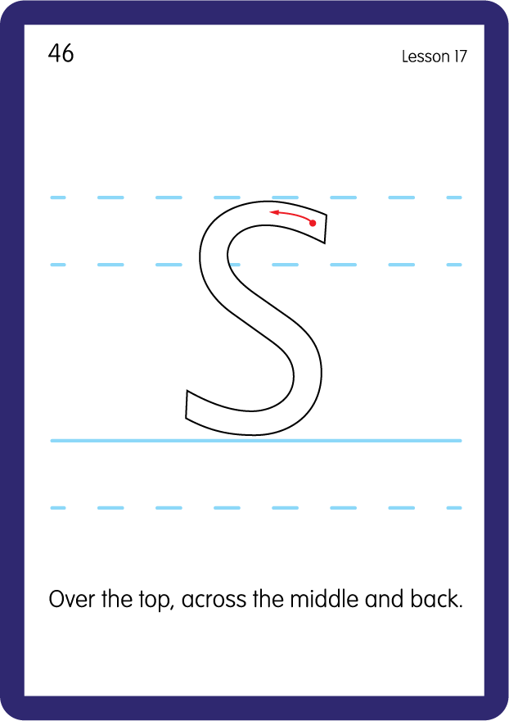
Teach Uppercase Formation
USING JNL686
BACK

Slide 17

Display the Alphabet in order
PRACTISE – 10MINS
a b c d e f g h i j k l m n o p q r s t u v w x y z
A B C D E F G H I J K L M N O P Q R S T U V W X Y Z
USING MAGNETIC LETTERS AND A WHITEBOARD

Slide 18
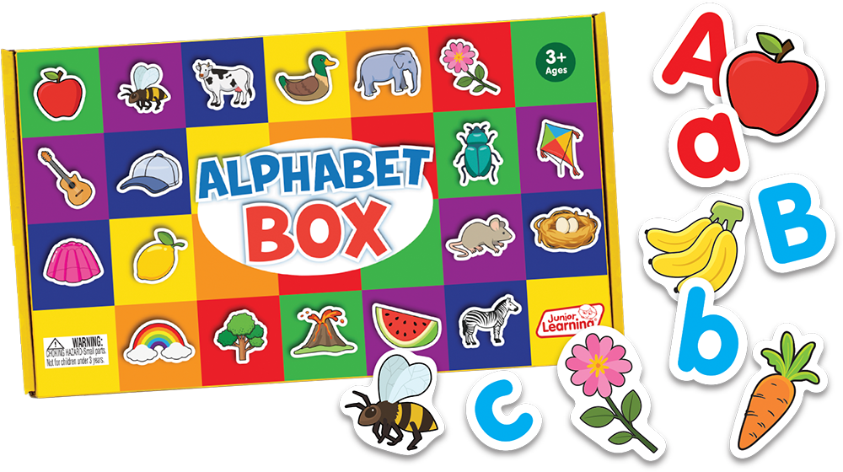
Provide uppercase letters and lowercase letters, mix them up and invite the children to match them up.
Practise both lowercase and uppercase formation.

