Slide 1


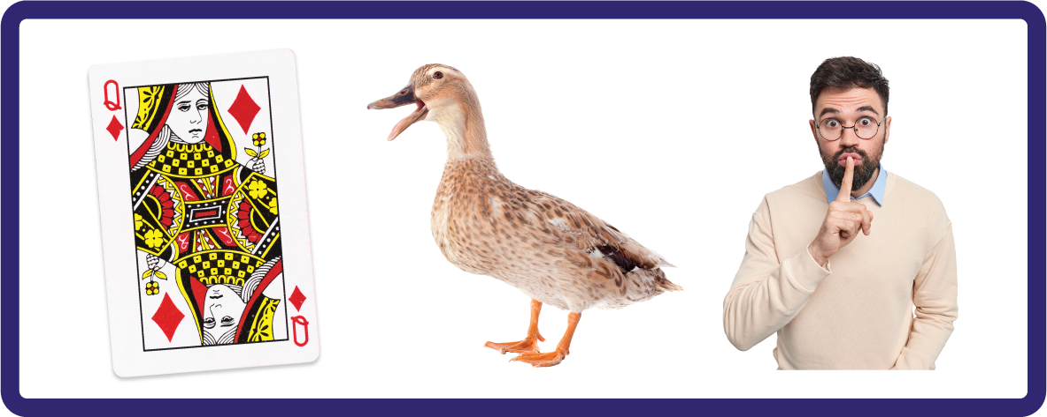
j | v | w | x | y | z | zz | qu | ch
sh | th | ng | ai | ee | igh | oa | oi | oo
ow | ar | air | ear | er | ur | or | ure
Digraph 'qu'
Lesson 21

Slide 2
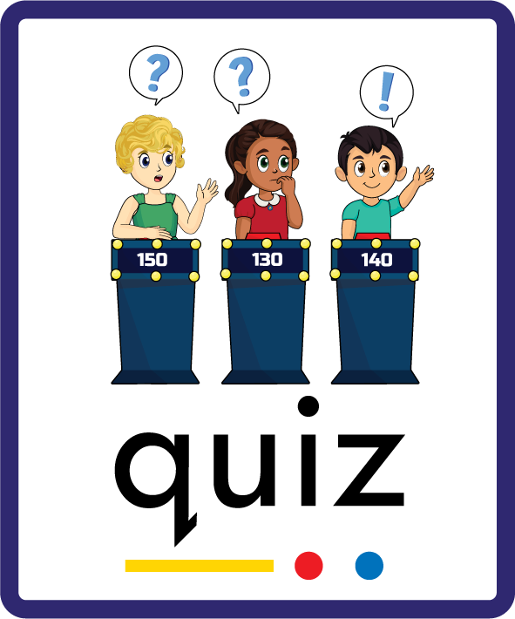
Learn and practise digraph qu.
Recall all GPCs learned so far using flashcards.
Review Phase 2 Common Exception Words as I is no go to into the put his has of pull full.
Phonemic Awareness Cards
Grapheme to Phoneme Cards
Phoneme Frame Cards
Alien Word Cards
JNL691
JNL686
JNL689
JNL692

Slide 3























Recall all GPCs learned so far using flashcards.

Slide 4







Recall all GPCs learned so far using flashcards.

Slide 5














Review Phase 2 Common Exception Words as I is no go to into the put his has of pull full.

Slide 6
Hear Phonemes
USING JNL691
FRONT

Slide 7
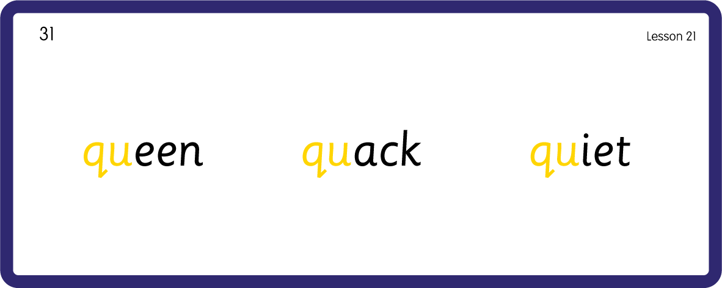
Hear Phonemes
USING JNL691
BACK

Slide 8
Teach Grapheme Caption
USING JNL686
FRONT

Slide 9
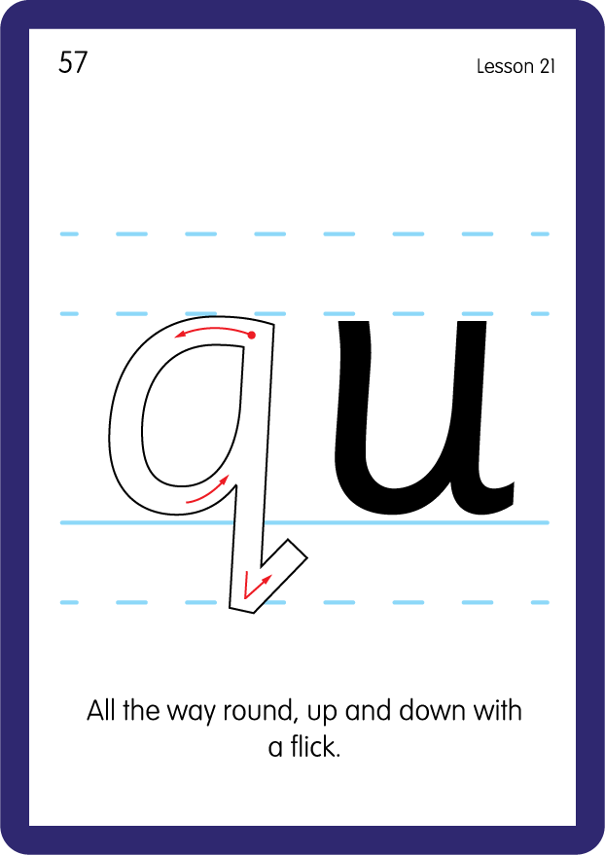
Teach Lowercase Formation
USING JNL686
BACK

Slide 10

Explain Decoding

Slide 11
Model Blending Phonemes
qu
ee
n
USING SOUND BUTTONS
Sound Buttons
Vowel
Consonant
Consonant Digraph
Long Vowel Sound
R-controlled Digraph
Split Digraph
Syllable / Silent Letter

Slide 12
Model Blending Phonemes
qu
i
ck
USING SOUND BUTTONS
Sound Buttons
Vowel
Consonant
Consonant Digraph
Long Vowel Sound
R-controlled Digraph
Split Digraph
Syllable / Silent Letter

Slide 13

Explain Encoding

Slide 14
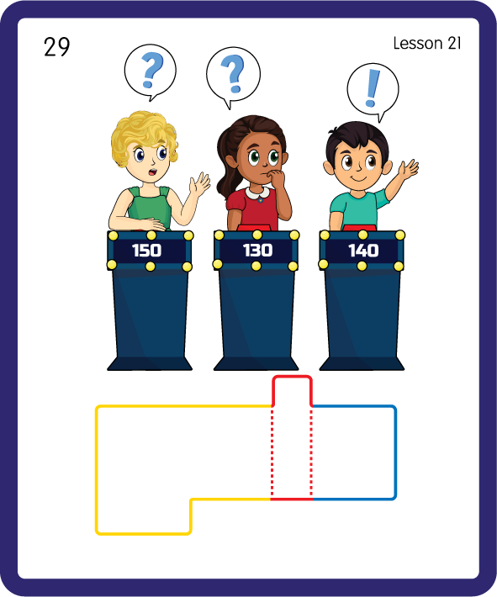
Build a Decodable Word
USING JNL689
BACK

Slide 15
Build a Decodable Word
USING JNL689
FRONT

Slide 16

Practise with Alien Words
USING JNL692
BACK

Slide 17
Practise with Alien Words
USING JNL692
FRONT

Slide 18

Practise Building Words
PRACTISE – 10MINS
i
t
z
ck
a
qu
USING MAGNETIC LETTERS AND A WHITEBOARD

Slide 19
Practise Building Words
PRACTISE – 10MINS
i
t
z
ck
a
qu
quit quiz quick quack
USING MAGNETIC LETTERS AND A WHITEBOARD

Slide 20


Make a queen crown out of paper.
Sort objects/pictures that start with ‘c’ or ‘qu’ and distinguish between the two.
c
qu
or

