Slide 1


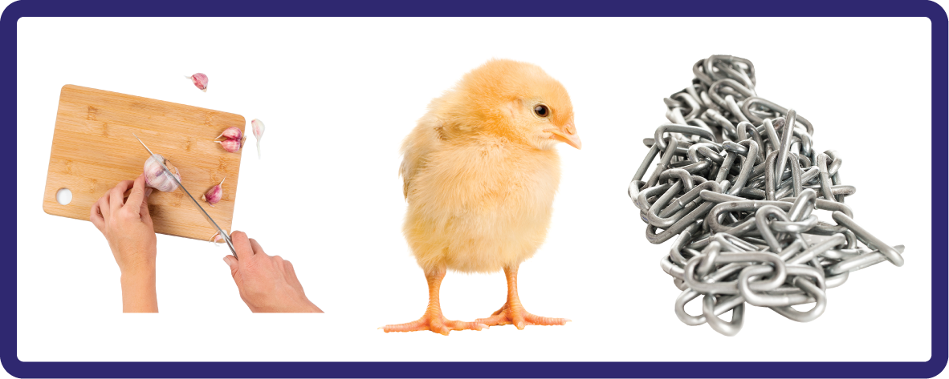
j | v | w | x | y | z | zz | qu | ch
sh | th | ng | ai | ee | igh | oa | oi | oo
ow | ar | air | ear | er | ur | or | ure
Consonant Digraph 'ch'
Lesson 22

Slide 2

Learn and practise consonant digraph ch.
Recall all GPCs learned so far using flashcards.
Review Phase 2 Common Exception Words as I is no go to into the put his has of pull full.
Phonemic Awareness Cards
Grapheme to Phoneme Cards
Phoneme Frame Cards
Alien Word Cards
JNL691
JNL686
JNL689
JNL692

Slide 3























Recall all GPCs learned so far using flashcards.

Slide 4








Recall all GPCs learned so far using flashcards.

Slide 5














Review Phase 2 Common Exception Words as I is no go to into the put his has of pull full.

Slide 6
Hear Phonemes
USING JNL691
FRONT

Slide 7
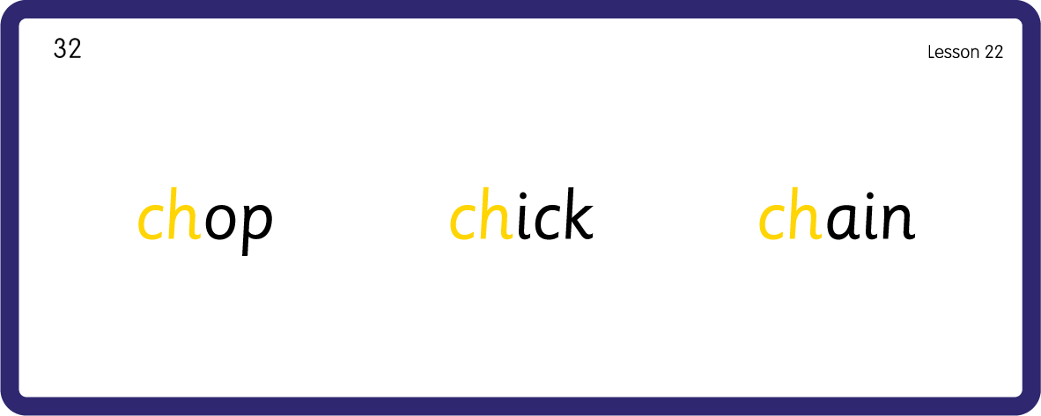
Hear Phonemes
USING JNL691
BACK

Slide 8
Teach Grapheme Caption
USING JNL686
FRONT

Slide 9
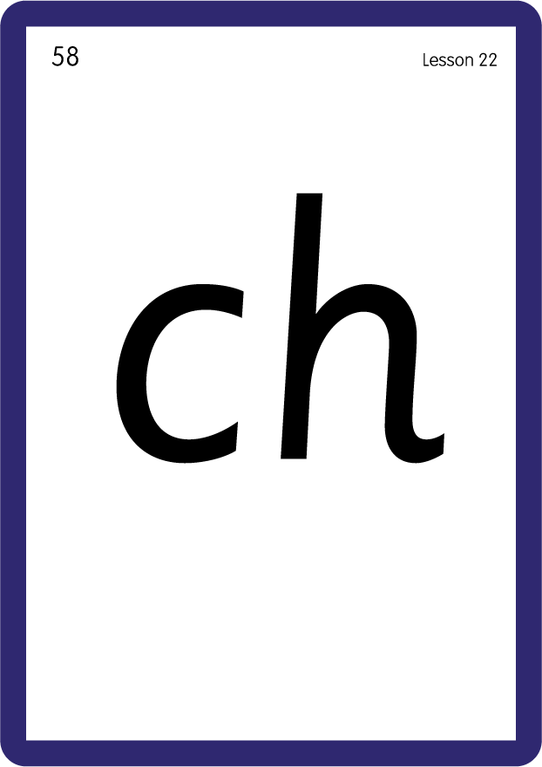
Review Lowercase Formation
USING JNL686
BACK

Slide 10

Explain Decoding

Slide 11
Model Blending Phonemes
ch
i
p
s
USING SOUND BUTTONS
Sound Buttons
Vowel
Consonant
Consonant Digraph
Long Vowel Sound
R-controlled Digraph
Split Digraph
Syllable / Silent Letter

Slide 12
Model Blending Phonemes
ch
o
p
USING SOUND BUTTONS
Sound Buttons
Vowel
Consonant
Consonant Digraph
Long Vowel Sound
R-controlled Digraph
Split Digraph
Syllable / Silent Letter

Slide 13

Explain Encoding

Slide 14
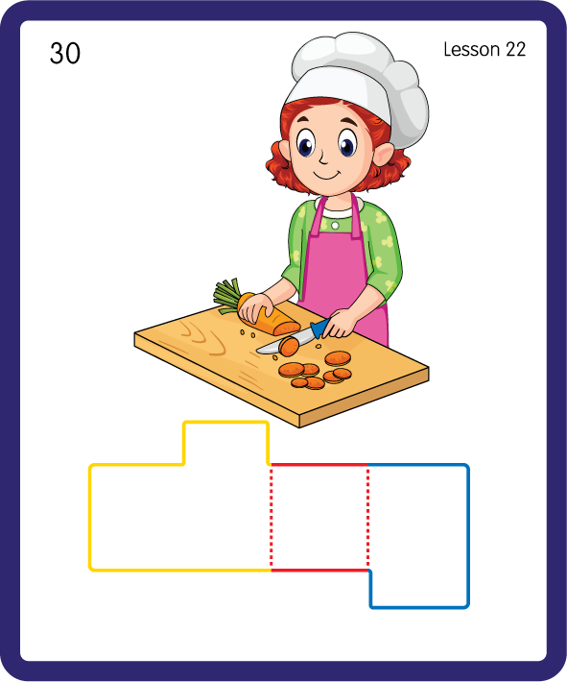
Build a Decodable Word
USING JNL689
BACK

Slide 15
Build a Decodable Word
USING JNL689
FRONT

Slide 16
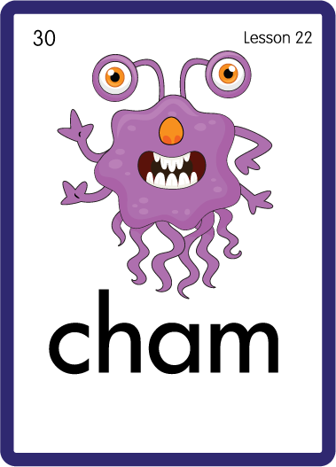
Practise with Alien Words
USING JNL692
BACK

Slide 17
Practise with Alien Words
USING JNL692
FRONT

Slide 18

Practise Building Words
PRACTISE – 10MINS
o
p
n
ll
e
i
u
ck
ch
s
r
m
USING MAGNETIC LETTERS AND A WHITEBOARD

Slide 19
Practise Building Words
PRACTISE – 10MINS
o
p
n
ll
e
i
u
ck
ch
s
r
m
chop chin chip chill check chick such rich much
USING MAGNETIC LETTERS AND A WHITEBOARD

