Slide 1



j | v | w | x | y | z | zz | qu | ch
sh | th | ng | ai | ee | igh | oa | oi | oo
ow | ar | air | ear | er | ur | or | ure
Review qu ch sh
Lesson 24

Slide 2
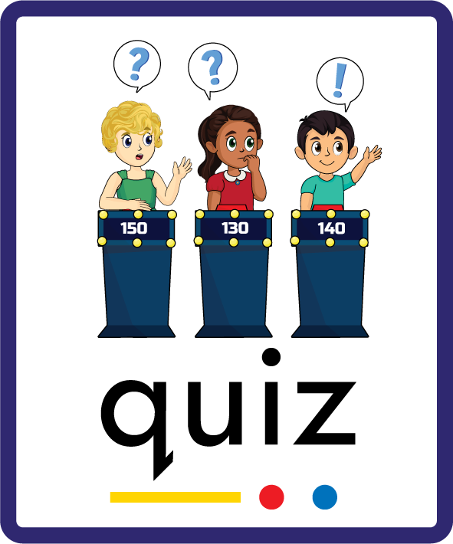

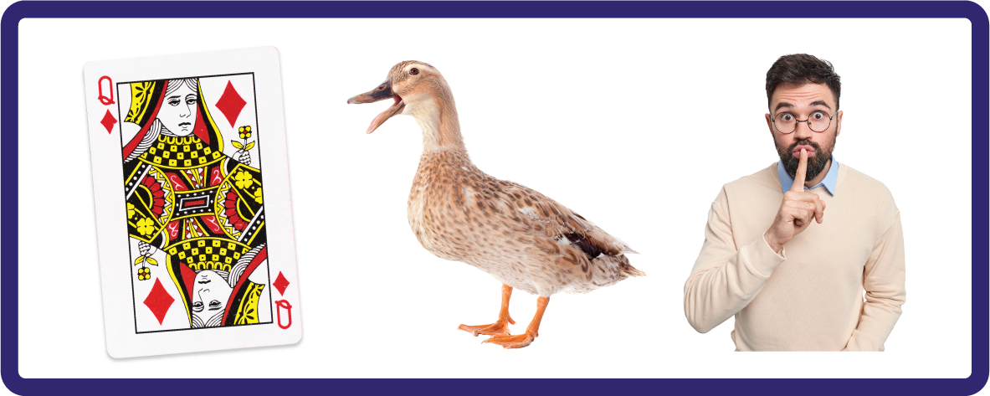

Learn and practise consonant digraphs qu ch sh.
Recall all GPCs learned so far using flashcards.
Review Alphabet Song.
Phonemic Awareness Cards
Grapheme to Phoneme Cards
Phoneme Frame Cards
Alien Word Cards
Common Exception Word Cards
JNL691
JNL686
JNL689
JNL692
JNL687

Slide 3























Recall all GPCs learned so far using flashcards.

Slide 4






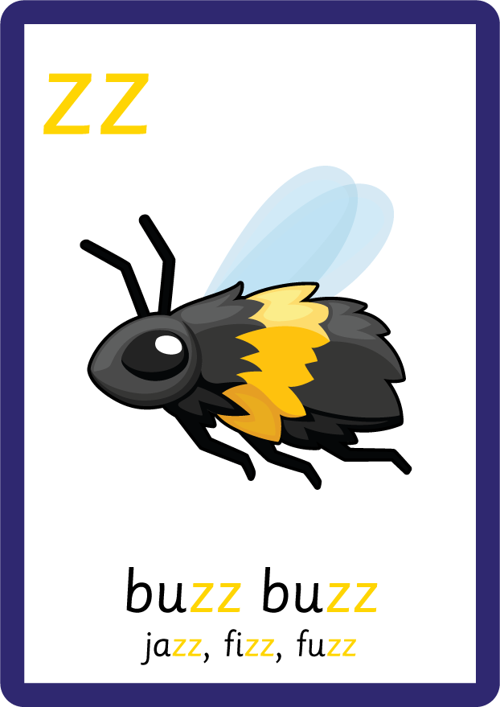
Recall all GPCs learned so far using flashcards.

Slide 5

Review the Alphabet Song.
a, b, c, d, e, f, g (pause)
h, i, j, k, l, m, n (pause)
o, p, q (pause) r, s, t (pause)
u v w (pause) x y z (pause)
Now I know my abc's, Next time won't you sing with me.

Slide 6
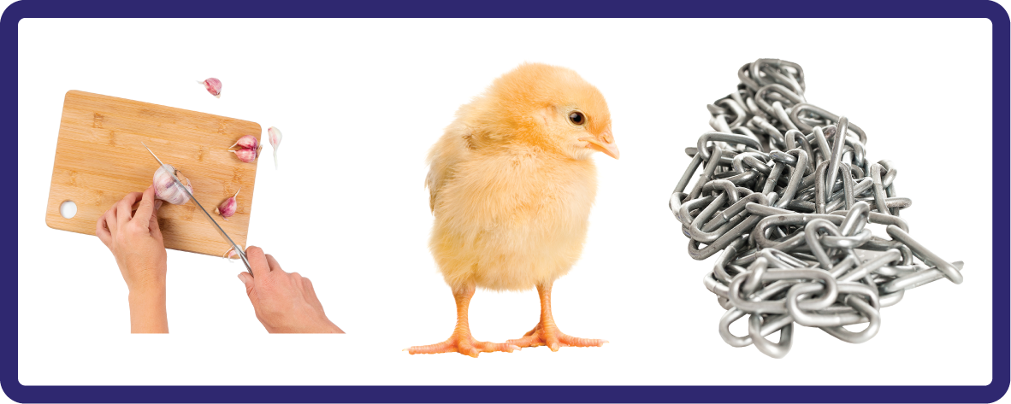

Hear Phonemes
USING JNL691
FRONT

Slide 7
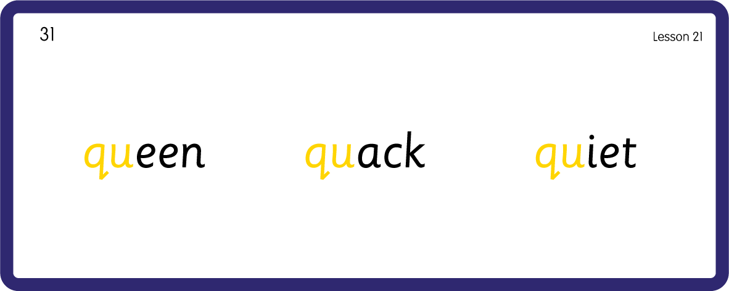
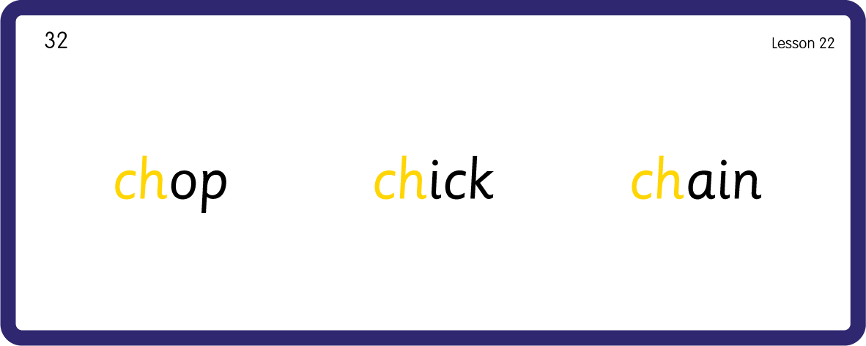
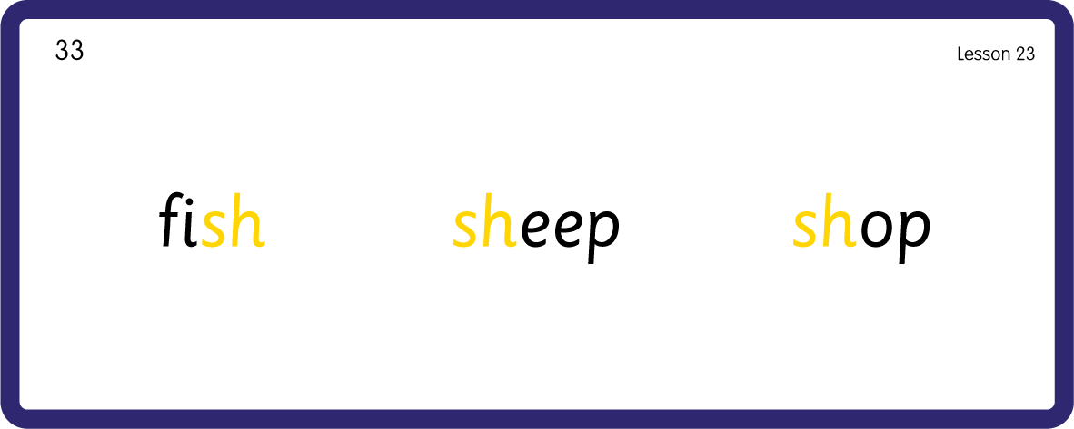
Hear Phonemes
USING JNL691
BACK

Slide 8
Review Grapheme Caption
USING JNL686
FRONT

Slide 9
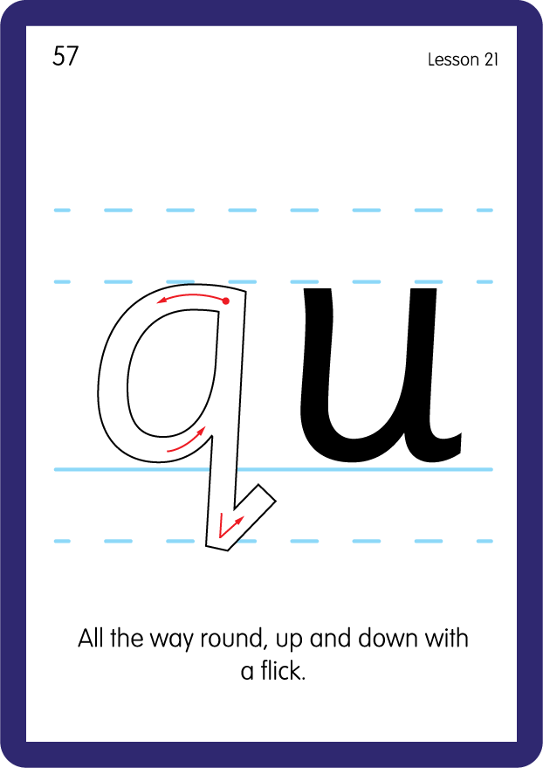
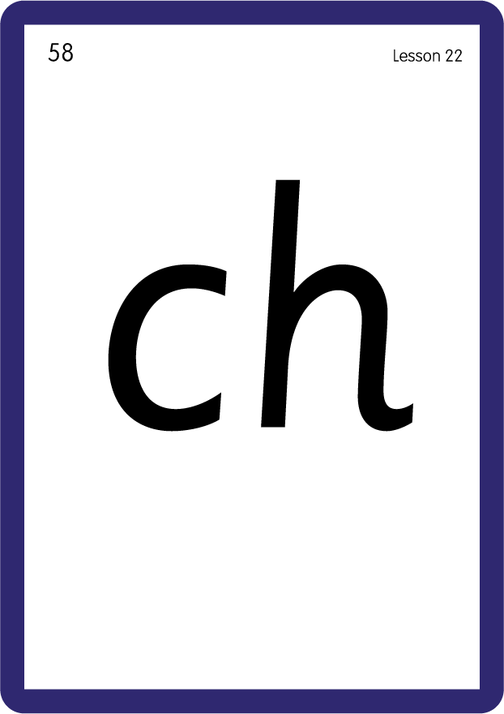

Review Lowercase Formation
USING JNL686
BACK

Slide 10
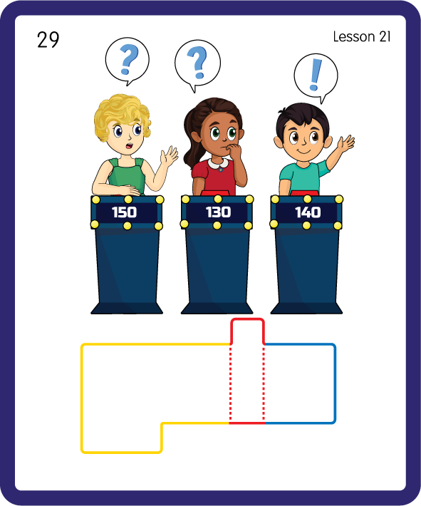
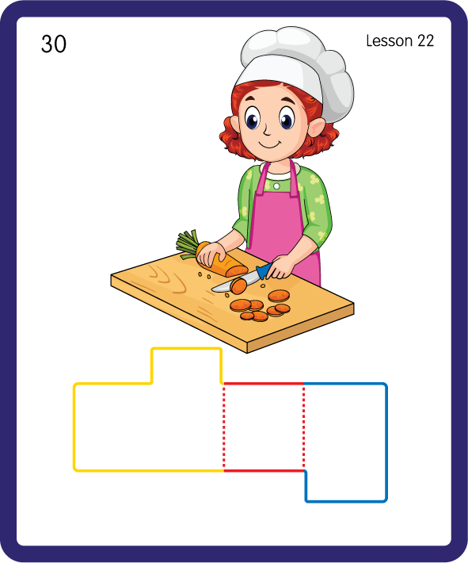
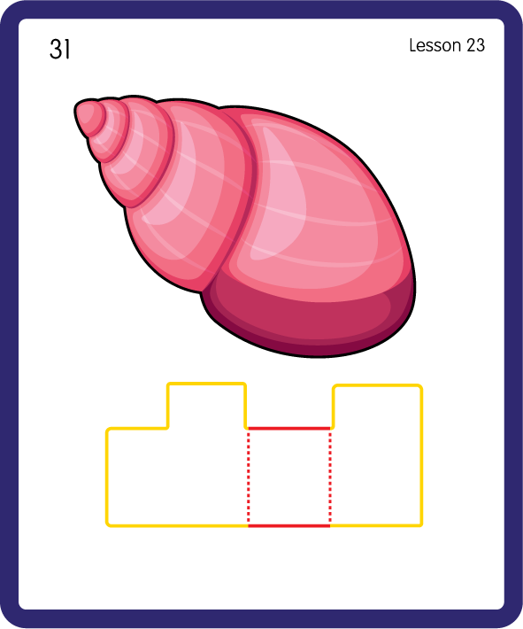
Build a Decodable Word
USING JNL689
BACK

Slide 11


Build a Decodable Word
USING JNL689
FRONT

Slide 12

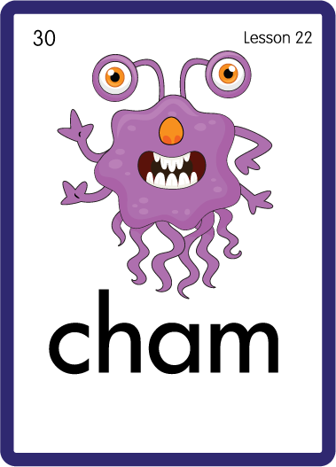

Practise with Alien Words
USING JNL692
BACK

Slide 13


Practise with Alien Words
USING JNL692
FRONT

Slide 14
Practise Common Exception Words
USING JNL687
FRONT

Slide 15
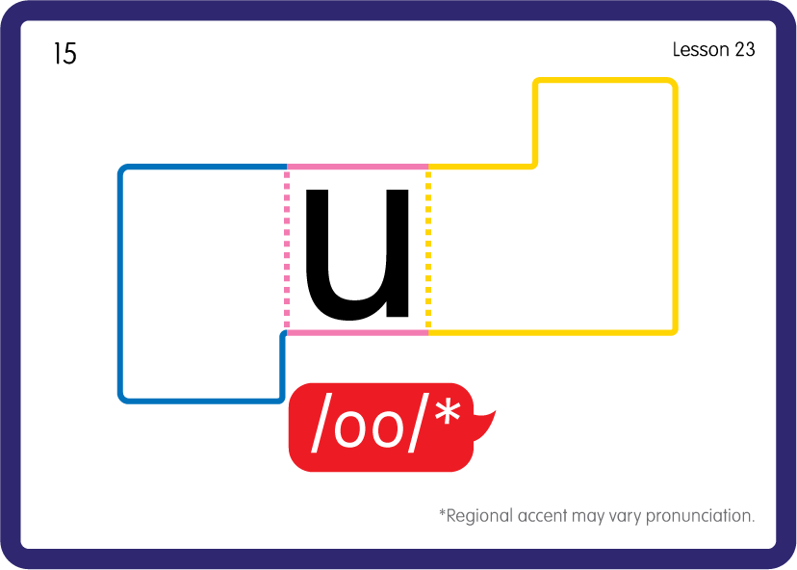
Practise Common Exception Words
USING JNL687
BACK

