Slide 1




j | v | w | x | y | z | zz | qu | ch
sh | th | ng | ai | ee | igh | oa | oi | oo
ow | ar | air | ear | er | ur | or | ure
Review Common Exception Words
Lesson 25

Slide 2


Learn and practise Common Exception Words.
Recall all GPCs learned so far using flashcards.
Common Exception Word Cards Phase 2
Common Exception Word Cards Phase 3
Letter Sounds Phase 2
Letter Sounds Phase 3
JNL686
JNL686
JNL687
JNL687

Slide 3






















Recall all GPCs learned so far using flashcards.

Slide 4











Review Phase 2 Common Exception Words as I is no go to into the put his has of pull full.

Slide 5









Recall all GPCs learned so far using flashcards.

Slide 6
Practise Common Exception Words
USING JNL687
FRONT

Slide 7
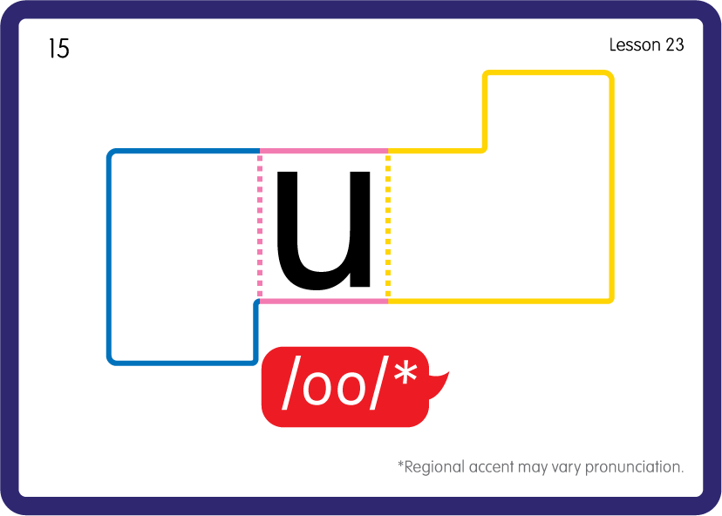
Practise Common Exception Words
USING JNL687
FRONT

Slide 8

Practise Common Exception Words
This part is tricky because the letter is making a different sound.
Try saying the word aloud, then spelling it on a phoneme frame
USING JNL687
BACK

Slide 9

Practise Building Common Exception Words
PRACTISE – 10MINS
p
u
t
f
ll
sh
USING A PHONEME FRAME
Sound Buttons
Vowel
Consonant
Consonant Digraph
Long Vowel Sound
R-controlled Digraph
Split Digraph
Syllable / Silent Letter

Slide 10
Practise Building Common Exception Words
PRACTISE – 10MINS
p
u
t
f
ll
sh
put pull full push
USING A PHONEME FRAME
Sound Buttons
Vowel
Consonant
Consonant Digraph
Long Vowel Sound
R-controlled Digraph
Split Digraph
Syllable / Silent Letter

