Slide 1



j | v | w | x | y | z | zz | qu | ch
sh | th | ng | ai | ee | igh | oa | oi | oo
ow | ar | air | ear | er | ur | or | ure
Review th (voiced and unvoiced), ng
Lesson 29 & 30

Slide 2




Learn and practise consonant digraphs th (voiced), th (unvoiced), ng.
Recall all GPCs learned so far.
Review Phase 2 Common Exception Words as I is no go to into the put his has of pull full.
Review Alphabet Song.
Phonemic Awareness Cards
Grapheme to Phoneme Cards
Phoneme Frame Cards
Alien Word Cards
High Frequency Word Cards
JNL691
JNL686
JNL689
JNL692
JNL688

Slide 3























Recall all GPCs learned so far using flashcards.

Slide 4










Recall all GPCs learned so far using flashcards.

Slide 5














Review Phase 2 Common Exception Words as I is no go to into the put his has of pull full.

Slide 6

Review Phase 3 Common Exception Word push.

Slide 7

Review the Alphabet Song.
a, b, c, d, e, f, g (pause)
h, i, j, k, l, m, n (pause)
o, p, q (pause) r, s, t (pause)
u v w (pause) x y z (pause)
Now I know my abc's, Next time won't you sing with me.

Slide 8


Hear Phonemes
USING JNL691
FRONT

Slide 9
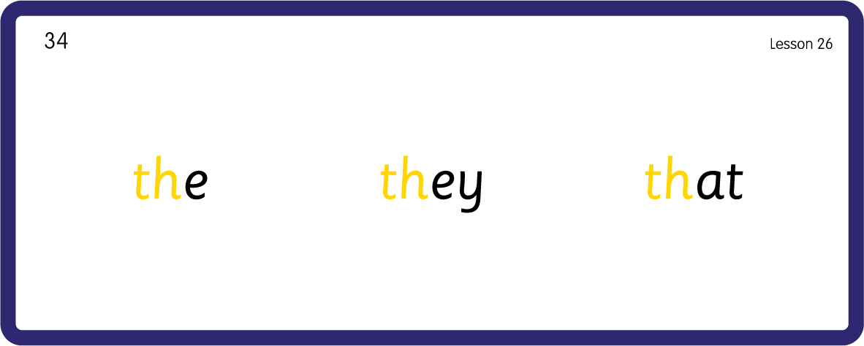
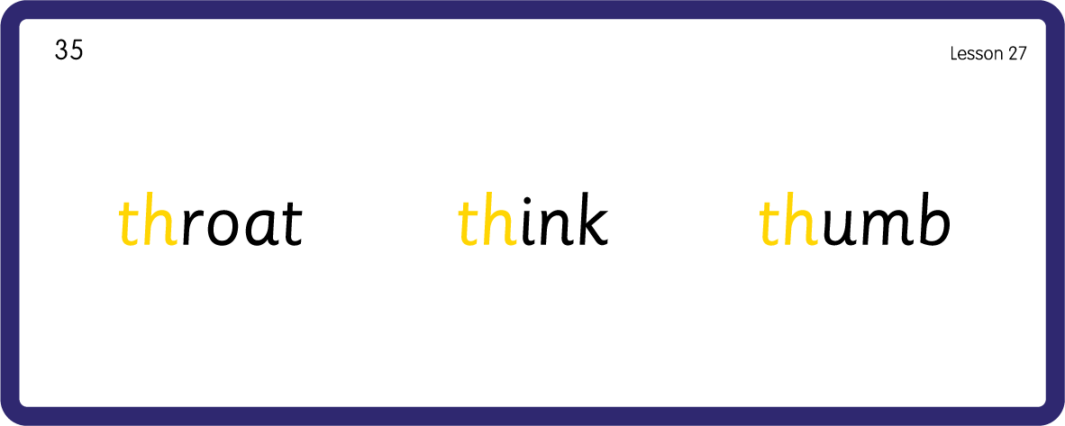
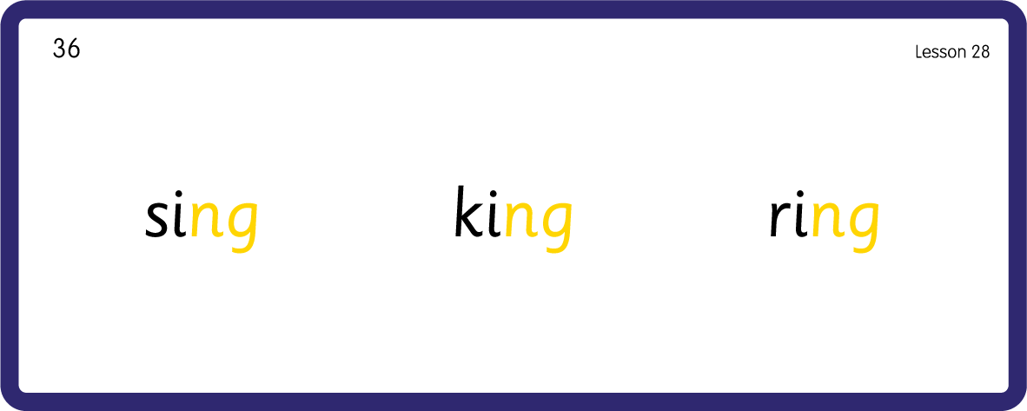
Hear Phonemes
USING JNL691
BACK

Slide 10
Review Grapheme Caption
USING JNL686
FRONT

Slide 11


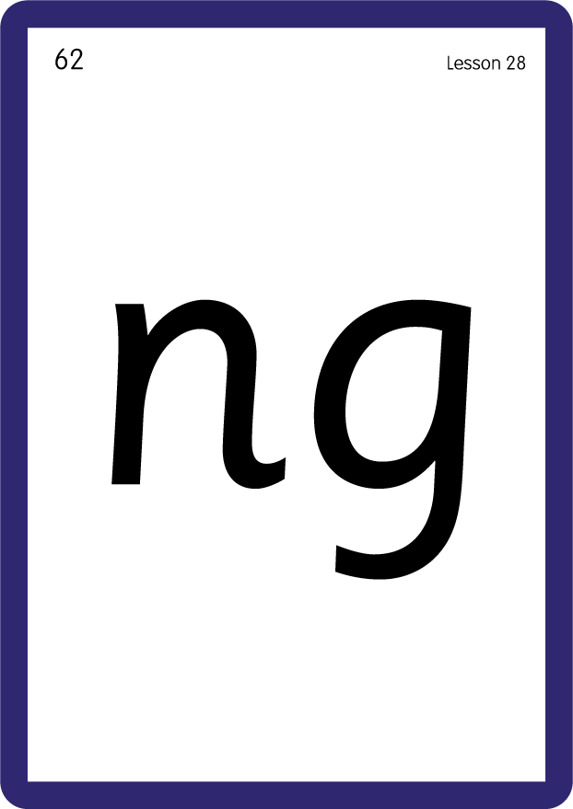
Review Lowercase Formation
USING JNL686
BACK

Slide 12
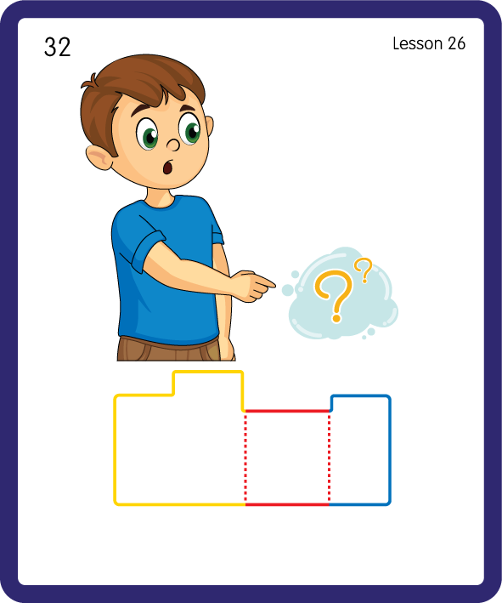
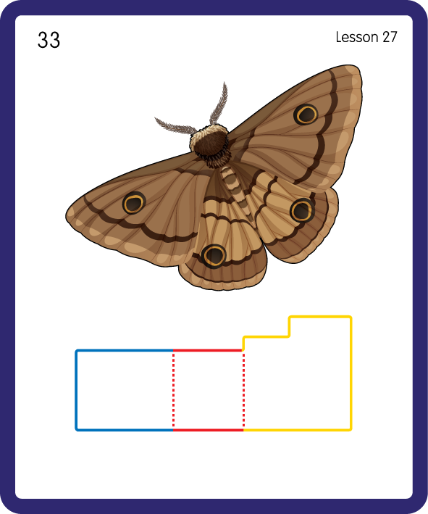
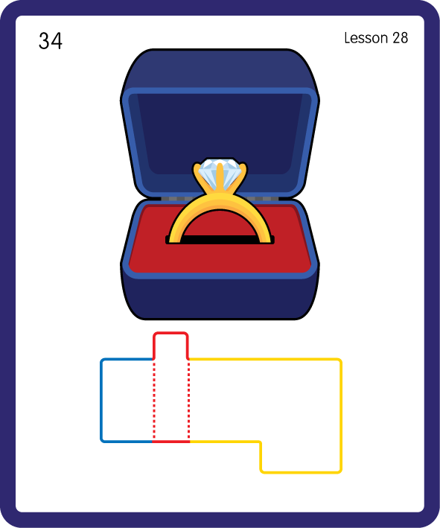
Build a Decodable Word
USING JNL689
BACK

Slide 13


Build a Decodable Word
USING JNL689
FRONT

Slide 14

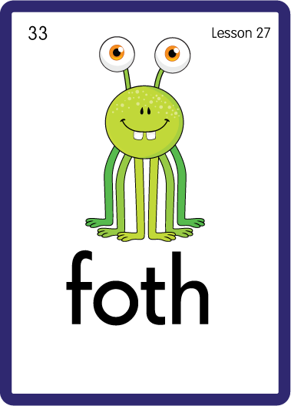
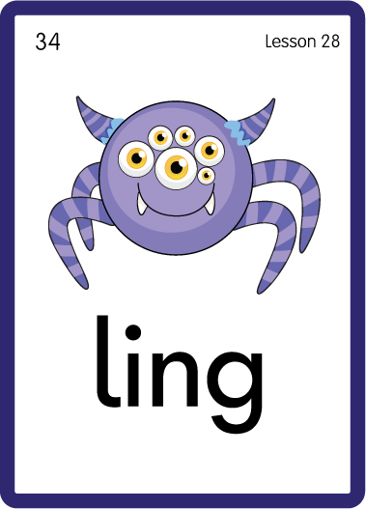
Practise with Alien Words
USING JNL692
BACK

Slide 15


Practise with Alien Words
USING JNL692
FRONT

Slide 16




Practise High Frequency Words
USING JNL688
FRONT

Slide 17
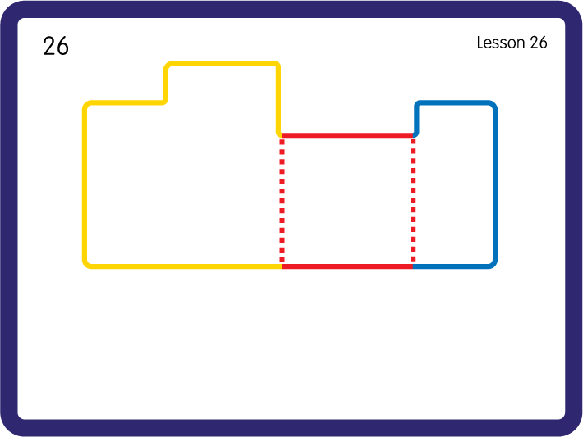
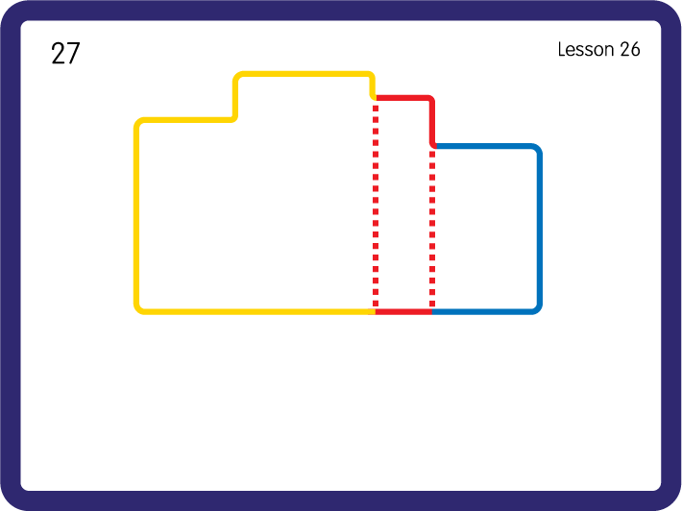
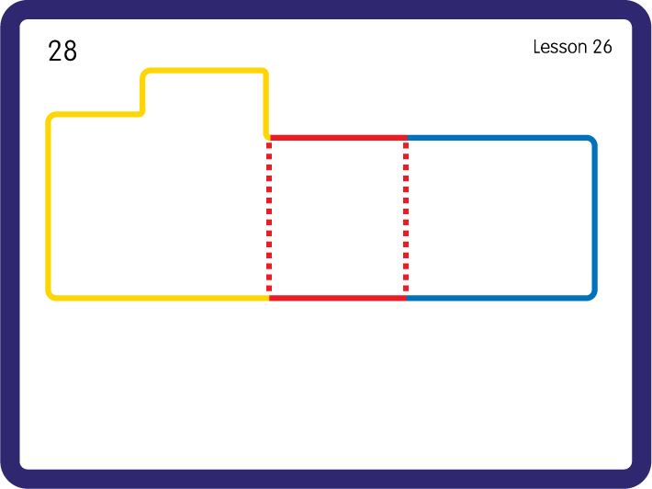
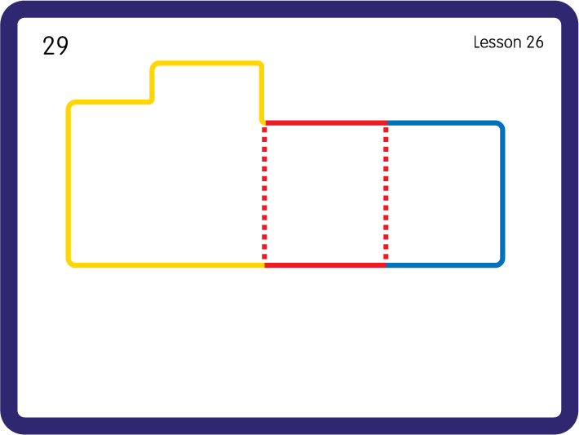
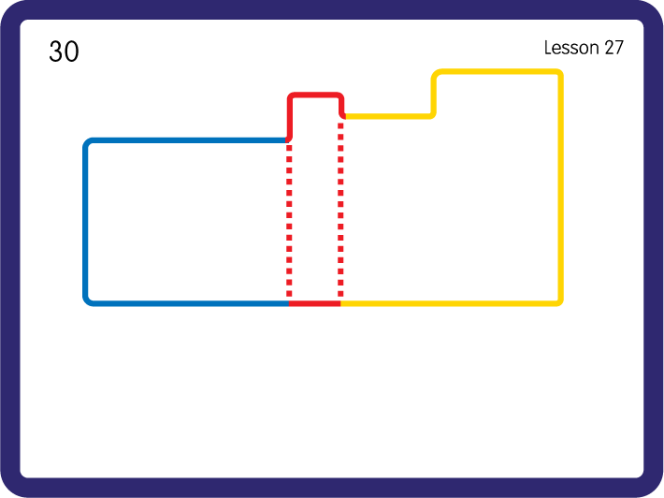
Practise High Frequency Words
USING JNL688
BACK

