Slide 1



j | v | w | x | y | z | zz | qu | ch
sh | th | ng | ai | ee | igh | oa | oi | oo
ow | ar | air | ear | er | ur | or | ure
Review ai ee igh
Lesson 35

Slide 2


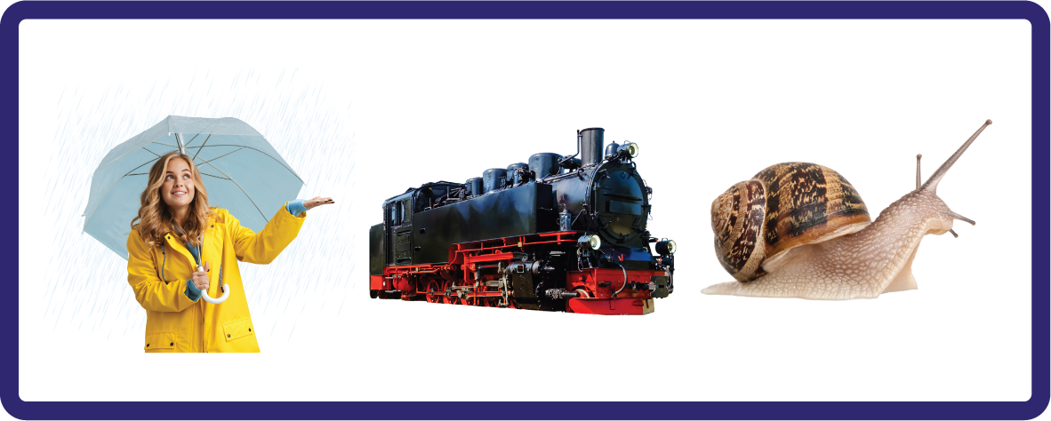


Learn and practise vowel digraphs ai ee and trigraph igh.
Recall all GPCs learned so far using flashcards.
Review all Phase 3 Common Exception Words learned so far push they me we be he she my by.
Phonemic Awareness Cards
Grapheme to Phoneme Cards
Phoneme Frame Cards
Alien Word Cards
Common Exception Word Cards
High Frequency Word Cards
JNL691
JNL686
JNL689
JNL692
JNL687
JNL688

Slide 3























Recall all GPCs learned so far using flashcards.

Slide 4













Recall all GPCs learned so far using flashcards.

Slide 5














Review Phase 2 Common Exception Words as I is no go to into the put his has of pull full.

Slide 6








Review Phase 3 Common Exception Words push they me we be he she my by.

Slide 7
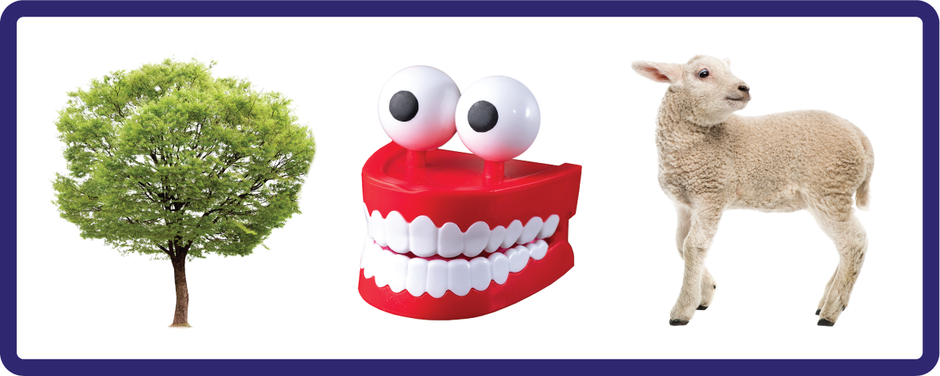

Hear Phonemes
USING JNL691
FRONT

Slide 8
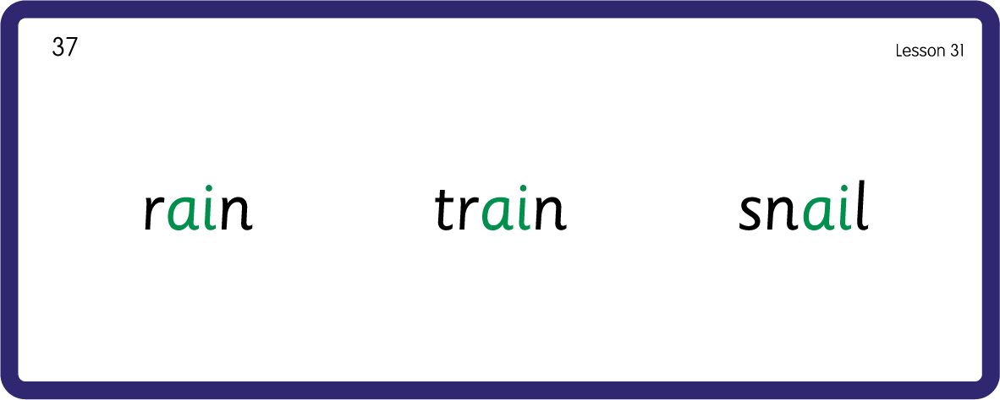
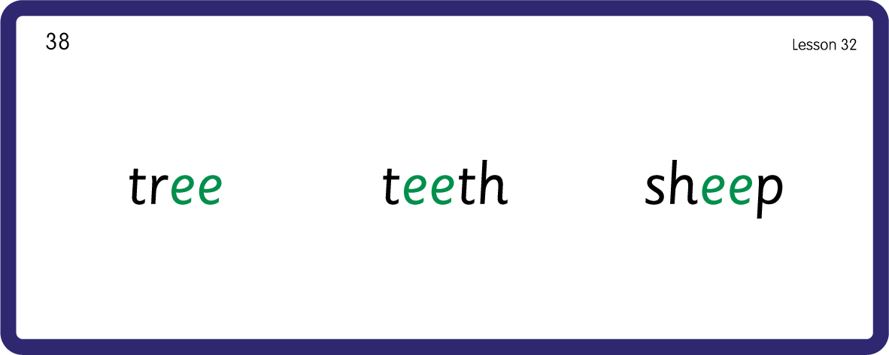
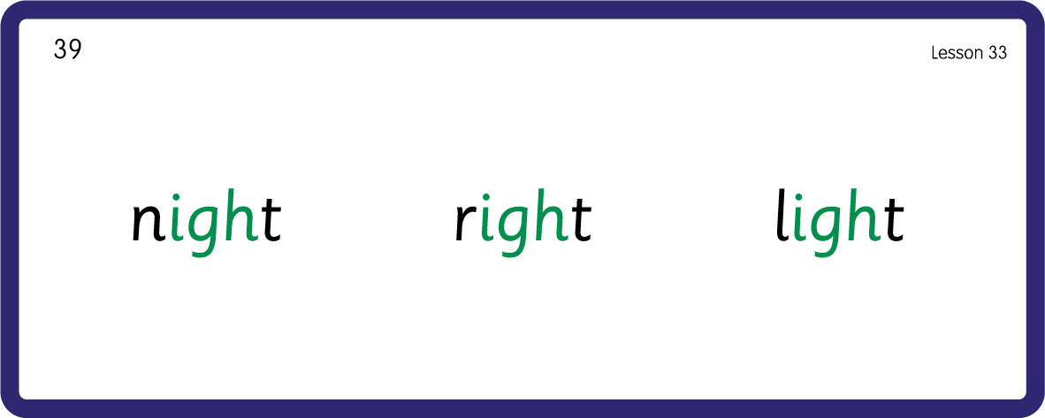
Hear Phonemes
USING JNL691
BACK

Slide 9
Review Grapheme Caption
USING JNL686
FRONT

Slide 10



Review Lowercase Formation
USING JNL686
BACK

Slide 11
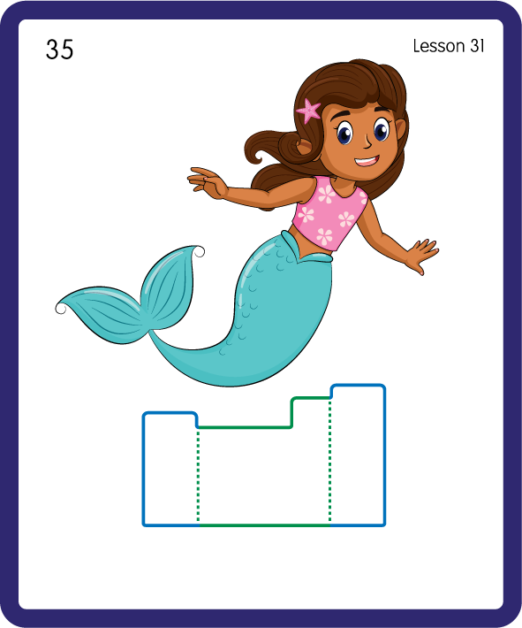
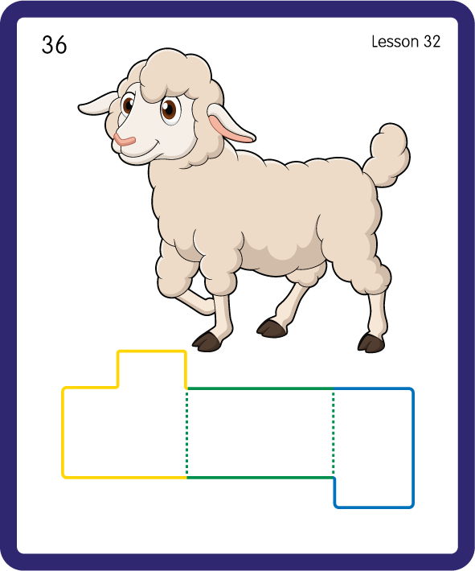
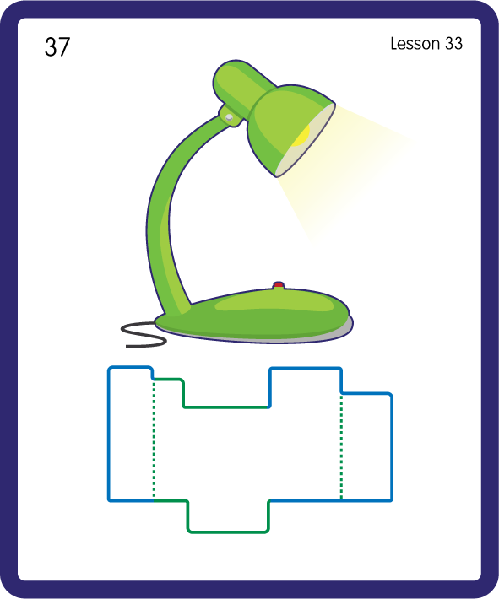
Build a Decodable Word
USING JNL689
BACK

Slide 12


Build a Decodable Word
USING JNL689
FRONT

Slide 13

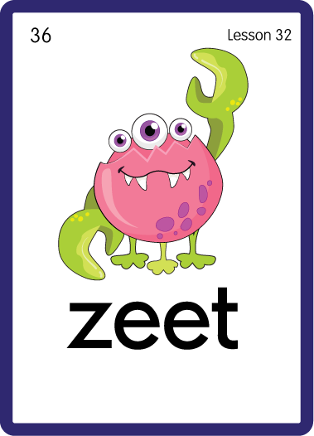

Practise with Alien Words
USING JNL692
BACK

Slide 14


Practise with Alien Words
USING JNL692
FRONT

Slide 15
Practise Common Exception Words
USING JNL687
FRONT

Slide 16
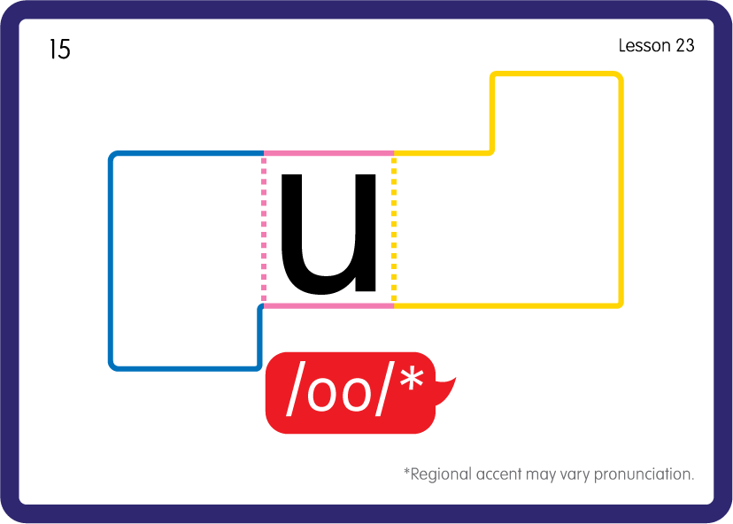
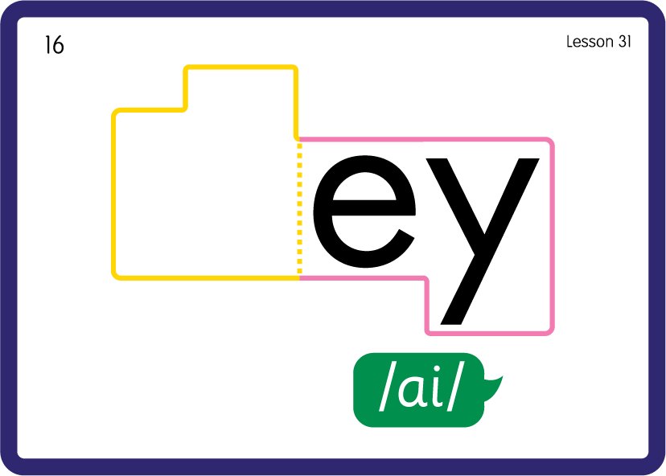
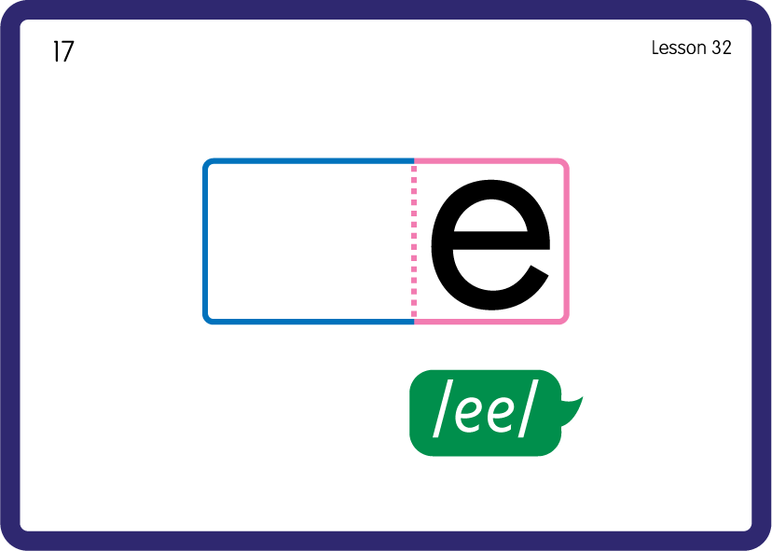
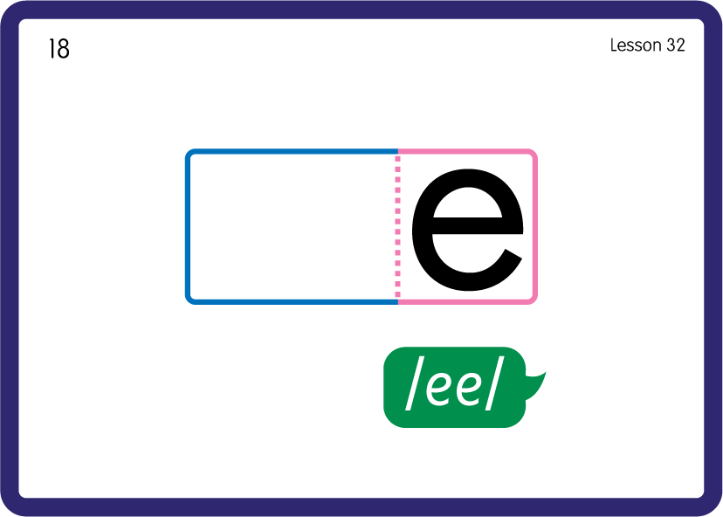
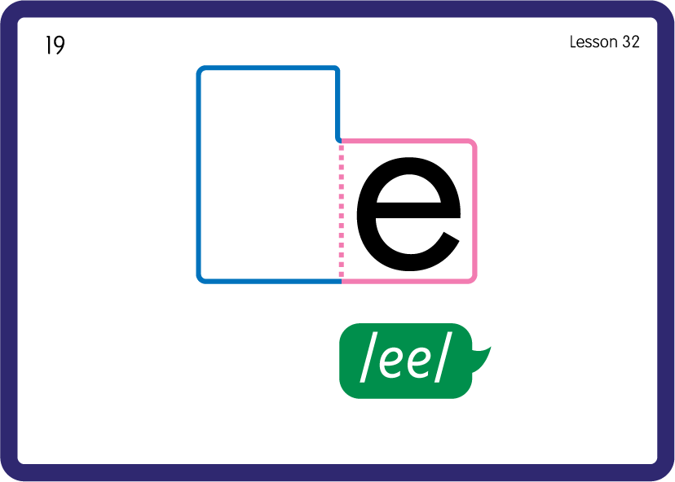
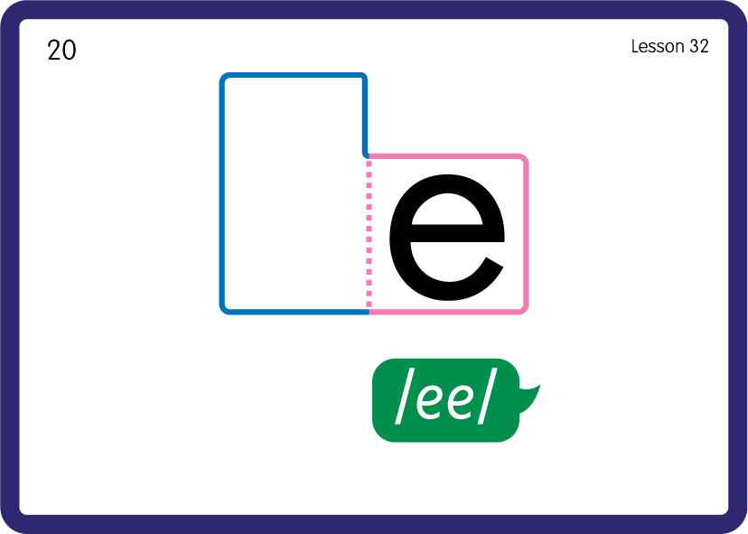
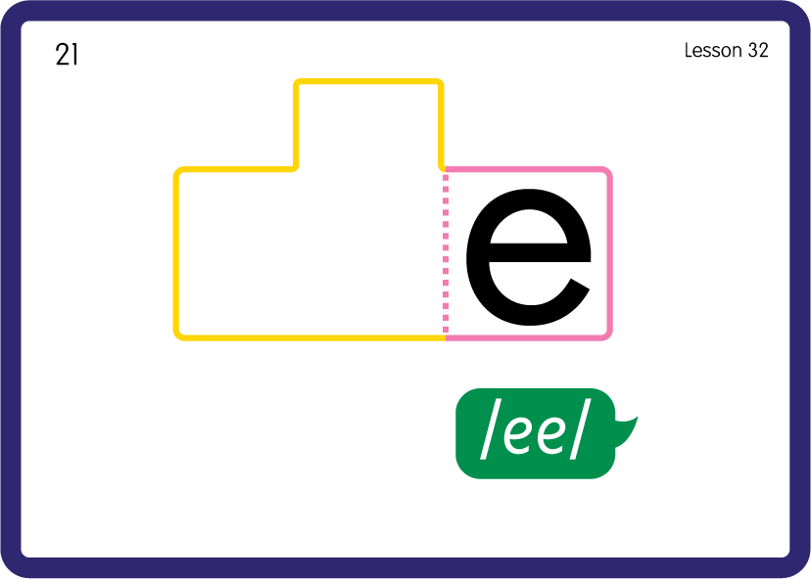
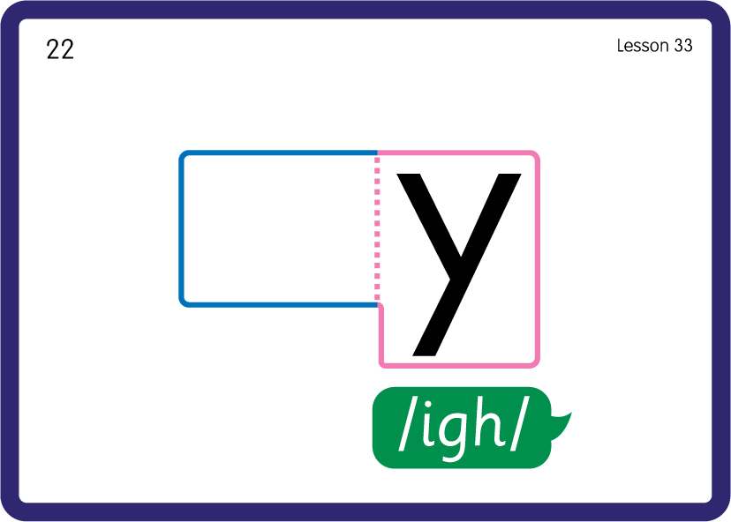
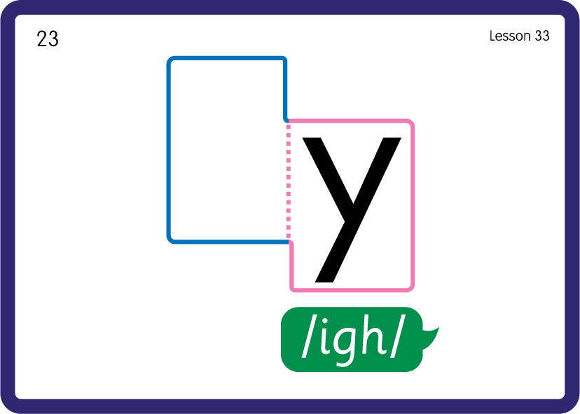
Practise Common Exception Words
USING JNL687
BACK

Slide 17






Practise High Frequency Words
USING JNL688
FRONT

Slide 18
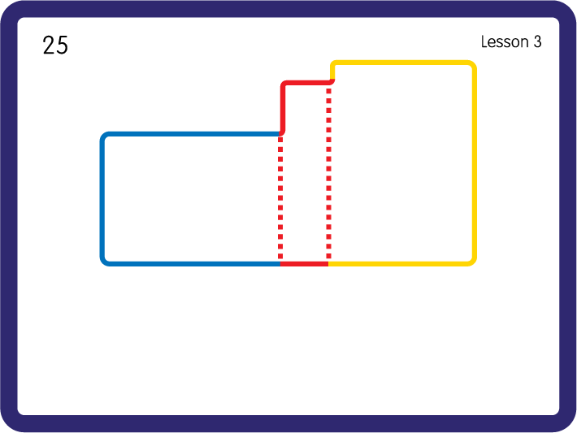
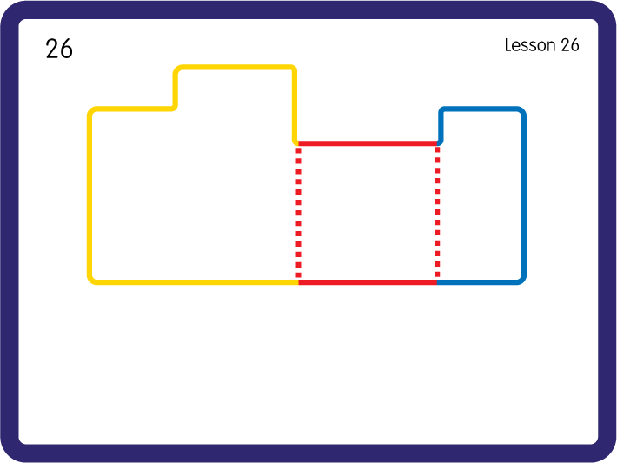
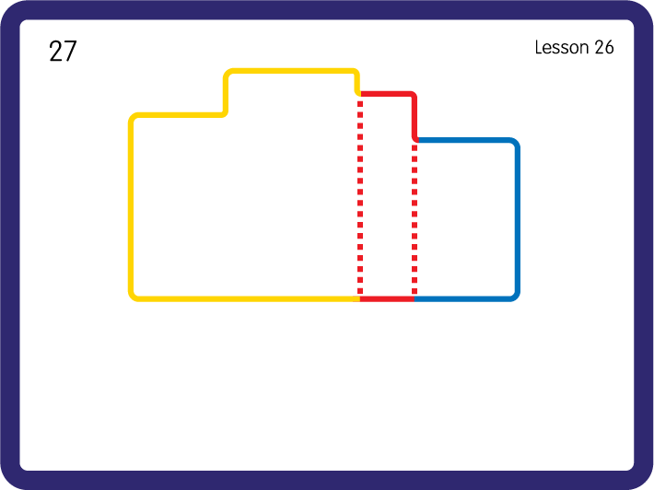
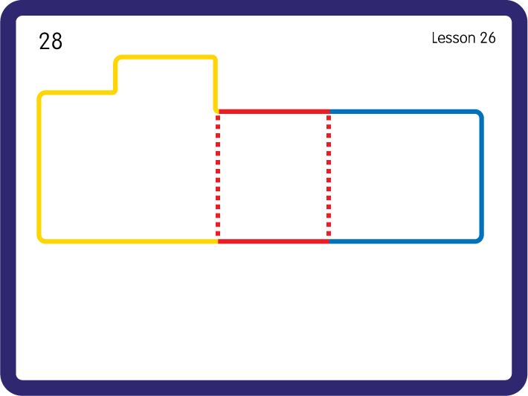
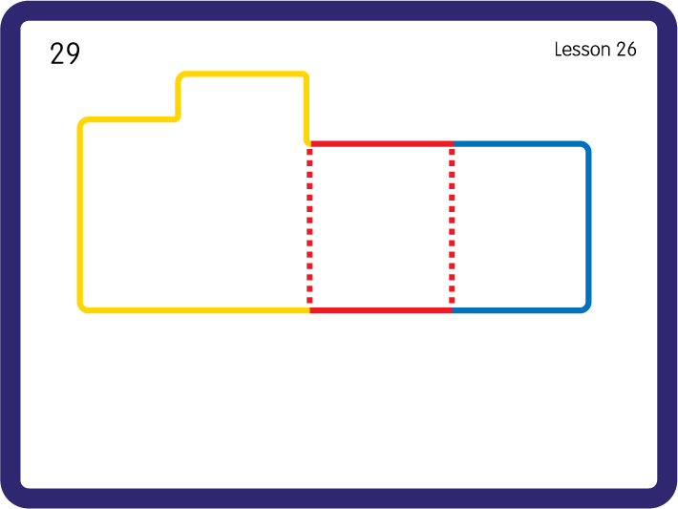
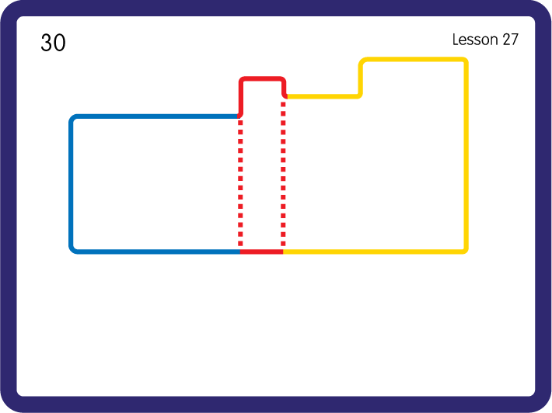
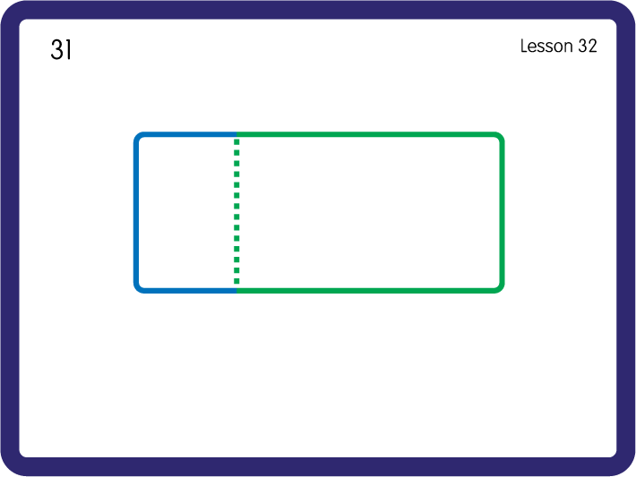
Practise High Frequency Words
USING JNL688
BACK

Slide 19


Sorting with Feely bags - ai ee igh; Have children sort objects beginning with the letter sounds into the correct bags.
ee
igh

