Slide 1




j | v | w | x | y | z | zz | qu | ch
sh | th | ng | ai | ee | igh | oa | oi | oo
ow | ar | air | ear | er | ur | or | ure
Vowel Digraph 'oo' (short)
Lesson 38

Slide 2


Learn and practise vowel digraph oo (short).
Recall all GPCs learned so far using flashcards.
Review Phase 2 Common Exception Words as I is no go to into the put his has of pull full.
Phonemic Awareness Cards
Grapheme to Phoneme Cards
Phoneme Frame Cards
Alien Word Cards
Common Exception Word Cards
High Frequency Word Cards
JNL691
JNL686
JNL689
JNL692
JNL687
JNL688

Slide 3























Recall all GPCs learned so far using flashcards.

Slide 4


















Recall all GPCs learned so far using flashcards.

Slide 5














Review Phase 2 Common Exception Words as I is no go to into the put his has of pull full.

Slide 6
Hear Phonemes
USING JNL691
FRONT

Slide 7
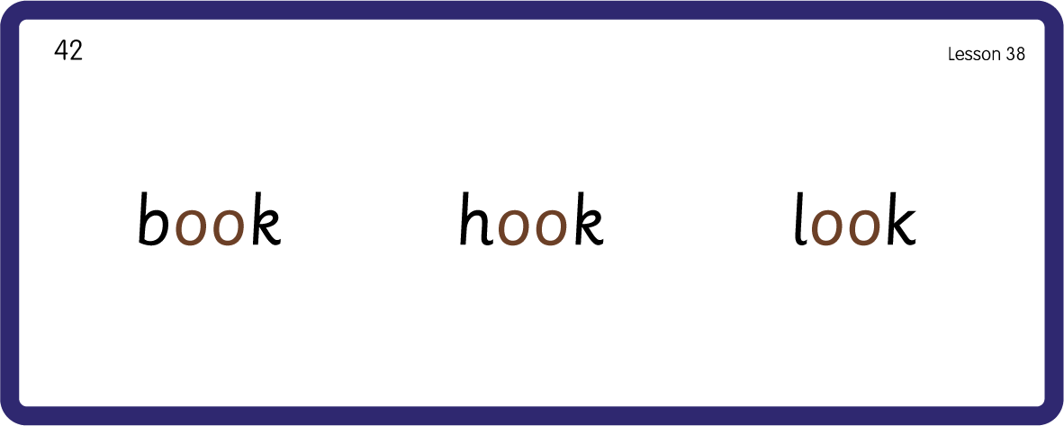
Hear Phonemes
USING JNL691
BACK

Slide 8
Teach Grapheme Caption
USING JNL686
FRONT

Slide 9
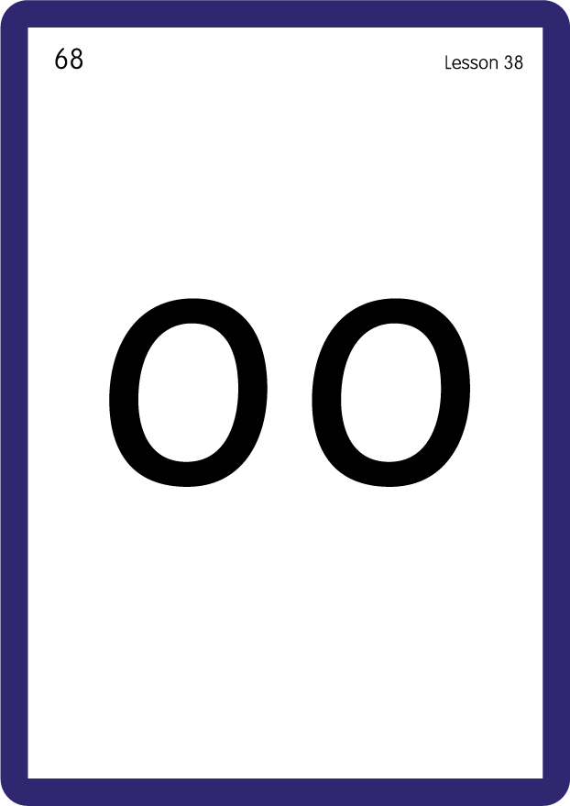
Review Lowercase Formation
USING JNL686
BACK

Slide 10

Explain Decoding

Slide 11
Model Blending Phonemes
h
oo
d
USING SOUND BUTTONS
Sound Buttons
Vowel
Consonant
Consonant Digraph
Long Vowel Sound
R-controlled Digraph
Split Digraph
Syllable / Silent Letter

Slide 12
Model Blending Phonemes
l
oo
k
USING SOUND BUTTONS
Sound Buttons
Vowel
Consonant
Consonant Digraph
Long Vowel Sound
R-controlled Digraph
Split Digraph
Syllable / Silent Letter

Slide 13

Explain Encoding

Slide 14
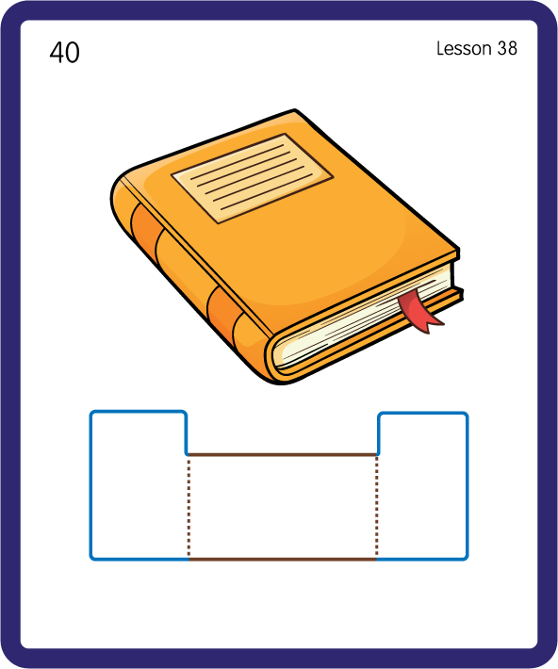
Build a Decodable Word
USING JNL689
BACK

Slide 15
Build a Decodable Word
USING JNL689
FRONT

Slide 16

Practise with Alien Words
USING JNL692
BACK

Slide 17
Practise with Alien Words
USING JNL692
FRONT

Slide 18
Practise Common Exception Words
USING JNL687
FRONT

Slide 19
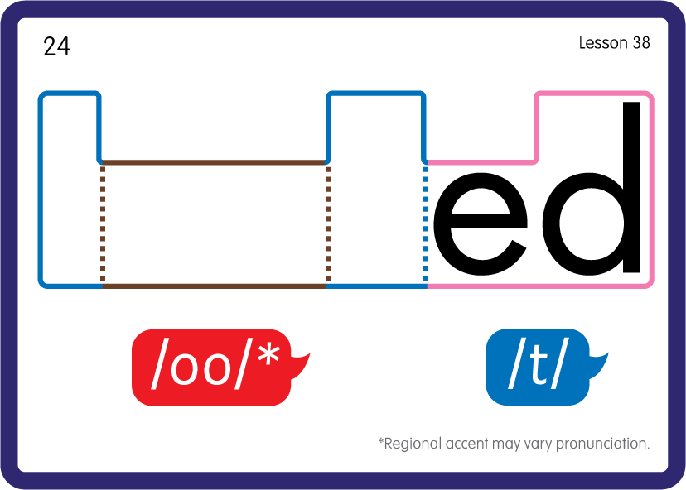
Practise Common Exception Words
USING JNL687
BACK

Slide 20
Practise High Frequency Words
USING JNL688
FRONT

Slide 21
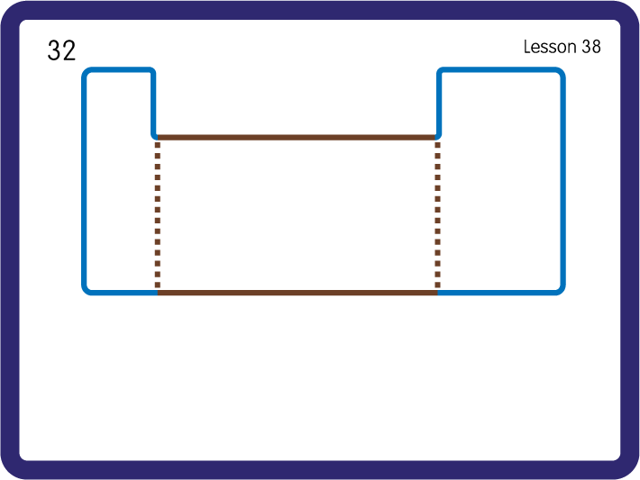
Practise High Frequency Words
USING JNL688
BACK

Slide 22

Practise Building Words
PRACTISE – 10MINS
t
d
g
c
h
b
f
l
k
w
oo
USING MAGNETIC LETTERS AND A WHITEBOARD

Slide 23
Practise Building Words
PRACTISE – 10MINS
t
d
g
c
h
b
f
l
k
w
oo
book cook foot good took hook wool wood
USING MAGNETIC LETTERS AND A WHITEBOARD

