Slide 1

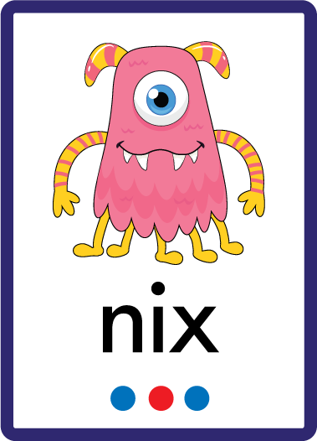
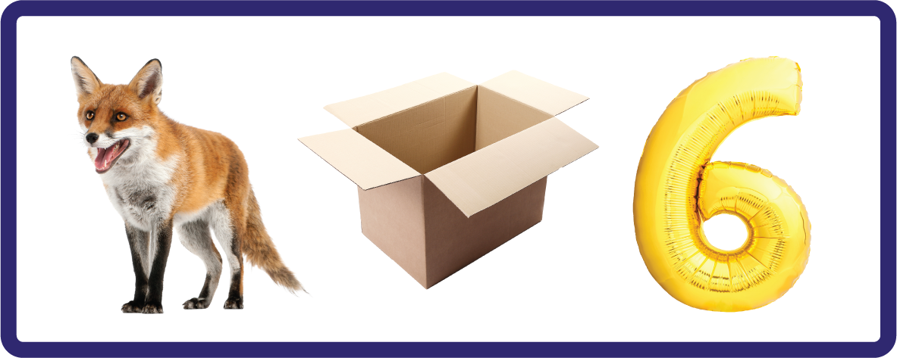
j | v | w | x | y | z | zz | qu | ch
sh | th | ng | ai | ee | igh | oa | oi | oo
ow | ar | air | ear | er | ur | or | ure
Letter Sound 'x'
Lesson 4

Slide 2

Learn and practise letter / sound x.
Recall all GPCs learned so far using flashcards.
Review Phase 2 Common Exception Words as I is no go to into the put his has of pull full.
Phonemic Awareness Cards
Grapheme to Phoneme Cards
Phoneme Frame Cards
Alien Word Cards
JNL691
JNL686
JNL689
JNL692

Slide 3























Recall all GPCs learned so far using flashcards.

Slide 4



Recall all GPCs learned so far using flashcards.

Slide 5














Review Phase 2 Common Exception Words as I is no go to into the put his has of pull full.

Slide 6
Hear Phonemes
USING JNL691
FRONT

Slide 7
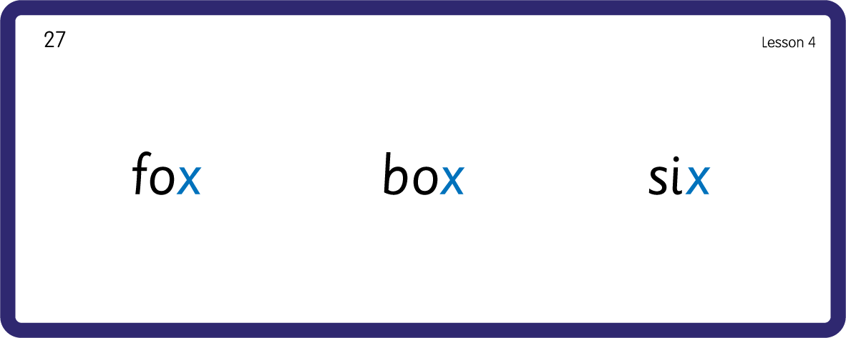
Hear Phonemes
USING JNL691
BACK

Slide 8
Teach Grapheme Caption
USING JNL686
FRONT

Slide 9
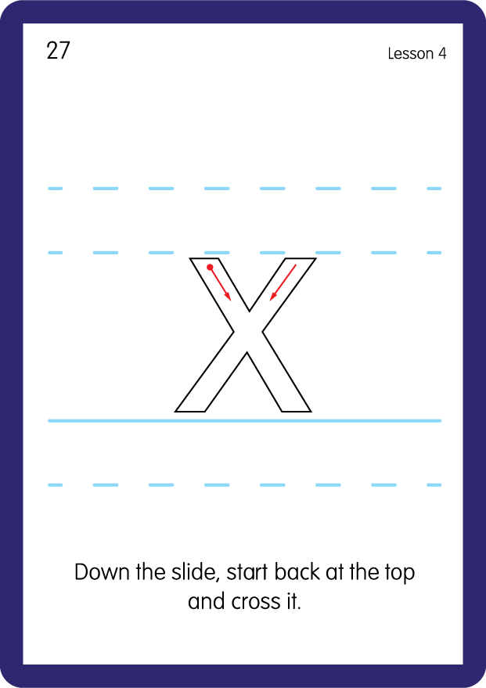
Teach Lowercase Formation
USING JNL686
BACK

Slide 10

Explain Decoding

Slide 11
Model Blending Phonemes
f
o
x
USING SOUND BUTTONS
Sound Buttons
Vowel
Consonant
Consonant Digraph
Long Vowel Sound
R-controlled Digraph
Split Digraph
Syllable / Silent Letter
Notes:
Note: Letter sound ‘x’ technically makes 2 sounds; /k/ /s/. For the sake of Kindergarten level comprehension at this early stage, only 1 sound button is used to represent the dual sound /ks/.

Slide 12
Model Blending Phonemes
s
i
x
USING SOUND BUTTONS
Sound Buttons
Vowel
Consonant
Consonant Digraph
Long Vowel Sound
R-controlled Digraph
Split Digraph
Syllable / Silent Letter
Notes:
Note: Letter sound ‘x’ technically makes 2 sounds; /k/ /s/. For the sake of Kindergarten level comprehension at this early stage, only 1 sound button is used to represent the dual sound /ks/.

Slide 13
Model Blending Phonemes
f
a
x
USING SOUND BUTTONS
Sound Buttons
Vowel
Consonant
Consonant Digraph
Long Vowel Sound
R-controlled Digraph
Split Digraph
Syllable / Silent Letter
Notes:
Note: Letter sound ‘x’ technically makes 2 sounds; /k/ /s/. For the sake of Kindergarten level comprehension at this early stage, only 1 sound button is used to represent the dual sound /ks/.

Slide 14

Explain Encoding

Slide 15
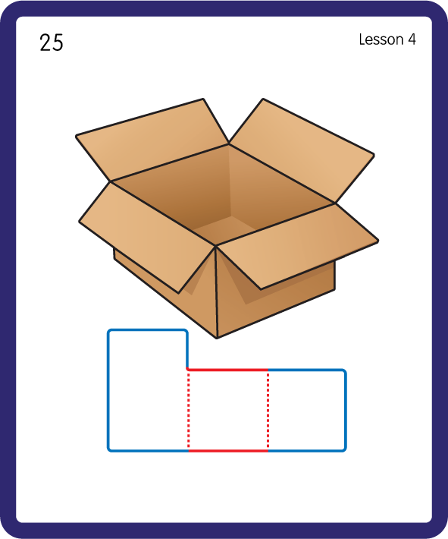
Build a Decodable Word
USING JNL689
BACK

Slide 16
Build a Decodable Word
USING JNL689
FRONT

Slide 17
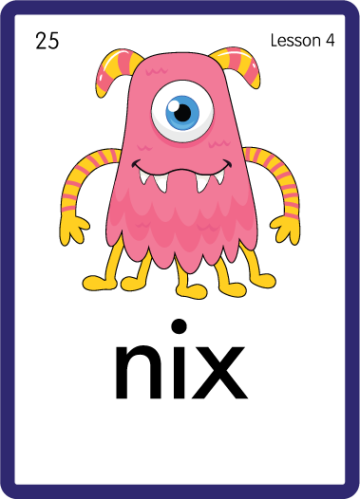
Practise with Alien Words
USING JNL692
BACK

Slide 18
Practise with Alien Words
USING JNL692
FRONT

Slide 19

Practise Building Words
PRACTISE – 10MINS
s
a
t
i
m
o
b
x
f
USING MAGNETIC LETTERS AND A WHITEBOARD

Slide 20
Practise Building Words
PRACTISE – 10MINS
s
a
t
i
m
o
b
x
f
mix fix box tax six
USING MAGNETIC LETTERS AND A WHITEBOARD

Slide 21

Draw ‘x’ in a variety of sizes and media, for example using chalk to draw on the ground.
Make grapheme with playdough.
Explore words in environment for decoding.
Use letters for building words and encoding.
Make 'x' letter with straws.
x

